Slide 1
Tutor-Student Assignment Problem
Bipartite Matching with One Sided Preferences
Prepared by: Darryl Teo

Slide 2
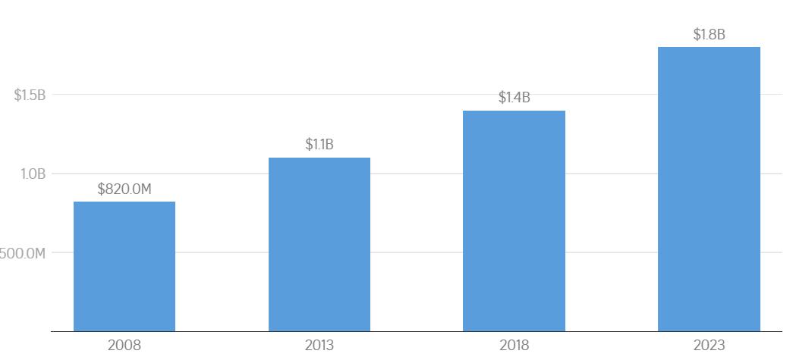
Introduction
Parents across many Asian countries including Singapore, Hong Kong, and Macao seek to give their children a competitive edge via tutoring services^{1,2,4}
Extremely robust demand for tutoring services in Singapore
Total annual spending on tuition⁵

Slide 3
Objective
To generate an optimal assignment for tutors and students under capacity constraints and one-sided tutor preferences.
Satisfy constraints + maximize tutor preferences
smooth operations + tutors happy 😀
better quality teaching
satisfied students + better results 💯
parents continue with the tuition centre + recommend it to their friends
profit 💵

Slide 4
Literature Review
Magnanti and Natarajan³ discusses methods to efficiently and fairly match students to projects, with one sided preferences from the students.
Efficient – preferences are comprehensively elicited and utilized.
Fair – no discrimination on factors including gender or nationality.
Evaluation metric – % of students assigned to top 3 choices
Urbina et al.⁶ discusses methods to associate students and teachers for tutoring according to their skills and affinities.
Cluster students and teachers based on skills including Communication, Digital, Autonomy, and Interpersonal.

Slide 5
Modeling Assumptions
For all students, changing of centres is not allowed.
For existing students, changing of tutors is not allowed. Exceptions are granted for students that are matched wrongly based on tutoring needs.
A feasible assignment exists, that is, the number of students does not exceed the total capacity of tutors, for both normal and extensive teaching needs.
Tutors can teach at multiple centres.

Slide 6
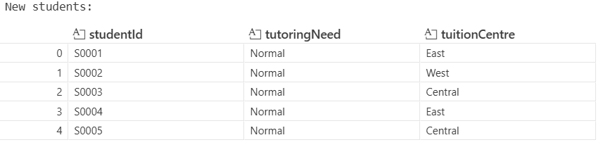
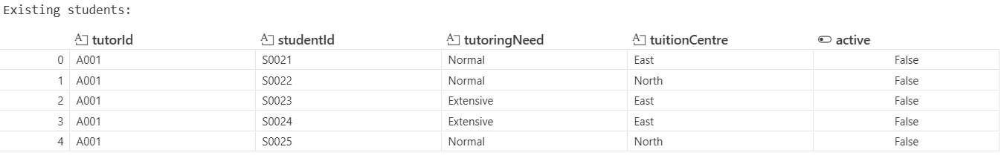
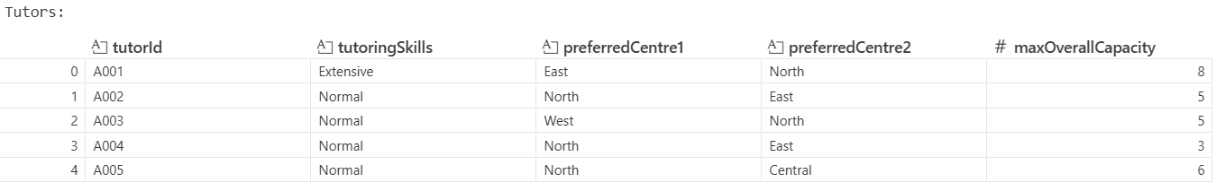
Data Available (Rows Truncated)

Slide 7
Data Validation
✅ 0 duplicates/missing data
✅ Sufficient capacity – normal and extensive needs both satisfied
❌ New students are assigned smaller IDs than existing students.
❌2 existing extensive needs students assigned to normal skills tutor (we will reassign them)

Slide 8
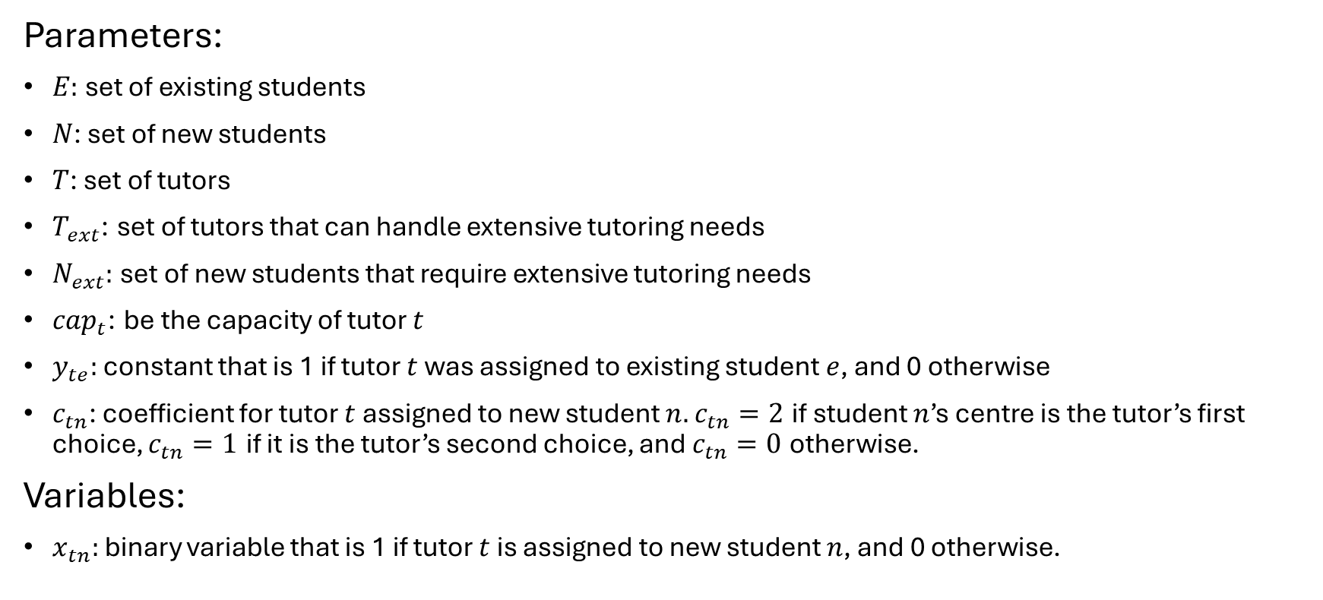
Mathematical Model (General)
Parameters:
$E:$ set of existing students
$N$: set of new students
$T$: set of tutors
$T_{ext}$: set of tutors that can handle extensive tutoring needs
$N_{ext}:$ set of new students that require extensive tutoring needs
$cap_{t}$: be the capacity of tutor $t$
$y_{te}:$ constant that is 1 if tutor $t$ was assigned to existing student $e$, and 0 otherwise
$c_{tn}$: coefficient for tutor $t$ assigned to new student $n.$ $c_{tn}=2$ if student $n$’s centre is the tutor’s first choice, $c_{tn}=1$ if it is the tutor’s second choice, and $c_{tn}=0$ otherwise.
Variables:
$x_{tn}:$ binary variable that is 1 if tutor $t$ is assigned to new student $n$, and 0 otherwise.

Slide 9
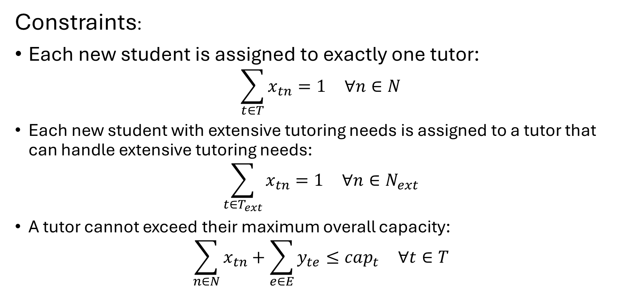
Mathematical Model (General)
Constraints:
Each new student is assigned to exactly one tutor:
$$\sum_{t∈T}^{​}{x_{tn}}=1 ∀n∈N$$
Each new student with extensive tutoring needs is assigned to a tutor that can handle extensive tutoring needs:
$$\sum_{t∈T_{ext}}^{​}{x_{tn}}=1 ∀n∈N_{ext}$$
A tutor cannot exceed their maximum overall capacity:
$$\sum_{n∈N}^{​}{x_{tn}}+\sum_{e∈E}^{​}{y_{te}}≤cap_{t} ∀t∈T$$

Slide 10
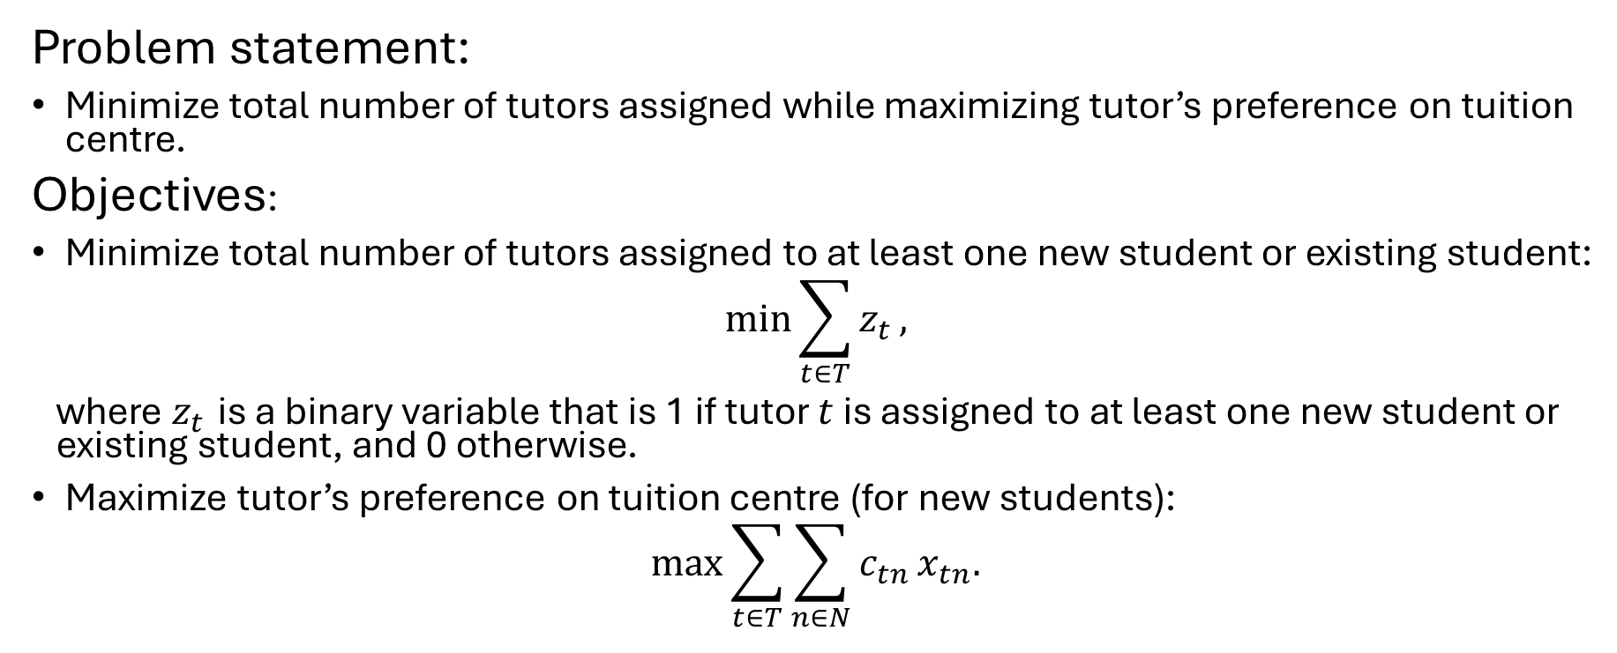
Mathematical Model (a)
Problem statement:
Minimize total number of tutors assigned while maximizing tutor’s preference on tuition centre.
Objectives:
Minimize total number of tutors assigned to at least one new student or existing student:
$$min\sum_{t∈T}^{​}{z_{t}},$$
where $z_{t}$ is a binary variable that is 1 if tutor $t$ is assigned to at least one new student or existing student, and 0 otherwise.
Maximize tutor’s preference on tuition centre (for new students):
$$max\sum_{t∈T}^{​}{\sum_{n∈N}^{​}{c_{tn}}}x_{tn}.$$

Slide 11
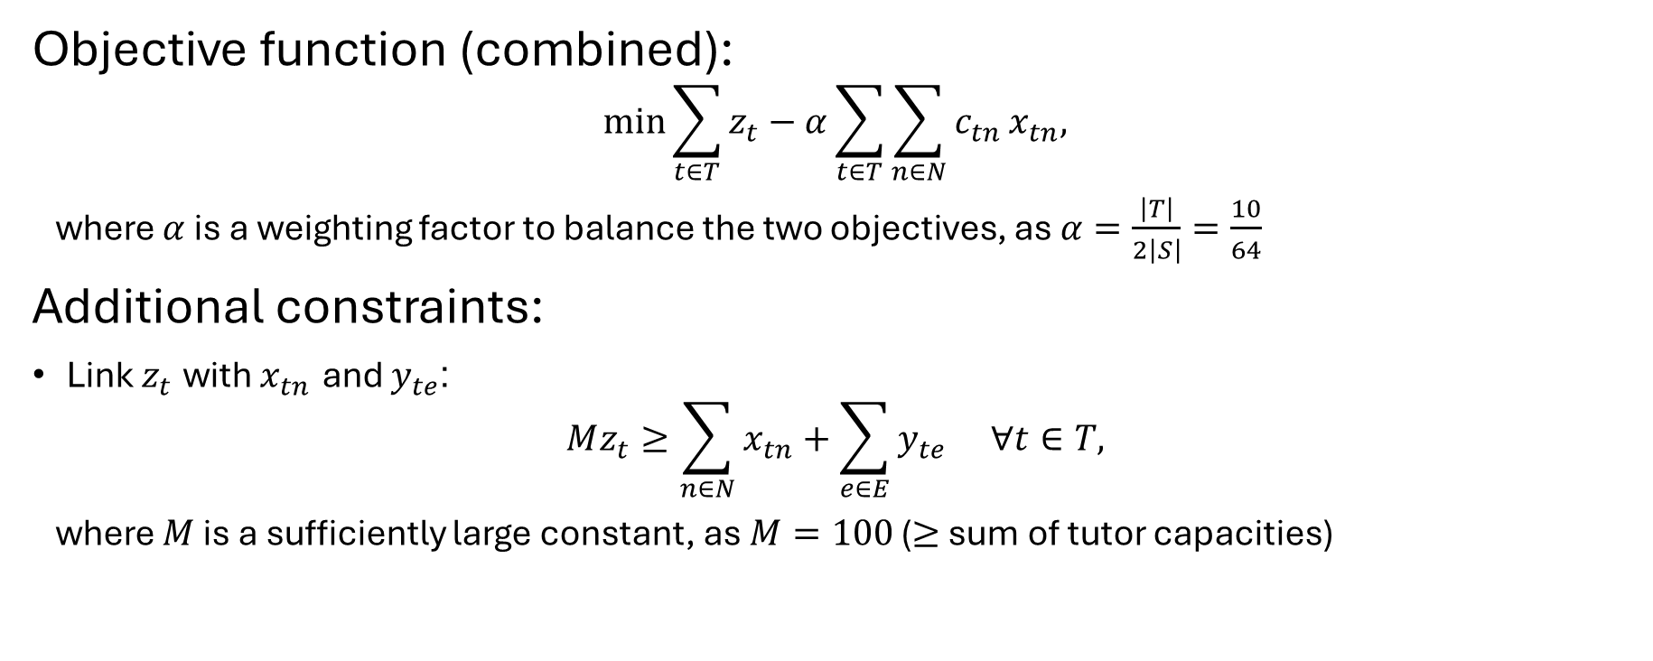
Mathematical Model (a)
Objective function (combined):
$$min\sum_{t∈T}^{​}{z_{t}}−α\sum_{t∈T}^{​}{\sum_{n∈N}^{​}{c_{tn}}}x_{tn},$$
where $α$ is a weighting factor to balance the two objectives, as $α=\frac{\left|T\right|}{2\left|S\right|}=\frac{10}{64}$
Additional constraints:
Link $z_{t}$ with $x_{tn}$ and $y_{te}$:
$$Mz_{t}≥\sum_{n∈N}^{​}{x_{tn}}+\sum_{e∈E}^{​}{y_{te}} ∀t∈T,$$
where $M$ is a sufficiently large constant, as $M=100$ ($≥$ sum of tutor capacities)

Slide 12
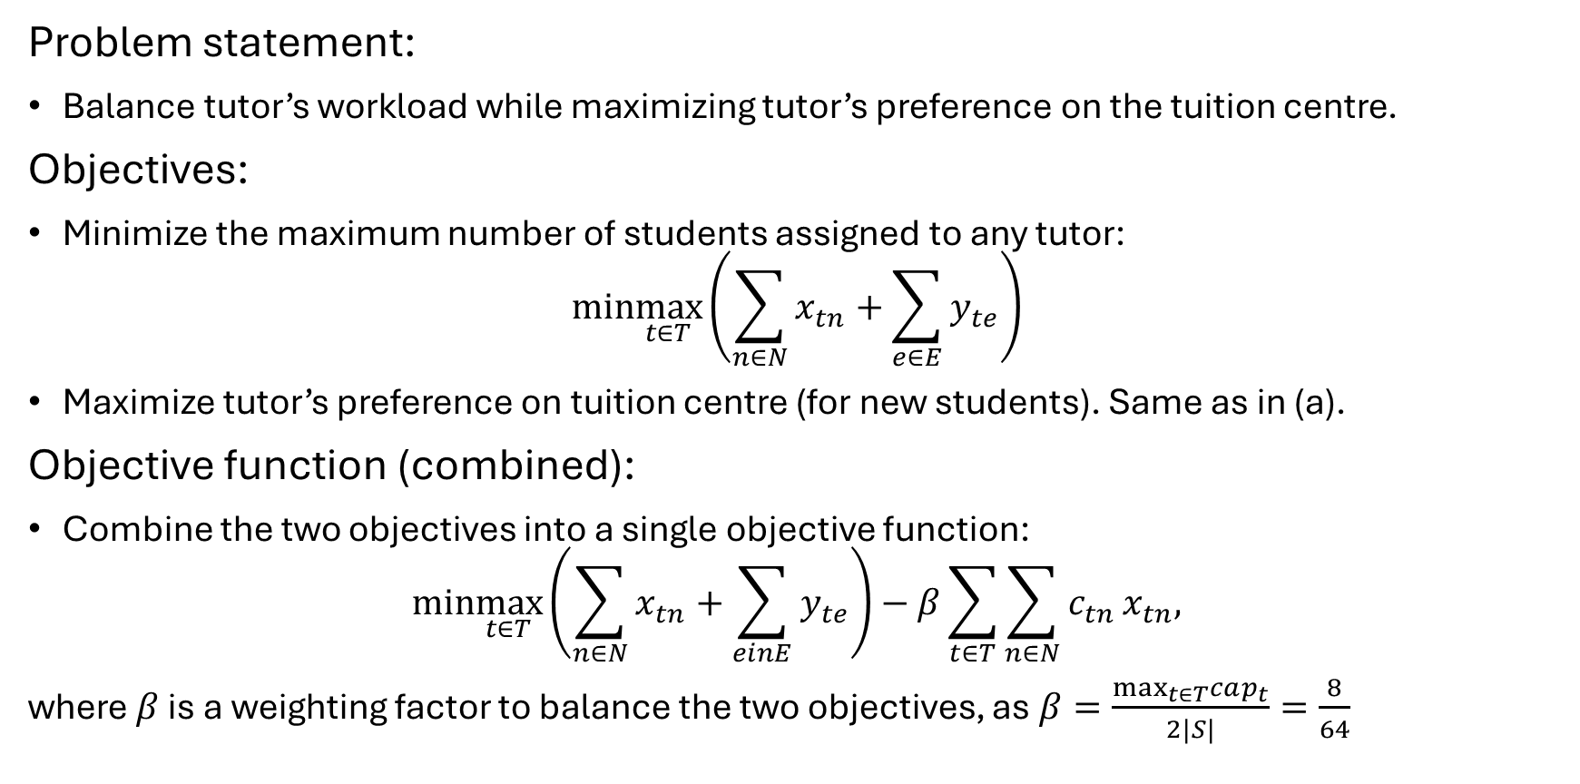
Mathematical Model (b)
Problem statement:
Balance tutor’s workload while maximizing tutor’s preference on the tuition centre.
Objectives:
Minimize the maximum number of students assigned to any tutor:
$$min\max_{t∈T}\left(\sum_{n∈N}^{​}{x_{tn}}+\sum_{e∈E}^{​}{y_{te}}\right)$$
Maximize tutor’s preference on tuition centre (for new students). Same as in (a).
Objective function (combined):
Combine the two objectives into a single objective function:
$$min\max_{t∈T}\left(\sum_{n∈N}^{​}{x_{tn}}+\sum_{einE}^{​}{y_{te}}\right)−β\sum_{t∈T}^{​}{\sum_{n∈N}^{​}{c_{tn}}}x_{tn},$$
where $β$ is a weighting factor to balance the two objectives, as $β=\frac{\max_{t∈T}cap_{t}}{2|S|}=\frac{8}{64}$

Slide 13
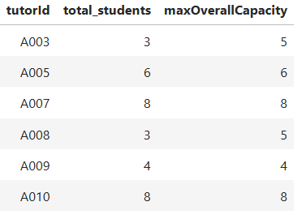
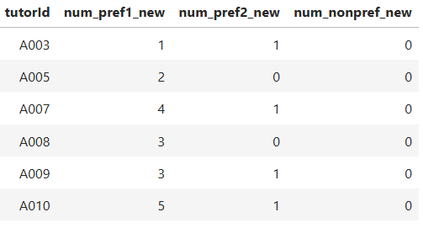
Results (a)
Minimize tutors assigned
Only 6 out of 10 tutors received an assignment
Maximize tutor preferences
Most tutor assignments are at their #1 centre
No tutor assigned to a non-preferred centre

Slide 14
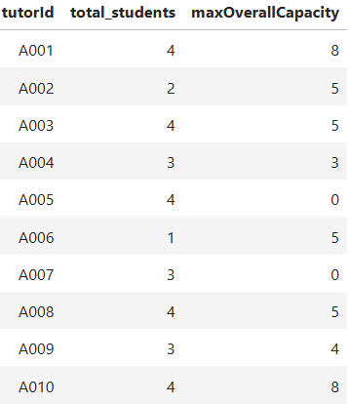
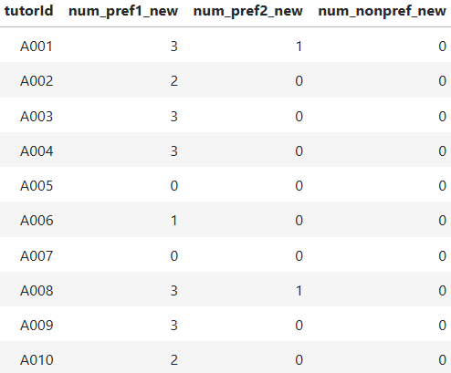
Results (b)
Balance tutor workload
The worst-off tutor (workload) was assigned 4 students
Maximize tutor preferences
Almost all tutor assignments are at their #1 centre
Two tutors had 1 assignment at #2 centre
No tutor assigned to a non-preferred centre

Slide 15
Conclusion and Future Work
Modeled the Tutor-Student Assignment Problem --- Bipartite Matching with One Sided Preferences as an integer programming problem.
The problem was solved to optimality, satisfied all constraints and generated optimal assignments for both task (a) and (b)
Studies done by Magnanti and Natarajan³ and Urbina et al.⁶ suggest that with more data, we can more efficiently assign tutors to students.
Further work can be done to identify student characteristics that allow for synergistic grouping of students, expanding the tutoring service to group tuition.

Slide 16
Thank you ☺

Slide 17
References
[1] Claudia Chan and Mark Bray. Marketized private tutoring as a supplement to regular schooling: Liberal studies and the shadow sector in hong kong secondary education. Journal of Curriculum Studies, 46(3):361–388, February 2014.
[2] Titus Siu Pang Li and Ben Cheong Choi. Private supplementary tutoring in macao: past, present and the future. Asia Pacific Journal of Education, 34(4):505–517, October 2014.
[3] Thomas L. Magnanti and Karthik Natarajan. Allocating students to multidisciplinary capstone projects using discrete optimization. Interfaces, 48(3):204–216, June 2018.
[4] Charlene Tan. Private supplementary tutoring and parentocracy in singapore. Interchange, 48(4):315–329, February 2017.
[5] Elisha Tushara. Spending by s’pore families on private tuition rises to 1.8 billion in 2023, 2025.
[6] Argelia B. Urbina Najera, Jorge de la Calleja, and Ma. Auxilio Medina. Associating students and teachers for tutoring in higher education usin clustering and data mining. Computer Applications in Engineering Education, 25(5):823–832, June 2017

