Slide 1
Tutor-Student Assignment Problem
Bipartite Matching with One Sided Preferences
Prepared by: Darryl Teo

Slide 2
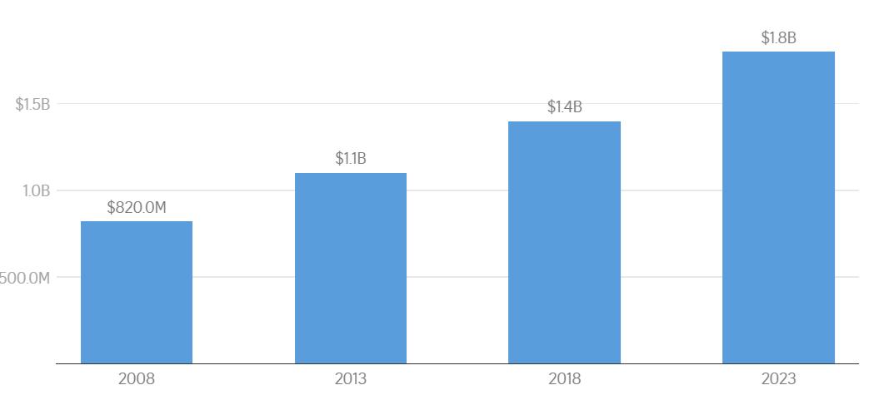
Introduction
Parents across many Asian countries including Singapore, Hong Kong, and Macao seek to give their children a competitive edge via tutoring services¹
Extremely robust demand for tutoring services in Singapore
Total annual spending on tuition²
¹ Tan, 2017; Chan and Bray, 2014; Li and Choi, 2014
² Tushara, 2025

Slide 3
Objective
To generate an optimal assignment for tutors and students under capacity constraints and one-sided tutor preferences.
Satisfy constraints + maximize tutor preferences → smooth operations + tutors happy → better quality teaching → satisfied students + better results → parents continue with the tuition center + recommend it to their friends → profit

Slide 4
Literature Review
Magnanti and Natarajan¹ discusses methods to efficiently and fairly match students to projects, with one sided preferences from the students.
Efficient – preferences are comprehensively elicited and utilized.
Fair – no discrimination on factors including gender or nationality.
Evaluation metric – % of students assigned to top 3 choices
Urbina et al.² discusses methods to associate students teachers for tutoring according to their skills and affinities.
Cluster students and teachers based on skills including Communication, Digital, Autonomy, and Interpersonal.
¹ Magnanti and Natarajan, 2018
² Urbina et al., 2017

Slide 5
Modeling Assumptions

Slide 6
Mathematical Model (General)

Slide 7
Mathematical Model (a)

Slide 8
Mathematical Model (b)

Slide 9
Results (a)

Slide 10
Results (b)

Slide 11
Conclusion and Future Work
Not enough data
Group students – identify characteristics that allow more students, vs which need 1-1, scolding etc
Link these to objective

