Slide 1
Tutor-Student Assignment Problem
Bipartite Matching with One Sided Preferences
Prepared by: Darryl Teo

Slide 2
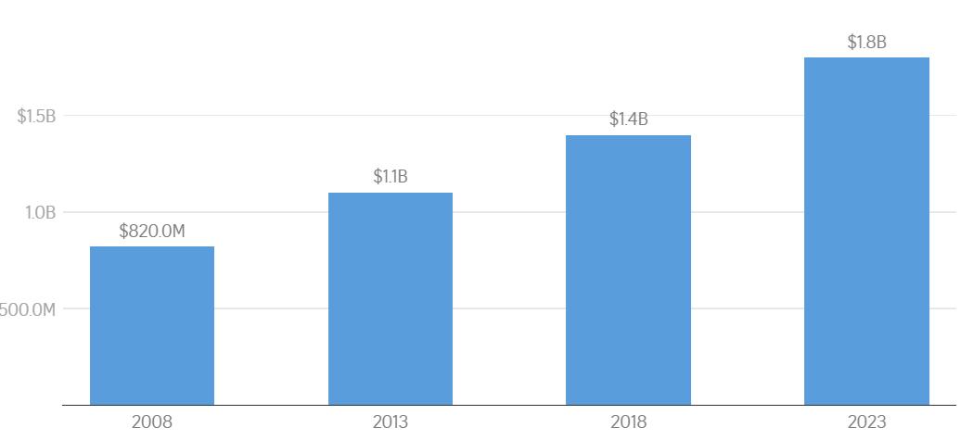
Introduction
Parents across many Asian countries including Singapore, Hong Kong, and Macao seek to give their children a competitive edge via tutoring services¹
Extremely robust demand for tutoring services in Singapore
Total annual spending on tuition²
¹ Tan, 2017; Chan and Bray, 2014; Li and Choi, 2014
² Tushara, 2025

Slide 3
Objective
To generate an optimal assignment for tutors and students under capacity constraints and one-sided tutor preferences.
Satisfy constraints + maximize tutor preferences
smooth operations + tutors happy 😀
better quality teaching
satisfied students + better results 💯
parents continue with the tuition centre + recommend it to their friends
profit 💵

Slide 4
Literature Review
Magnanti and Natarajan¹ discusses methods to efficiently and fairly match students to projects, with one sided preferences from the students.
Efficient – preferences are comprehensively elicited and utilized.
Fair – no discrimination on factors including gender or nationality.
Evaluation metric – % of students assigned to top 3 choices
Urbina et al.² discusses methods to associate students and teachers for tutoring according to their skills and affinities.
Cluster students and teachers based on skills including Communication, Digital, Autonomy, and Interpersonal.
¹ Magnanti and Natarajan, 2018
² Urbina et al., 2017

Slide 5
Modeling Assumptions
For all students, changing of centres is not allowed.
For existing students, changing of tutors is not allowed. Exceptions are granted for students that are matched wrongly based on tutoring needs.
A feasible assignment exists, that is, the number of students does not exceed the total capacity of tutors, for both normal and extensive teaching needs.
Tutors can teach at multiple centres.

Slide 6
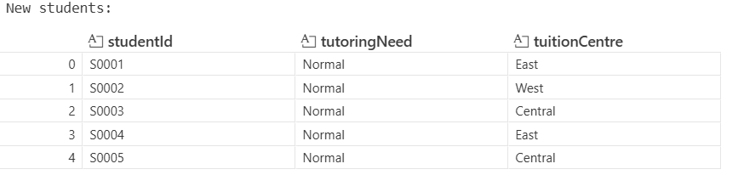
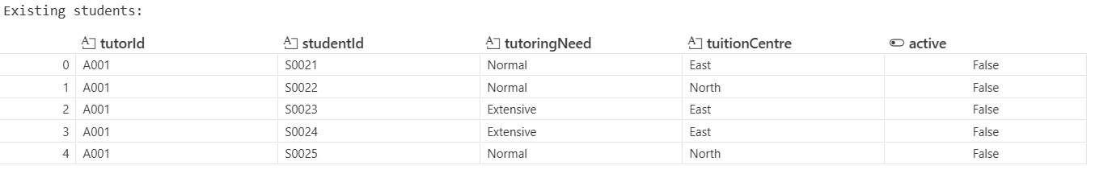
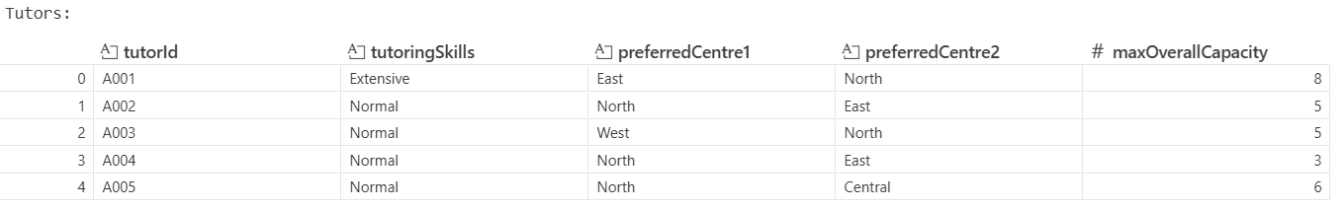
Data Available (Rows Truncated)

Slide 7
Data Validation
✅ 0 duplicates/missing data
✅ Sufficient capacity – normal and extensive needs both ok
❌ New students are assigned smaller IDs than existing students.
❌2 existing extensive needs students assigned to normal skills tutor (we will reassign them)

Slide 8
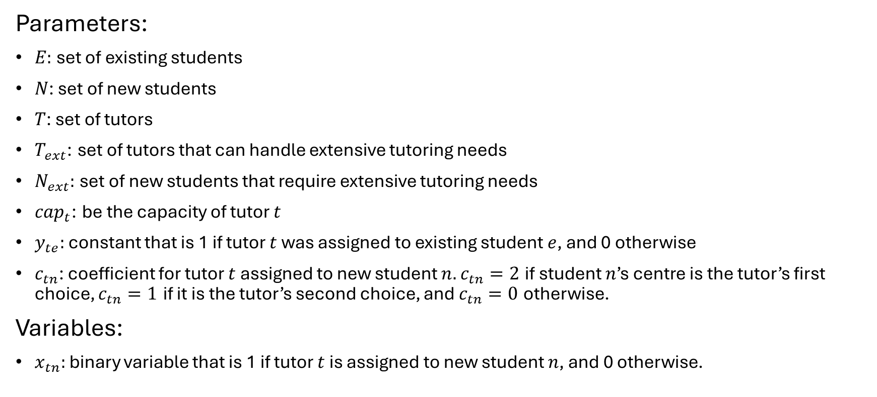
Mathematical Model (General)
Parameters:
$E:$ set of existing students
$N$: set of new students
$T$: set of tutors
$T_{ext}$: set of tutors that can handle extensive tutoring needs
$N_{ext}:$ set of new students that require extensive tutoring needs
$cap_{t}$: be the capacity of tutor $t$
$y_{te}:$ constant that is 1 if tutor $t$ was assigned to existing student $e$, and 0 otherwise
$c_{tn}$: coefficient for tutor $t$ assigned to new student $n.$ $c_{tn}=2$ if student $n$’s centre is the tutor’s first choice, $c_{tn}=1$ if it is the tutor’s second choice, and $c_{tn}=0$ otherwise.
Variables:
$x_{tn}:$ binary variable that is 1 if tutor $t$ is assigned to new student $n$, and 0 otherwise.

Slide 9
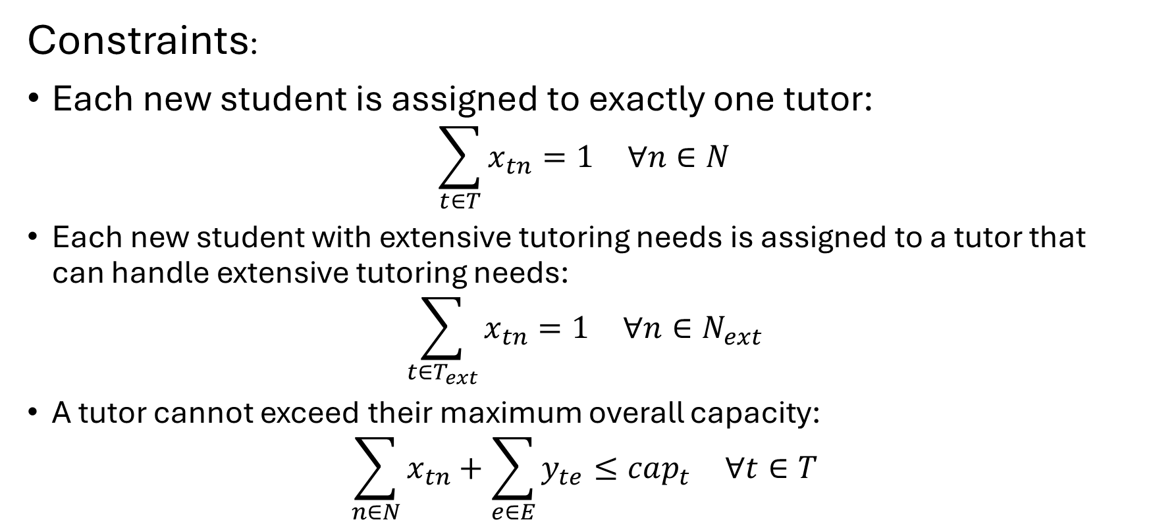
Mathematical Model (General)
Constraints:
Each new student is assigned to exactly one tutor:
$$\sum_{t∈T}^{​}{x_{tn}}=1 ∀n∈N$$
Each new student with extensive tutoring needs is assigned to a tutor that can handle extensive tutoring needs:
$$\sum_{t∈T_{ext}}^{​}{x_{tn}}=1 ∀n∈N_{ext}$$
A tutor cannot exceed their maximum overall capacity:
$$\sum_{n∈N}^{​}{x_{tn}}+\sum_{e∈E}^{​}{y_{te}}≤cap_{t} ∀t∈T$$

Slide 10
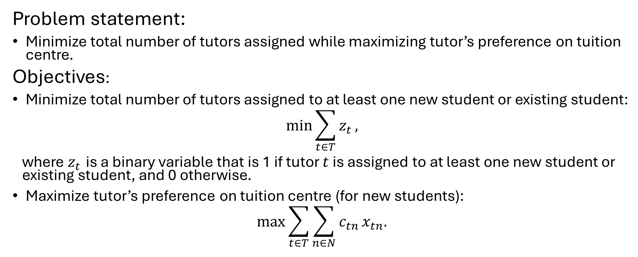
Mathematical Model (a)
Problem statement:
Minimize total number of tutors assigned while maximizing tutor’s preference on tuition centre.
Objectives:
Minimize total number of tutors assigned to at least one new student or existing student:
$$min\sum_{t∈T}^{​}{z_{t}},$$
where $z_{t}$ is a binary variable that is 1 if tutor $t$ is assigned to at least one new student or existing student, and 0 otherwise.
Maximize tutor’s preference on tuition centre (for new students):
$$max\sum_{t∈T}^{​}{\sum_{n∈N}^{​}{c_{tn}}}x_{tn}.$$

Slide 11
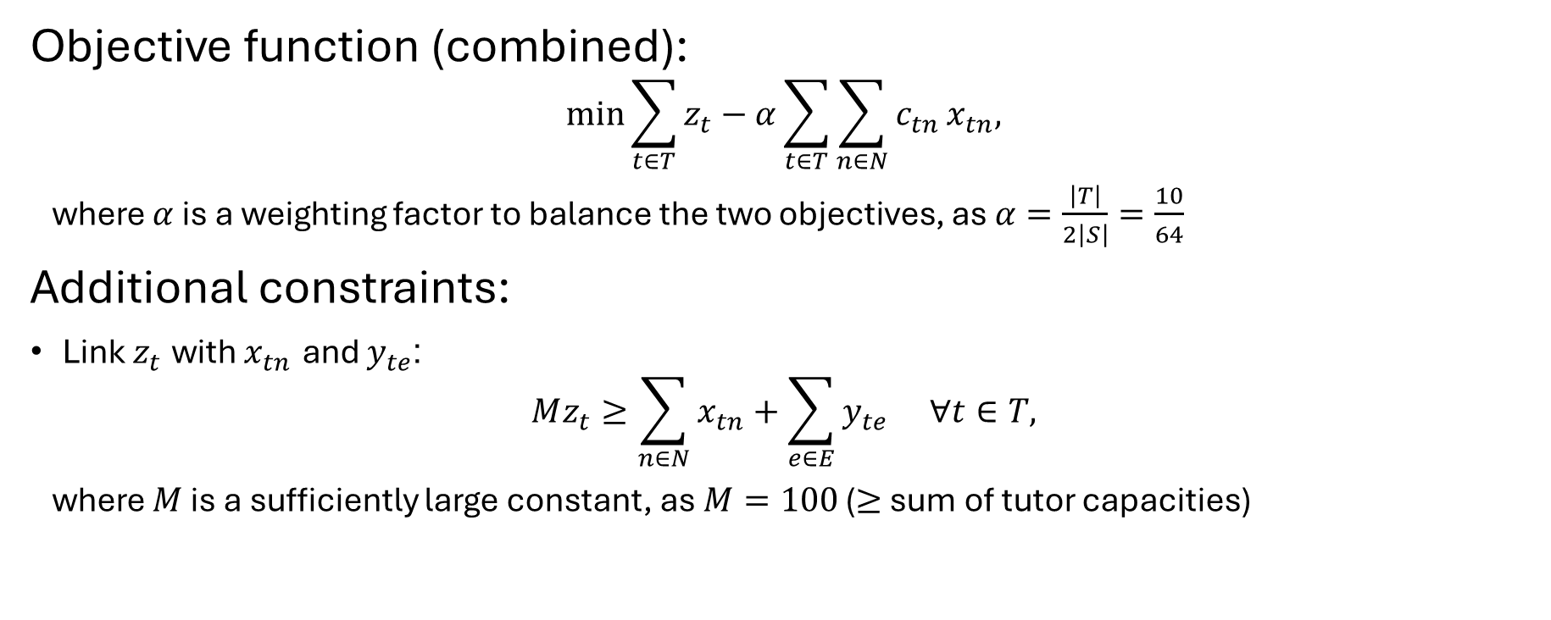
Mathematical Model (a)
Objective function (combined):
$$min\sum_{t∈T}^{​}{z_{t}}−α\sum_{t∈T}^{​}{\sum_{n∈N}^{​}{c_{tn}}}x_{tn},$$
where $α$ is a weighting factor to balance the two objectives, as $α=\frac{\left|T\right|}{2\left|S\right|}=\frac{10}{64}$
Additional constraints:
Link $z_{t}$ with $x_{tn}$ and $y_{te}$:
$$Mz_{t}≥\sum_{n∈N}^{​}{x_{tn}}+\sum_{e∈E}^{​}{y_{te}} ∀t∈T,$$
where $M$ is a sufficiently large constant, as $M=100$ ($≥$ sum of tutor capacities)

Slide 12
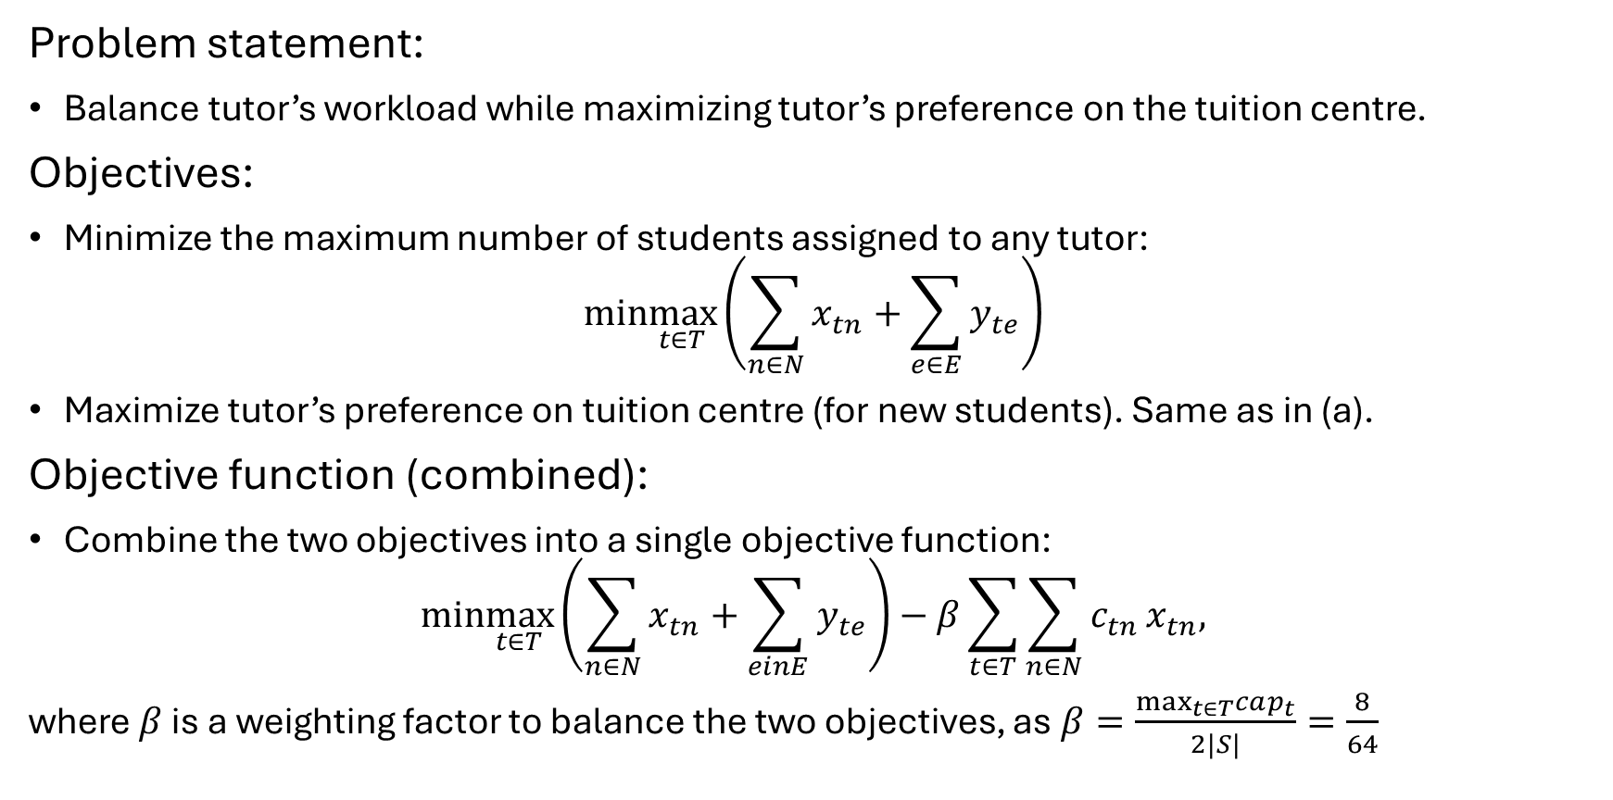
Mathematical Model (b)
Problem statement:
Balance tutor’s workload while maximizing tutor’s preference on the tuition centre.
Objectives:
Minimize the maximum number of students assigned to any tutor:
$$min\max_{t∈T}\left(\sum_{n∈N}^{​}{x_{tn}}+\sum_{e∈E}^{​}{y_{te}}\right)$$
Maximize tutor’s preference on tuition centre (for new students). Same as in (a).
Objective function (combined):
Combine the two objectives into a single objective function:
$$min\max_{t∈T}\left(\sum_{n∈N}^{​}{x_{tn}}+\sum_{einE}^{​}{y_{te}}\right)−β\sum_{t∈T}^{​}{\sum_{n∈N}^{​}{c_{tn}}}x_{tn},$$
where $β$ is a weighting factor to balance the two objectives, as $β=\frac{\max_{t∈T}cap_{t}}{2|S|}=\frac{8}{64}$

Slide 13
Results (a)

Slide 14
Results (b)

Slide 15
Conclusion and Future Work
Not enough data
Group students – identify characteristics that allow more students, vs which need 1-1, scolding etc
Link these to objective

