Slide 1
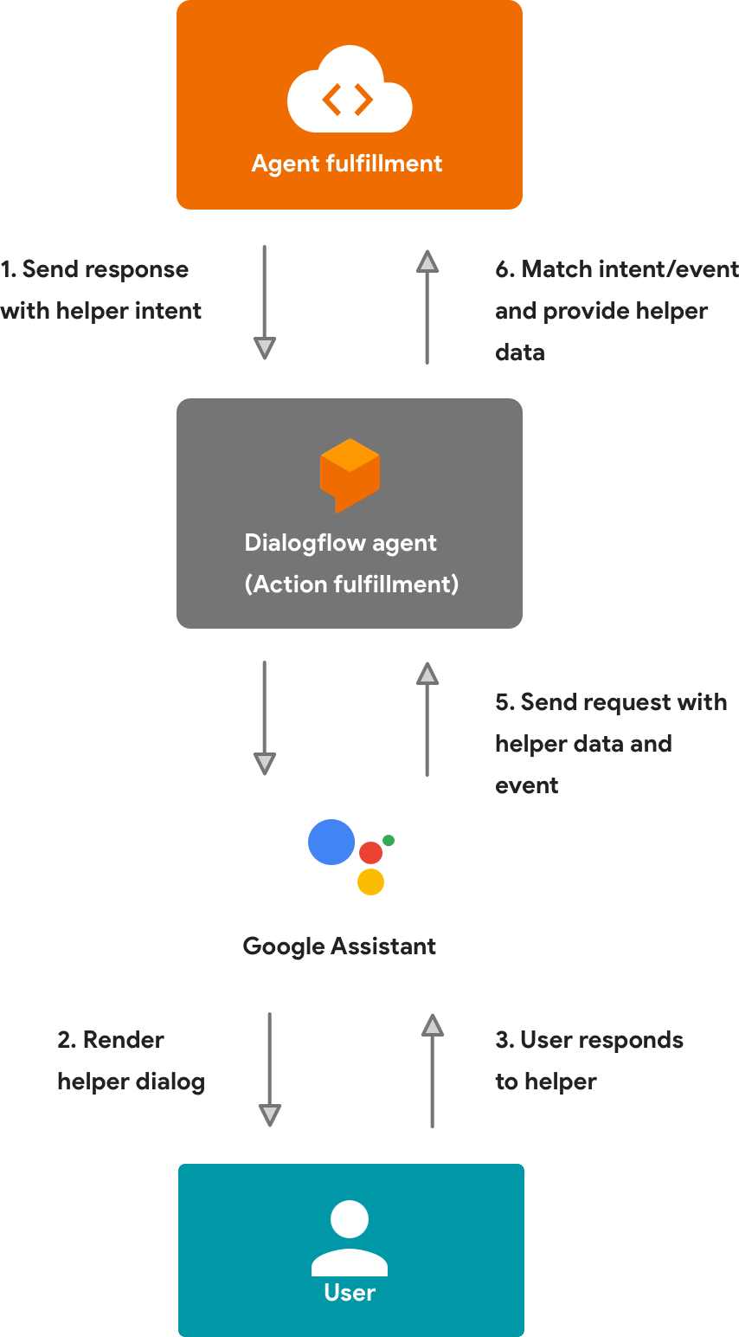






Slide 2
DialogFlow NodeJS API
DialogFlow Intent Fulfillment
Firebase Android SDK
Or
HTTPS Call

Slide 3
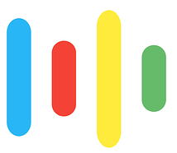
Firebase Android SDK
DialogFlow NodeJS API
DialogFlow Intent Fulfillment
Android Speech APIs

