Slide 1

Project Title -
Seasonal Agriculture Performance Analysis
Student Name – MANNEM DURGA DARSAN
College Name- Seshadri Rao Gudlavalleru Engineering College
AICTE STU ID : STU69becaa8dbac91774111400

Slide 2

PROBLEM STATEMENT
Agricultural activities are influenced by seasonal variations in environmental conditions,
farming practices, resource availability and market conditions. As a result, agricultural
performance may differ from one season to another.
However, raw agricultural data does not clearly explain how agricultural performance changes
across seasons or what patterns can be observed in different seasonal conditions.
The problem is to analyze the given agricultural dataset and investigate seasonal differences
in agricultural performance by identifying meaningful patterns, trends, relationships and
variations within the available data.

Slide 3
Project Description
This project analyzes agricultural data across different seasons to identify patterns and variations in crop production, environmental conditions, resource usage, and economic performance. Using data cleaning, analysis, and visualization techniques, the project compares seasonal agricultural performance and provides meaningful insights and recommendations for better agricultural planning.

Slide 4

WHO ARE THE END USERS?
Farmers and agricultural workers
Agricultural planners and policymakers
Government and agricultural departments
Researchers and data analysts
Agricultural organizations and stakeholders
Students and educational institutions

Slide 5

Technology Used
Python – Data analysis and processing
Jupyter Notebook – Analysis and project documentation
Pandas & NumPy – Data cleaning and manipulation
Matplotlib & Seaborn – Data visualization
Statistical Analysis – Identifying patterns, trends, relationships, and seasonal variations

Slide 6
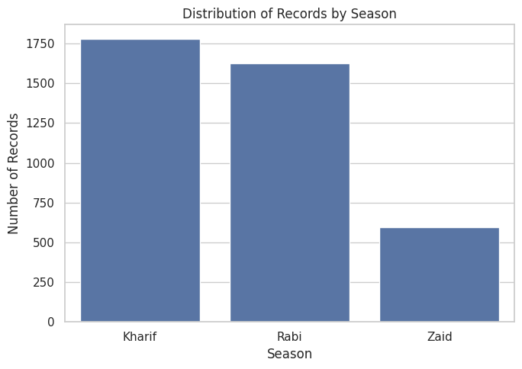
RESULTS
The chart shows the distribution of agricultural records across different seasons. Kharif has the highest number of records, followed by Rabi, while Zaid has the lowest number of records. This indicates that the dataset contains more agricultural observations from the Kharif and Rabi seasons, which may provide more detailed insights for analyzing their seasonal performance.

Slide 7
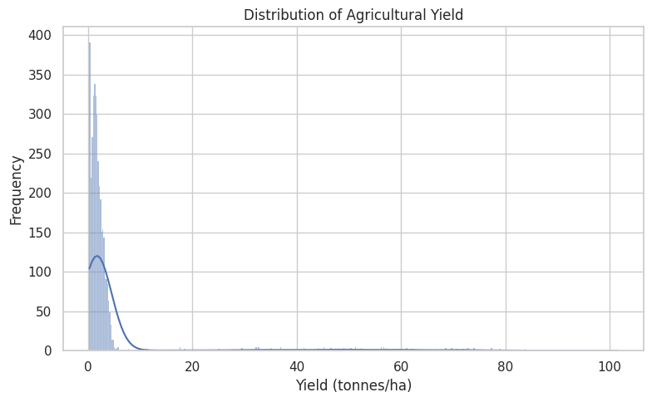
RESULTS
The chart shows the distribution of agricultural yield (tonnes/ha). Most records have yield values concentrated in the lower range, while a small number of records have very high yield values. This indicates a right-skewed distribution and the presence of possible outliers, showing significant variation in agricultural productivity.

Slide 8
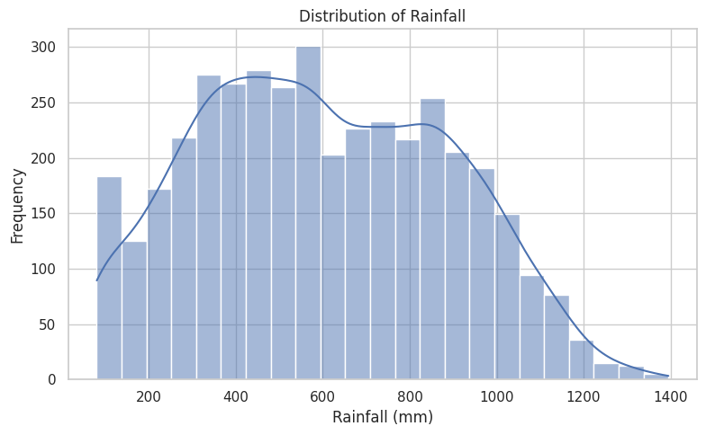
RESULTS
The chart shows the distribution of rainfall (mm) across agricultural records. Rainfall values are spread over a wide range, with most observations concentrated between approximately 300 and 900 mm. The distribution shows variation in environmental conditions, which can be further analyzed to understand its impact on agricultural performance and crop yield.

Slide 9
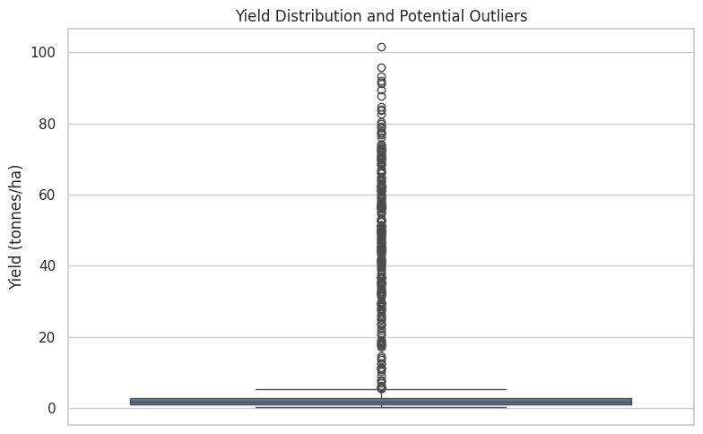
RESULTS
The box plot shows the distribution of agricultural yield and potential outliers. Most yield values are concentrated in a low range, while several observations have unusually high values. These points are identified as potential outliers, indicating significant variation in agricultural productivity and requiring further investigation.

Slide 10
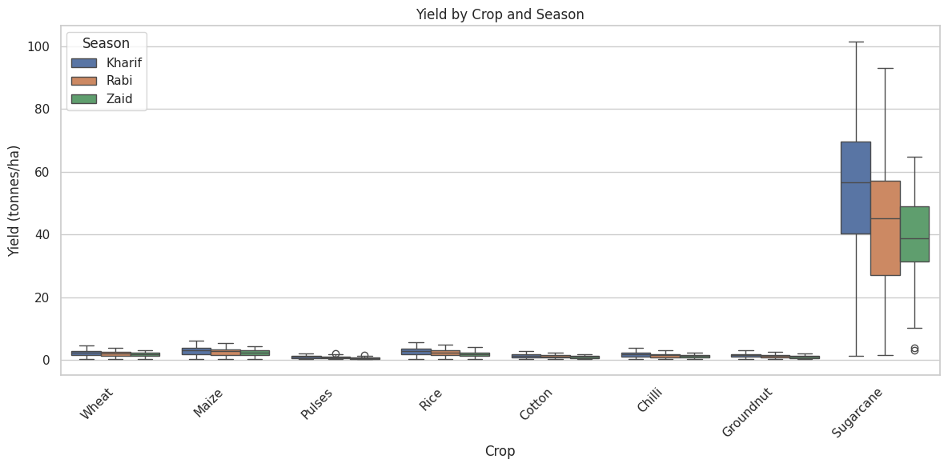
RESULTS
The chart compares agricultural yield across different crops and seasons. Most crops show relatively low and stable yield values, while Sugarcane has significantly higher yields and greater variation across Kharif, Rabi, and Zaid seasons. This indicates that crop type and seasonal conditions can have a strong impact on agricultural productivity.

Slide 11
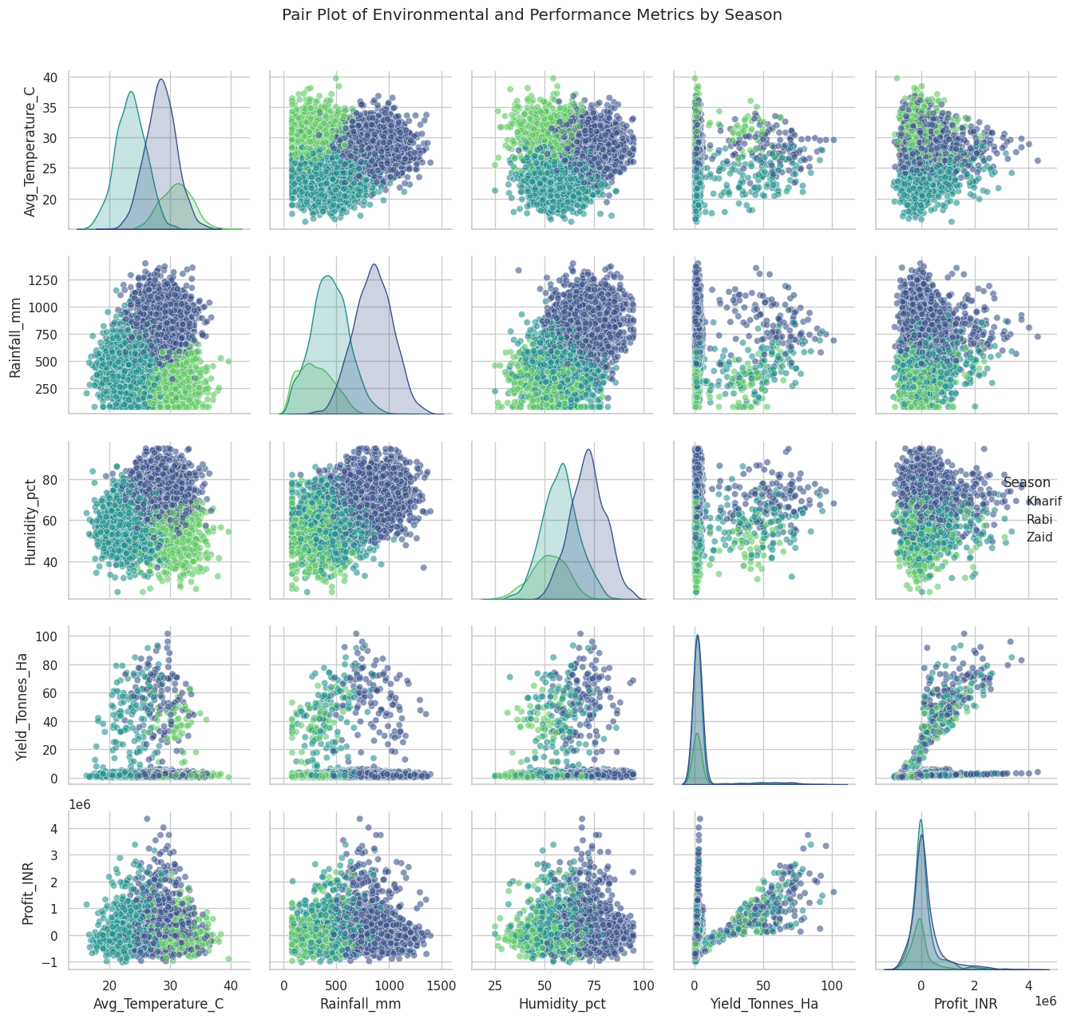
RESULTS
The pair plot shows the relationships between average temperature, rainfall, humidity, agricultural yield, and profit across the Kharif, Rabi, and Zaid seasons. It highlights clear seasonal differences in environmental conditions and agricultural performance. The analysis also shows relationships between yield and profit, helping identify how changes in agricultural productivity can influence economic outcomes.

Slide 12
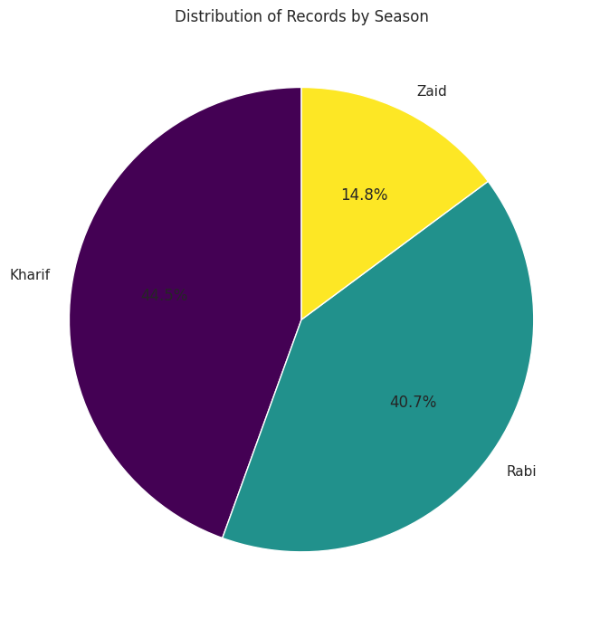
Future scope
The pie chart shows the percentage distribution of agricultural records across seasons. Kharif has the highest share (44.5%), followed by Rabi (40.7%), while Zaid (14.8%) has the lowest share. This shows that most agricultural activities in the dataset are concentrated during the Kharif and Rabi seasons.

Slide 13
GitHub Link
https://github.com/darsan-0/Seasonal-Agriculture-Performance-Analysis.git

Slide 14

VOIS Course completion certificate - Course name- Data Visualization

Slide 15
Thank you
.
.

