Slide 1

MY OWN NOTEPAD
Submitted By
Darsana Dasan
S5 MCA
Reg No:MCT19MC002

Slide 2

Abstract
Notepad is a generic text editor included with all version of Microsoft windows that allows you to create, open, and read plain text files.
Tkinter is a GUI library of python from which we can create multiple GUI apps. Here, using tkinter we will develop a notepad like text editor.
In this project, we create our own notepad with some additional features. These additional features include images and shapes.

Slide 3

Software Requirements
The Python language is used to develop a notepad application based on Graphical User Interface.
Python :
Python is an interpreted high-level general purpose programming language. It supports multiple programming paradigms, including object-oriented and functional programming. It’s often described as “Batteries Included”.

Slide 4
PyCharm :
PyCharm is the most popular IDE for python, and includes great features such as excellent code completion and inspection with advanced debugger and support for web programming and various frameworks. It focuses on creating IDE for various web development languages like JavaScript and PHP.
Tkinter :
Tkinter is the standard GUI library for python. Python when combined with Tkinter provides a fast and easy way o create GUI applications.
Os :
OS module provide a portable way of using operating system dependent functionality. It mainly read, write and manipulate files

Slide 5

System Requirements
SOFTWARE | HARDWARE
OS : Windows 10 | Processor : 11th Gen Intel(R) Core(TM) i3
Software Used : PyCharm | Speed : 2 GHz and above
Data Science Tools : Tkinter, Os | RAM : 8.00 GB
Script : Python | Disk Space : Approximately 476.92
Interpreter : Python 3.9 | Keyboard : Standard Windows Keyboard
Code Editor : PyCharm | Monitor : 5VGA

Slide 6

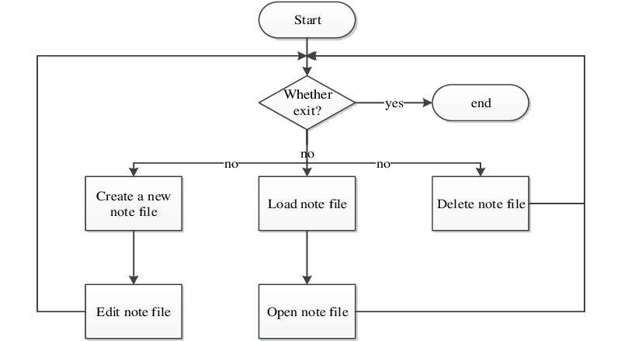
System Design
WORK FLOW DIAGRAM

Slide 7

USE CASE DIAGRAM
FILE
EDIT
VIEW
COLOR THEME
USER

Slide 8

Product Backlog
Step 1 : Roadmaps and Requirements
Roadmaps and Requirements are the foundation of any product backlog. Roadmap is the collection of required dataset. In this project, there is no need of any dataset collection.
Requirements are the list of backlog items that are needed to accomplish in order to complete a project. In this project the main requirement is to enter text data
save, open, delete, edit, and manipulate it.
Step 2 : List Tasks
Various tasks include, the text data entered can have different font family, size, and colour. The text can also be underlined, made bold/italics and can be justified(left/right/centre).
As additional feature we can change the theme of notepad and in the status bar we can see how much characters and words are used in the entered data.
As a user requirement(user stories) images and shapes are added to this notepad.

Slide 9
Sprint Backlog
USER STORY | NOT STARTED | IN PROGRESS | COMPLETED
Requirements |  |  | Completed
Model Identification |  |  | Completed
Testing Model |  | In Processing
Evaluation Model |  | In Processing
UI Design |  | In Processing
Documentation | Not Started

Slide 10

Thank You!

