Slide 1
23CS201 - Data Structures and Algorithms using C++
Study Materials

Slide 2
Basics of C++:
C++ is a versatile programming language known for its efficiency, flexibility,
and wide applicability. It combines procedural, object-oriented, and generic
programming features, allowing developers to create high-performance
software across various domains. With its rich standard library and support
for low-level memory manipulation, C++ is commonly used in system
software, game development, embedded systems, and more. Its syntax is
based on C, enhancing it with features like classes, inheritance,
polymorphism, templates, and exception handling, making it a powerful
tool for software development.

Slide 3
Arrays:
The array stores a fixed-size sequential collection of elements of the same type.
An array is used to store a collection of data, but it is often more useful to think of an array as a collection of variables of the same type.
Instead of declaring individual variables, such as number0, number1, ..., and number99, you declare one array variable such as numbers and use numbers[0], numbers[1], and ...numbers[99] to represent individual variables.
A specific element in an array is accessed by an index.
All arrays consist of contiguous memory locations.
The lowest address corresponds to the first element and the highest address to the last element.

Slide 4
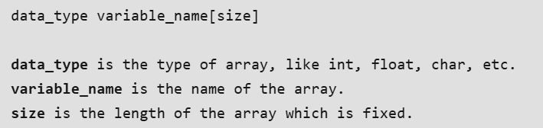
Types of array:
There are two types of arrays:
One Dimensional Array
Multi Dimensional Array
One Dimensional Array: A one dimensional array is a collection of same data
types.
1-D array is declared as:

Slide 5
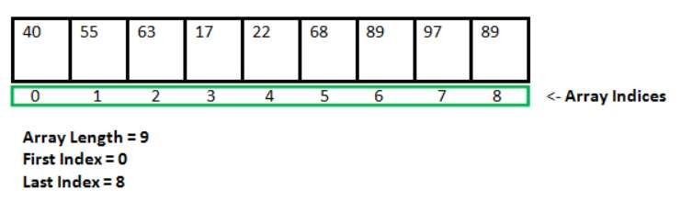
Representation of Array:

Slide 6
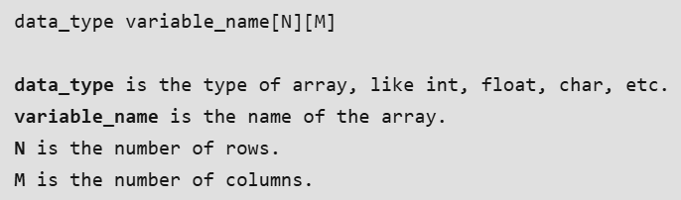
Multi-Dimensional Array:
A multidimensional array is also known as array of arrays.
Generally, we use a two-dimensional array.
It is also known as the matrix.
We use two indices to traverse the rows and columns of the 2D array.
It is declared as:

Slide 7
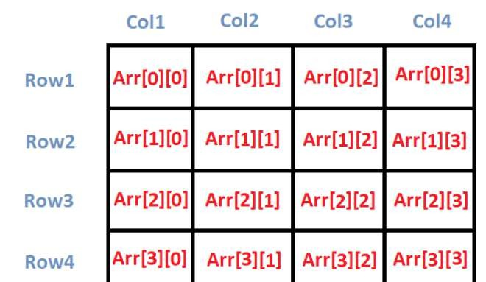
Multi-Dimensional Array:

Slide 8
Strings:
C++ strings are sequences of characters stored in a char array.
Strings are used to store words and text.
They are also used to store data, such as numbers and other types of information.
Strings in C++ can be defined either using the std::string class or the C-style character arrays.
This class provides a convenient way to manipulate strings,including operations like concatenation, substring extraction, and comparison.
Strings are fundamental for representing and processing textual data in computer
programs.

Slide 9
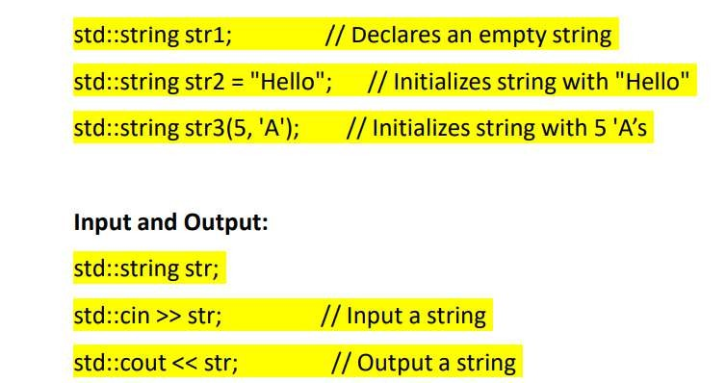
Declaration and Initialization::

Slide 10
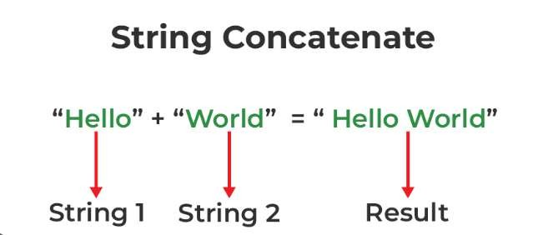
String Concatenation:

Slide 11
String Manipulation:
substr(): Extracts a substring from a string.
find(): Finds the first occurrence of a substring within a string.
replace(): Replaces a portion of the string with another string.
erase(): Removes characters from the string.
insert(): Inserts characters into the string.
Conversion:
c_str(): Converts a std::string to a C-style string (const char*).
std::to_string(): Converts numeric types to string

Slide 12

Pointers:
Pointers are symbolic representations of addresses.They enable programs to simulate call-by-reference as well as to create and manipulate dynamic data structures.
Iterating over elements in arrays or other data structures is one of the main use of pointers.
The address of the variable you’re working with is assigned to the pointer
variable that points to the same data type (such as an int or string).
Syntax:

Slide 13
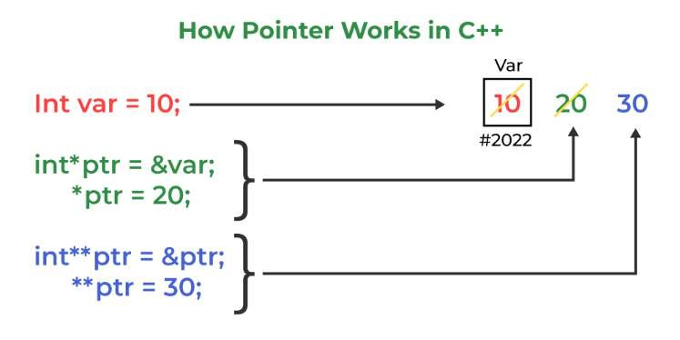
Steps to Solve RMQ Using a Segment Tree:

Slide 14
How to use a pointer?:
Define a pointer variable
Assigning the address of a variable to a pointer using the unary operator (&) which returns the address of that variable.
Accessing the value stored in the address using unary operator (*) which returns the value of the variable located at the address specified by its operand.
The reason we associate data type with a pointer is that it knows how many bytes the data is stored in. When we increment a pointer, we increase the pointer by the size of the data type to which it points.

Slide 15
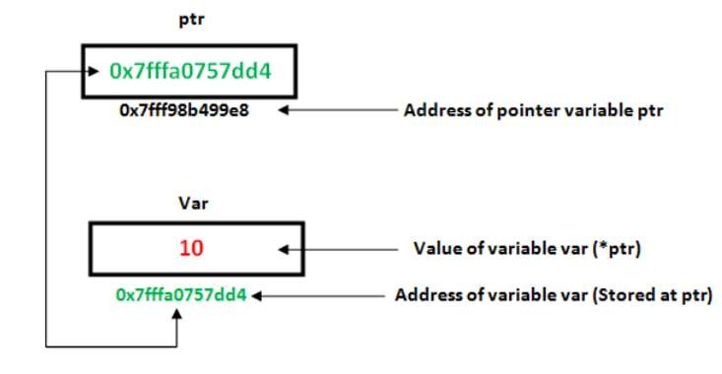
Pointers:

Slide 16
References and Pointers:
There are 3 ways to pass C++ arguments to a function:
Call-By-Value
Call-By-Reference with a Pointer Argument
Call-By-Reference with a Reference Argument

Slide 17
Structures:
A structure is a user-defined data type in C/C++.
A structure creates a data type that can be used to group items of possibly different types into a single type.
The C++ Course covers how to define and use structures effectively in C++, helping you manage complex data efficiently.
A structure is a user-defined data type that groups related variables of different types.
Key Points: Structures are used to represent records.

Slide 18
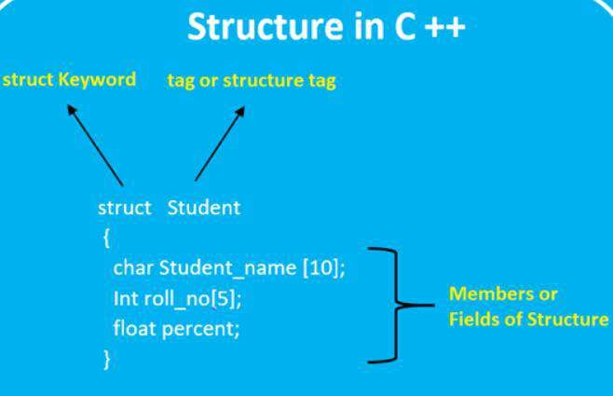
Structures:

Slide 19
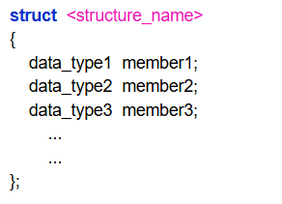
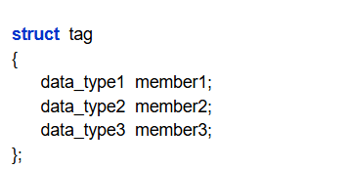
Declaration:

Slide 20
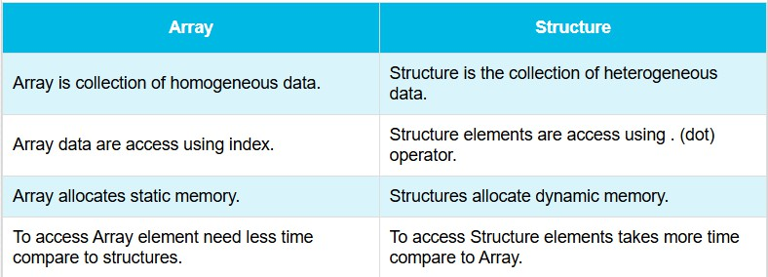
Difference Between Array and Structure:

