Slide 1
23CS201 -Data Structures and Algorithms using C++
Study Materials

Slide 2
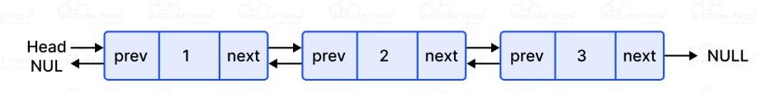
Doubly Linked List:
A doubly linked list is a type of data structure where each element, known as a node, holds data and two references: one pointing to the next node and one pointing to the previous node.
This two-way linking allows for movement in both directions through the list, making it more versatile than a singly linked list which only allows movement in one direction.

Slide 3
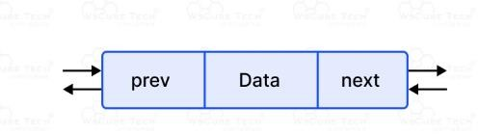
Structure of a Doubly Linked List:
In a data structure, a doubly linked list is represented using nodes that have three fields:
Data
A pointer to the next node (next)
A pointer to the previous node (prev)

Slide 4
Working of a Doubly Linked List:
A Doubly linked list node contains three fields:
Left pointer,
Information and
Right pointer.
The left pointer points to the node which is before the current node and the right pointer points to the node after the current node.
A Doubly linked list allows backward traversing if required. All other functions are similar to linked list.
It is different from the normal linked list by allowing the bidirectional traversal which in turn reduces the time complexity of any operation.

Slide 5
Characteristics of a doubly linked list:
Each node contains two pointers: one pointing to the previous node and one pointing to the next node.
The first node’s previous pointer points to null and the last node’s next pointer points to null.
The linked list can be traversed in both forward and backward directions.
The size of the linked list can be dynamically adjusted based on the number of
elements added or removed.
Insertions and deletions can be performed in constant time at both the beginning and the end of the list.
Access and search operations have O(n) time complexity, where n is the number
of elements in the list.
It requires more memory compared to a singly linked list, as each node has two pointers.

Slide 6
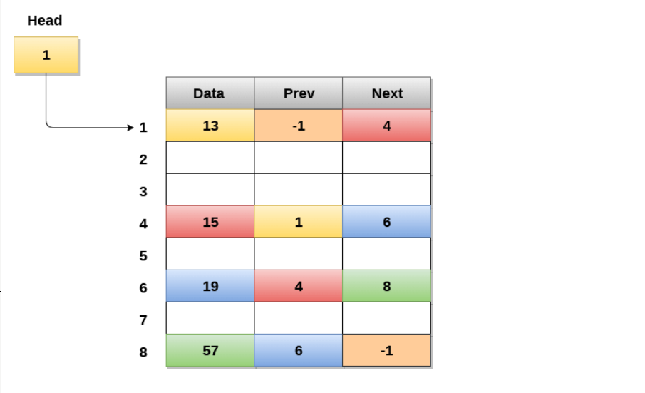
Memory Representation of a doubly linked list

Slide 7
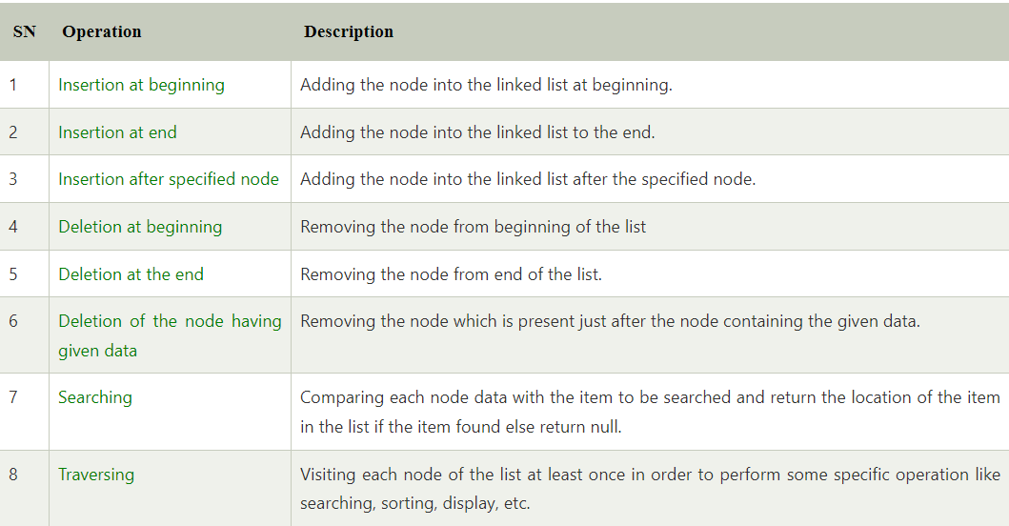
Operations:

Slide 8
Applications:
Doubly linked list can be used in navigation systems where both forward and backward traversal is required.
It can be used to implement different tree data structures.
It can be used to implement undo/redo operations.
Doubly linked lists are used in web page navigation in both forward and backward
directions.
It can be used in games like a deck of cards.

Slide 9
Advantages:
Bidirectional Navigation: Allows traversal in both forward and backward directions, facilitating easier and more flexible data manipulation.
Easier Insertion and Deletion: Nodes can be added or removed from both ends and the middle of the list without needing to traverse the entire list, especially if the tail pointer is maintained.
Efficient Operations at Both Ends: Adding or removing elements at the beginning and the end is efficient because both head and tail pointers provide direct access to the endpoints of the list.
Dynamic Size: The size of the list can increase or decrease dynamically, which is
efficient for memory usage since it allocates space only as needed.

Slide 10
Disadvantages:
Increased Memory Usage: Each node requires extra memory for an additional pointer (previous pointer), which can be significant in memory-constrained environments.
Complexity: Managing two pointers (next and prev) per node increases the complexity of the operations, making the code more prone to errors such as memory leaks and pointer corruption.
Slower Individual Operations: The overhead of maintaining an extra pointer can slightly slow down operations compared to singly linked lists, as more pointer operations are required.
Overhead in Memory Management.

