Slide 1
23CS201 - Data Structures and Algorithms using C++
Study Materials

Slide 2
Stack:
A Stack is a linear data structure that follows the LIFO (Last-In-First-Out) principle.
Stack has one end, whereas the Queue has two ends (front and rear).
It contains only one pointer top pointer pointing to the topmost element of the stack.
Whenever an element is added in the stack, it is added on the top of the stack,
and the element can be deleted only from the stack.
In other words, a stack can be defined as a container in which insertion and deletion can be done from the one end known as the top of the stack.

Slide 3
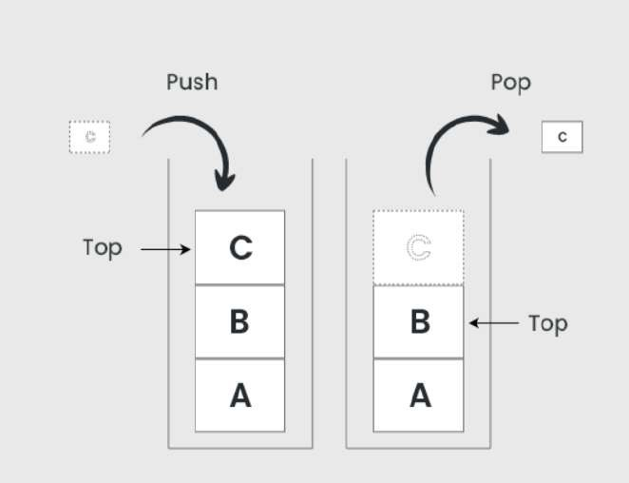
Stack representation:

Slide 4
key points:
It is called as stack because it behaves like a real-world stack, piles of books, etc.
A Stack is an abstract data type with a pre-defined capacity, which means that it can store the elements of a limited size.
It is a data structure that follows some order to insert and delete the elements, and that order can be LIFO or FILO.

Slide 5
Working of Stack:
Stack works on the LIFO pattern. As we can observe in the below figure there are five memory blocks in the stack; therefore, the size of the stack is 5.
Suppose we want to store the elements in a stack and let's assume that stack is empty.
We have taken the stack of size 5 as shown below in which we are pushing the
elements one by one until the stack becomes full.
Since our stack is full as the size of the stack is 5.
In the above cases, we can observe that it goes from the top to the bottom when we were entering the new element in the stack.
The stack gets filled up from the bottom to the top.

Slide 6
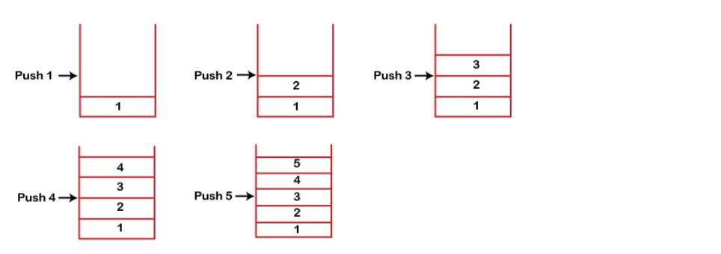
Representation of Stack:

Slide 7
Basic Operations:
push() to insert an element into the stack
pop() to remove an element from the stack
top() Returns the top element of the stack.
isEmpty() returns true if the stack is empty else false.
size() returns the size of the stack.

Slide 8
Linked list implementation:
Instead of using array, we can also use linked list to implement stack.
Linked list allocates the memory dynamically.
However, time complexity in both the scenario is same for all the operations push, pop and peek.
In linked list implementation of stack, the nodes are maintained non-contiguously
in the memory.
Each node contains a pointer to its immediate successor node in the stack.
Stack is said to be overflown if the space left in the memory heap is not enough
to create a node.

Slide 9
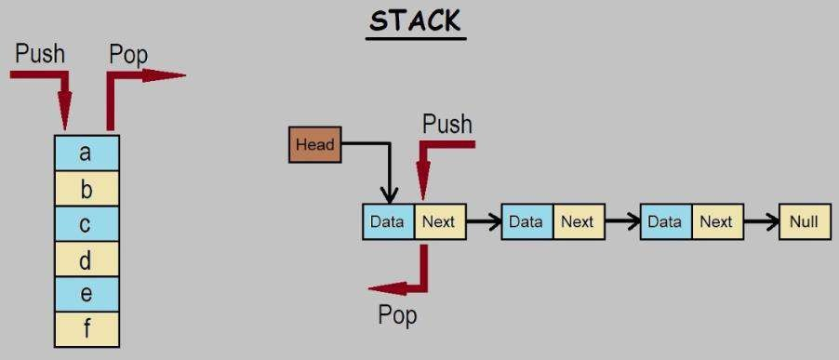
Linked list implementation:

Slide 10
Array implementation:
An array implementation, the stack is formed by using the array.
All the operations regarding the stack are performed using arrays.
Step-by-step approach:
Initialize an array to represent the stack.
Use the end of the array to represent the top of the stack.
Implement push (add to end), pop (remove from the end), and peek (check end) operations, ensuring to handle empty and full stack conditions.

Slide 11
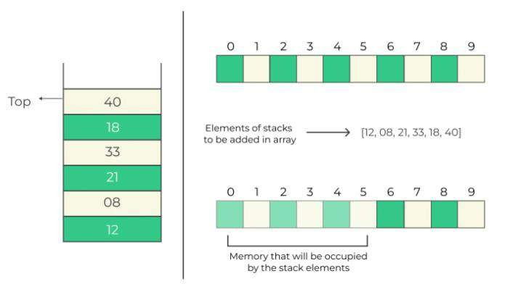
Array implementation:

