Slide 1
23IT201- DATABASE MANAGEMENT SYSTEMS
Course Title: Database Management Systems
Academic Year: 2024 - 2025 (Even Sem)
MODULE II CONSTRAINTS AND SQL COMMANDS

Slide 2
Serializability
23IT201- DATABASE MANAGEMENT SYSTEMS
A serializable schedule over a set S of committed transactions is a schedule whose effect on any consistent database instance is guaranteed to be identical to that of some complete serial schedule over S.
The database instance that results from executing the given schedule is identical to the database instance that results from executing the transactions in some serial order.
Thus a (possibly concurrent) schedule is serializable if it is equivalent to a serial schedule.
MODULE II CONSTRAINTS AND SQL COMMANDS

Slide 3
Serializability
23IT201- DATABASE MANAGEMENT SYSTEMS
Basic Assumption – Each transaction preserves database consistency.
Thus serial execution of a set of transactions preserves database consistency.
A (possibly concurrent) schedule is serializable if it is equivalent to a serial schedule.Different forms of schedule equivalence give rise to the notions of:
conflict serializability
view serializability
We ignore operations other than read and write instructions, and we assume that transactions may perform arbitrary computations on data in local buffers in between reads and writes. Our simplified schedules consist of only read and write instructions.
MODULE II CONSTRAINTS AND SQL COMMANDS

Slide 4
Conflict Serializability
23IT201- DATABASE MANAGEMENT SYSTEMS
Instructions l_{i} and l_{j} of transactions T_{i} and T_{j} respectively, conflict if and only if there exists some item Q accessed by both l_{i} and l_{j}, and at least one of these instructions wrote Q.
l_{i} = read(Q), l_{j} = read(Q). l_{i} and l_{j} don’t conflict.
l_{i} = read(Q), l_{j} = write(Q). They conflict.
l_{i} = write(Q), l_{j} = read(Q). They conflict
l_{i} = write(Q), l_{j} = write(Q). They conflict
Intuitively, a conflict between l_{i} and l_{j} forces a (logical) temporal order between them. If l_{i} and l_{j} are consecutive in a schedule and they do not conflict, their results would remain the same even if they had been interchanged in the schedule.
MODULE II CONSTRAINTS AND SQL COMMANDS

Slide 5
Conflict Serializability
23IT201- DATABASE MANAGEMENT SYSTEMS
If a schedule S can be transformed into a schedule S´ by a series of swaps of non-conflicting instructions, we say that S and S´ are conflict equivalent.
We say that a schedule S is conflict serializable if it is conflict equivalent to a serial schedule
Example of a schedule that is not conflict serializable:
T₃ T₄
read(Q)
write(Q)
write(Q)
We are unable to swap instructions in the above schedule to obtain either the serial schedule < T₃, T₄ >, or the serial schedule < T₄, T₃ >.
MODULE II CONSTRAINTS AND SQL COMMANDS

Slide 6
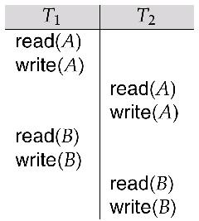
Conflict Serializability
23IT201- DATABASE MANAGEMENT SYSTEMS
Schedule 3 below can be transformed into Schedule 1, a serial schedule where T₂ follows T₁, by series of swaps of
non-conflicting instructions. Therefore Schedule 3 is conflict serializable.
MODULE II CONSTRAINTS AND SQL COMMANDS

Slide 7
View Serializability
23IT201- DATABASE MANAGEMENT SYSTEMS
Let S and S´ be two schedules with the same set of transactions. S and S´ are view equivalent if the following three conditions are met:
For each data item Q, if transaction T_{i} reads the initial value of Q in schedule S, then transaction T_{i} must, in schedule S´, also read the initial value of Q.
For each data item Q if transaction T_{i} executes read(Q) in schedule S, and that value was produced by transaction T_{j} (if any), then transaction T_{i} must in schedule S´ also read the value of Q that was produced by transaction T_{j} .
For each data item Q, the transaction (if any) that performs the final write(Q) operation in schedule S must perform the final write(Q) operation in schedule S´.
As can be seen, view equivalence is also based purely on reads
and writes alone.
MODULE II CONSTRAINTS AND SQL COMMANDS

Slide 8
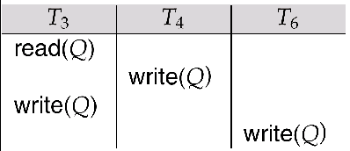
23IT201- DATABASE MANAGEMENT SYSTEMS
View Serializability
A schedule S is view serializable it is view equivalent to a serial schedule.
Every conflict serializable schedule is also view serializable.
Schedule 9 (from text) — a schedule which is view-serializable but not conflict serializable.
Every view serializable schedule that is not conflict serializable has blind writes.
MODULE II CONSTRAINTS AND SQL COMMANDS

Slide 9
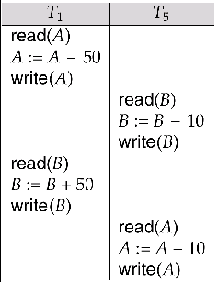
23IT201- DATABASE MANAGEMENT SYSTEMS
Schedule 8 (from text) given below produces same outcome as the serial schedule < T₁, T₅ >, yet is not
conflict equivalent or view equivalent to it.
Determining such equivalence requires analysis of operations other than read and write.
MODULE II CONSTRAINTS AND SQL COMMANDS

Slide 10
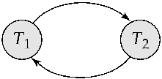
Testing for Serializability
23IT201- DATABASE MANAGEMENT SYSTEMS
Consider some schedule of a set of transactions T₁, T₂,
..., T_{n}
Precedence graph — a direct graph where the vertices are the transactions (names).
We draw an arc from T_{i} to T_{j} if the two transaction conflict, and T_{i} accessed the data item on which the conflict arose earlier.
We may label the arc by the item that was accessed.
Example 1
x
y
MODULE II CONSTRAINTS AND SQL COMMANDS

Slide 11
Example Schedule (Schedule A)
23IT201- DATABASE MANAGEMENT SYSTEMS
T₁
T₂ T₃ T₄ T₅
read(X)
read(Y) read(Z)
read(V) read(W) read(W)
read(Y) write(Y)
write(Z)
read(U)
read(Y) write(Y) read(Z) write(Z)
read(U) write(U)

Slide 12
Precedence Graph for Schedule A
23IT201- DATABASE MANAGEMENT SYSTEMS
T₁
T₂
T₄
T
3
MODULE II CONSTRAINTS AND SQL COMMANDS

Slide 13
Test for Conflict Serializability
23IT201- DATABASE MANAGEMENT SYSTEMS
A schedule is conflict serializable if and only if its precedence graph is acyclic.
Cycle-detection algorithms exist which take order n² time, where n is the number of vertices in the graph. (Better algorithms take order n + e where e is the number of edges.)
If precedence graph is acyclic, the serializability order can be obtained by a topological sorting of the graph. This is a linear order consistent with the partial order of the graph.
For example, a serializability order for Schedule A would be
T₅ → T₁ → T₃ → T₂ → T₄ .
MODULE II CONSTRAINTS AND SQL COMMANDS

Slide 14
Test for View Serializability
23IT201- DATABASE MANAGEMENT SYSTEMS
The precedence graph test for conflict serializability must be modified to apply to a test for view serializability.
The problem of checking if a schedule is view serializable falls in the class of NP-complete problems. Thus existence of an efficient algorithm is unlikely.
However practical algorithms that just check some sufficient conditions for view serializability can still be used.
MODULE II CONSTRAINTS AND SQL COMMANDS

