Slide 1
Title of Topic: Introduction to DBMS, Characteristics of DBMS, DBMS vs File Systems, need for DBMS Course Code: 23IT201 Course Title: Database Management Systems Session Number: 1 Academic Year: 2024 - 2025 (Even Sem)
23IT201-DATABASE MANAGEMENT SYSTEMS
MODULE 1-INTRODUCTION

Slide 2
1. Introduction to DBMS, Characteristics of DBMS, DBMS vs File Systems, need for DBMS. 2. Three Level DBMS Architecture 3. Data Models Introduction, Benefits, and Phases 4. ER Diagrams – Symbols, Components, Relationships, Weak entities, Attributes, Cardinality. 5. Relational Algebra, Domain Relational Calculus, Tuple Relational 6.Calculus Keys - primary Key, Foreign Key.
23IT201-DATABASE MANAGEMENT SYSTEMS
Module 1 – INTRODUCTION
MODULE 1-INTRODUCTION
2

Slide 3
23IT201-DATABASE MANAGEMENT SYSTEMS
Introduction to DBMS, Characteristics of DBMS, DBMS vs File Systems, need for DBMS
Topics to be Covered
DataBase (DB)
DataBase Management System (DBMS)
Applications of DBMS
Metadata
Very Large DataBase
DBMS vs File System
Users of DataBase System
MODULE 1-INTRODUCTION

Slide 4
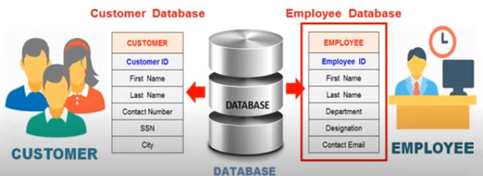
23IT201-DATABASE MANAGEMENT SYSTEMS
DataBase (DB)
Well organized collection of data that are related in a meaningful way which can be accessed in different logical orders but are stored only once
The data (collection of raw facts and figures) in the database is therefore integrated, structured and shared
Stores only persistent data (once stored it always stays there unless deleted by an explicit request)
Feature of Database
Well organized and Related data
Self-Describing
Stored only once
Accessible in different orders without great difficulty
MODULE 1-INTRODUCTION

Slide 5
23IT201-DATABASE MANAGEMENT SYSTEMS
Database (DB)
DBMS stands for Database Management System.
DBMS = Database + Management System.
Database is a collection of data and Management System is a set of programs to store and retrieve those data.
A Database Management System (DBMS) is a software system that is designed to manage and organize data in a structured manner.
It allows users to create, modify, and query a database, as well as manage the security and access controls for that database.
MODULE 1-INTRODUCTION

Slide 6
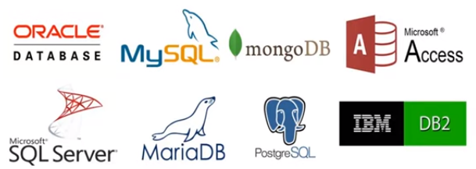

23IT201-DATABASE MANAGEMENT SYSTEMS
DataBase Management System (DBMS)
Contains information about a particular enterprise
Collection of interrelated data
Set of programs to access the data
Environment that is both convenient and efficient to use
Software system for creating, organizing and managing the database
Provides an environment to perform operations on the database for creating, inserting, deleting, updating and retrieval of data
DBMS:
MODULE 1-INTRODUCTION

Slide 7
23IT201-DATABASE MANAGEMENT SYSTEMS
Database Management System (DBMS) –
CHARACTERISTICS OF DBMS
1.Data modeling:
A DBMS provides tools for creating and modifying data models, which define the structure and relationships of the data in a database.
2.Data storage and retrieval:
A DBMS is responsible for storing and retrieving data from the database, and can provide various methods for searching and querying the data.
MODULE 1-INTRODUCTION

Slide 8
23IT201-DATABASE MANAGEMENT SYSTEMS
Database Management System (DBMS) –
CHARACTERISTICS OF DBMS
3.Concurrency control:
A DBMS provides mechanisms for controlling concurrent access to the database, to ensure that multiple users can access the data without conflicting with each other.
4.Data integrity and security:
A DBMS provides tools for enforcing data integrity and security constraints, such as constraints on the values of data and access controls that restrict who can access the data
MODULE 1-INTRODUCTION

Slide 9
23IT201-DATABASE MANAGEMENT SYSTEMS
Database Management System (DBMS) –
CHARACTERISTICS OF DBMS
5.Backup and recovery:
A DBMS provides mechanisms for backing up and recovering the data in the event of a system failure.
6. DBMS can be classified into two types:
Relational Database Management System (RDBMS) and Non-Relational Database Management System (NoSQL or Non-SQL)
7. RDBMS:
Data is organized in the form of tables and each table has a set of rows and columns. The data is related to each other through primary and foreign keys.
MODULE 1-INTRODUCTION

Slide 10
23IT201-DATABASE MANAGEMENT SYSTEMS
Database Management System (DBMS) –
CHARACTERISTICS OF DBMS
8.NoSQL:
Data is organized in the form of key-value pairs, document, graph, or column-based. These are designed to handle large-scale, high-performance scenarios.
MODULE 1-INTRODUCTION

Slide 11
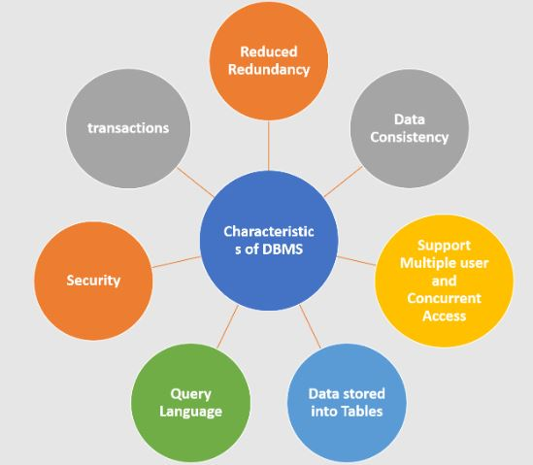
23IT201-DATABASE MANAGEMENT SYSTEMS
Database Management System (DBMS) –
CHARACTERISTICS OF DBMS
MODULE 1-INTRODUCTION

Slide 12
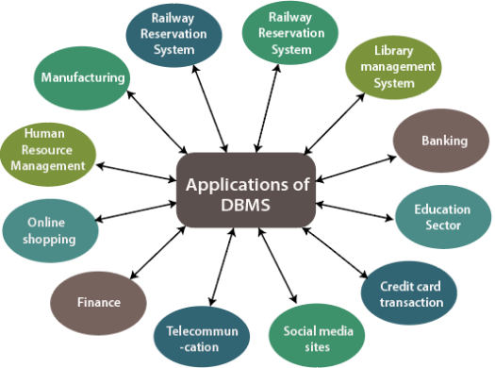
23IT201-DATABASE MANAGEMENT SYSTEMS
Applications of DBMS
Online retailers: Order Tracking, Customized Recommendations
Manufacturing: Production, Inventory, Orders, Supply Chain
Human resources: Employee Records, Salaries, Tax Deductions
MODULE 1-INTRODUCTION

Slide 13
23IT201-DATABASE MANAGEMENT SYSTEMS
Metadata
Data about data is called as Metadata
Database includes information about how data is stored in computer storage
Document type | Book
Last name of author | Bloomfield
First name of author | Leonard
Year of publication | 1933
Title | Language
City | New York
Publisher | Holt, Rinehart & Winston
MODULE 1-INTRODUCTION

Slide 14
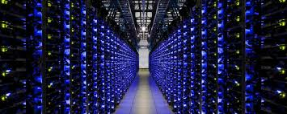
23IT201-DATABASE MANAGEMENT SYSTEMS
Very Large DataBase
Google, Yahoo, MSN - Search, Mail and Other Services
Ebay - Buy and Sell
YouTube - Videos (put & share)
MySpace - Social Networking
Facebook - Social Networking
Wikipedia - Online Encyclopedia
Telecommunications
Flickr - Share Photos
Blogger - Own Blogs
Fotolog - Share Photos & Blogs
MODULE 1-INTRODUCTION

Slide 15
23IT201-DATABASE MANAGEMENT SYSTEMS
DBMS vs File System
DBMS (Collection of Data) | File System (Collection of Data)
User is not required to write the procedures | User has to write the procedures for managing the database
Gives an abstract view of data that hides the details | Provides the detail of the data representation and storage of data
Provides a crash recovery mechanism, i.e., DBMS protects the user from the system failure | Doesn't have a crash mechanism, i.e., if the system crashes while entering some data, then the content of the file will lost
Provides a good protection mechanism | Very difficult to protect a file
MODULE 1-INTRODUCTION

Slide 16
23IT201-DATABASE MANAGEMENT SYSTEMS
DBMS vs File System
DBMS (Collection of Data) | File System (Collection of Data)
Contains a wide variety of sophisticated techniques to store and retrieve the data | Can't efficiently store and retrieve the data
Takes care of Concurrent access of data using some form of locking | Concurrent access has many problems like redirecting the file while other deleting some information or updating some information
Redundancy control is available in DBMS | Redundancy control is not available in file system
Unauthorized access is restricted in DBMS | Unauthorized access is not restricted in the file system
MODULE 1-INTRODUCTION

Slide 17
23IT201-DATABASE MANAGEMENT SYSTEMS
DBMS vs File System
DBMS (Collection of Data) | File System (Collection of Data)
Provide back up and recovery | Data lost in file system can't be recovered
Provide multiple user interfaces | Data is isolated in file system
Coordinates both the physical and the logical access to the data | Coordinates only the physical access
Designed to allow flexible access to data (i.e. queries) | Designed to allow predetermined access to data (i.e. compiled programs).
Designed to coordinate multiple users accessing the same data at the same time | Designed to allow one or more programs to access different data files at the same time
MODULE 1-INTRODUCTION

Slide 18
23IT201-DATABASE MANAGEMENT SYSTEMS
Users of DataBase System
DataBase Administrator (DBA)
Manage all level of DBMS model
DBA is responsible for
Schema definition
Storage structure and access-method definition
Schema and physical-organization modification
Granting of authorization for data access
Acquiring s/w and h/w resources as needed
Routine maintenance
End Users
Access to the database for querying, updating, and generating reports
MODULE 1-INTRODUCTION

Slide 19
23IT201-DATABASE MANAGEMENT SYSTEMS
Users of DataBase System
DataBase Designers
Logical Designers - Identifying the data to be stored in the database and relationship between them
Physical Designers - Choosing appropriate structures to represent and store data
System Analysts and Application Programmers
System Analysts communicate with all prospective database users, in order to understand their requirements especially naive and parametric end users, and develop specifications
Application programmers implement specifications as programs; then test, debug, document, and maintain canned transactions
MODULE 1-INTRODUCTION

Slide 20
23IT201-DATABASE MANAGEMENT SYSTEMS
Users of DataBase System
Casual End Users
Occasionally access the database
Need different information each time
Learn only a few facilities that they may use repeatedly
Naive or Parametric or Unsophisticated End Users
Constantly querying and updating the database, using standard types of queries and updates
Need to learn very little about the facilities provided by the DBMS
Reservation clerks for airlines, hotels, and car rental companies check availability for a given request and make reservations
MODULE 1-INTRODUCTION

Slide 21
23IT201-DATABASE MANAGEMENT SYSTEMS
Users of DataBase System
Sophisticated End Users
Engineers, scientists, business analysts, and others who thoroughly familiarize themselves with the facilities of the DBMS
Try to learn most of the DBMS facilities in order to achieve their complex requirements
Stand-Alone Users
Maintain personal databases by using ready-made program packages that provide easy- to-use menu or graphics-based interfaces
An example is the user of a tax package that stores a variety of personal financial data for tax purposes
MODULE 1-INTRODUCTION

Slide 22
23IT201-DATABASE MANAGEMENT SYSTEMS
Users of DataBase System
Tool Developers
Tools are optional packages that are often purchased separately
Include packages for database design, performance monitoring, natural language or graphical interfaces, prototyping, simulation, and test data generation
Operators and Maintenance Personnel
System administration personnel who are responsible for the actual running and maintenance of the hardware and software environment for the database system
MODULE 1-INTRODUCTION

Slide 23
23IT201-DATABASE MANAGEMENT SYSTEMS
Introduction to DBMS, Characteristics of DBMS, DBMS vs File Systems, need for DBMS
Summary
DataBase (DB)
DataBase Management System (DBMS)
Applications of DBMS
Characteristics of DBMS
Metadata
Very Large DataBase
DBMS vs File System
Users of DataBase System
MODULE 1-INTRODUCTION

Slide 24
23IT201-DATABASE MANAGEMENT SYSTEMS
Introduction to DBMS, Characteristics of DBMS, DBMS vs File Systems, need for DBMS
Try Yourself
A person has to create a database for a university so that the university will have all its data in the database. Identify the data to be added for the university database.
Maintaining a customer database is an important way to keep up-to-date on customer information and data. An online shopping system maintains all its customer data in a database. List out the data available in such a customer database.
An employer has to maintain his employee details in a database. He informs one of his employee to create a database to store the details of all the employees. Organize the data for the employee database.
MODULE 1-INTRODUCTION

Slide 25
23IT201-DATABASE MANAGEMENT SYSTEMS
Session 2 - DBMS Architecture, Data Models – Introduction, Benefits, and Phases
MODULE 1-INTRODUCTION

