Slide 1
Title of Topic: JOINS Course Code: 23IT201 Course Title: DataBase Management Systems Academic Year: 2024 - 2025 (Even Sem)
JOINS
MODULE 2

Slide 2
JOINS
JOINS
Module 2
MODULE 2
2

Slide 3
JOINS
JOINS
Topics to be Covered
Joins
Natural Join
Inner Join
Outer Join
Left Outer Join
Right Outer Join
Full Outer Join
MODULE 2

Slide 4
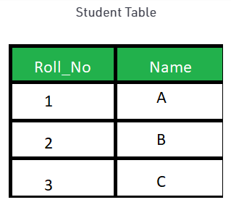
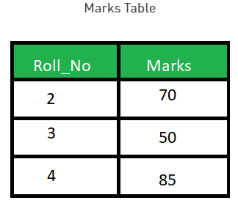
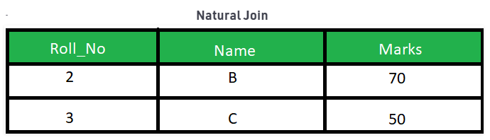

JOINS
Join Operations
Natural Join
Operates on two relations and produces a relation as the result
Considers only those pairs of tuples with the same value on those attributes that appear in the schemas of both relations
E.g., SELECT * FROM Student S NATURAL JOIN Marks M;
Output
Join: Part 1: Part 2:
MODULE 2

Slide 5
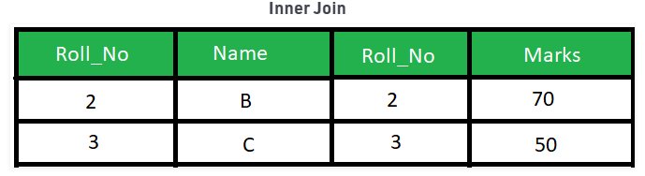
JOINS
Join Operations
Inner Join
Selects all rows from both the tables as long as the condition satisfies
Create the result-set by combining all rows from both the tables where the value of the common field will be same
E.g., SELECT * FROM student S INNER JOIN Marks M ON S.Roll_No = M.Roll_No;
Output
MODULE 2

Slide 6
JOINS
Join Operations
Outer Join
Three forms of outer join
The left outer join (left join) preserves tuples only in the relation named before (to the left of) the left outer join operation
The right outer join (right join) preserves tuples only in the relation named after (to the right of) the right outer join operation
The full outer join (full join) preserves tuples in both relations
MODULE 2

Slide 7
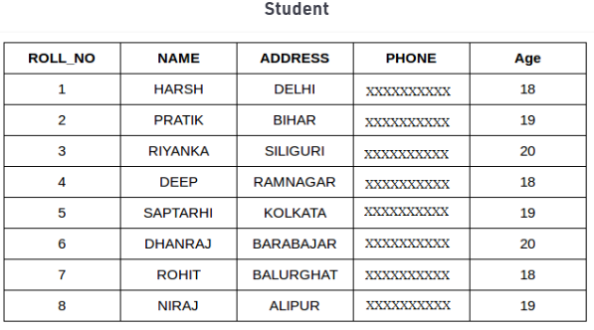
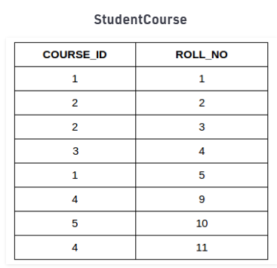
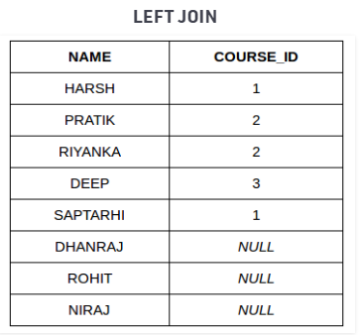
JOINS
Join Operations
Left Outer Join
Returns all the rows of the table on the left side of the join and matching rows for the table on the right side of join (The rows for which there is no matching row on right side, the result-set will contain null)
E.g., SELECT Student.NAME, StudentCourse.COURSE_ID FROM Student LEFT JOIN StudentCourse ON StudentCourse.ROLL_NO = Student.ROLL_NO;
Output
MODULE 2

Slide 8
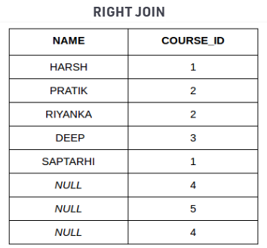
JOINS
Join Operations
Right Outer Join
Returns all the rows of the table on the right side of the join and matching rows for the table on the left side of join (The rows for which there is no matching row on left side, the result-set will contain null)
E.g., SELECT Student.NAME, StudentCourse.COURSE_ID FROM Student RIGHT JOIN StudentCourse ON StudentCourse.ROLL_NO = Student.ROLL_NO;
Output
MODULE 2

Slide 9
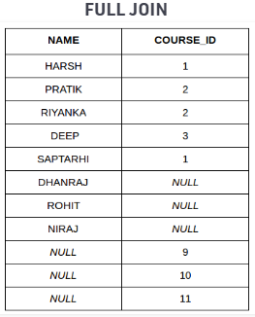
JOINS
Join Operations
Full Outer Join
Combining result of both LEFT JOIN and RIGHT JOIN
The result-set will contain all the rows from both the tables (The rows for which there is no matching, the result-set will contain NULL values)
E.g., SELECT Student.NAME, StudentCourse.COURSE_ID FROM Student FULL JOIN StudentCourse ON StudentCourse.ROLL_NO = Student.ROLL_NO;
Output
MODULE 2

Slide 10
JOINS
Writing Optimized Queries
Given a query, there are generally a variety of methods for computing the answer
A query could be expressed in several different ways
Each SQL query can itself be translated into a relational-algebra expression in one of several ways
Furthermore, the relational-algebra representation of a query specifies only partially how to evaluate a query; there are usually several ways to evaluate relational-algebra expressions
As an illustration, consider the query:
select salary
from instructor
where salary < 75000;
MODULE 2

Slide 11

JOINS
Writing Optimized Queries
This query can be translated into either of the following relational-algebra expressions:
Further, we can execute each relational-algebra operation by one of several different algorithms
For example, to implement the preceding selection, every tuple in instructor can be searched to find tuples with salary less than 75000
If a B+-tree index is available on the attribute salary, we can use the index instead to locate the tuples
MODULE 2

Slide 12
JOINS
Writing Optimized Queries
To specify fully how to evaluate a query, we need not only to provide the relational-algebra expression, but also to annotate it with instructions specifying how to evaluate each operation
The different evaluation plans for a given query can have different costs
It is not expected users to write their queries in a way that suggests the most efficient evaluation plan
Rather, it is the responsibility of the system to construct a query-evaluation plan that minimizes the cost of query evaluation; this task is called query optimization
MODULE 2

