Slide 1
Title of Topic: NORMALIZATION Course Code: 23IT201 Course Title: DataBase Management Systems MODULE –II Academic Year: 2024 - 2025 (Even Sem)
23IT201- DATABASE MANAGEMENT SYSTEMS
MODULE II CONSTRAINTS AND SQL COMMANDS

Slide 2
DDL Commands - Create, Drop, Alter, Truncate, Rename, - DML Commands – Normalization - 1NF, 2NF, 3NF, BCNF, 4NF - Select, Insert, Update, Delete, Any, All, In, Exists, Non Exists, Union, Intersection, Subqueries - nested, correlated, Joins- Inner, Outer, and Equi, Functions - SUM, COUNT, AVG, MIN, MAX, Clauses - Group By, Having By, Embedded SQL, Dynamic SQL, Transaction Concepts – Transaction model – ACID Properties – Serializability
23IT201- DATABASE MANAGEMENT SYSTEMS
Module 2 – CONSTRAINTS AND SQL COMMANDS
MODULE 2 -CONSTRAINTS AND SQL COMMANDS
2

Slide 3

23IT201- DATABASE MANAGEMENT SYSTEMS
Data Normalization
Formal process of decomposing relations with anomalies to produce smaller, well- structured and stable relations
Primarily a tool to validate and improve a logical design so that it satisfies certain constraints that avoid unnecessary duplication of data
Theory

Slide 4
23IT201- DATABASE MANAGEMENT SYSTEMS
Well-Structured Relations
A relation that contains minimal data redundancy and allows users to insert, delete, and update rows without causing data inconsistencies
Goal is to avoid (minimize) anomalies
Insertion Anomaly – adding new rows forces user to create duplicate data
Deletion Anomaly – deleting a row may cause loss of other data representing completely different facts
Modification Anomaly – changing data in a row forces changes to other rows because of duplication
General rule of thumb: a table should not pertain to more than one entity type
Theory

Slide 5

23IT201- DATABASE MANAGEMENT SYSTEMS
Question – Is this a relation?
Answer – Yes: unique rows and no multivalued attributes
Question – What’s the primary key?
Answer – Composite: EmpID, CourseTitle
Theory

Slide 6
Module 2 20CS401 – Database Management Systems
Anomalies in this Table
Insertion – can’t enter a new employee without having the employee take a class
Deletion – if we remove employee 140, we lose information about the existence of a Tax Acc class
Modification – giving a salary increase to employee 100 forces us to update multiple records
Theory

Slide 7
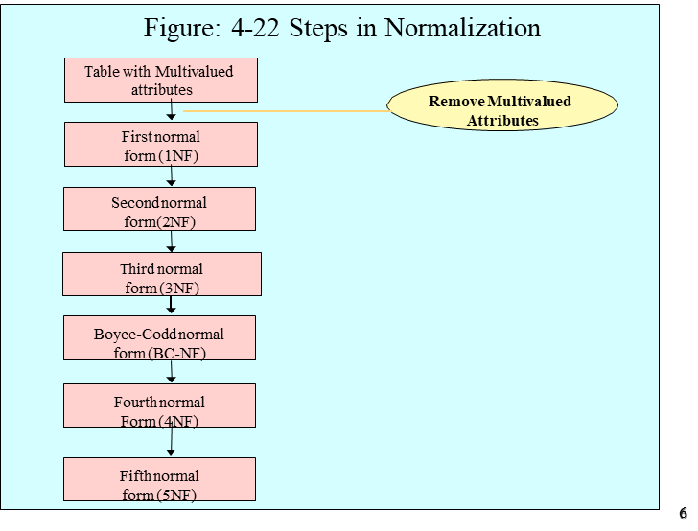
Module 2 20CS401 – Database Management Systems
Theory

Slide 8
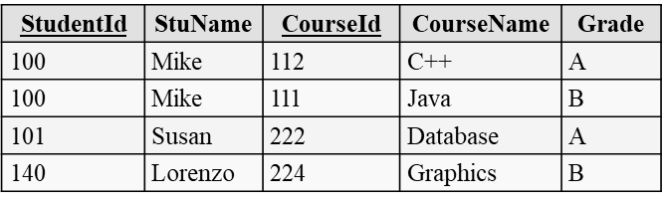
23IT201-DATABASE MANAGEMENT SYSTEMS
First Normal Form (1NF)
A relation is in first Normal Form if and only if all underlying domains contain atomic values only
In other words, a relation doesn’t have multivalued attributes (MVA)
A primary key has been identified
Every relation is in 1NF by definition
1NF example:
Student
Theory

Slide 9
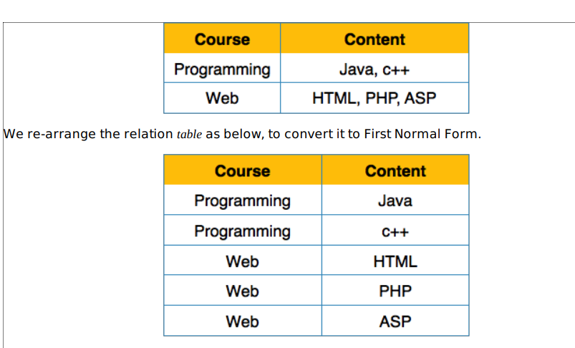
23IT201-DATABASE MANAGEMENT SYSTEMS
Theory

Slide 10
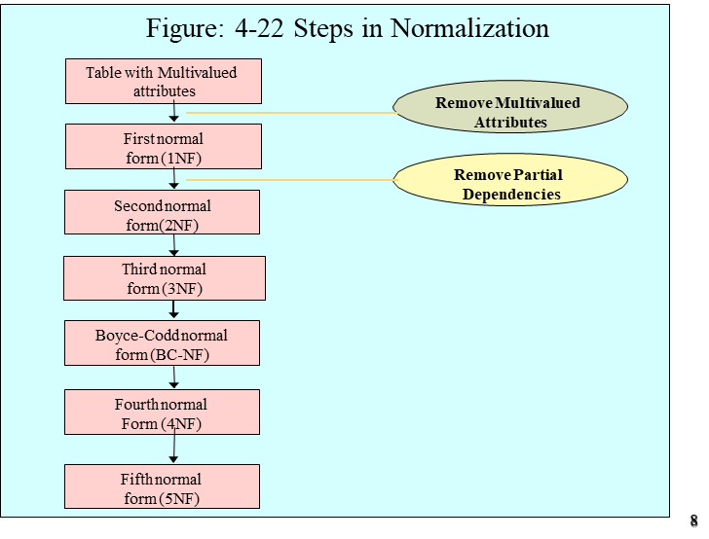
23IT201-DATABASE MANAGEMENT SYSTEMS
Theory

Slide 11
23IT201-DATABASE MANAGEMENT SYSTEMS
Second Normal Form (2NF)
1NF PLUS every non-key attribute is fully functionally dependent on the ENTIRE primary key
Every non-key attribute must be defined by the entire key, not by only part of the key
No partial functional dependencies
Theory

Slide 12
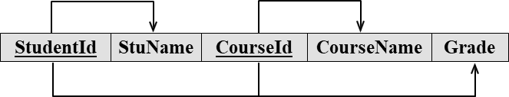
23IT201-DATABASE MANAGEMENT SYSTEMS
Functional Dependencies in Student
Can represent FDs with arrows as above, or
StudentId StuName,
CourseId CourseName
StudentId,CourseId Grade (and StuName, CourseName)
Any partial FDs ?
Theory

Slide 13

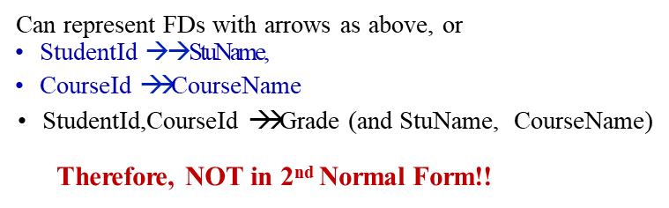
23IT201-DATABASE MANAGEMENT SYSTEMS
Theory

Slide 14
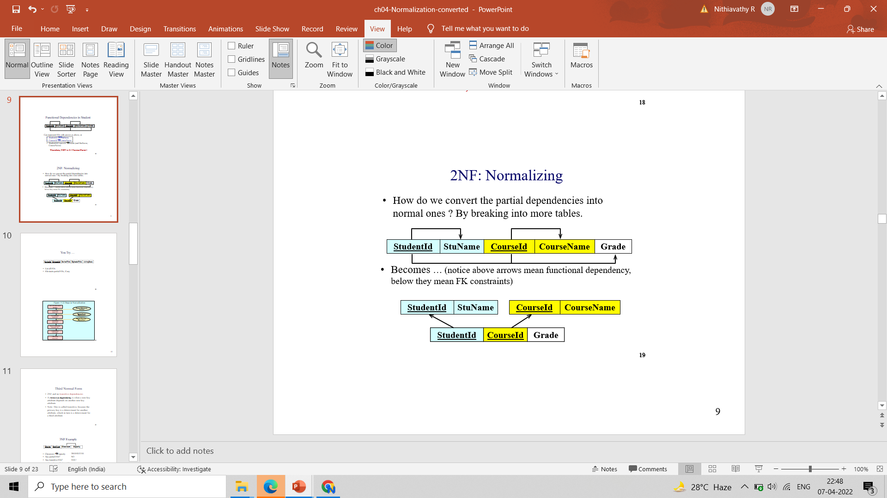
23IT201-DATABASE MANAGEMENT SYSTEMS
2NF: Normalizing
To convert the partial dependencies into normal ones we have to breaking into more tables.
arrows mean functional dependency, below they mean FK constraints
Theory

Slide 15
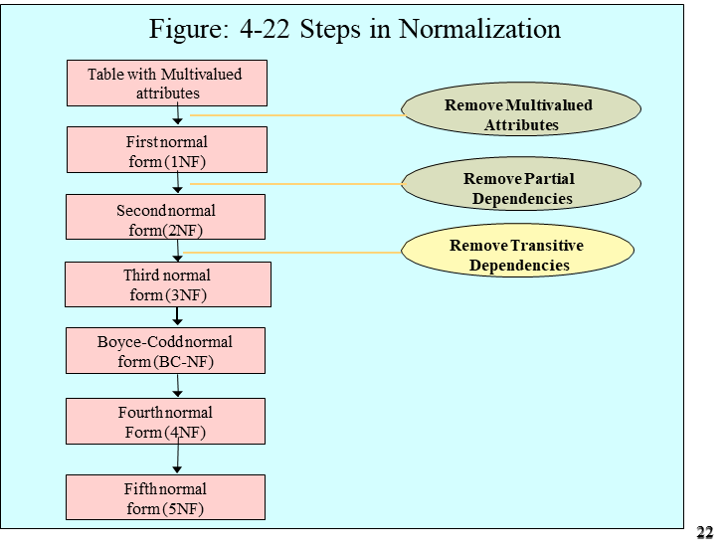
23IT201-DATABASE MANAGEMENT SYSTEMS
Theory

Slide 16
23IT201-DATABASE MANAGEMENT SYSTEMS
Third Normal Form
2NF and no transitive dependencies
A transitive dependency is when a non-key attribute depends on another non-key attribute
Note: This is called transitive, because the primary key is a determinant for another attribute, which in turn is a determinant for a third attribute
Theory

Slide 17
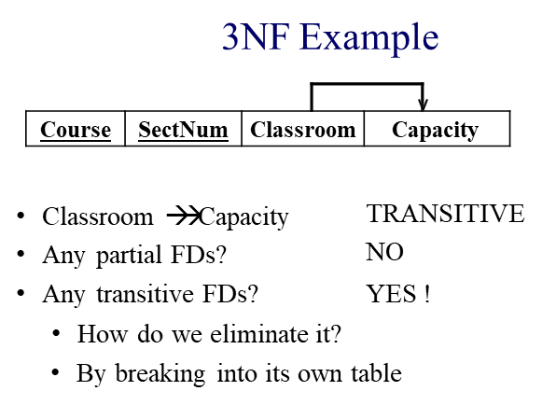
23IT201-DATABASE MANAGEMENT SYSTEMS
Theory

Slide 18
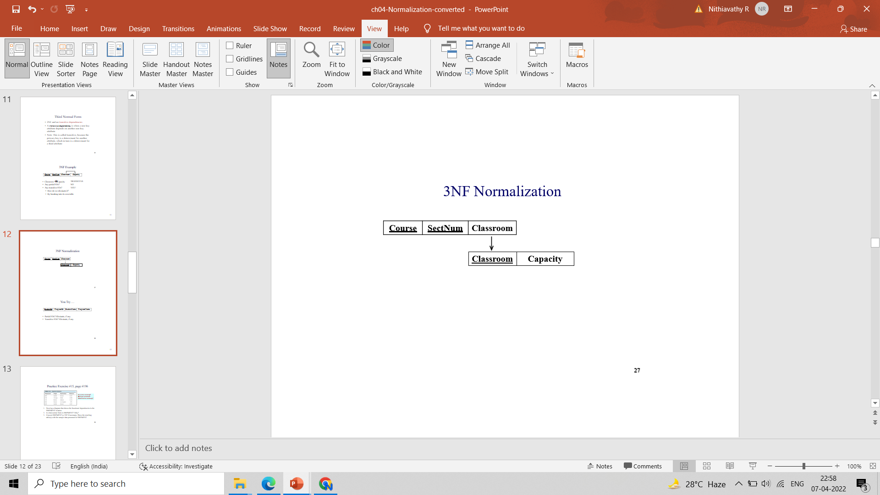
23IT201-DATABASE MANAGEMENT SYSTEMS
No non-prime attribute is transitively dependent on prime key attribute. For any non-trivial functional dependency,
X → A, then
either − X is a superkey or,
A is prime attribute.
Theory

Slide 19

23IT201-DATABASE MANAGEMENT SYSTEMS
In the above Student_detail relation, Stu_ID is the key and only prime key attribute. We find that City can be identified by Stu_ID as well as Zip itself. Neither Zip is a super key nor is City a prime attribute. Additionally, Stu_ID → Zip → City, so there exists transitive dependency. To bring this relation into third normal form, we break the relation into two relations as follows −
Theory

Slide 20
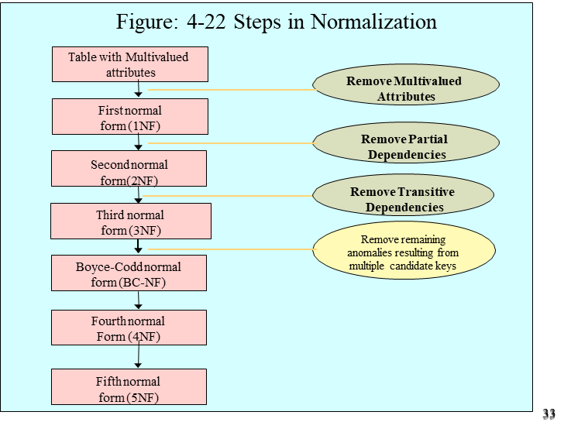
23IT201-DATABASE MANAGEMENT SYSTEMS
Theory

Slide 21
23IT201-DATABASE MANAGEMENT SYSTEMS
Boyce-Codd Normal form (BCNF)
Slight difference with 3NF
To be in 3NF but not in BNF, needs two composite candidate keys, with one attribute of one key depending on one attribute of the other
Not very common.
If a table contains only one candidate key, the 3NF and the BCNF are equivalent.
Theory

Slide 22

23IT201-DATABASE MANAGEMENT SYSTEMS
BCNF Example
Assume that
For each subject, each student is taught by one Instructor
Each Instructor teaches only one subject
Each subject is taught by several Instructors
Course, Student instructor
Instructor Course
Theory

Slide 23
23IT201-DATABASE MANAGEMENT SYSTEMS
BCNF
Boyce-Codd normal form (BCNF)
A relation is in BCNF, if and only if, every determinant is a candidate key.
The difference between 3NF and BCNF is that for a functional dependency A B, 3NF allows this dependency in a relation if B is a primary-key attribute and A is not a candidate key,
whereas BCNF insists that for this dependency to remain in a relation, A must be a candidate key.
Theory

Slide 24
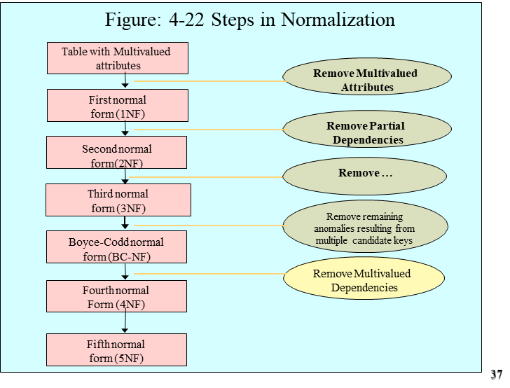
23IT201-DATABASE MANAGEMENT SYSTEMS
Theory

Slide 25

23IT201-DATABASE MANAGEMENT SYSTEMS
4NF
A multi-valued dependency exists when
There are at least 3 attributes A, B, C in a relation and
For each value of A there is a well defined set of values for B, and a well defined set of values for C,
But the set of values for B is independent on the set of values for C
4NF = 3NF with no multi-valued dependency
Theory

Slide 26

23IT201-DATABASE MANAGEMENT SYSTEMS
Assume that
Each subject is taught by many Instructors
The same books are used in many subjects
Each Instructor uses a different book
Theory

Slide 27
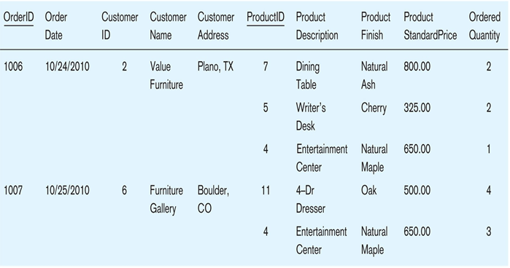
23IT201-DATABASE MANAGEMENT SYSTEMS
Example :INVOICE Data
Table with multivalued attributes, not in 1st normal form
Theory

Slide 28
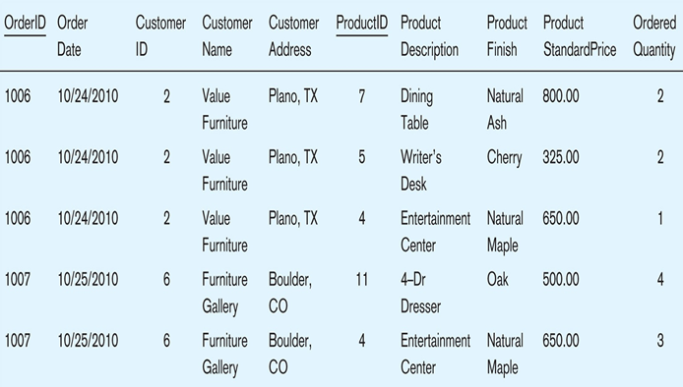
23IT201-DATABASE MANAGEMENT SYSTEMS
INVOICE relation (1NF)
Table with no multivalued attributes and unique rows
this is relation, but not a well-structured one. WHY?
Theory

Slide 29
23IT201-DATABASE MANAGEMENT SYSTEMS
Anomalies in this Table
Insertion–if new product is ordered for order 1007 of existing customer, customer data must be re-entered, causing duplication
Deletion–if we delete the Dining Table from Order 1006, we lose information concerning this item's finish and price
Update–changing the price of product ID 4 requires update in several records
Theory

Slide 30

23IT201-DATABASE MANAGEMENT SYSTEMS
Theory

Slide 31
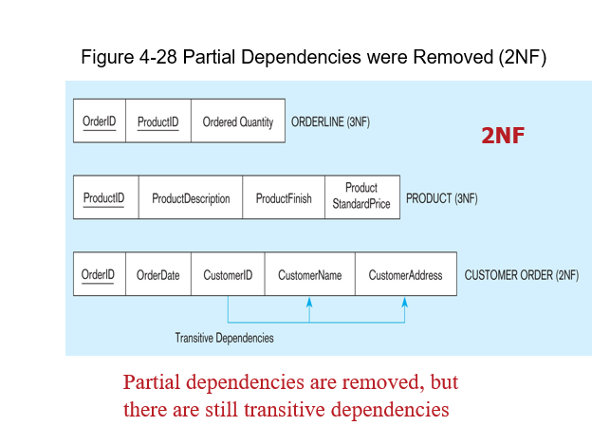
23IT201-DATABASE MANAGEMENT SYSTEMS
Theory

Slide 32
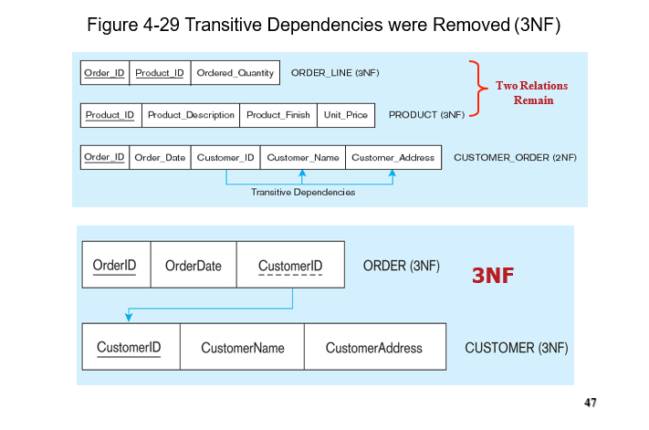
23IT201-DATABASE MANAGEMENT SYSTEMS
Theory

Slide 33
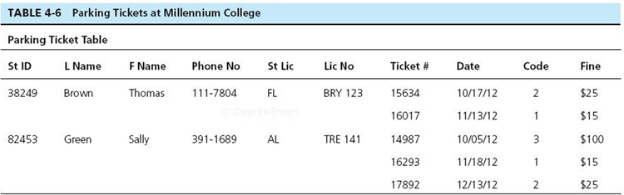
23IT201-DATABASE MANAGEMENT SYSTEMS
Try yourself
Convert to 1NF Relation
Draw dependency diagram showing all functional dependencies
Identify anomalies
Convert to 3NF Relations
Develop EER Diagram with appropriate cardinalities
Theory

