Slide 1
The Smart Leftover Food Recipe Generator
Cook Smart with What You Already Have

Slide 2
Problem Statement
In most households, food often goes to waste because people are unaware of how to creatively use leftover or partially used ingredients.
Existing recipe applications typically require users to search for a specific dish and then procure the necessary ingredients, which does not help when the goal is to utilize what is already available at home.
There is a lack of simple, accessible tools that can take stock of existing ingredients and instantly recommend practical recipes, leading to unnecessary food wastage and repeated grocery expenses.

Slide 3
Project Outcome
A fully functional Flutter-based mobile application that accepts user-input ingredients and generates matching recipes.
A ranked list of recipes based on ingredient availability, showing the best matches first.
Detailed recipe view with cooking instructions, preparation time, and ingredient list.
A practical tool that demonstrably reduces the decision-making effort involved in "what to cook with what I have".
A working prototype suitable for demonstration, further development, or deployment.

Slide 4
Objectives
To reduce household food wastage by making effective use of existing/leftover ingredients.
To help users quickly decide what to cook without needing to buy additional ingredients.
To design a simple, user-friendly mobile interface for entering ingredients and browsing recipe suggestions.
To implement an efficient ingredient-to-recipe matching mechanism.
To promote sustainable, mindful, and economical cooking habits among users.

Slide 5
Scope of the Project
The application is designed for individuals, students, and households looking for quick and practical meal ideas using ingredients they already possess.
Within its scope, the app allows users to:
Enter or select available ingredients through the app interface
Receive a list of recipes ranked according to ingredient match
View complete recipe details, including preparation steps and cooking time
Optionally filter results based on dietary preferences (vegetarian, vegan, etc.)
The project can further be extended to include features like photo-based ingredient recognition, expiry-date tracking, and nutritional analysis, making it scalable for future enhancement.

Slide 6
System Advantages
Helps reduce food wastage at the household level.
Saves users time and mental effort in daily meal planning.
Encourages creative and resourceful cooking using existing stock.
Reduces unnecessary grocery expenses.
Can contribute to healthier eating habits by suggesting balanced recipe options.
Simple and intuitive interface suitable for all age groups.

Slide 7
Applications
Daily meal planning for individuals and families.
Particularly useful for students and hostel residents with limited ingredients and cooking resources.
Can be adapted for use in restaurants, canteens, or catering services to minimize kitchen-level food waste.
Supports sustainability and eco-conscious lifestyle initiatives.
Can be integrated into smart kitchen or smart home ecosystems in the future.

Slide 8
Conclusion
The Smart Leftover Food Recipe Generator effectively addresses a common yet often overlooked problem — food wastage resulting from a lack of recipe ideas for leftover ingredients.
By reversing the conventional recipe-search process and focusing on ingredients already available, the application promotes sustainability, reduces unnecessary expenditure, and simplifies everyday cooking decisions.
Built using Flutter for cross-platform compatibility, the project demonstrates how thoughtful application design can contribute to solving real-world problems, while also leaving room for future enhancements such as image-based ingredient detection and expiry tracking.

Slide 9
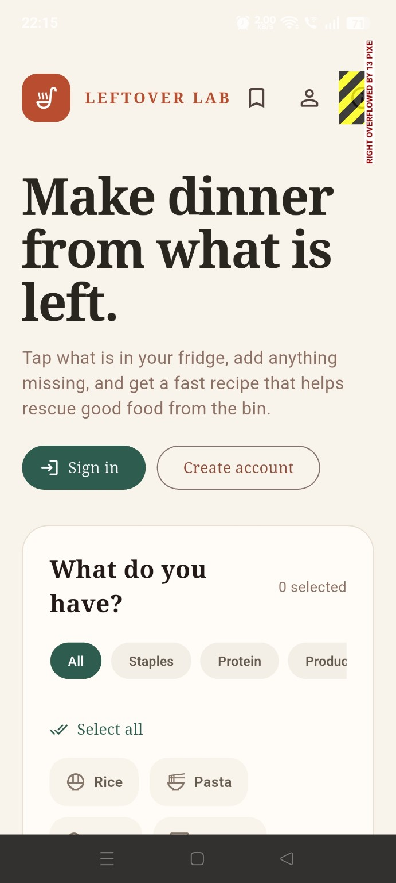
User Home Page
Purpose: Main entry page of the application.
Features:
Leftover Lab logo and branding.
Bookmark icon → opens saved recipes.
Profile icon → opens account/sign-in page.
Main heading: "Make dinner from what is left."
Explains that users can select ingredients they already have.
Sign In button for existing users.
Create Account button for new users.
Beginning of ingredient selection section.
Goal: Introduce the app and allow users to start using it.

Slide 10
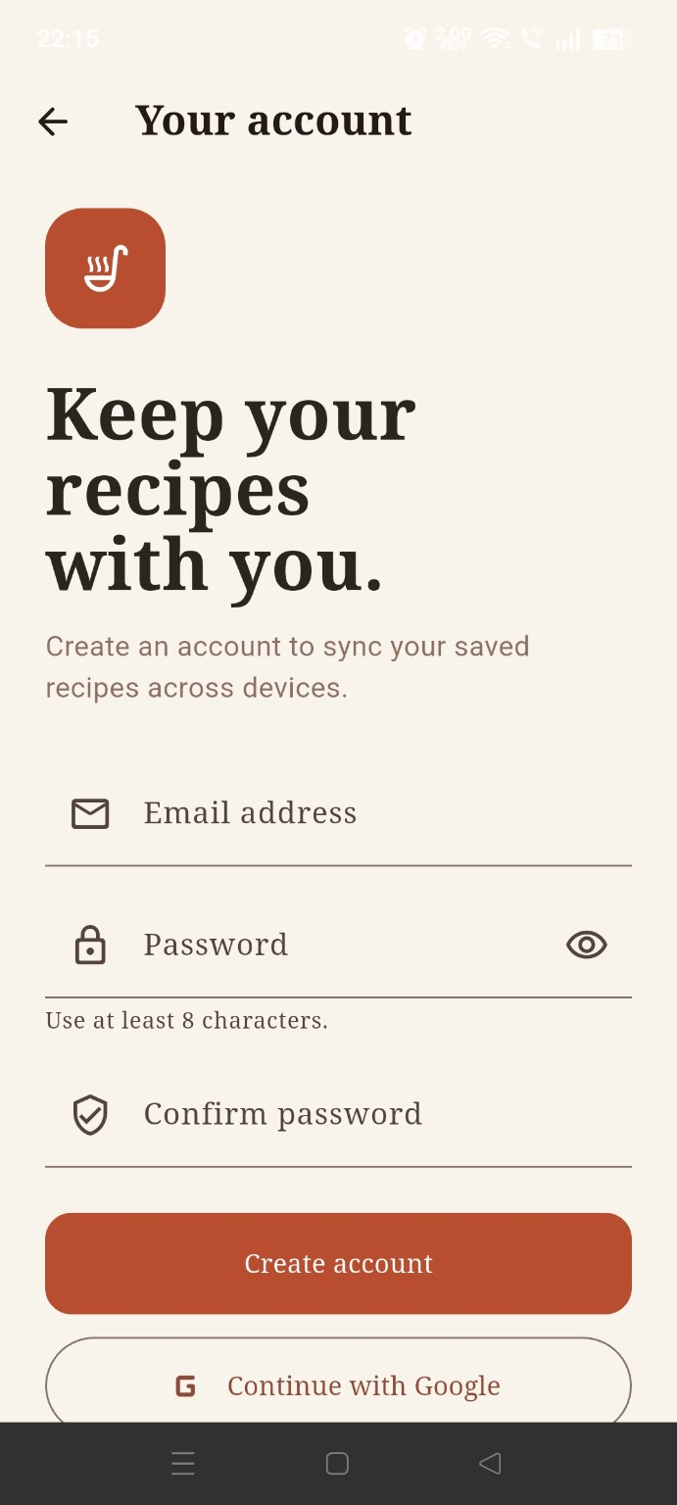
2. User Create Account
Purpose: Register a new user.
Fields:
Email Address
Password
Confirm Password
Buttons:
Create Account
Continue with Google
Validation:
Password must contain at least 8 characters.
Confirm password must match password.
Goal: Create a personal account to sync saved recipes.

Slide 11
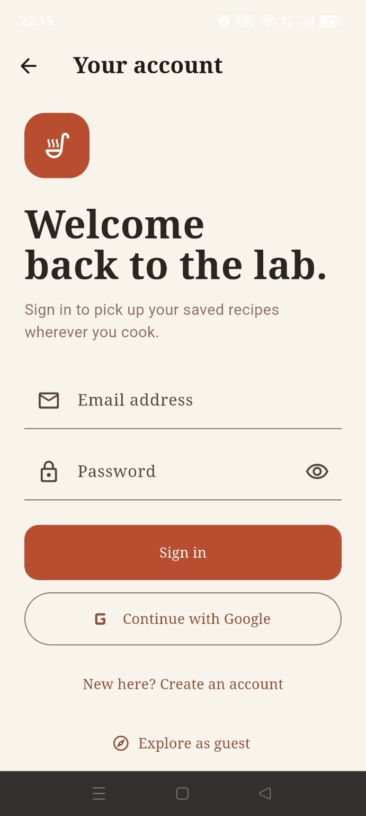
3. User Sign In Page
Purpose: Login for existing users.
Fields:
Email Address
Password
Buttons:
Sign In
Continue with Google
Additional Options:
Create Account
Explore as Guest
Goal: Access saved recipes and personalized data.

Slide 12
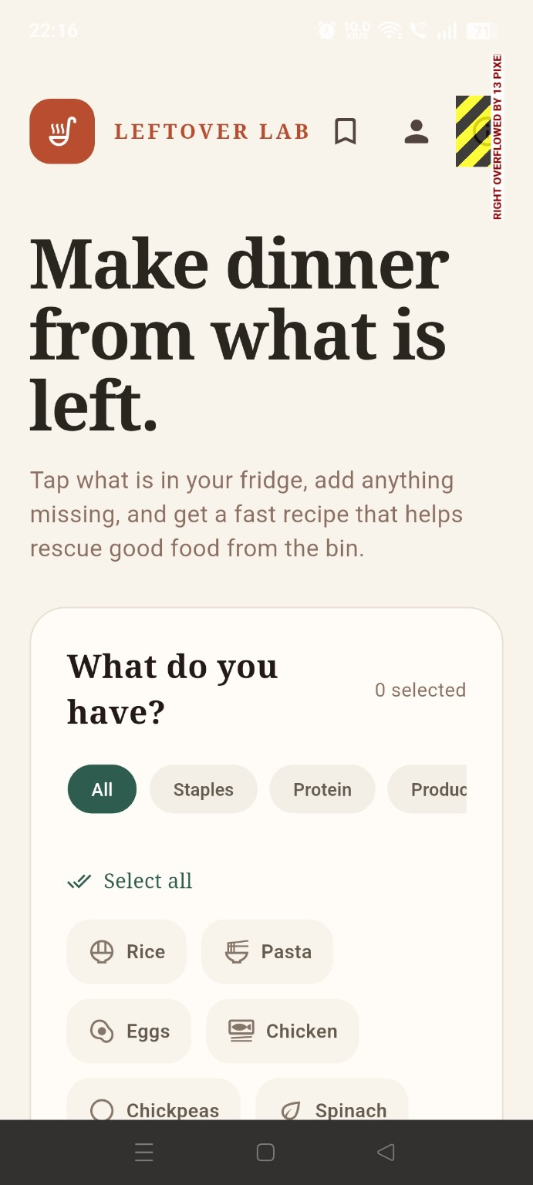
4. User Logged-in Home Page
Purpose: Main dashboard after login.
Changes from landing page:
User icon indicates logged-in state.
Ingredient section becomes fully usable.
Features:
Ingredient categories
  All
  Staples
  Protein
  Produce
Ingredient selection area.
Goal: Start selecting available ingredients.

Slide 13
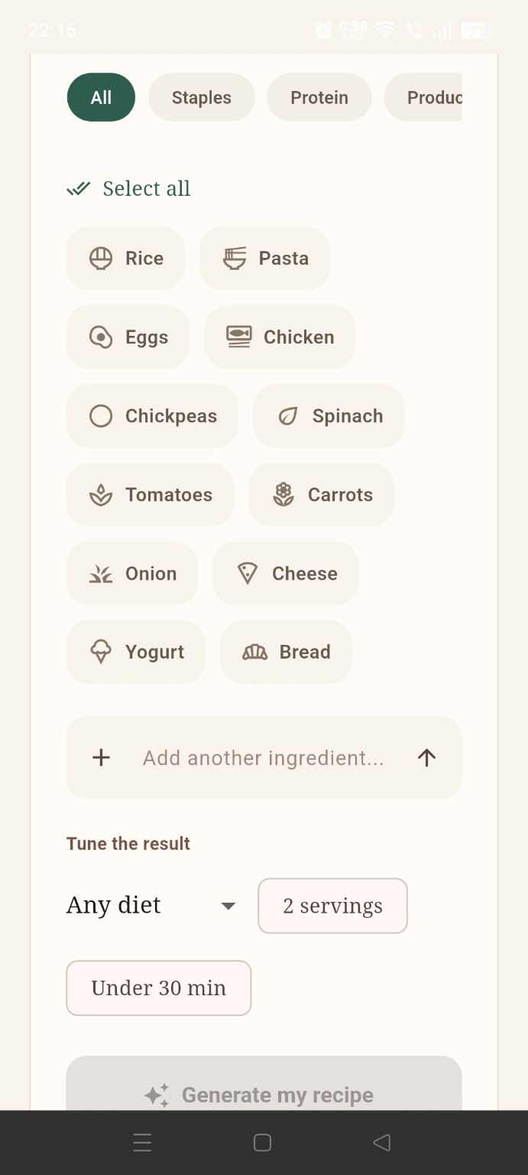
5. Ingredient Selection Page
Purpose: Choose ingredients available in the kitchen.
Sample Ingredients:
Rice
Pasta
Eggs
Chicken
Chickpeas
Spinach
Tomatoes
Carrots
Onion
Cheese
Yogurt
Bread
Functions:
Select individual ingredients.
Select All option.
Categorized filtering.
Goal: Collect ingredient data for recipe generation.

Slide 14
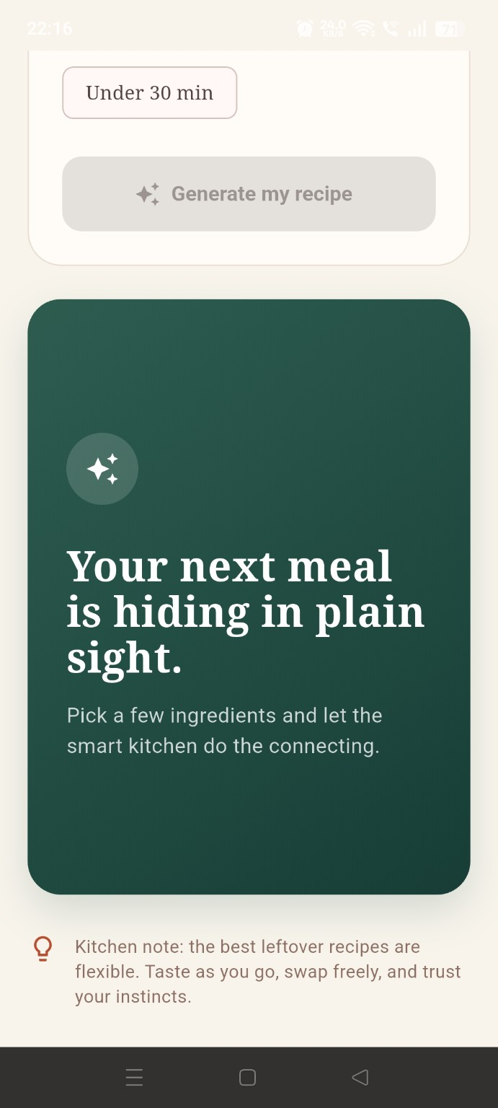
6. Recipe Preference Section
Purpose: Customize generated recipes.
Options:
Add another ingredient manually.
Diet filter (Any Diet).
Number of servings (2 servings).
Cooking time filter (Under 30 min).
Button:
Generate My Recipe
Informational Card:
Explains that AI can create meals from available ingredients.
Goal: Fine-tune recipe recommendations.

Slide 15
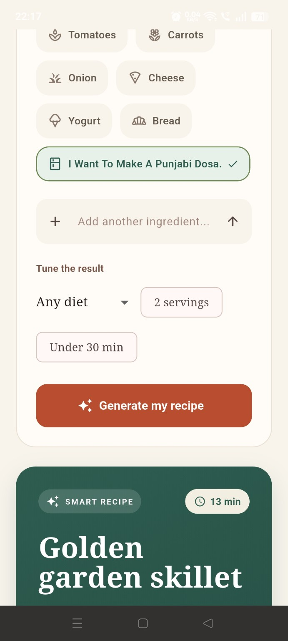
7. Custom Ingredient Added
Purpose: User adds a custom ingredient or dish request.
Example:
"I Want To Make A Punjabi Dosa"
Behavior:
Custom request becomes part of recipe generation.
Generate button becomes active.
Goal: Allow personalized recipe requests beyond predefined ingredients.

Slide 16
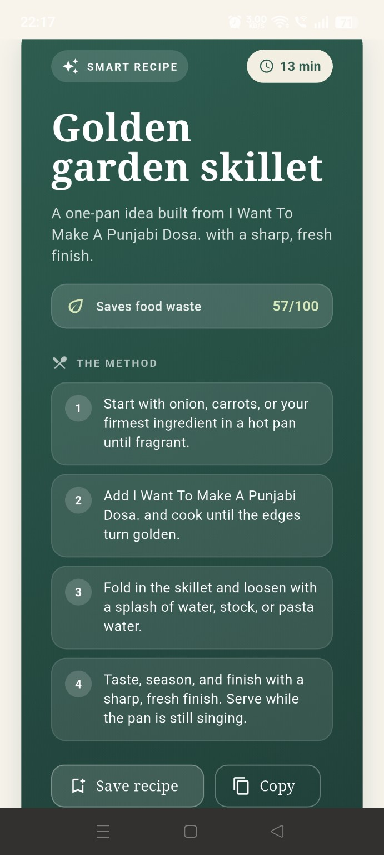
8. Generated Recipe Summary
Purpose: Display AI-generated recipe preview.
Recipe:
Golden Garden Skillet
Information Shown:
Smart Recipe badge
Estimated cooking time (13 min)
Short recipe description
Generated from selected ingredients
Goal: Present the best recipe suggestion.

Slide 17
9. Recipe Detail Page
Purpose: Show complete recipe instructions.
Sections:
Recipe title
Cooking time
Food waste score
Step-by-step cooking method
Actions:
Save Recipe
Copy Recipe
Goal: Help users cook the generated meal.

Slide 18
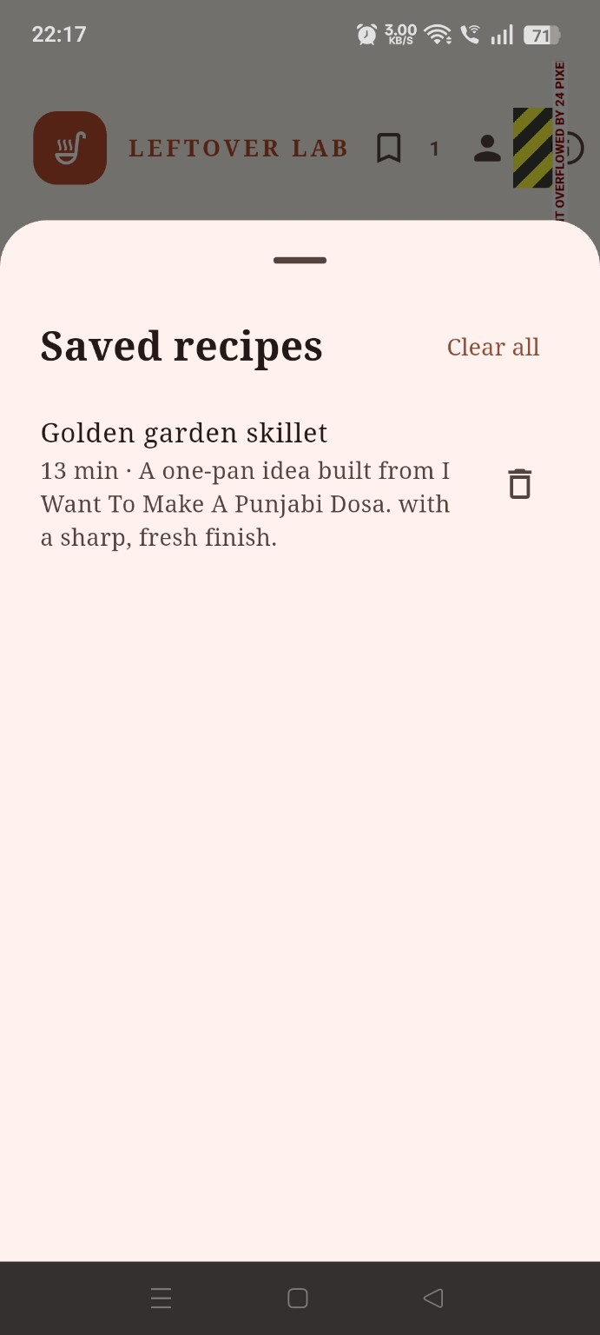
10. Saved Recipes Drawer
Purpose: Manage saved recipes.
Features:
List of saved recipes.
Recipe summary.
Delete individual recipe.
Clear All recipes.
Goal: Quick access to favorite recipes.

Slide 19
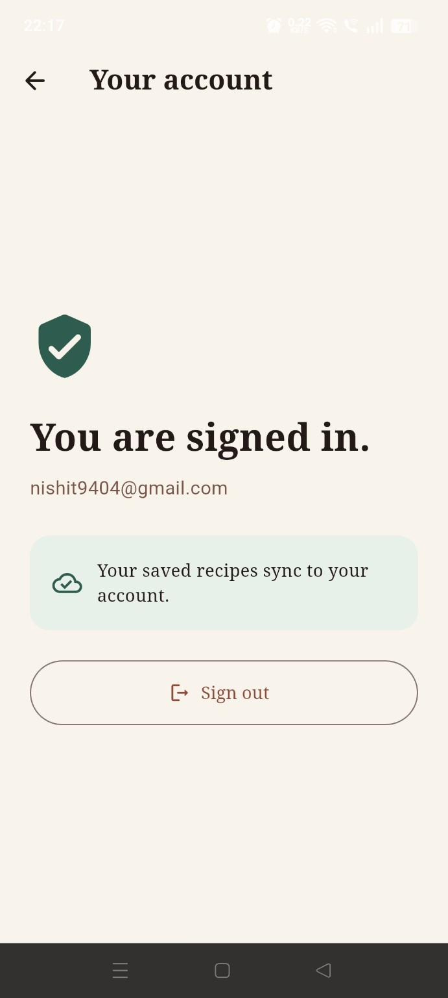
11. Account Profile Page
Purpose: User account management.
Information Displayed:
Signed-in status.
User email address.
Cloud sync confirmation.
Actions:
Sign Out
Goal: Manage account and recipe synchronization.

Slide 20
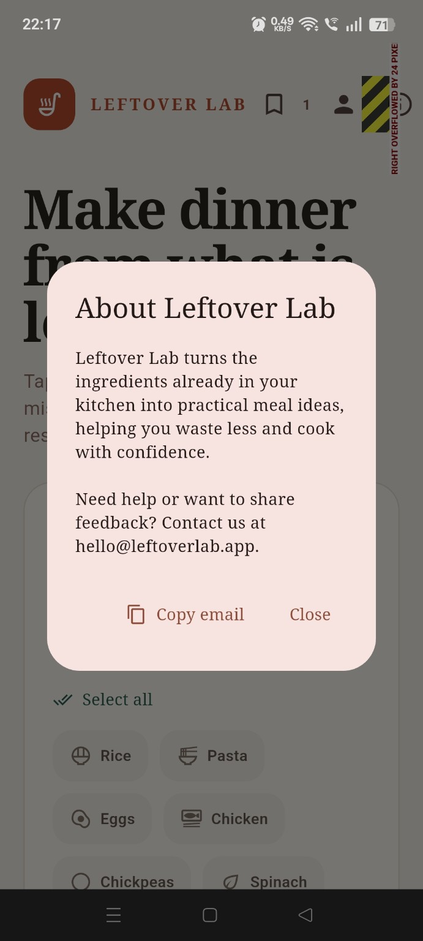
11. About Leftover Lab
Purpose: Provides information about the Leftover Lab application and its mission.
Information Displayed:
Overview of how the app helps users create meals from leftover ingredients.
Benefits such as reducing food waste and simplifying meal planning.
Support and feedback contact email address.
Actions:
Copy Email
Close
Goal: Inform users about the app and provide a way to contact the developers for support or feedback.

Slide 21
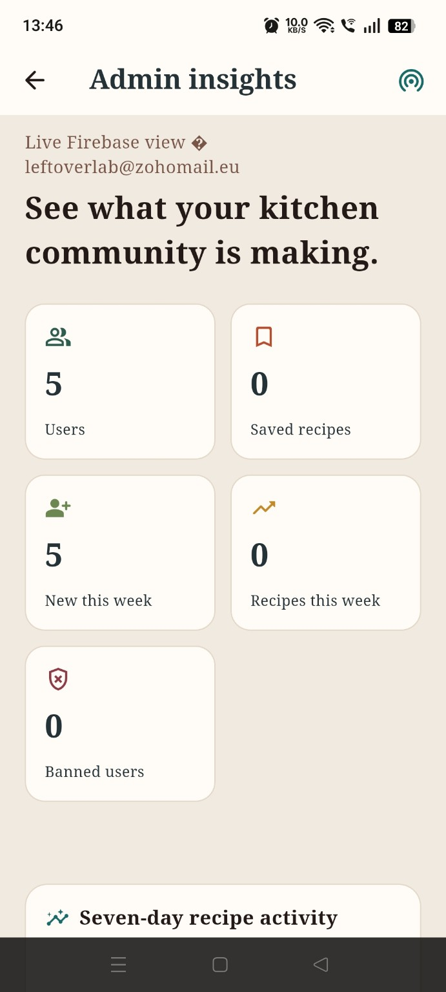
12. Admin Insights Page
Purpose: Admin dashboard for monitoring the overall recipe community.
Information Displayed:
Total number of registered users — 5.
Total number of saved recipes — 0.
Number of new users this week — 5.
Number of recipes created/activity this week — 0.
Number of banned users — 0.
Seven-day recipe activity.
Most saved recipes.
Actions:
View overall user and recipe statistics.
Monitor seven-day recipe activity.
Review the most saved recipes.
Goal: Give the Admin a quick overview of the application's users, recipe activity, and community engagement.

Slide 22
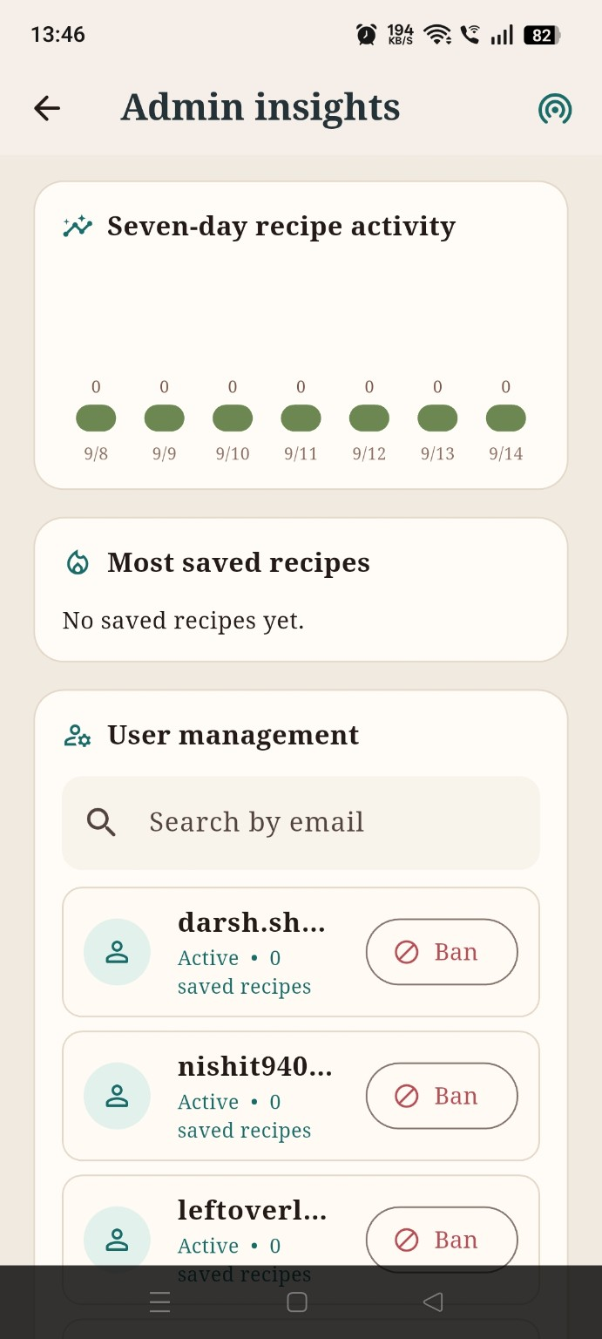
13. User Management Page
Purpose: Manage registered users of the recipe application.
Information Displayed:
List of registered users.
User email/name.
User account status such as Active.
Number of saved recipes for each user.
Banned-user information.
Actions:
Search users by email.
View individual user status.
Ban users.
Goal: Allow the Admin to monitor and control user accounts and maintain a safe and properly managed community.

Slide 23
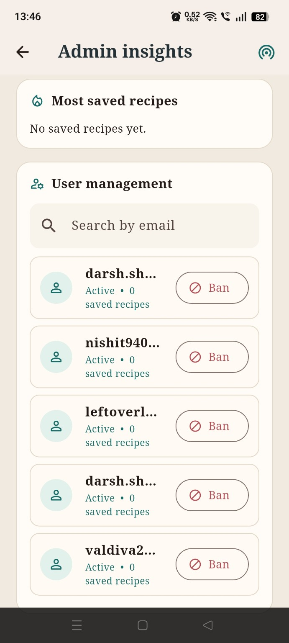
14. Recipe Activity & Saved Recipes Page
Purpose: Monitor recipe-related activity and identify popular recipes.
Information Displayed:
Seven-day recipe activity.
Daily recipe activity from 9/8 to 9/14.
Number of recipe activities for each day.
Most saved recipes.
Current message: “No saved recipes yet.”
Actions:
Monitor daily recipe activity.
Identify recipes that are saved most frequently.
Track recipe engagement over time.
Goal: Help the Admin understand recipe usage, activity trends, and which recipes are most popular among users.

Slide 24
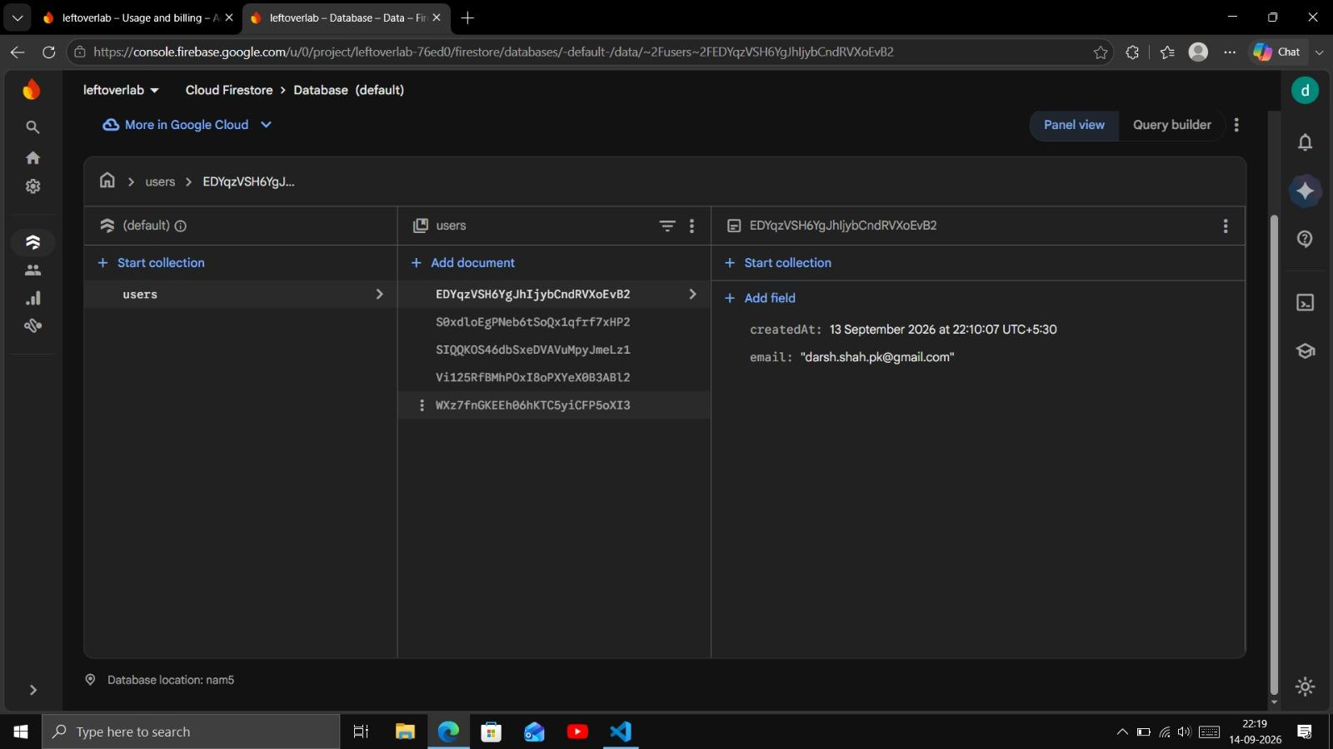
15. Database
Purpose:
Manage and monitor your application's database.
Store and organize application data in the cloud.
Information Displayed:
Collections — groups of related data, such as users.
Documents — individual records inside a collection.
Fields — details stored in each document, such as email and createdAt.
Actions:
Start collection → Create a new collection.
Add document → Add a new record.
Add field → Add information to an existing document.
Query builder → Create queries to find/filter database data.
Select documents to view their stored information.
Goal: Store, organize, view, and manage application data efficiently using Firebase Cloud Firestore.

Slide 25
THANK YOU

