Slide 1
Prediction of LC50 value using Quantitative structure activity relationship models (QSAR models)
iNeuron
Darshan Satone

Slide 2
Project Detail
Project Title | QSAR models – Analysis
Technology | Machine Learning
Domain | Chemical
Project Difficulty Level | Intermediate
Programming Language | Python
Tools Used | Jyputer Notebook, MS-Excel

Slide 3
Objective
The goal of this project is to predict quantitative structure activity relationship with toxicity level. To build the project we have used the scientific dataset containing 6 attributes (molecular descriptors) of 908 chemicals used to predict quantitative acute aquatic toxicity towards the fish Pimephales promelas (fathead minnow).

Slide 4
Problem Statement
Thousands of chemical substances for which no ecological toxicity data are available can benefit from QSAR modelling to help prioritise testing. One of the data set encompassing in vivo test data on fish for hundreds of chemical substances using the ECOTOX database of the US Environmental Protection Agency.
We can utilize this to develop QSAR models that could forecast two sorts of end points: acute LC50 (median lethal concentration) and points of departure akin to the NOEC (no observed effect concentration) for any period (the “LC50” and “NOEC” models, respectively).
Study factors, such as species and exposure route, were incorporated as features in these models to allow for the simultaneous use of many data types. To maximise generalizability to other species, a novel way of substituting taxonomic categories for species dummy variables was introduced.
The goal here is to build an end-to-end automated Machine Learning model that predicts the LC50 value, the concentration of a compound that causes 50% lethality of fish in a test batch over a duration of 96 hours, using 6 given molecular descriptors.

Slide 5
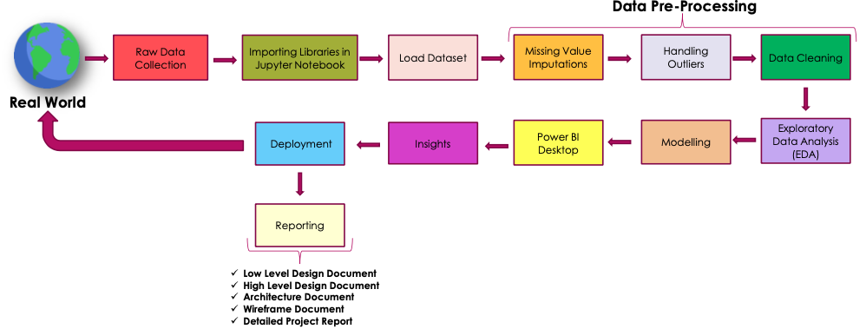
Architecture

Slide 6
Dataset Information
This dataset was used to develop quantitative regression QSAR models to predict acute aquatic toxicity towards the fish Pimephales promelas (fathead minnow) on a set of 908 chemicals. LC50 data, which is the concentration that causes death in 50% of test fish over a test duration of 96 hours, was used as model response. The model comprised 6 molecular descriptors: MLOGP (molecular properties), CIC0 (information indices), GATS1i (2D autocorrelations), NdssC (atom-type counts), NdsCH ((atom-type counts), SM1_Dz(Z) (2D matrix-based descriptors).
Data Set Characteristics: | Multivariate | Number of Instances: | 908 | Area: | Physical
Attribute Characteristics: | Real | Number of Attributes: | 7 | Date Donated | 2019-09-23
Associated Tasks: | Regression | Missing Values? | N/A | Number of Web Hits: | 46489

Slide 7
Dataset Information
The model comprised 6 molecular descriptors and 1 quantitative experimental response :
MLOGP (molecular properties),
CIC0 (information indices),
GATS1i (2D autocorrelations),
NdssC (atom-type counts),
NdsCH ((atom-type counts),
SM1_Dz(Z) (2D matrix-based descriptors).
quantitative response, LC50 [-LOG(mol/L)]
Details can be found in the quoted reference: M. Cassotti, D. Ballabio, R. Todeschini, V. Consonni. A similarity-based QSAR model for predicting acute toxicity towards the fathead minnow (Pimephales promelas), SAR and QSAR in Environmental Research (2015), 26, 217-243; doi: 10.1080/1062936X.2015.10189380

Slide 8
Insights
Trial and Error: To achieve better behaviour of the regression model, the process consisted of repeatedly testing the architectures in order to optimize them, which is why hyperparameter optimization can never be lacking to improve the model's metrics. Documentation was also a fundamental pillar in the development of this project.
Most important features: When implementing the importance feature, it was possible to notice that certain features have more weight for the assessment of toxicity. Performing the feature importance technique is necessary to achieve understanding beyond the data and achieve a better interpretation of the model.

Slide 9
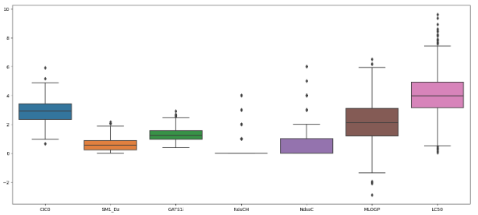
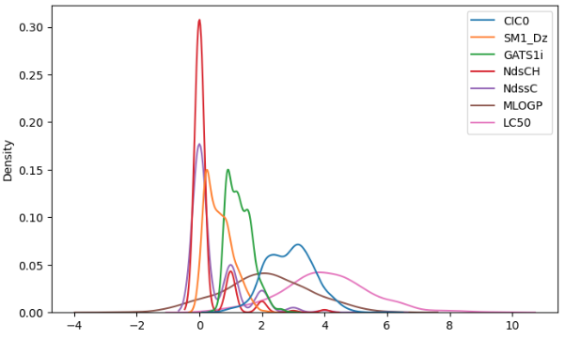
Insights
The above graphs are for outliers and density. Since it’s a scientific data we can ignore outliers where as from density graph we can see NdsCH have the maximum density followed by NdssC.

Slide 10
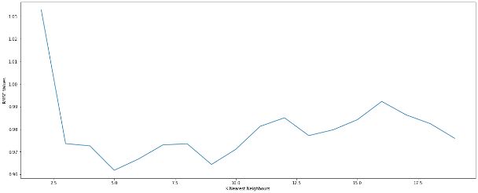
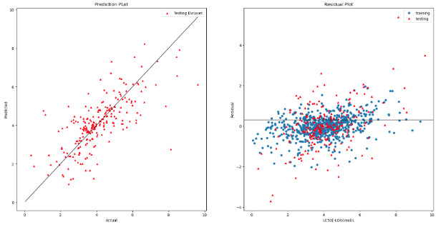
Multiple Linear Regression

Slide 11
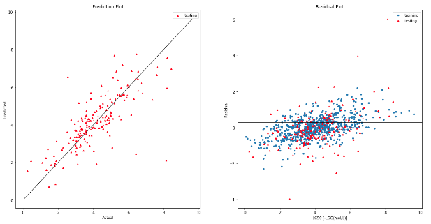

xgboost

Slide 12
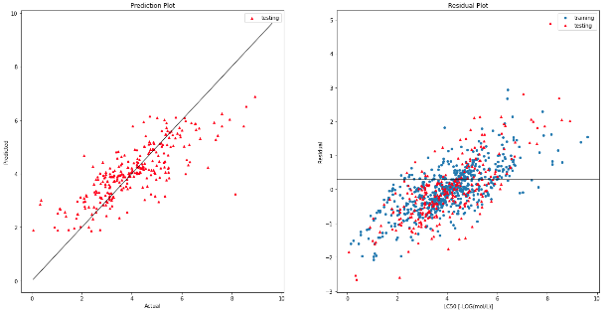
Random Forest Regressor Model

Slide 13
Conclusion
The architecture that has behaved best is the third, firstly having fewer parameters than architecture two, this being positive for running it on Arduino and achieving better results than it.
In the case of architecture one, because it is simpler, it obtains fewer results. Importance of Early Stopping: For the specific case of architecture 3, it was noted that when running 20,000 epochs, a regression coefficient of 0.67 was achieved, however, when implementing an early stopping of 700 epochs, it is possible to appreciate that the mean square error is 0.88 being lower than the other that obtained a valuation of 1.42, that is why although the regression coefficient is further from the ideal value (one) the range of error that includes the valuation is smaller, and it is a point in favor in decision-making in something as important as the determination of toxicity in fish.

