Slide 1
Efficient shipping system

Slide 2
Introduction
Our project name is Efficient Shipping System. This project is online marketplace which provides platform for customer to connect with many transporters within a click. The main objective of our system is to save customers time as well as money.
From our system transporter can get information of many products posted by customers and it will be helpful to expand their business.
In our system customer will post their product and can select the transporter as per his requirement. He can go for direct selection or can go for Auction.
On the other hand transporter can bid for products and provide efficient service to customer.
This system is customer friendly and affordable.This system will create virtual competition between transporters which will benefit the customers.

Slide 3
Problem Statement
Transporter having their own online platform
Fixed rates
Date of delivery by their convenience
For getting better Rates, Customer have to visit many individual platforms
Time Consuming
Transporters not having online platforms , Customer has to reach them physically , time consuming

Slide 4
Solution
Our platforms is used by both customers and transporters
Product request is sent at the time to all the transporters who have registered
Don’t need to go anywhere physically
Customer can see Transporters list who have responded to that request and customer will select one of them by their choice
After all this process contact information is exchanged therefore the security can maintained

Slide 5
Key - Points
This is single platform for customers and different transporters.
Customer doesn’t need search for various individual platforms.
Customers doesn’t need to go physically anywhere.
Here both customer and transporter tasks becomes easy.
Security is maintained here

Slide 6
Modules
Login and Registration
Direct Booking
Feedback And Complaint
Payment
Auction and bidding

Slide 7
Development Tools Details
Tools | Use
Spring Boot | Back End
React | Front End
MySQL | Database

Slide 8
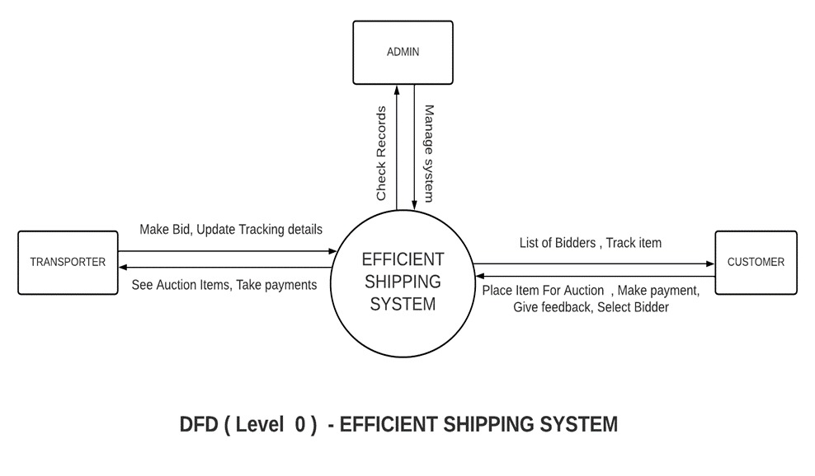
DFD Diagram

Slide 9
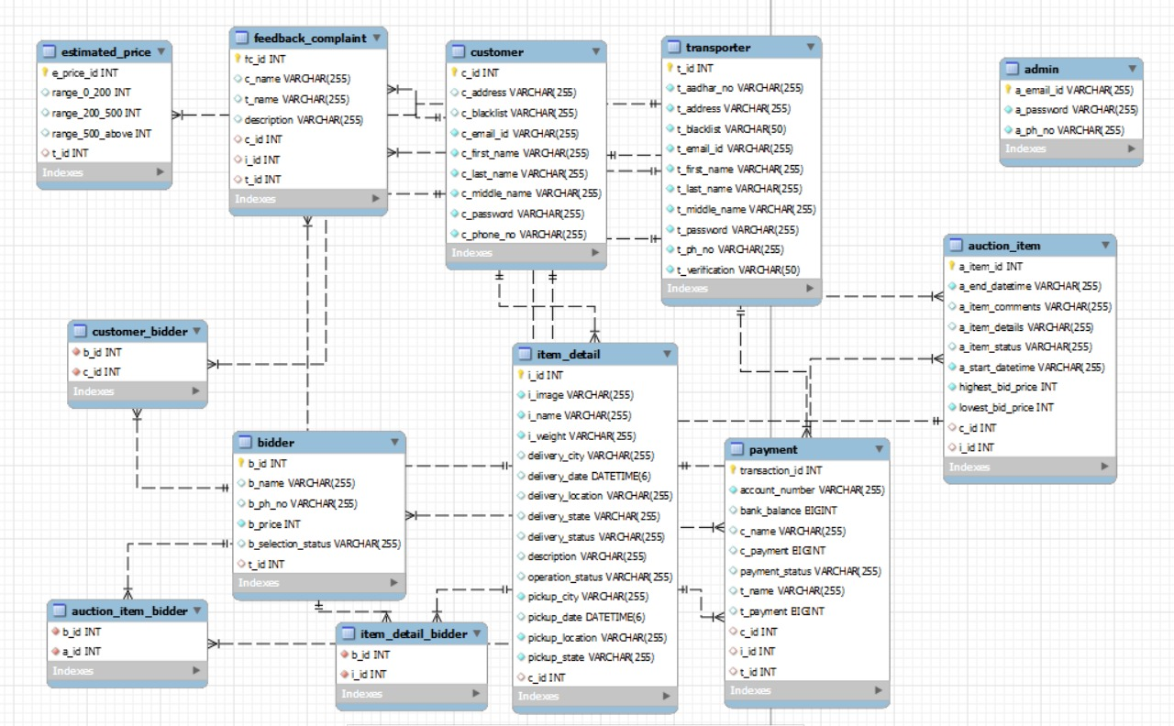
ER Diagram

Slide 10
Thank You

