Slide 1
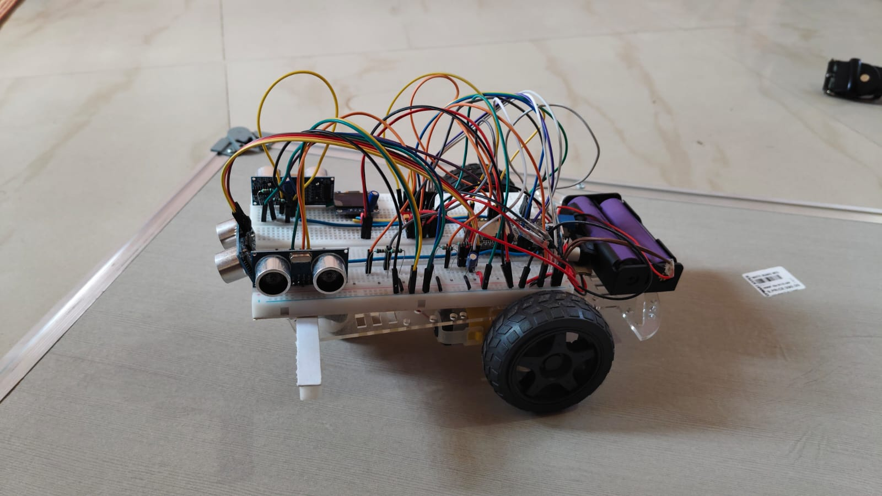
KANDA
Knowledge-driven Autonomous Navigation
and Decision-making Agent
A Multimodal Embodied Robot Agent Powered by LLMs
with Hardware Aware Action Generation
Review I · Phase 2: Embodiment Layer Complete
PHASE 2 ✅ COMPLETE

Slide 2
Table of Contents
Review I · KANDA Robot Project
01
Introduction
02
Meet KANDA
03
System Design
04
Methodology
05
Use of Tools & Techniques
06
Implementation Progress
07
Identification of Journal / Conference
08
References

Slide 3
Introduction
A Multimodal Embodied Robot Agent Powered by LLMs with Hardware Aware Action Generation
KANDA is a low-cost, embodied robot designed for household companion applications — combining physical sensing, autonomous navigation, and LLM-based reasoning on commodity hardware (ESP32 + Raspberry Pi).
What KANDA Does
Research Gap Addressed
Autonomous navigation on commodity hardware — ESP32 + HC-SR04 sensors + motor driver
✗ LLM-robot systems (SayCan, RT-2) require expensive proprietary hardware
LLM as the reasoning brain — Raspberry Pi bridges robot to GPT-4 / Gemini API
✗ Low-cost ESP32 systems (ESP-SparkBot) have voice only — no navigation
Household companion use cases — elderly care, child tutoring, reminders, home automation
✗ No open protocol translates LLM output into hardware-safe motor commands
Safety-first LLM-to-hardware execution — every command validated before motor execution
✗ Companion robotics research uses commercial robots, not DIY platforms

Slide 4
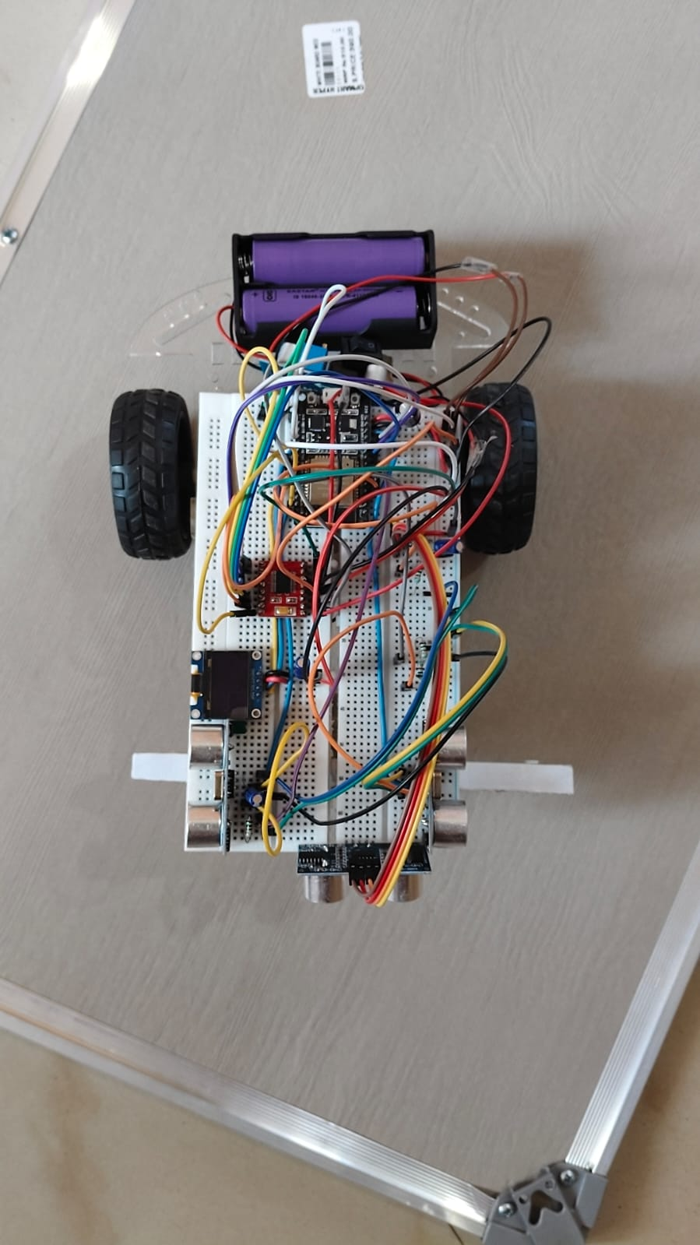
Meet KANDA
Phase 2 — Built & Working ✅
Battery + BMS
ESP32
TB6612FNG
OLED Display
Breadboard wiring
Top View — ESP32 · TB6612FNG · OLED · Battery
Front View — HC-SR04 Sensors · Wheels · Full Assembly

Slide 5
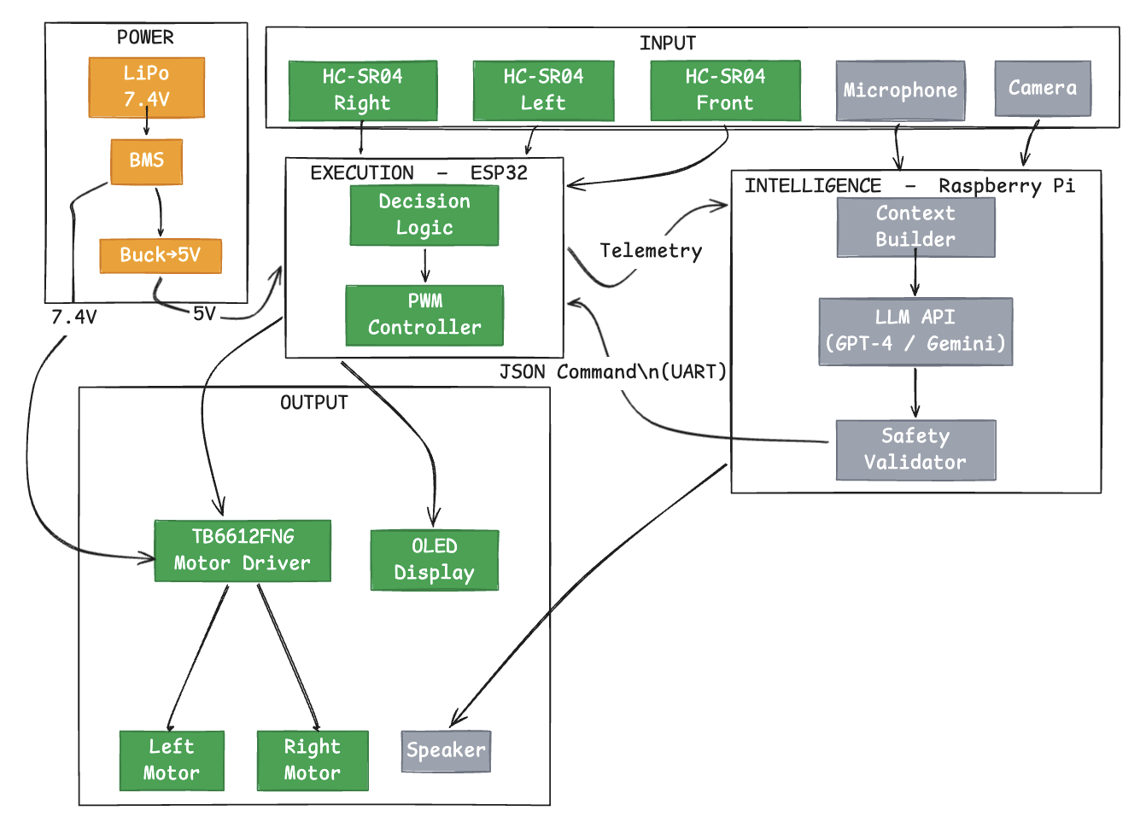
System Design — Architecture
Two-layer design: Embodiment (✅ done) · Intelligence (⏳ planned)
✅ Completed
⏳ Planned

Slide 6
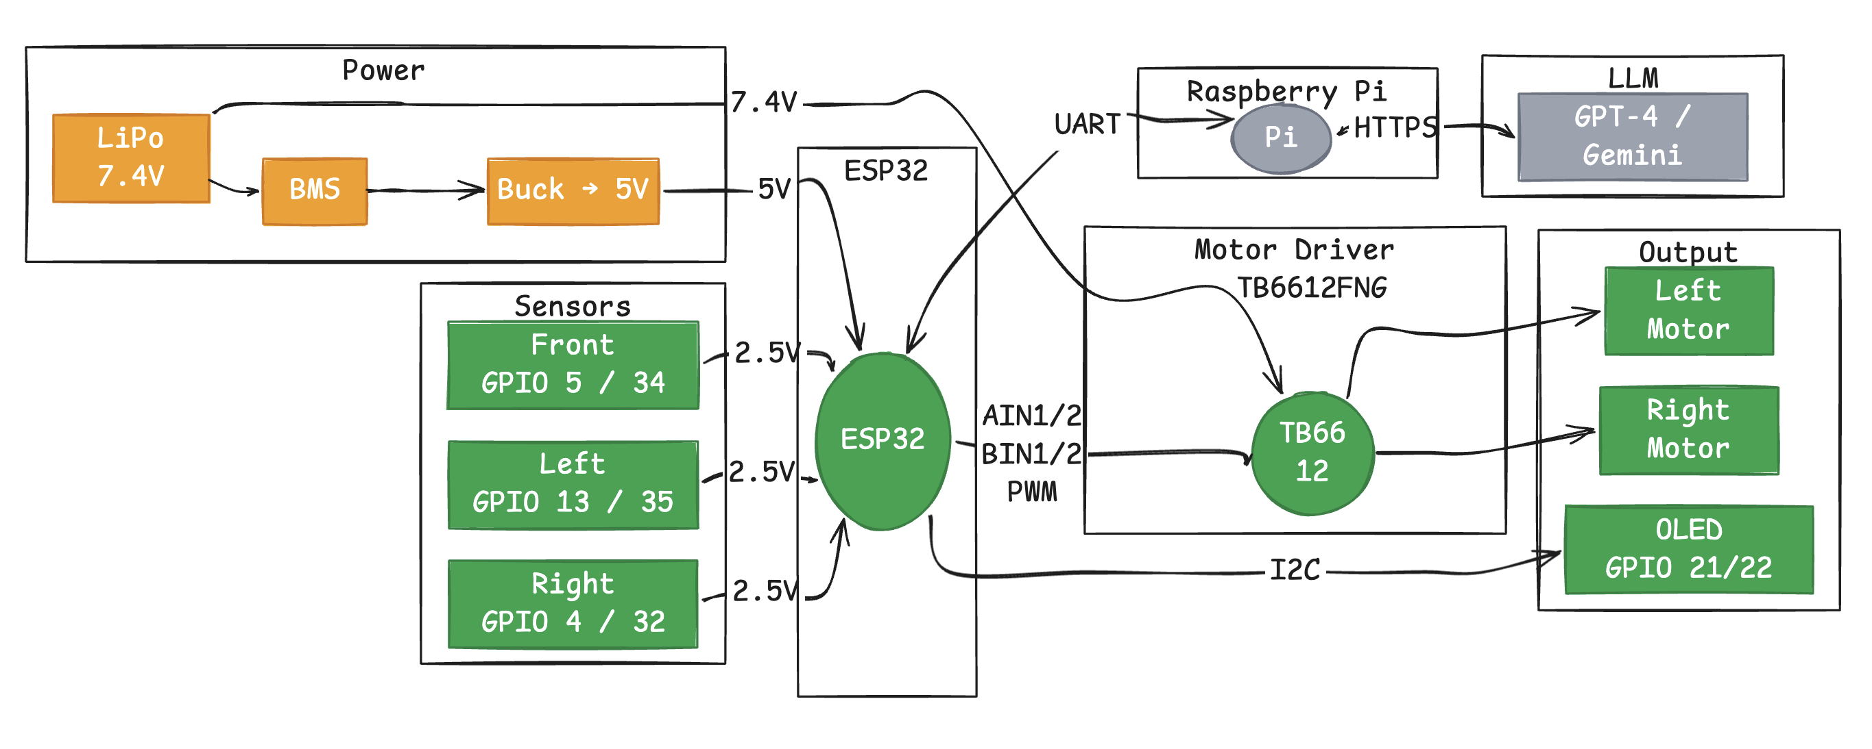
Low-Level Design — Pin Mapping & Wiring
Signal conditioning · Power architecture · Component connections
ECHO pins: 5V → 2.5V via 1kΩ+1kΩ divider
PWM: 1kHz · 8-bit · ledcAttach() API
I2C: GPIO21 SDA · GPIO22 SCL
Motors: direct battery feed (not through buck)

Slide 7
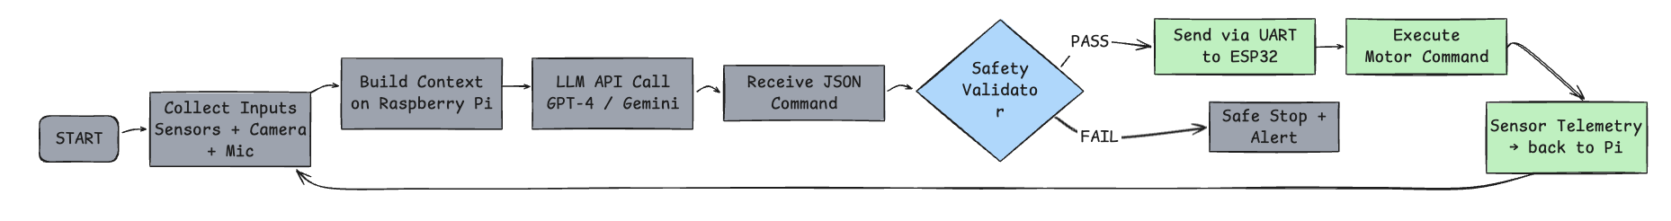
Methodology — Sense → Decide → Act Loop
Current: rule-based (green) · Planned: LLM-driven (gray)
Phase 2 ✅ Complete
• Read F/L/R sensor distances
• Rule-based obstacle logic
• Motor control via PWM
• OLED + Serial feedback
Phase 3 ⏳ Planned
• Camera + Mic + Sensor input
• LLM API call (Raspberry Pi)
• Safety validator
• JSON → UART → ESP32
• TTS verbal response

Slide 8
Use of Tools & Techniques
Hardware + Software stack with justification
ESP32
Microcontroller
Dual-core, 3.3V, abundant GPIO, ledcAttach PWM API
TB6612FNG
Motor Driver
Efficient H-bridge, 1.2A/ch, STBY pin, direction+PWM control
HC-SR04 ×3
Ultrasonic
2–400cm range; 1kΩ+1kΩ divider → 5V ECHO to 2.5V safe
SSD1306 OLED
Display
I2C (2 pins), 128×64, real-time decision feedback
Buck Converter
Power Reg.
Stable 5V for ESP32; motors run on direct battery to avoid surge
Raspberry Pi
AI Compute
Full Linux OS, Python, LLM API client, UART to ESP32
GPT-4 / Gemini
LLM Reasoning
Multimodal capability, JSON function calling for motor commands
Whisper (OpenAI)
Speech-to-Text
Converts microphone audio to text for LLM context
JSON Protocol
Command Bridge
Type-safe, range-validated, hardware-safe action interface

Slide 9
Implementation Progress
Phase 2 complete · Phase 3 defined and ready to build
✅ Phase 2 — Complete
⏳ Phase 3 — Planned
✓ Power architecture: Battery → BMS → Buck → ESP32
○ Raspberry Pi integration + UART bridge to ESP32
✓ 3× HC-SR04 sensors with voltage dividers (5V→2.5V)
○ Camera module: visual scene input to LLM context
✓ TB6612FNG motor control: direction + PWM speed
○ Microphone + Whisper speech transcription pipeline
✓ SSD1306 OLED: real-time sensor + decision display
○ LLM API integration (GPT-4 / Gemini)
✓ Conflict-free pin mapping (no strapping/UART pins)
○ Safety validator: range checks before motor execution
✓ Obstacle avoidance firmware (ESP32 Arduino core v3)
○ Text-to-speech verbal companion responses
✓ Smooth steering: front stop + side correction logic
○ Closed-loop: sensor telemetry back to LLM context
KANDA — Phase 2 Hardware (Built & Tested)

Slide 10
Identification of Journal / Conference
Target venues for publishing KANDA research
IEEE Robotics and Automation Letters (RA-L)
Q1 · Impact Factor ~5.2
Top venue for embodied AI + robot control research. Directly relevant to hardware-aware LLM action generation.
Primary Target
ACM/IEEE HRI — Human-Robot Interaction Conference
Top-tier conference
Premier venue for companion robotics research. Covers elderly assistance, child interaction, and social robots.
Primary Target
Frontiers in Robotics and AI
Q2 · Open Access
Published companion robot design studies (2024). Strong fit for KANDA's household application domain.
Primary Target
JMIR Human Factors
Q1 · Open Access
Published LLM+robot geriatric care studies (2025). Direct match for elderly companion evaluation results.
Secondary Option
IEEE Access
Q2 · Open Access
Broad engineering scope. Suitable for the embedded systems + AI integration aspect of KANDA.
Secondary Option

Slide 11
References
[1] M. Ahn et al., "Do As I Can, Not As I Say," arXiv:2204.01691, Google, 2022.
[2] A. Brohan et al., "RT-2: Vision-Language-Action Models," arXiv:2307.15818, Google DeepMind, 2023.
[3] D. Driess et al., "PaLM-E: An Embodied Multimodal Language Model," arXiv:2303.03378, 2023.
[4] "Safety Guardrails for LLM-Enabled Robots (RoboGuard)," arXiv:2503.07885, 2025.
[5] "SafeEmbodAI: Safety Validation for Mobile Robot Navigation," arXiv:2409.01630, 2024.
[6] J. Shen et al., "Socially Assistive Robot + LLM in Geriatric Care," JMIR Human Factors, 2025.
[7] "Conversational Companion Robots With Older Adults," Frontiers in Robotics and AI, 2024.
[8] Espressif Systems, "ESP-SparkBot: LLM Robot with ESP32-S3," Espressif Dev Portal, 2025.
[9] A. Radford et al., "Robust Speech Recognition via Large-Scale Weak Supervision (Whisper)," OpenAI, 2022.
[10] Espressif Systems, ESP32 Technical Reference Manual, v5.2, 2024.
[11] Toshiba Semiconductor, TB6612FNG Motor Driver Datasheet, 2020.
[12] Solomon Systech, SSD1306 OLED Driver Datasheet, 2008.

Slide 12
Thank You
A Multimodal Embodied Robot Agent Powered by LLMs with Hardware Aware Action Generation
Phase 2 Complete · Foundation ready for LLM Integration
Hardware ✅
Navigation ✅
OLED ✅
LLM ⏳
Companion ⏳
"The hardware works. The architecture is sound. KANDA is ready to think."

