Slide 1
The Periodic Table

Slide 2

Hello!
Name: Sondagar Darshak Rajeshbhai
Id No:19IT139
Name: Tarpara Vitan Bhaskarbhai
Id No:19IT142

Slide 3
1. Front Page
Let’s start ……..

Slide 4
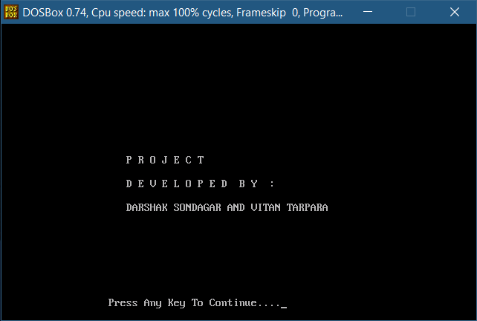

Slide 5
This is front page of this project
Here you can see across the front page the name of the project developer.
Here we use the turbo c compiler for making this project.
This project is develop by darshak and vitan from IT department.
Here we can press any key to continue in project.

Slide 6
2.Welcome Page

Slide 7
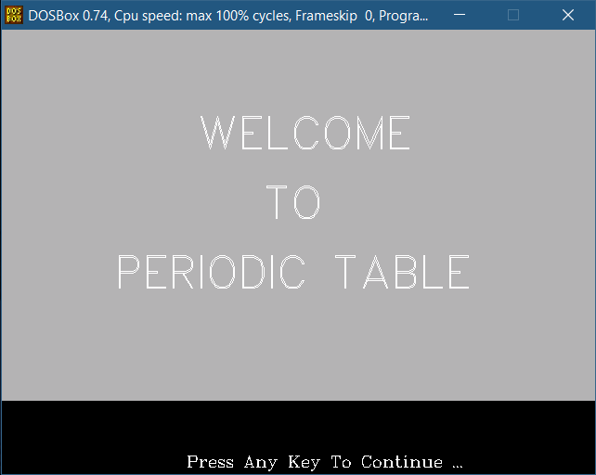

Slide 8
This is Second page of this project
Here we use graphics.h header file for this title page.
The graphics.h header file provides access to a simple graphics library that makes it possible to draw lines, rectangles, ovals, arcs, polygons, images, and strings on a graphical window. The second step is initialize the graphics drivers on the computer using initgraph method of graphics.

Slide 9
3.The Main Page

Slide 10
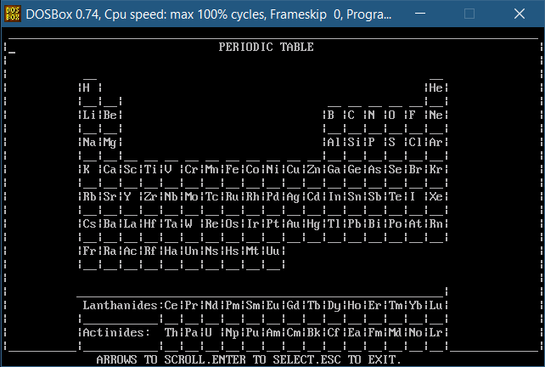

Slide 11
Continue……..
This is main page of this project.
Here we can see the hole periodic table with name of each element.

Slide 12
4.Detalis of the element

Slide 13
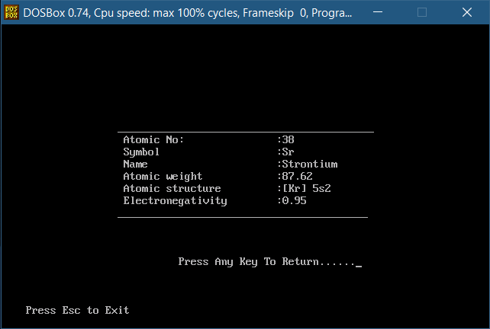

Slide 14
Continue….
Here we see the frame on this picture.
Which show the element details like Atomic number, Atomic name, Element symbol, Atomic
weight, Atomic structure, Electronegativity.

Slide 15
Thank You…….

