Slide 1

MindCoach Chatbot Developed by Tech-Savvy
AML 3304
Software Tools and Emerging Technologies for AI and ML
Submitted To INSTRUCTOR: Peter Sigurdson

Slide 2

Tech-Savvy Team
Darshakkumar Ranpariya – C0849251
Mehul Kakadiya – C0849255
Kushagra Bhatt – C0849344
Paritosh Bhayan – C0833106

Slide 3

Introduction
Our project on fine-tuning GPT on self-help books.
The purpose of this project was to explore how the GPT-3.5 language model can be fine-tuned on self-help books to create a chatbot that can provide useful advice and guidance to people seeking self-improvement.
We chose this topic because we are interested in the potential of artificial intelligence to help people live happier and more fulfilling lives.
In this presentation, we'll be giving an overview of the project, describing the technologies we used, and explaining the development process.

Slide 4

Project Overview
The project is an AI-based chatbot that provides advice and guidance to people seeking self-improvement.
The chatbot is based on the GPT-3.5 language model and was fine-tuned on a corpus of self-help books to generate responses that are relevant and helpful.
The chatbot can provide advice on a range of topics, including self-confidence, motivation, goal-setting, habits, and more.

Slide 5

Technologies Used
The project was built using Python programming language.
The GPT-3.5 language model was used as the base model for the chatbot.
Libraries used,
llama_index
streamlit

Slide 6

Project Development
The project was developed, using an iterative development process.
The development process involved several stages, including data preparation, fine-tuning the GPT-3.5 language model, and testing and validation.
The main challenge during the development process was finding a suitable corpus of self-help books that could be used to train the language model.
To overcome this challenge, We used a combination of publicly available self-help books and books purchased from online bookstores.

Slide 7

Books we have used to train model
The Seven Habits of Highly Effective People
How to Win Friends and Influence People
The Power of Now
The 5 Love Languages
Atomic Habits

Slide 8
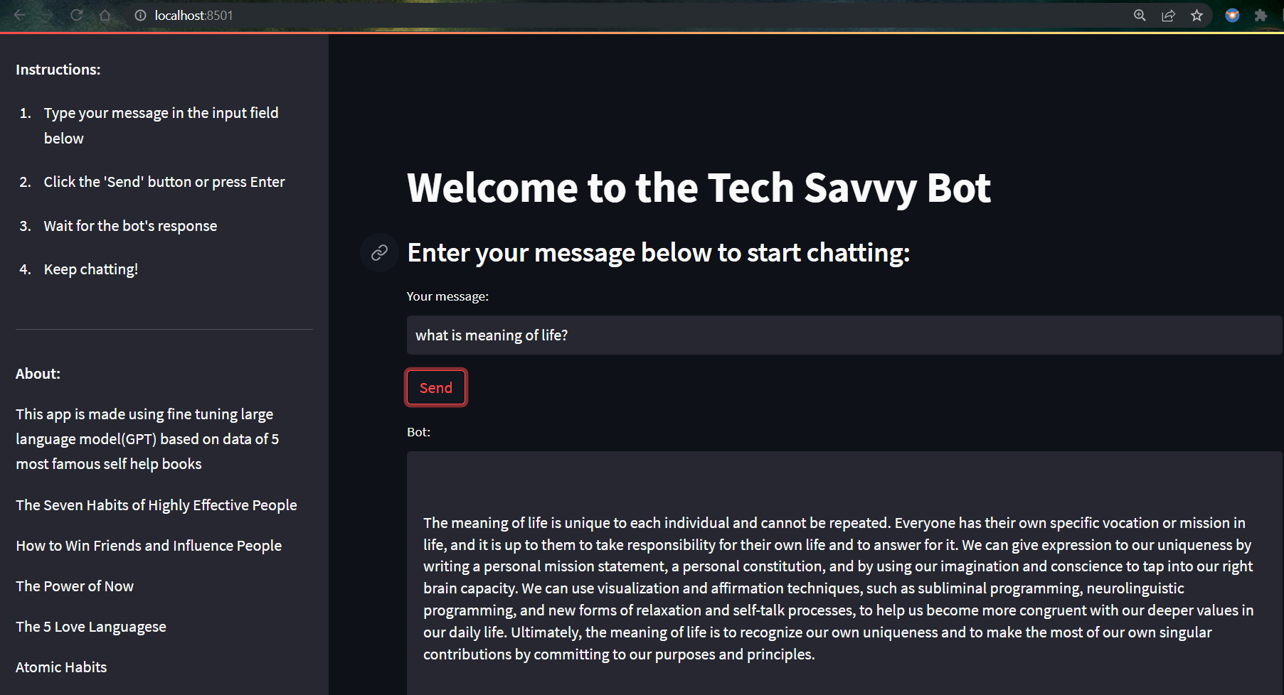
Demo

Slide 9
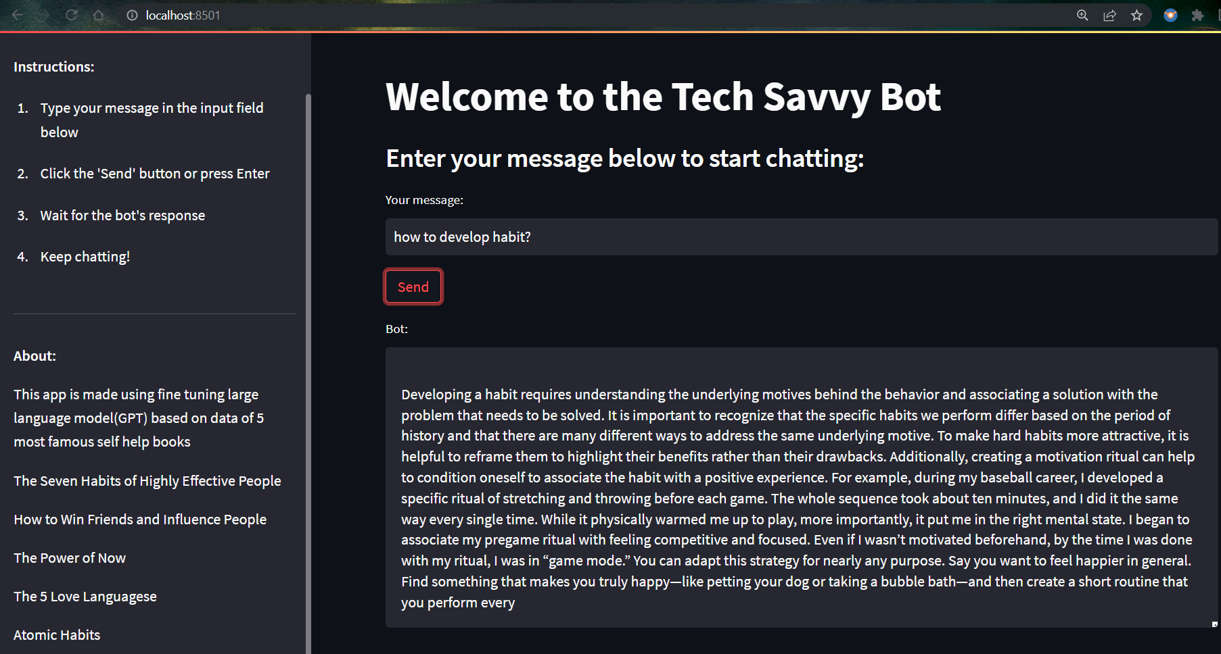

Slide 10
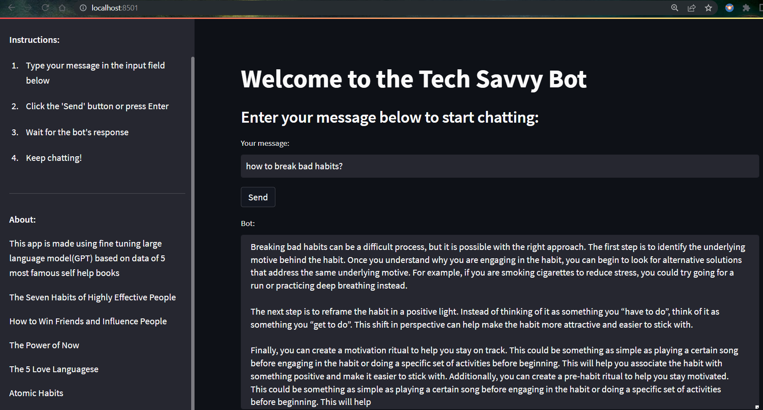

Slide 11
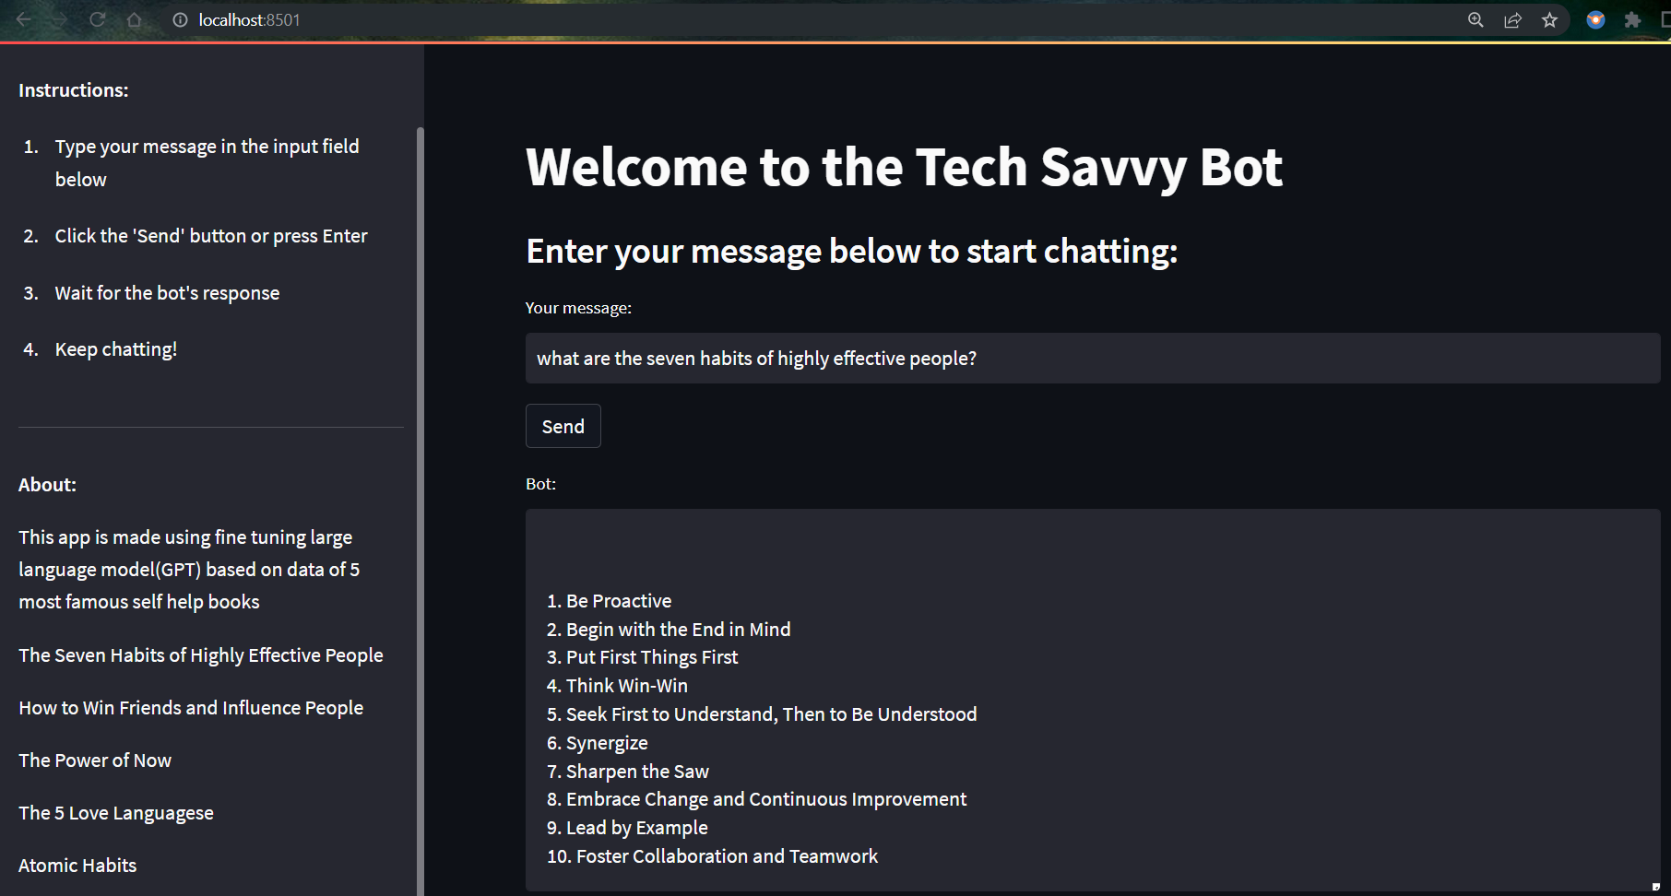

Slide 12
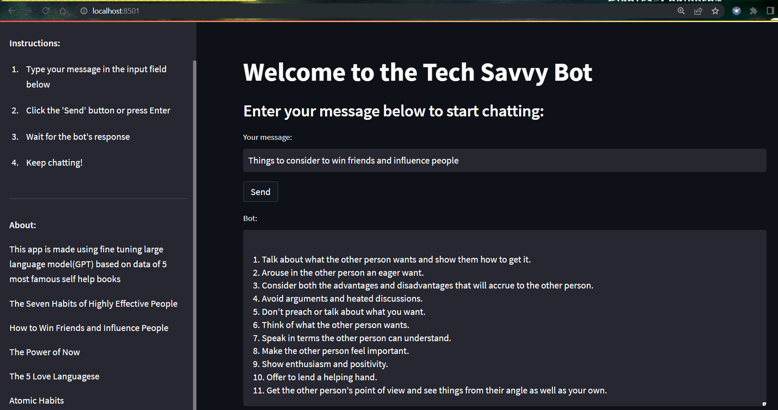

Slide 13
Project Link
https://github.com/darshakpranpariya/Finetuning-GPT

Slide 14


Conclusion
This project demonstrates the potential of the GPT-3.5 language model fine-tuned on self-help books to provide valuable advice and guidance to people seeking self-improvement.
The project also highlights the importance of data preparation and the challenges involved in finding a suitable corpus of self-help books to train the language model.

Slide 15

References
OpenAI. (2021). GPT-3.5: A Language Model for Few-Shot Learners. Retrieved from https://openai.com/blog/few-shot-learning-with-gpt/
Brown, T. B., Mann, B., Ryder, N., Subbiah, M., Kaplan, J., Dhariwal, P., ... & Amodei, D. (2020). Language models are few-shot learners. Advances in Neural Information Processing Systems, 33, 18741-18755.
Devlin, J., Chang, M. W., Lee, K., & Toutanova, K. (2018). BERT: Pre-training of deep bidirectional transformers for language understanding. arXiv preprint arXiv:1810.04805.
Google Cloud Platform. (2021). Google Cloud Compute Engine. Retrieved from https://cloud.google.com/compute

Slide 16

Thank You

