Slide 1

Note: The data and information in this document is reflective of a hypothetical situation and client. This document is to be used for KPMG Virtual Internship purposes only.
Sprocket Central Pty Ltd
Data analytics approach
[Division Name] - [Engagement Manager], [Senior Consultant], [Junior Consultant]

Slide 2
Note: The data and information in this document is reflective of a hypothetical situation and client. This document is to be used for KPMG Virtual Internship purposes only.
Agenda
Introduction
Tableau Data Exploration

Slide 3
Note: The data and information in this document is reflective of a hypothetical situation and client. This document is to be used for KPMG Virtual Internship purposes only.
Introduction
Tableau Desktop Analysis:
Looking for the important points to Analyze the trends (All graphs are in Tableau Desktop):
Gender vs Profit graphic review
Customer Id vs Months graphic review
Transactions Months vs Profit
Industry vs Car Purchase vs Gender vs Customer Id

Slide 4
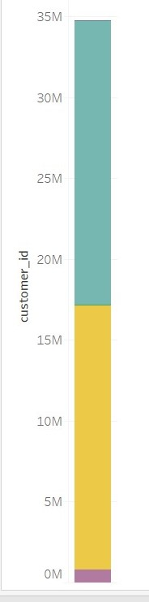
Note: The data and information in this document is reflective of a hypothetical situation and client. This document is to be used for KPMG Virtual Internship purposes only.
Tableau Data Exploration
Gender vs Profit Graphic Review
As we can see there are more, number of female customers then the male customers.
We have female population contributed in car purchase as 52.9% on the other hand male customers have contributed 45.6% and rest are the unknown genders.

Slide 5
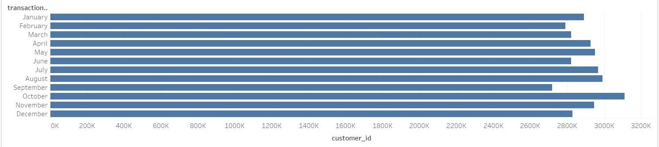
Note: The data and information in this document is reflective of a hypothetical situation and client. This document is to be used for KPMG Virtual Internship purposes only.
Tableau Data Exploration
Customer Id vs Months Graphic Review
Here we can see our most customer purchased cars during month of October which is followed by,
August, July and November.
Round the year, we can see there are at least 2600K customers buying the car.

Slide 6
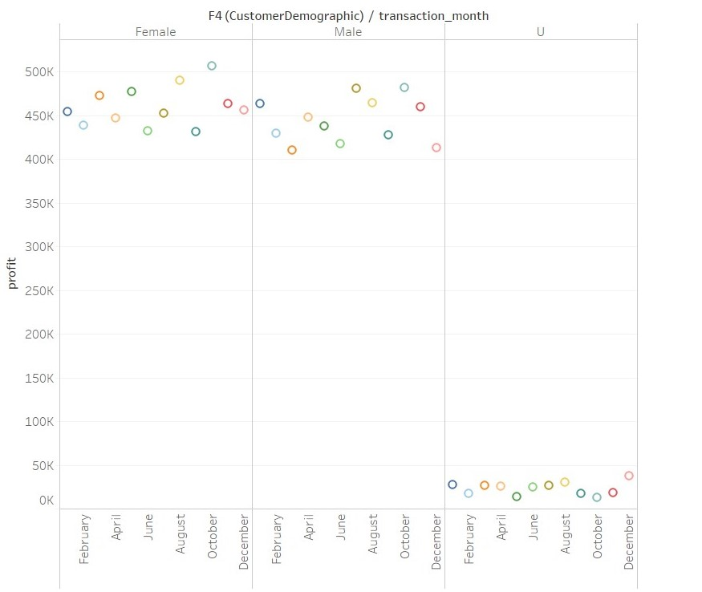
Note: The data and information in this document is reflective of a hypothetical situation and client. This document is to be used for KPMG Virtual Internship purposes only.
Tableau Data Exploration
Transaction Month vs Profit
Female customers have provided higher profit overall than the male customers. Peak profit for female customers is more than 500K where as, male customers had peek at ~480K.
Also, mean of unknown gender customers are around 30K over the year.

Slide 7
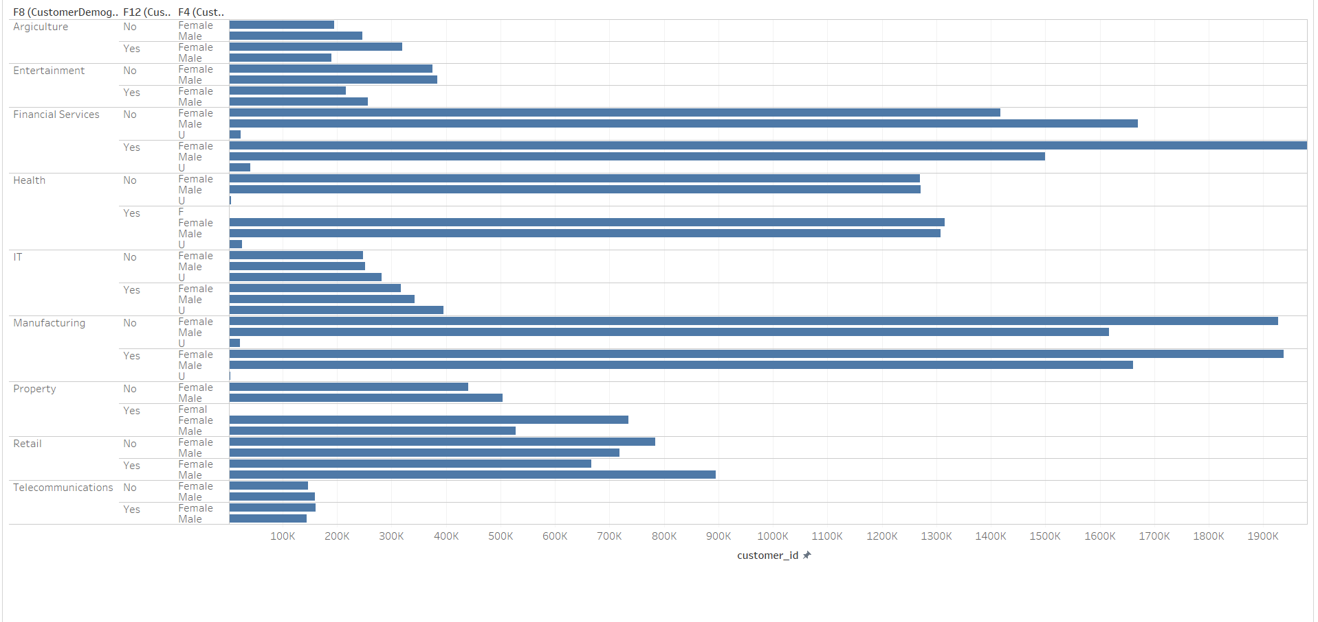
Note: The data and information in this document is reflective of a hypothetical situation and client. This document is to be used for KPMG Virtual Internship purposes only.
Tableau Data Exploration
Industry vs Car Purchase vs Gender vs Customer Id

Slide 8
Note: The data and information in this document is reflective of a hypothetical situation and client. This document is to be used for KPMG Virtual Internship purposes only.
Tableau Data Exploration
Industry vs Car Purchase vs Gender vs Customer Id
As in above slide we can see, in Manufacturing and financial services we had most customers those purchased the car.
The Agriculture and Telecommunication industry customers had shown less car purchased for the year.

Slide 9
Note: The data and information in this document is reflective of a hypothetical situation and client. This document is to be used for KPMG Virtual Internship purposes only.
Appendix

