Slide 1

Note: The data and information in this document is reflective of a hypothetical situation and client. This document is to be used for KPMG Virtual Internship purposes only.
Sprocket Central Pty Ltd
Data analytics approach
[Division Name] - [Engagement Manager], [Senior Consultant], [Junior Consultant]

Slide 2
Note: The data and information in this document is reflective of a hypothetical situation and client. This document is to be used for KPMG Virtual Internship purposes only.
Agenda
Introduction
Data Exploration
Model Development
Interpretation

Slide 3
Note: The data and information in this document is reflective of a hypothetical situation and client. This document is to be used for KPMG Virtual Internship purposes only.
Introduction
New customers analyze:
Look into these factors in new customers:
Age distributions
Number of bike purchases in 3 years / percentages purchases
Job industry category.
Wealth segments
Number of cars own on each states.

Slide 4
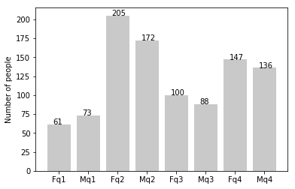
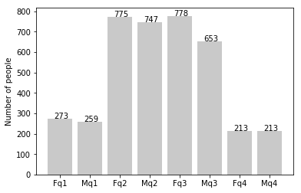
Note: The data and information in this document is reflective of a hypothetical situation and client. This document is to be used for KPMG Virtual Internship purposes only.
Data Exploration
Customers’ age distribution
New
As per given criteria our new customers are aged between 25 to 48.
At the older ages greater than 48 the number of car purchases drops significantly. But, after 59 age there is slight increase in percentage.
People below age 25 are showing less purchases.
q1: Under 25; q2: 25 to 48; q3: 48 to 59; q4: Over 59
Old

Slide 5
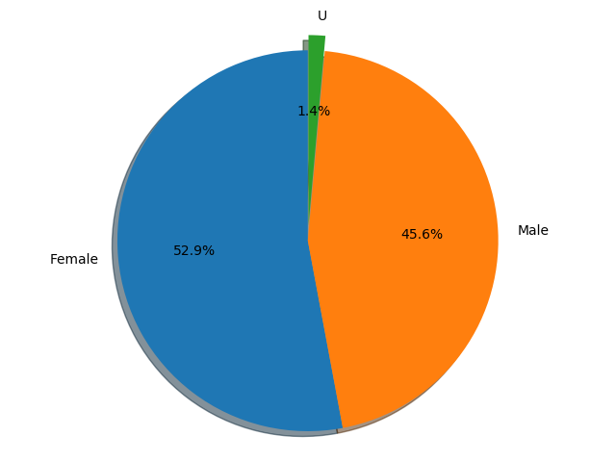
Note: The data and information in this document is reflective of a hypothetical situation and client. This document is to be used for KPMG Virtual Internship purposes only.
Model Development
Bike purchases last 3 years
In this pie chart we can observe that female’s have contributed to nearly 52.9% of overall bike purchase.
On the other hand male’s have contributed to 45.6% of overall bike purchases.
So, we can focus more on females to advertise the data.

Slide 6
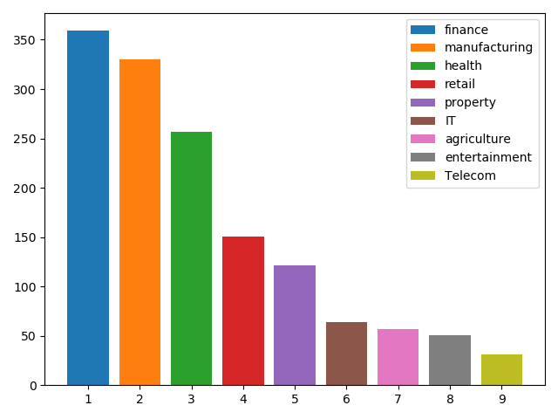
Note: The data and information in this document is reflective of a hypothetical situation and client. This document is to be used for KPMG Virtual Internship purposes only.
Interpretation
Job industry category.
In the bike purchases the top two are finance and manufacture industries are there so, we should focus on this two industries.

Slide 7
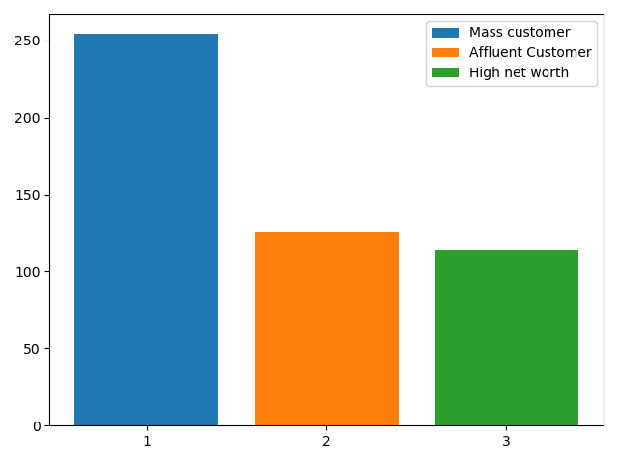
Note: The data and information in this document is reflective of a hypothetical situation and client. This document is to be used for KPMG Virtual Internship purposes only.
Interpretation
Wealth segments
If we see number of car purchase wise affluency rates, then we can observe the Mass consumer purchases higher amount of bikes.
Next is affluent customers which are closely followed by the high net worth people.

Slide 8
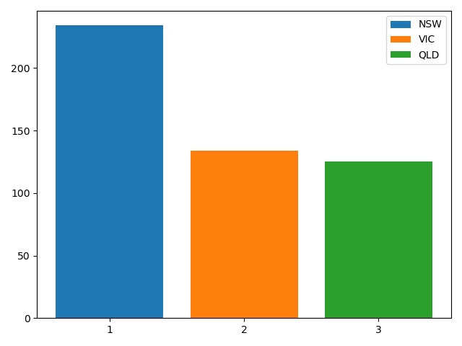
Note: The data and information in this document is reflective of a hypothetical situation and client. This document is to be used for KPMG Virtual Internship purposes only.
Interpretation
Numbers of cars owned
NSW region should be given higher priority since the number of car purchases are higher in that region.
VIC and QLD region are having approximately same car purchases.

Slide 9
Note: The data and information in this document is reflective of a hypothetical situation and client. This document is to be used for KPMG Virtual Internship purposes only.
Appendix

