Slide 1
Plant Leaf Disease Detection and Prevention Platform: Empowering Farmers Through Deep Learning. PRESENTED BY : SAURABH (23MCA0263) , DARSHAN (23MCA0106), VINEET (23MCA0232) GUIDED BY : DR. MYTHILI N
VELLORE INSTITUTE OF TECHNOLOGY
SCHOOL OF COMPUTER SCIENCE AND ENGINEERING AND INFORMATION SYSTEMS (SCORE)
Notes:
dfdfdfdfdf

Slide 2
Table of contents
01
05
02
06
03
04
Problem Description
Flow Of System
Literature Review
References
Proposed Work
System Architecture
Notes:
Ensemble learning involves combining multiple models to improve overall performance, often resulting in higher accuracy than any individual model alone.

Slide 3
Problem Description
The traditional tools and techniques are not very useful since it take up lots of time and manual work
Time consuming, subjective and may not catch all diseases.
Diseases impact crop yield and quality.
Notes:
Of course! Let's consider a scenario where you're building a plant leaf disease detection system. Instead of relying on just one machine learning model, you can create an ensemble of models to improve accuracy.
Here's how it could work:
Multiple Model Types: Train several different types of models for disease detection. For instance, you could train a convolutional neural network (CNN), a decision tree classifier, and a support vector machine (SVM).
Model Variations: Create variations of each model by tweaking parameters or using different feature sets. For example, you might train one CNN with a certain architecture and another with a different architecture, or you might train decision trees with different maximum depths.
Training on Different Data Splits: Divide your dataset into multiple subsets and train each model on a different subset. This helps ensure that each model sees a slightly different perspective of the data.
Combine Predictions: Once you have trained all your models, combine their predictions using a technique like averaging or a voting system. For instance, if three out of five models predict that a plant leaf is diseased, you can classify it as diseased.
Thresholding: Adjust the threshold for classification based on the confidence of the ensemble prediction. You might set a higher threshold if the ensemble's confidence is low and a lower threshold if the confidence is high.
By combining predictions from multiple models trained on different variations of the data, you can create a more robust and accurate plant leaf disease detection system. This ensemble approach helps mitigate the weaknesses of individual models and improves overall performance.

Slide 4
Literature Reviews :
01 | Application of machine learning techniques in rice leaf disease detection | Materials Today: Proceedings, Volume 51, Part 8,2022,Pages 2277-2280,ISSN 2214-7853 | The review talks about how new technology like computer vision and machine learning is helping farmers, especially in detecting diseases in plants automatically. It mentions the big problems in farming like too many people to feed and climate change, and says that these new technologies can help solve some of these issues.
02 | KrishiMitr (Farmer’s Friend): Using Machine Learning to Identify Diseases in Plants | 2018 IEEE International Conference on Internet of Things and Intelligence System (IOTAIS), Bali, Indonesia, 2018, pp. 29-34 | This paper introduces a machine learning algorithm that learns on its own to detect leaf disease. It uses TensorFlow, a versatile framework, and was trained on 80,000 images of 15 plant types and 51 diseases.
03 | A Mobile-Based System for Detecting Plant Leaf Diseases Using Deep Learning | AgriEngineering 3, no. 3: 478-493. 2021 | This paper introduces a system, which with its easy-to-use interface, helps farmers make better decisions and improve crop health. The paper introduces this system and shows how effective it is for farming.

Slide 5
Literature Reviews :
04 | Plant Leaf Disease Prediction | International Journal for Research in Applied Science and Engineering Technology. 9. 1295-1305. 10.22214/ijraset.2021.36582. | Agriculture is key to India's economy, supporting most of its population. Plant diseases hurt crop yield and human health. This review emphasizes the importance of timely disease detection and the potential of CNNs to enhance agriculture in India.
05 | Using Deep Learning for Image-Based Plant Disease Detection | Using Deep Learning for Image-Based Plant Disease Detection , Frontiers in Plant Science VOLUME 7, YEAR=2016 | Advancements in smartphone technology and deep learning enable rapid crop disease identification. Leveraging a dataset of 54,000+ images, a neural network achieved 97.35% accuracy in identifying 14 crops and 26 diseases, promising widespread smartphone-assisted diagnosis for global food security.

Slide 6
Proposed work
Ensemble learning – CNN - Inception V3, MobileNet, MobileNetV2, VGG16, GoogleNet, and ResNet50
Online Leaf Disease Detection System
System will also recommend certain pesticides which they can use to cure the disease and stop further spread of the diseases
Implement this project in a regional language so as to make things more understandable for farmers
Community Forums or Q&A. – Advice from experts or fellow farmers.
01
02
03
Notes:
Integration with IoT Devices: If feasible, integrate your platform with IoT devices like sensors and drones for real-time monitoring of crops and early detection of diseases or pests.
Educational Resources: Offer educational materials such as articles, guides, and tutorials on topics like sustainable farming practices, organic pest control methods, and crop management
Community Forums or Q&A: Include a section where farmers can ask questions, share their experiences, and seek advice from experts or fellow farmers. This fosters a sense of community and collaboration among users. techniques.

Slide 7
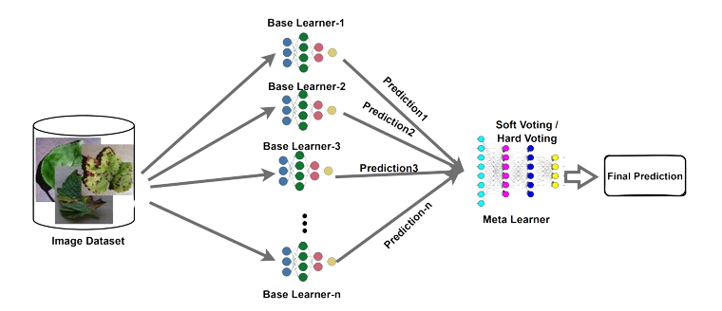
Ensemble Learning

Slide 8
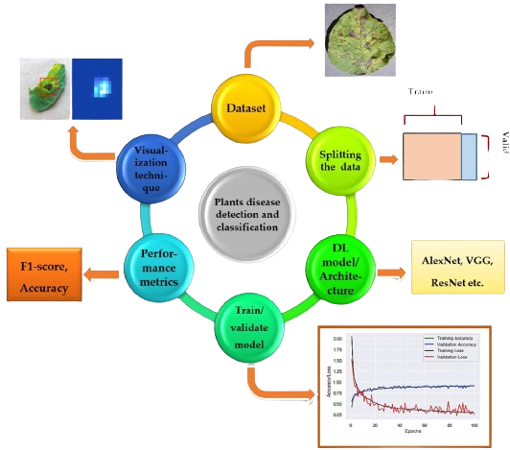
System Architecture

Slide 9
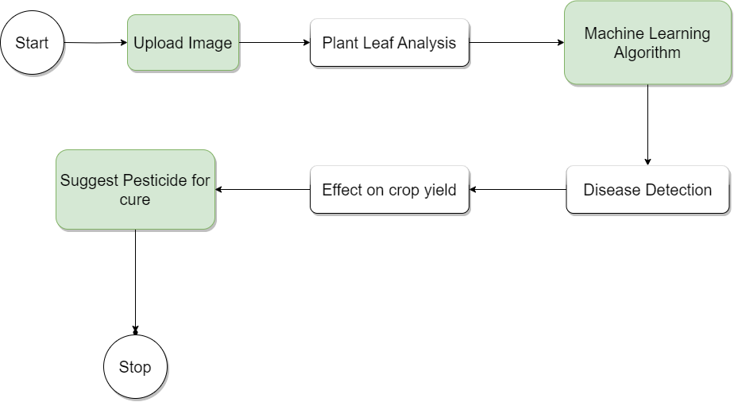
Flow of System

Slide 10
References
01 | Harikumar Pallathadka, Pavankumar Ravipati, Guna Sekhar Sajja, Khongdet Phasinam, Thanwamas Kassanuk, Domenic T. Sanchez, P. Prabhu,Application of machine learning techniques in rice leaf disease detection,Materials Today: Proceedings,Volume 51, Part 8,2022,Pages 2277-2280,ISSN 2214-7853
02 | P. Sharma, Y. P. S. Berwal and W. Ghai, "KrishiMitr (Farmer’s Friend): Using Machine Learning to Identify Diseases in Plants," 2018 IEEE International Conference on Internet of Things and Intelligence System (IOTAIS), Bali, Indonesia, 2018, pp. 29-34,
03 | Ahmed, Ahmed Abdelmoamen, and Gopireddy Harshavardhan Reddy. 2021. "A Mobile-Based System for Detecting Plant Leaf Diseases Using Deep Learning" AgriEngineering 3, no. 3: 478-493.
04 | Monigari, Vaishnavi. (2021). Plant Leaf Disease Prediction. International Journal for Research in Applied Science and Engineering Technology. 9. 1295-1305. 10.22214/ijraset.2021.36582.
05 | Mohanty Sharada P. , Hughes David P. , Salathé Marcel Using Deep Learning for Image-Based Plant Disease Detection , Frontiers in Plant Science VOLUME 7, YEAR=2016

Slide 11
Thanks !
Do you have any questions?

