Slide 1
Computer Networks(CSE-302)
Project Based Assessment Evaluation
Darshan Kumar
122003059
B Tech CSE-3rd year

Slide 2
Problem statement: Design and Implementation of GBN & SR -Transport Layer protocols ,using a GUI model, their comparison

Slide 3
What is “Reliable Data Transfer?”
It Includes the following:
Guarantee on delivery of each segment(using feedback-ACK,NACK)
Guarantee on orderly delivery of segments(using sequence nos)
Guarantee on integrity of data, in each segment(using CHECKSUM)
(integrity refers to “no error ” in data in segments)

Slide 4
Summary of Reliable Data Transfer Mechanisms:
Checksum- used to detect errors, within data bits
Timers- to deal with (overly delayed)/lost packets or ACK
Sequence Numbers-to maintain ORDER in data segments, and to identify a re-transmission(duplicate packets)
ACK- as feedback for correctly received packet
NACK- as feedback for corrupt packet
Pipelining(having 1<=window size<=N)- to utilize bandwidth
(how pipelining is beneficial ,compared to “stop and wait”!!)

Slide 5
GBN-Protocol

Slide 6
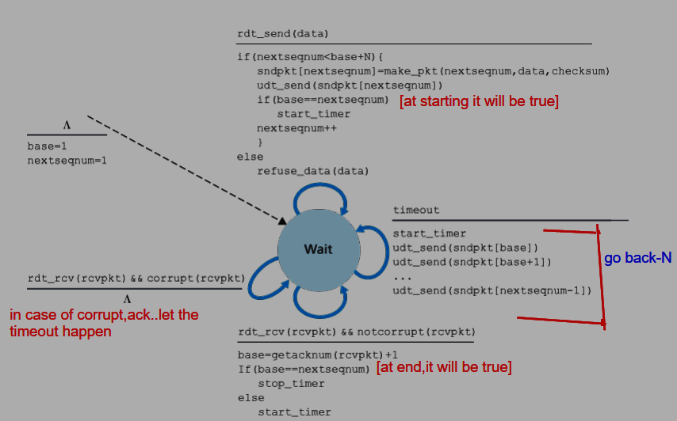
Sender side:

Slide 7
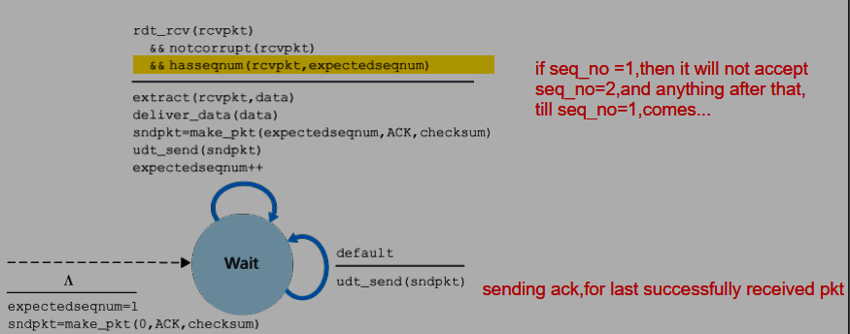
Receiver side:

Slide 8
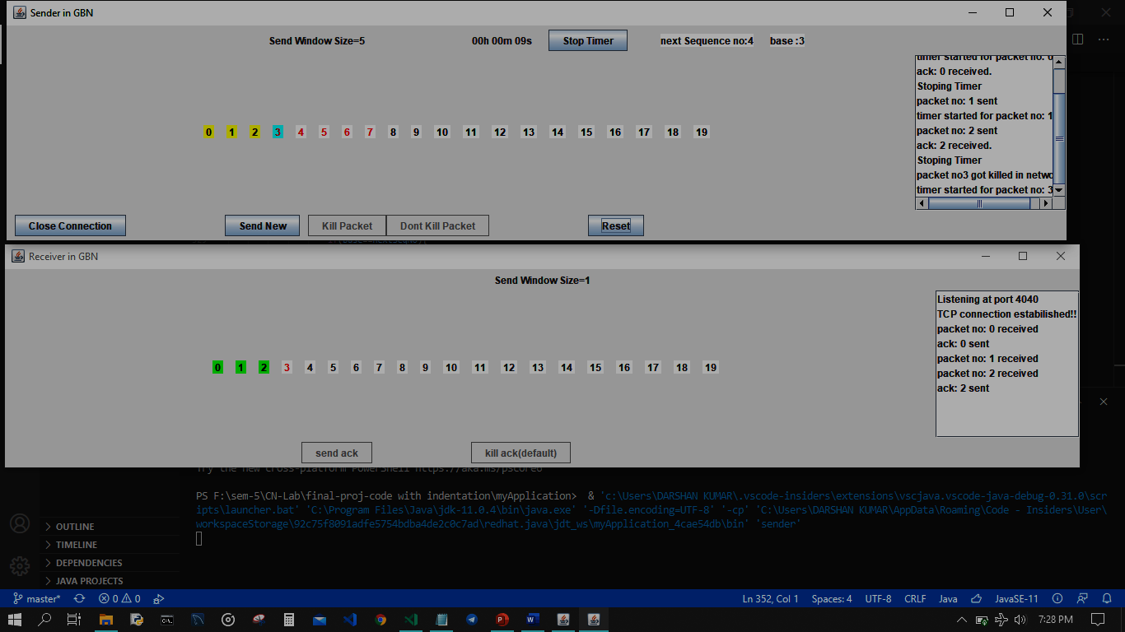
Explaining the GUI of my app(GBN):

Slide 9
Application Demo- for GBN Highlights: 1) cumulative ACK 2)single logical timer 3) receiver side window size=1

Slide 10
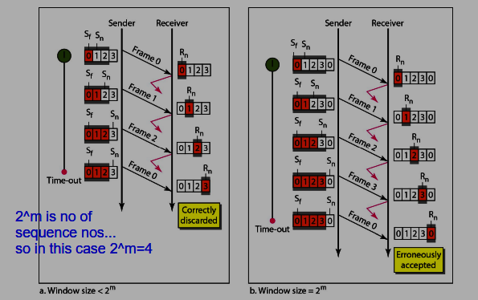
A Possible ambiguity with “window size”!!

Slide 11
Selective repeat Protocol

Slide 12
Sender side algorithm:
When the upper layer calls for sending data, it is checked ,If a unused sequence number is available, within window , if it is available, the data is made into a packet, required headers are added and sent. Otherwise it is buffered.
TIMEOUT EVENT: it is designed to protect against overly delayed/ lost packets .Unlike GBN, each packet in SR has a logical timer, and timeout of a particular timer, results in RESENDING the packet, corresponding to that timer. The timer is started/stopped/restarted based upon packet getting sent/ACK received/resent .
ACK RECEIVED: if the ACK is for the base packet of window, the window is then slided, such that the new base now is the nearest unacknowledged packet, to the previous base. New sequence numbers, which are now inside window, now can be utilized to send a packet, on demand, instantaneously.

Slide 13
Receiver side algorithm:
Any packet with sequence number in Range: [base,base+N-1] are correctly received .And a ACK is sent for that sequence number. If the packet is in the above range, but not in correct order, than ,they need to be buffered. When a packet ,with sequence number=base of receiver, arrives, then this packet, and previously buffered consecutive packets are together delivered, to its upper layer.( and window is slided, similar to sender side case).
For packets with sequence number in range : [0, base-1] ,a DUPLICATE ACK (as receiver has already acknowledged this packet) is sent.
In all other cases, received packet is discarded.

Slide 14
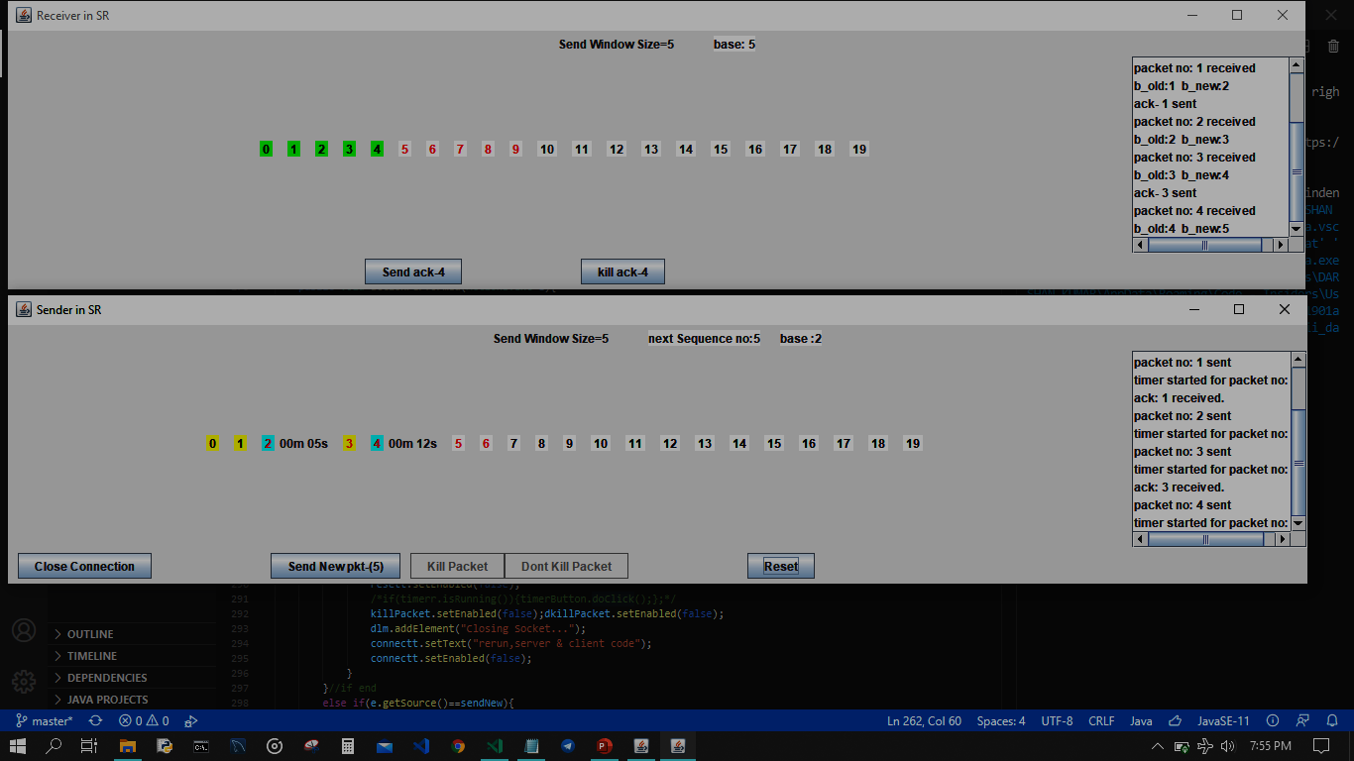
Explaining GUI of my app(SR):

Slide 15
Application Demo- for SR Highlights: 1) duplicate ACK 2)individual timer, for each sent packet 3) receiver side window size=sender window size 4) use of buffer on receiver side

Slide 16
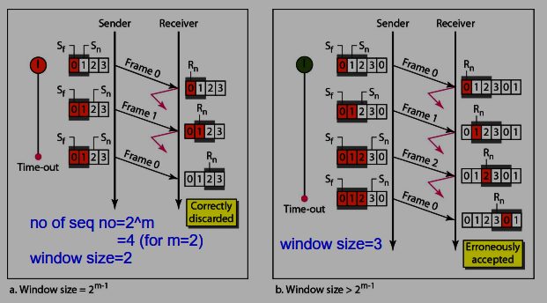
A Possible ambiguity with “window size”!!

Slide 17
Points of difference between the protocols Disadvantages of GBN:
A single error, in the 1st packet, will make the rest of the successive packets ,transmitted as waste. And will lead to RE-TRANSMISSION, which obviously can be avoided.
When window size is large, and there is high congestion in network, the probability of 1st packet of a retransmission getting dropped ,by a intermediate router is high. This adds to ,number of retransmissions, in a already congested channel.
The window size of 1 in receiver side, and large window size, on sender side, perform extremely bad, in a congested network (where changes of a packet, getting dropped is high).
It does not utilize the benefit of buffers, that can be added to both hosts, which will reduce, the discarding of ,rightly received packets(which were received out of sequence).
With buffers being introduced, the receiver, no longer needs to limit its window size to 1.
ALL THESE IDEAS, ARE INCOPERATED IN SR PROTOCOL.

Slide 18
DISADVANTAGES OF SR PROTOCOL:
Hardware limitations, play a big role in deciding the window size, as each sequence number, within the sender side window, needs to be allotted a timer, which must be capable of running simultaneously.(all N timers, running simultaneously).
Hardware limitations, in another form, will be the amount of Buffer, available especially for the RECEIVER side, this factor will limit the window size.
Congestion in the channel, is another factor, based on which , window size, should be determined. But Congestion changes with time, thus is un-predictable.
Flow Control is needed, to prevent overflow of receiver side Buffer.

Slide 19
Related topics:
In IPv4: it is TIME TO LIVE(TTL), field
In IPv6: it is HOP LIMIT field
Flow control
Congestion control(imp phases:slow start ,congestion avoidance)
Need of “reliable data transfer” in both “transport”, ”Link ” Layers

Slide 20
THANK YOU

Slide 21
My strong topics for viva:
unit-1 full (especially dns, http, smtp)
Unit 2: TCP vs UDP
Unit 3: routing algorithms(especially OSPF, BGP)
Unit 4: DHCP ,error detection techniques

