Slide 1
eatables
204682 – Ashwin K.V
204683 – Darshan Dinesh M.P
204684 – Delbin George

Slide 2


INTRODUCTION
EATABLES is a dynamic and user-friendly platform that provides a convenient way for food lovers to discover new dining options. With features like location-based restaurant searches, user reviews, personalized favorites lists, vlog uploads, and filtered search results, By creating a community-driven approach, EATABLES fosters engagement and encourages users to share their dining experiences and recommendations with others.
eatables
204682 – Ashwin K.V
204683 – Darshan Dinesh M.P
204684 – Delbin George

Slide 3
INTRODUCTION
eatables
EATABLES is a dynamic and user-friendly platform that provides a convenient way for food lovers to discover new dining options. With features like location-based restaurant recommendation, user reviews, personalized favorites lists, vlog uploads, and filtered search results, By creating a community-driven approach, EATABLES fosters engagement and encourages users to share their dining experiences and recommendations with others.
204682 – Ashwin K.V
204683 – Darshan Dinesh M.P
204684 – Delbin George

Slide 4
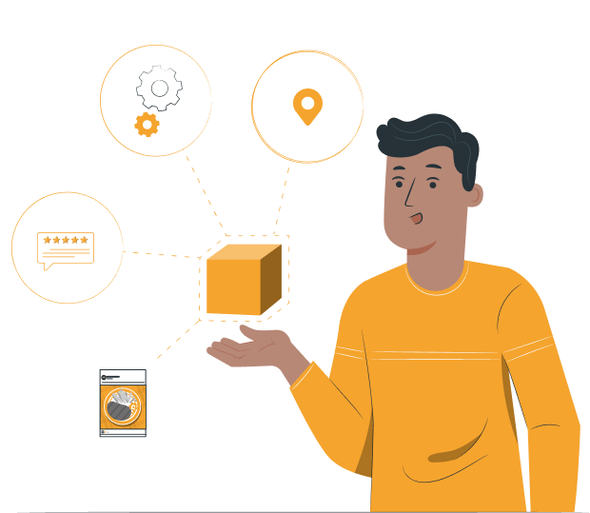
KEY FEATURES
eatables
INTRODUCTION
EATABLES is a dynamic and user-friendly platform that provides a convenient way for food lovers to discover new dining options. With features like location-based restaurant recommendation, user reviews, personalized favorites lists, vlog uploads, and filtered search results, By creating a community-driven approach, EATABLES fosters engagement and encourages users to share their dining experiences and recommendations with others.
User reviews and ratings for restaurants
Detailed restaurant information, including contact details and address
Personalized favorites list for easy reference
"Drops" feature for users to upload and share food vlog videos
Restaurant submission feature for users to suggest new restaurants
Admin panel for managing restaurant information and review user submitted suggestions
Mobile-friendly platform for easy access on-the-go

Slide 5
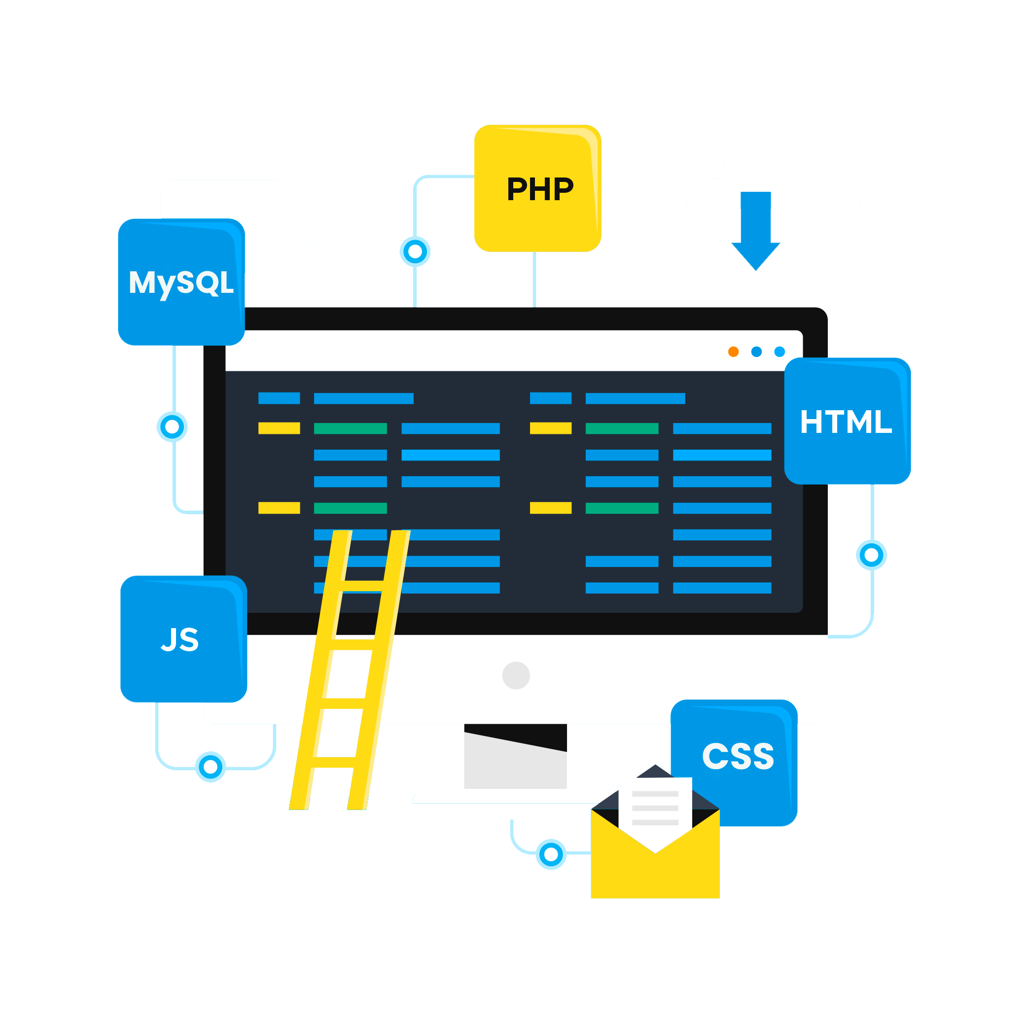
Technology Used
eatables
KEY FEATURES
INTRODUCTION
User reviews and ratings for restaurants
Detailed restaurant information, including contact details and address
Personalized favorites list for easy reference
"Drops" feature for users to upload and share food vlog videos
Restaurant submission feature for users to suggest new restaurants
Admin panel for managing restaurant information and review user submitted suggestions
Mobile-friendly platform for easy access on-the-go
EATABLES is a dynamic and user-friendly platform that provides a convenient way for food lovers to discover new dining options. With features like location-based restaurant recommendation, user reviews, personalized favorites lists, vlog uploads, and filtered search results, By creating a community-driven approach, EATABLES fosters engagement and encourages users to share their dining experiences and recommendations with others.
Our platform is built using HTML, JavaScript, and Tailwind CSS for the frontend, and PHP and MySQL for the backend. This powerful combination of technologies ensures that our platform is user-friendly, responsive, and efficient.
We integrated the Geolocation API to retrieve the user's location and provide location-based recommendations.

Slide 6
KEY FEATURES
eatables
Technology Used
Our platform is built using HTML, JavaScript, and Tailwind CSS for the frontend, and PHP and MySQL for the backend. This powerful combination of technologies ensures that our platform is user-friendly, responsive, and efficient.
We integrated the Geolocation API to retrieve the user's location and provide location-based recommendations.
User reviews and ratings for restaurants
Detailed restaurant information, including contact details and address
Personalized favorites list for easy reference
"Drops" feature for users to upload and share food vlog videos
Restaurant submission feature for users to suggest new restaurants
Admin panel for managing restaurant information and review user submitted suggestions
Mobile-friendly platform for easy access on-the-go

