Slide 1
CAMPUS RECRUITMENT PROJECT
By Darshan d s

Slide 2
What is this project about?
There are so many factors affect the placements of a student for a job.
In this project I am trying to understand some of those factors which recruiters consider important.
I have also created a machine learning algorithm which classifies the students who have a high chance of getting placed from those who won’t.

Slide 3
The Data set explained
The data set consists of Placement details of students in XYZ campus. It includes secondary and higher secondary percentage and specialization.
It also includes degree percentage, degree specialization, MBA percentage, MBA specialization, work experience if any and the salary offered to those who got placed.
The target variable is status, which contains two classes – ‘Placed’ and ‘Not Placed’.
The Data set contains 13 variables with 7 categorical (all of nominal level) and 6 continuous. The data size is small with only 215 entries.

Slide 4
What can we infer from the exploration of the data?
In the exploration process, I tried to answer a few questions:

Slide 5
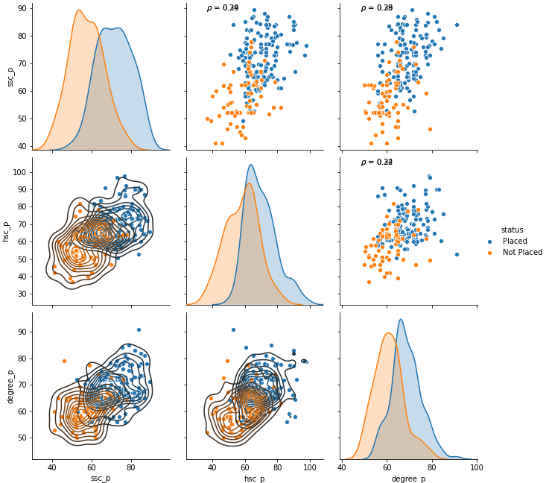
Does the 10th 12th and degree marks determine the chances of a student getting placed?
Figure shows the pair plot of 10th, 12th and degree marks which are categorized by status.
The orange dots represent Not Placed and the blue dot represent placement. If the 10th, 12th and degree marks are low, then we can see more orange dots, that means these students were not placed, and those students who performed well in these exams were successful in securing the placements.
So, the marks scored by a student in 10th, 12th and degree is a significant factor in securing the placements. But we can also see outliers in both the categories.

Slide 6
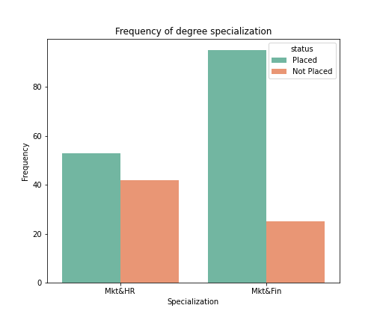
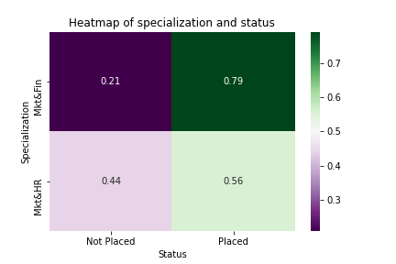
Is there a particular branch in MBA which offers good placement results?
Status | Not Placed | Placed | Total
Specialization in MBA
Market & Finance | 20.83 | 79.17 | 100
Market & HR | 44.21 | 55.79 | 100
If the specialization is Marketing and Finance, then the student has a 79.17% chance of getting placed.
Whereas there is only 55.79% chance for students who specialized in Marketing and HR.

Slide 7
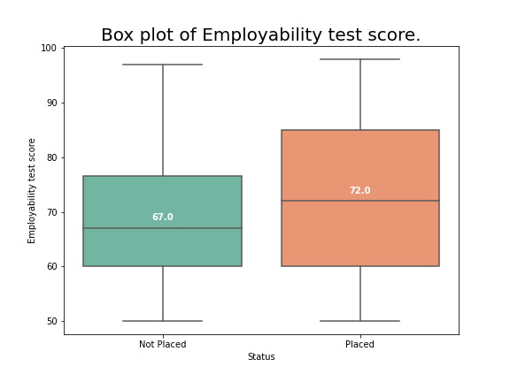
Does the marks from Employability test conducted by the college impacted the odds of getting placed?
From the boxplot we can see that, students who got placements have a median mark of 72%, but those who were not placed got a median score of 67%.
So, the employment score has an impact on placements.

Slide 8
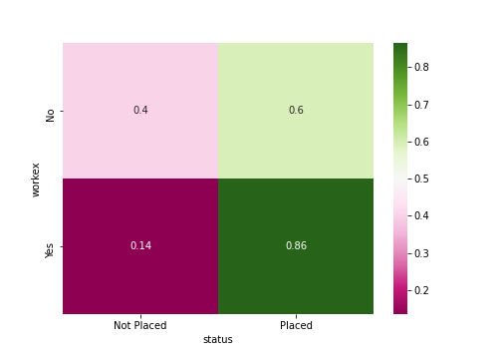
Does having a work experience improve the odds of getting placed?
Status | Not Placed | Placed | Total
Work experience
No | 40.42 | 59.57 | 100
Yes | 13.51 | 86.48 | 100
If the student doesn't have a work experience, then he/she has only 59.5% chance of getting placed.
But if he/she have work experience then the odds of getting placed increases to 86.4%.

Slide 9
How does the models perform?
Model | Accuracy | Accuracy 0 | Accuracy 1 | Precision | Recall | ROC area
Logistic Regression | 0.753846 | 0.727273 | 0.759259 | 0.759259 | 0.931818 | 0.892857
Random Forest | 0.8 | 0.722222 | 0.829787 | 0.829787 | 0.886364 | 0.900974
KNN | 0.753846 | 0.727273 | 0.759259 | 0.759259 | 0.931818 | 0.798701
SVM | 0.753846 | 0.727273 | 0.759259 | 0.759259 | 0.931818 | 0.830087
Based on the model comparison overall accuracy is higher for Random Forest Classifier which is 80% accuracy. All the other model having the overall accuracy at 75.38%. But the accuracy of classifying the negative class (accuracy of 0’s) are almost equal for all the models which is 72.72% accuracy.
Overall, we can select Random Forest Classifier to classify this data, as it performs well on most evaluation metrics.

Slide 10

THANK YOU
BY DARSHAN D S

