Slide 1
Property price prediction project
By Darshan DS

Slide 2
OBJECTIVES
The price of a property fluctuates based on so many factors. We need to identify most important factors.
Predicting the price of new property based on these factors.
Creating a Linear Model based on these features which can predict the dependent variable that is Property Sale Price with a higher accuracy.

Slide 3
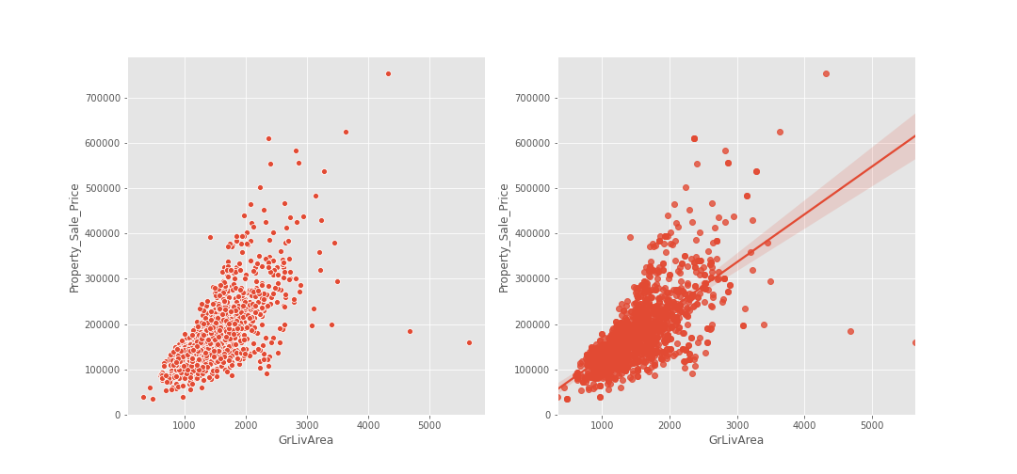
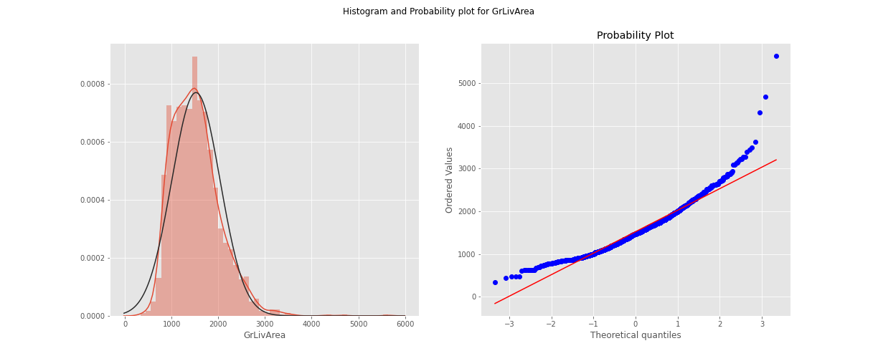
There is a high correlation between general living area and the price of a property.
As the living area of the property increases the price also increases.
Here slope = 0.83, which means that one unit of general living area will increase 0.83 units of property sale price

Slide 4
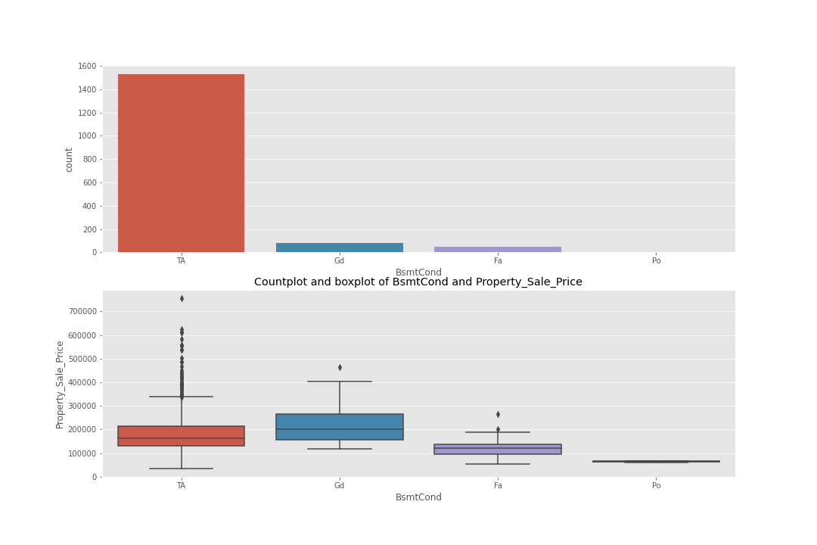
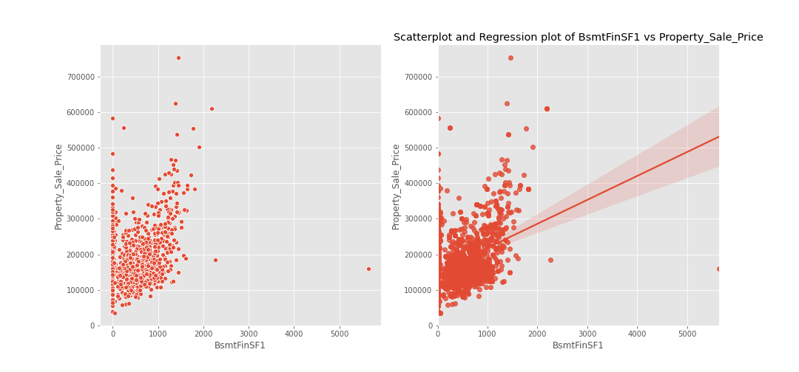
From the boxplot we can see that the Basement condition affects the price of the property
From the graph we can see that, there is a positive correlation between basement finish type and property sale price

Slide 5
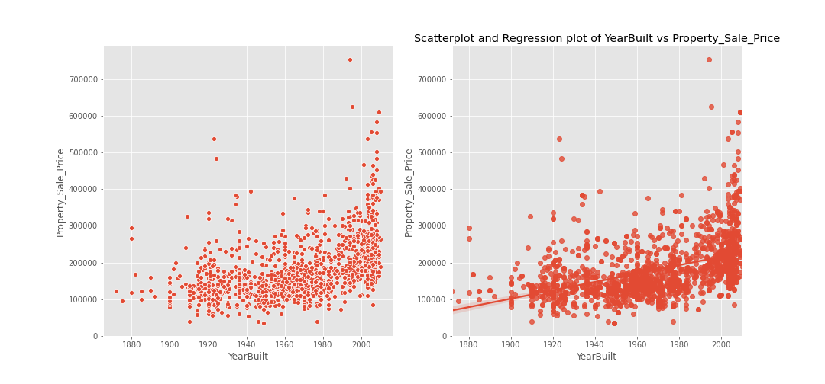
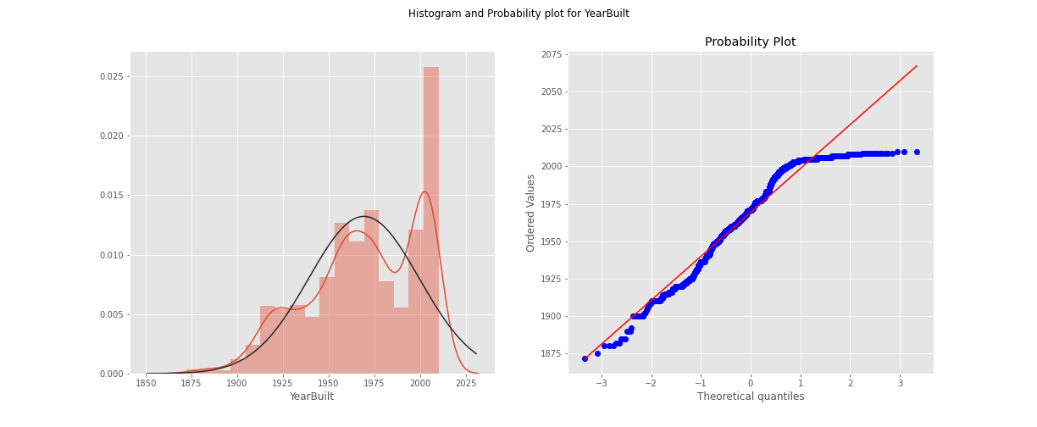
A general trend followed by property price is its increase over a time period.
Newly built property costs more than old property.
If we analyze the slope we can see that one unit of increase in Year will change 0.66 unit of Property price in the positive direction.

Slide 6
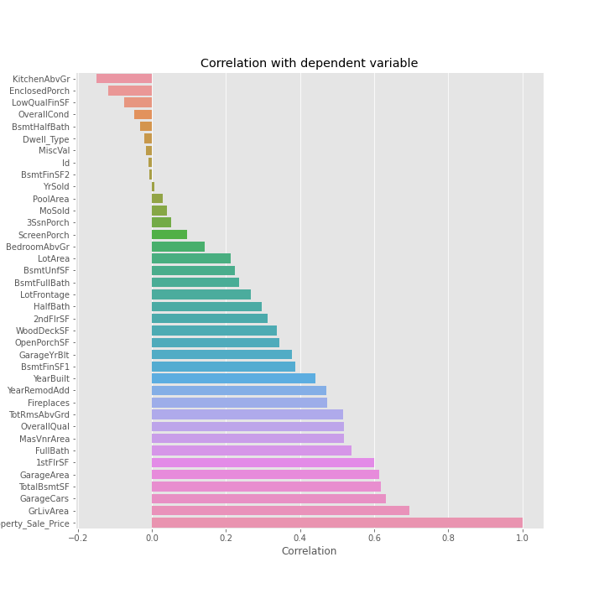
The graph shows the correlation of all the numerical variables with the dependent variable.
As we can see the highest positive correlation is given by general living area, garage cars, total basement area etc…
We can use only the most correlated features to build our regression model.

Slide 7
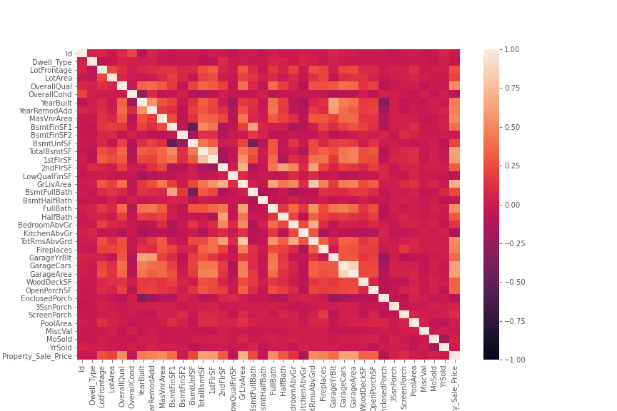
This graph can show us the correlation between all the numerical variables with each other.
As the points in the graph becomes whiter the correlation between those two variables are positive and vice versa.
Here we can look for multicollinearity, apart from a VIF factor analysis.

Slide 8
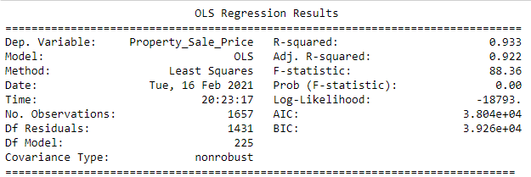
Lets build our base model
A base model is prepared for the comparison of this model with all the other models for understanding the accuracy.

Slide 9
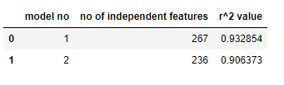
A new model is created by eliminating some of the unnecessary features.
To determine if a feature is unnecessary we can do some hypothesis tests.
After doing all those tests a new model is created and the differences between the r^2 values and number of coefficients are recorded.

Slide 10
Thank you

