Slide 1
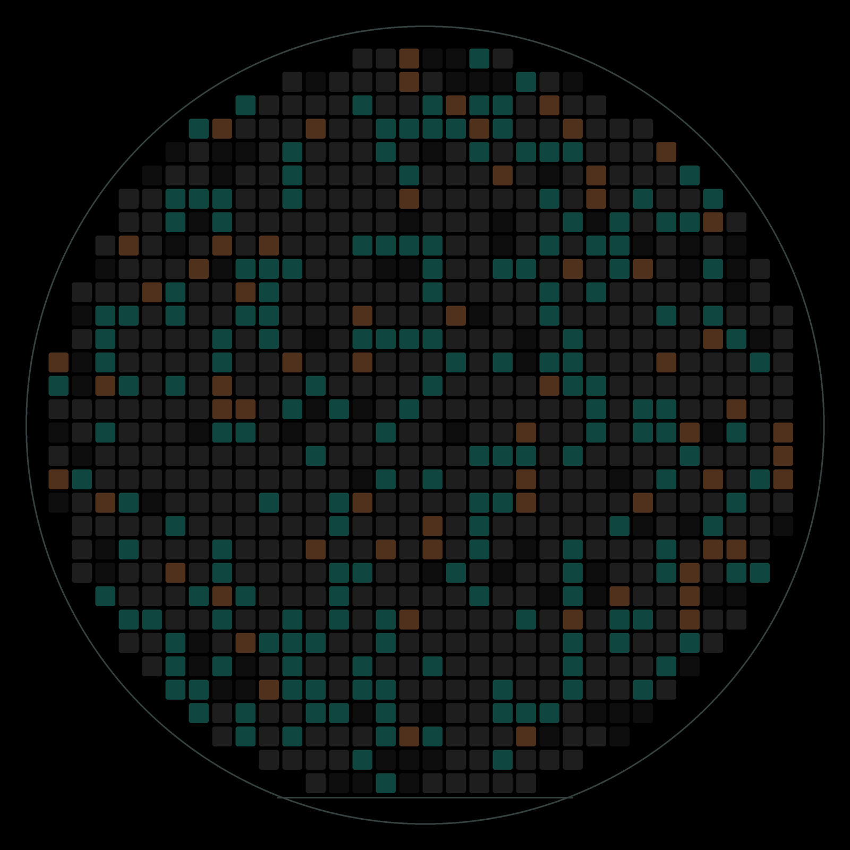
AI · CHIP TESTING
Smart Trim
& Fuse
A prototype for tuning chips right the first time, on synthetic data
Darshan Masur
Prototype on synthetic data · simulated results, not real-world savings · definitions: RESULTS_SOURCE_OF_TRUTH.md
Notes:
Hi, I'm Darshan. Thank you for having me. My project is called Smart Trim and Fuse. Every chip needs a little tuning before it ships, and today that tuning is slow trial and error. I'll show you how I used AI to get the setting right the first time, on four kinds of chips, without risking quality.

Slide 2

THE PROBLEM
Every chip needs a little tuning
No two chips are the same, so each one is tuned, then locked into one-time fuses.
~20 tries
to tune one microcontroller today
1 chance
a fuse can be burned only once
Tuning is slow, and a mistake can't be undone.
Prototype on synthetic data · simulated results, not real-world savings · definitions: RESULTS_SOURCE_OF_TRUTH.md
2
Notes:
No two chips come out of the factory exactly the same. One chip's voltage is a bit high, another's clock is a bit slow. So on the tester we tune each chip; that's called trimming. Today the tester tries a setting, measures, and tries again, about 20 times for one microcontroller. When it's right, the setting is burned into fuses, and a fuse can't be unburned. So the problem has two sides: it's slow, and there's no room for a mistake.

Slide 3
THE SOLUTION
My idea: predict, check, protect
Predict
AI guesses the setting from data the tester already has
Check
Measure once. If it's off, use today's search
Protect
Rules check every fuse before it is burned
1
2
3
›
›
The AI saves time; the check and the rules keep quality.
Prototype on synthetic data · simulated results, not real-world savings · definitions: RESULTS_SOURCE_OF_TRUTH.md
3
Notes:
My idea has three steps. Predict: the tester already measures a few things about each chip, so an AI model uses them to guess the right setting straight away. Check: the tester measures once. If the guess is off, it simply falls back to today's search, so a wrong guess costs a little time, never quality. Protect: before anything is burned, fixed rules check the fuse map. The AI makes it fast; the check and the rules keep it safe.

Slide 4
THE BOTTOM LINE
One idea, four kinds of chips
3.9×
faster tuning
Microcontroller
3.9×
fewer tuning tries
Power chip
1 pass
in the oven, not 3
Sensor
+35%
simulated revenue
SoC processor
Simulated on synthetic wafers the AI never saw, one wafer at a time.
All synthetic: 9 datasets, 4 kinds of chips. Not real-world savings.
Prototype on synthetic data · simulated results, not real-world savings · definitions: RESULTS_SOURCE_OF_TRUTH.md
4
Notes:
I used the same idea on four kinds of chips. A microcontroller: tuning is about four times faster. A power chip: about four times fewer tuning steps. A sensor: one trip through the oven instead of three, for the grades that allow it. And a bigger processor, the SoC: 35% more revenue from the very same chips, by matching them to what customers order. Every number was measured on wafers the AI never saw while learning, and I also held out every wafer one at a time to see how much the results move from wafer to wafer. The data is synthetic, made to look like real test data.

Slide 5
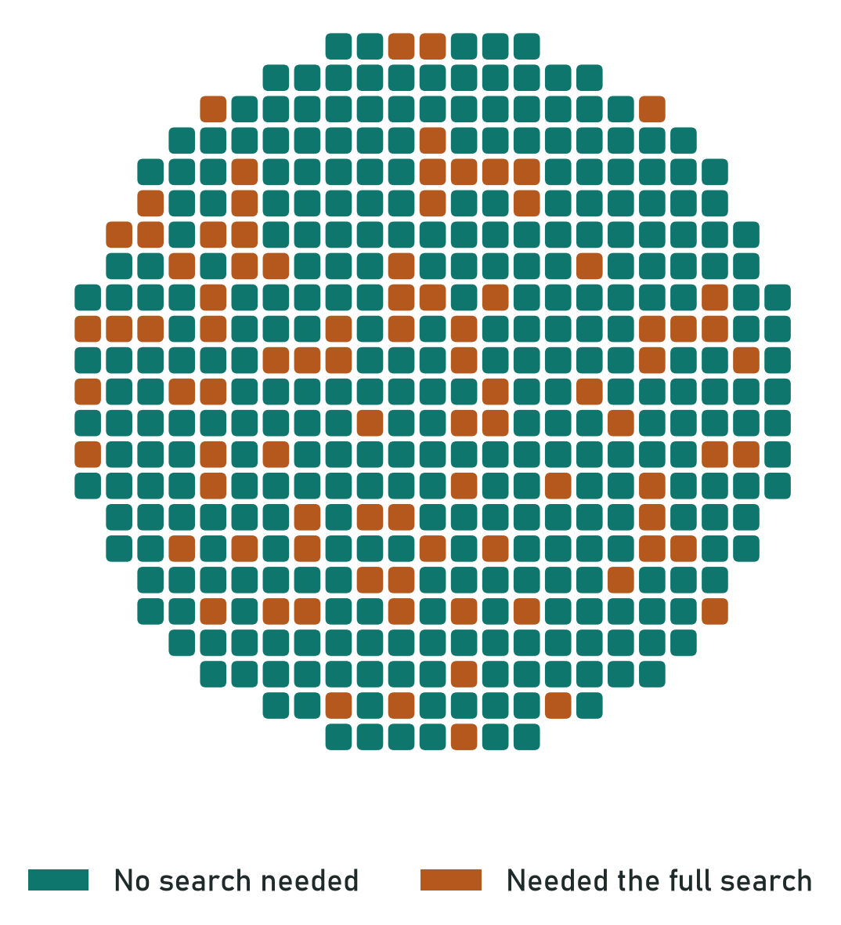
CHIP 1 OF 4 · MCU
1 · Microcontroller: right first time
83%
of chips need no search:
the AI's guess passes the check
20 → 5
tries to tune one chip
The rest fall back to today's search (simulated).
Prototype on synthetic data · simulated results, not real-world savings · definitions: RESULTS_SOURCE_OF_TRUTH.md
5
Notes:
Each square is one chip, drawn where it sat on a wafer the AI never saw. Teal means the AI's guess was right, so one quick check was enough. Copper means it was a little off, so the tester just did today's search: same quality, only slower. 83% of chips need no search, and the tries per chip drop from about 20 to 5. The model is a Random Forest; it beat five other models, including a neural network. When I hold out each of the 15 wafers in turn, the share needing no search goes from 67% on the hardest wafer to 91% on the easiest, so 83% is the middle, not a lucky split.

Slide 6
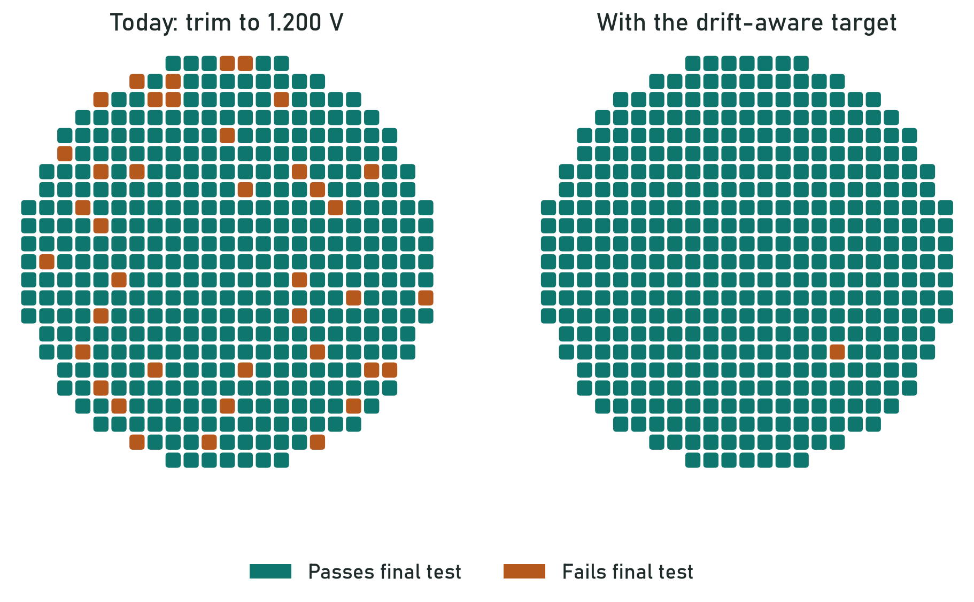
CHIP 1 OF 4 · MCU-C
2 · The AI found a hidden problem
91% → 99.4%
pass the final test
99.0–99.8%
across only 2 wafers:
an early result
Aim slightly low, so each chip lands on target after packaging.
Prototype on synthetic data · simulated results, not real-world savings · definitions: RESULTS_SOURCE_OF_TRUTH.md
6
Notes:
On one chip version, MCU-C, about 1 chip in 10 failed the final test even after perfect tuning. The reason: packaging shifts the voltage a little after tuning. So the model learns that shift and aims each chip slightly low, so it lands on target after packaging. Left is today, right is with the fix: the copper failures disappear. The model learned the shift on the big MCU-A product, and 50 MCU-C chips halve its error; that's transfer learning. The pass rate goes from 91% to 99.8%. One honest point: MCU-C has only 2 wafers. I checked it both ways round and with 20 different samples, and it stays between 99.0 and 99.8%, but with 2 wafers I call it an early result.

Slide 7
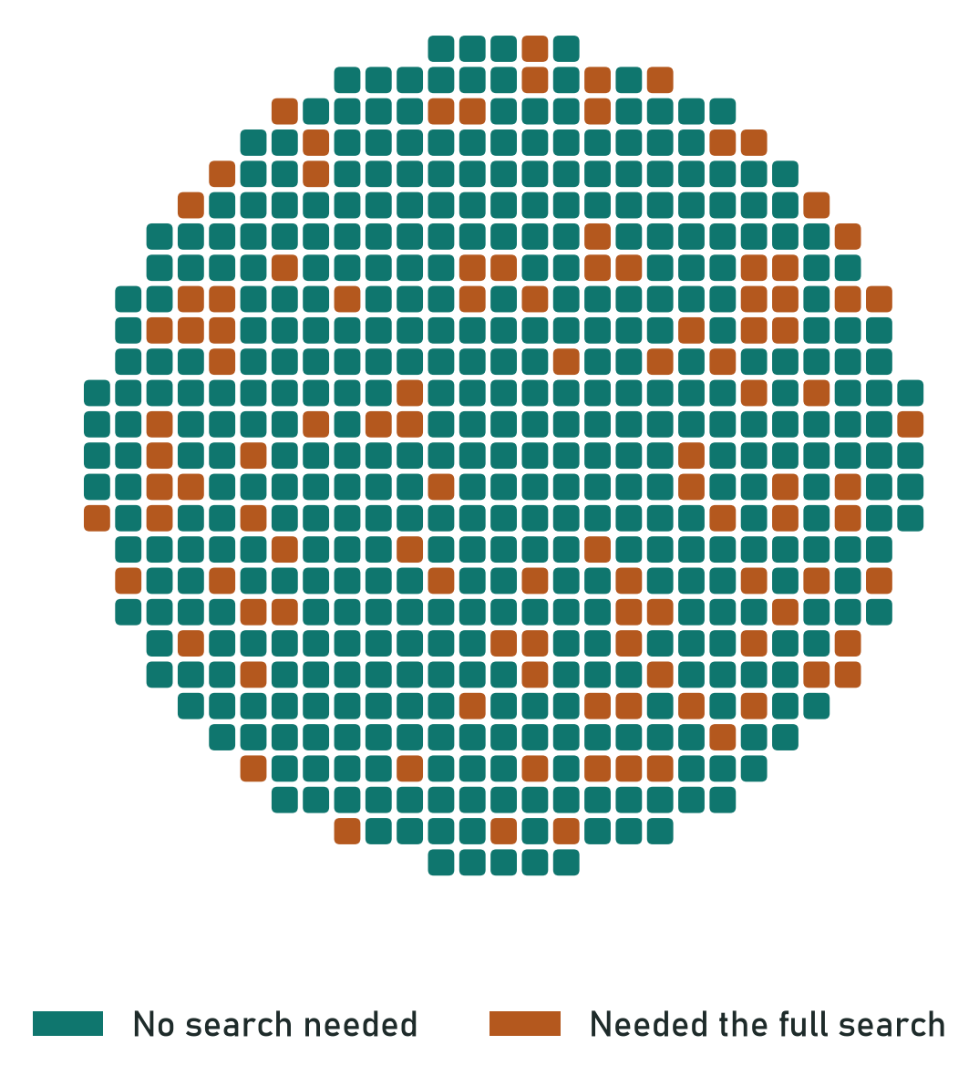
CHIP 2 OF 4 · PMIC
3 · Power chip: one reading, four outputs
45 → 12
tries to tune one chip
79%
of chips need no search
Similar on 2 versions it never saw: 3.5–3.9× fewer tries.
Prototype on synthetic data · simulated results, not real-world savings · definitions: RESULTS_SOURCE_OF_TRUTH.md
7
Notes:
A power chip has four output voltages, called rails. Today each one is tuned by trial and error, about 45 tries per chip. I found the rails follow one reference voltage almost in a straight line, so a simple linear model, Ridge, predicts all four from one reading. That cuts it to about 12 tries, and 78% of chips need no search at all. It works the same on all three PMIC versions. The customer settings for its one-time memory are checked by fixed datasheet rules.

Slide 8
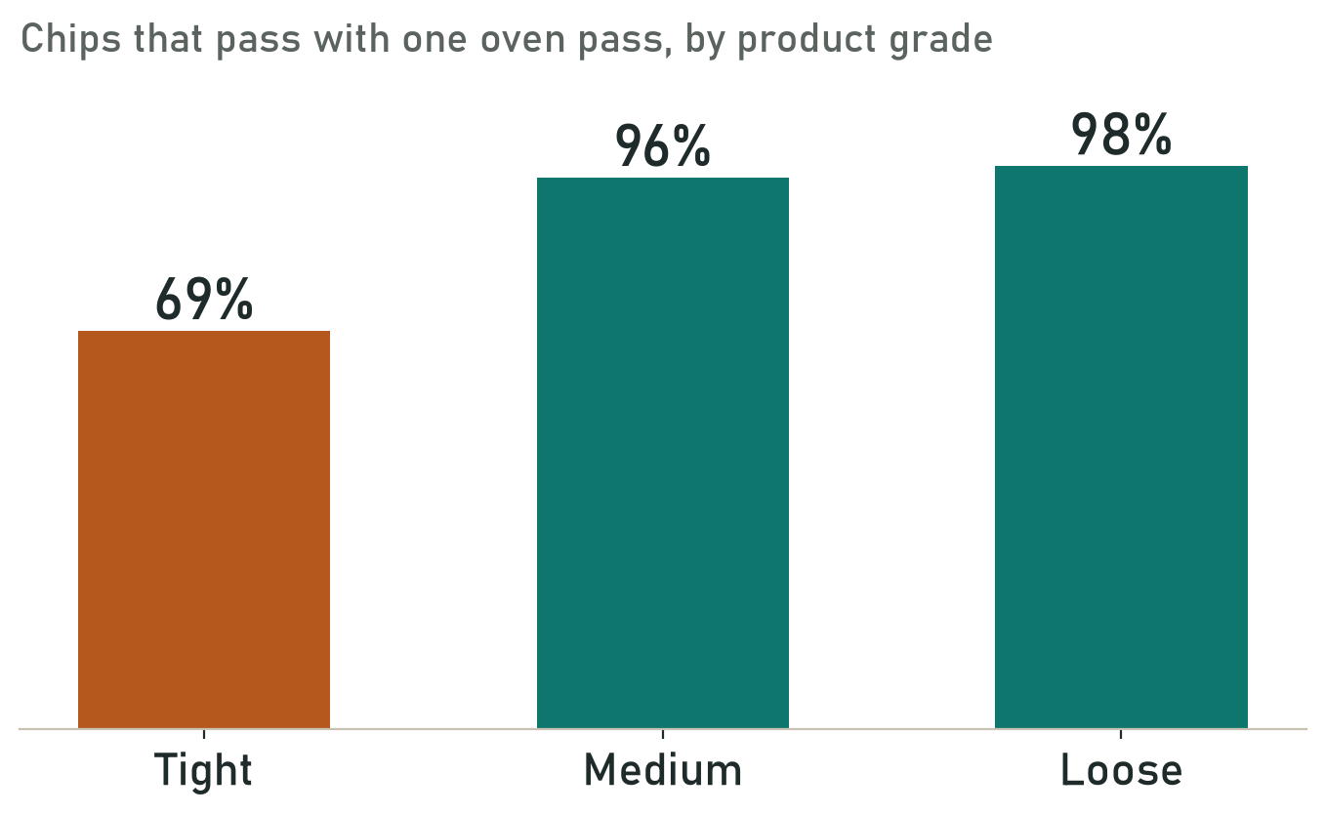
CHIP 3 OF 4 · SENSOR
4 · Sensor: one oven pass, not three
3 → 1
oven passes for medium
and loose grades
7.2 → 2.6 s
test time per chip
(assumes 1 pass = 1/3 of the time)
The tight grade keeps 3 passes: quality before speed.
Prototype on synthetic data · simulated results, not real-world savings · definitions: RESULTS_SOURCE_OF_TRUTH.md
8
Notes:
Sensors are calibrated at three temperatures, which means three trips through an oven. I test only at room temperature and let a model predict the hot and cold behaviour. For the medium and loose product grades, 96 to 98% of chips still pass, so one pass is enough, and the test time drops from about 7 seconds to under 3 per chip. For the tight grade only 69% pass, so I keep the full three-temperature test there. That's an honest limit.

Slide 9
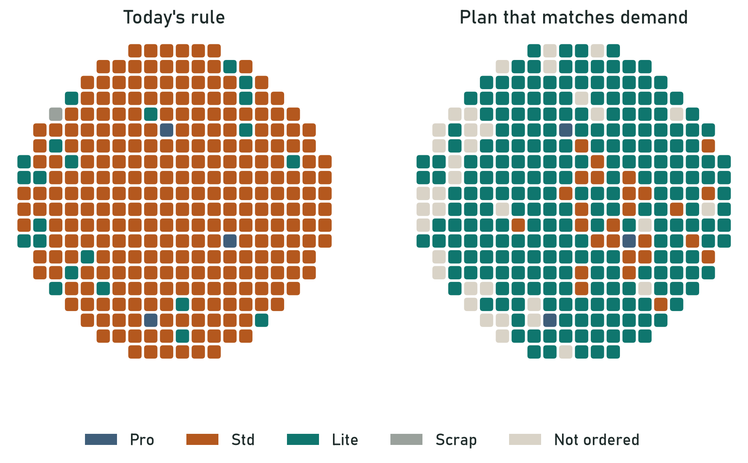
CHIP 4 OF 4 · SOC
5 · SoC: sell what customers order
+35%
simulated revenue,
synthetic demand
85%
skip the speed test,
0 of 1,540 sold too fast
Prototype on synthetic data · simulated results, not real-world savings · definitions: RESULTS_SOURCE_OF_TRUTH.md
9
Notes:
The SoC is a bigger processor sold as three products: Pro, Std and Lite. Today's rule gives every chip the best product it qualifies for. On the left, that makes almost every chip a Std, far more than customers order, while Lite runs short. A Std-quality chip always works as a Lite, so a planning tool, an integer program, decides what each chip is sold as. On the right, the slowest Std chips become Lite. Same chips, 35% more revenue a week. The speed test itself takes 450 ms. Predicting speed for every chip was too risky, but most chips are far from any product boundary. So only the chips within 80 MHz of a boundary get the speed test: 85% of chips skip it, and none was sold too fast on wafers kept aside. I chose that margin on separate validation wafers first.

Slide 10
RULE CHECKS
Every fuse word is rule-checked first
PASS only with an identified die and checked trim fields; otherwise REVIEW or BLOCK.
406/406
injected errors caught
0
false alarms (1,094 good)
100%
power-chip requests
match the rule labels
Fixed rules, not AI, decide. Synthetic errors only: a prototype, not a programming tool.
Prototype on synthetic data · simulated results, not real-world savings · definitions: RESULTS_SOURCE_OF_TRUTH.md
10
Notes:
Fuses are the one step that can't be undone, so here I didn't use AI at all. The chip's fuse layout is written in a schema, so I turned it into fixed rules that check every field before burning. In the audit file every bad fuse map was blocked, 406 out of 406, with zero false alarms. The same idea checks the customer settings for the power chip, and it was right every time.

Slide 11
METHODS
What I tried, and what won
✓
Random Forest and Ridge
simple, fast, and they won
✓
Transfer learning
fixed MCU-C with 50 chips
✓
Rules and an optimiser
fuses, settings, SoC plan
✕
Deep learning
never beat the simple models
✕
GNN, GAN, reinforcement learning
nothing extra to learn
Prototype on synthetic data · simulated results, not real-world savings · definitions: RESULTS_SOURCE_OF_TRUTH.md
11
Notes:
I didn't assume AI was needed; I tested it. For the microcontroller I compared a formula with six models: Ridge, Random Forest, three boosting models and a neural network. On data this size the simple models won. I also checked graph models across the wafer, GANs, sequence models and reinforcement learning. The leftover errors are random from chip to chip, so they had nothing extra to learn. Where there's an exact right answer, like fuse maps or the product plan, rules and an optimiser beat any model.

Slide 12
LIMITS
Honest limits and next steps
1
Synthetic data, prototype only
not ISO 26262, not for real fuses
2
Shadow mode first
AI runs beside today's flow
3
Always check before burning
in simulation, a wrong guess costs time only
4
Fine-tune per new chip version
like MCU-C, with few chips
5
Tight sensor grade: full test
quality before speed
Prototype on synthetic data · simulated results, not real-world savings · definitions: RESULTS_SOURCE_OF_TRUTH.md
12
Notes:
Two honest limits. The data is synthetic: it looks like real test data, but the values are simulated, so the next step is the same test on real wafers. And I'd never switch today's search off on day one: the AI would first run in shadow mode, beside the normal flow, so every decision can be compared. The check before burning always stays, so a wrong guess costs time, never quality. For each new chip version, a small fine-tune, like I did for MCU-C. And the tight sensor grade keeps its full test.

Slide 13
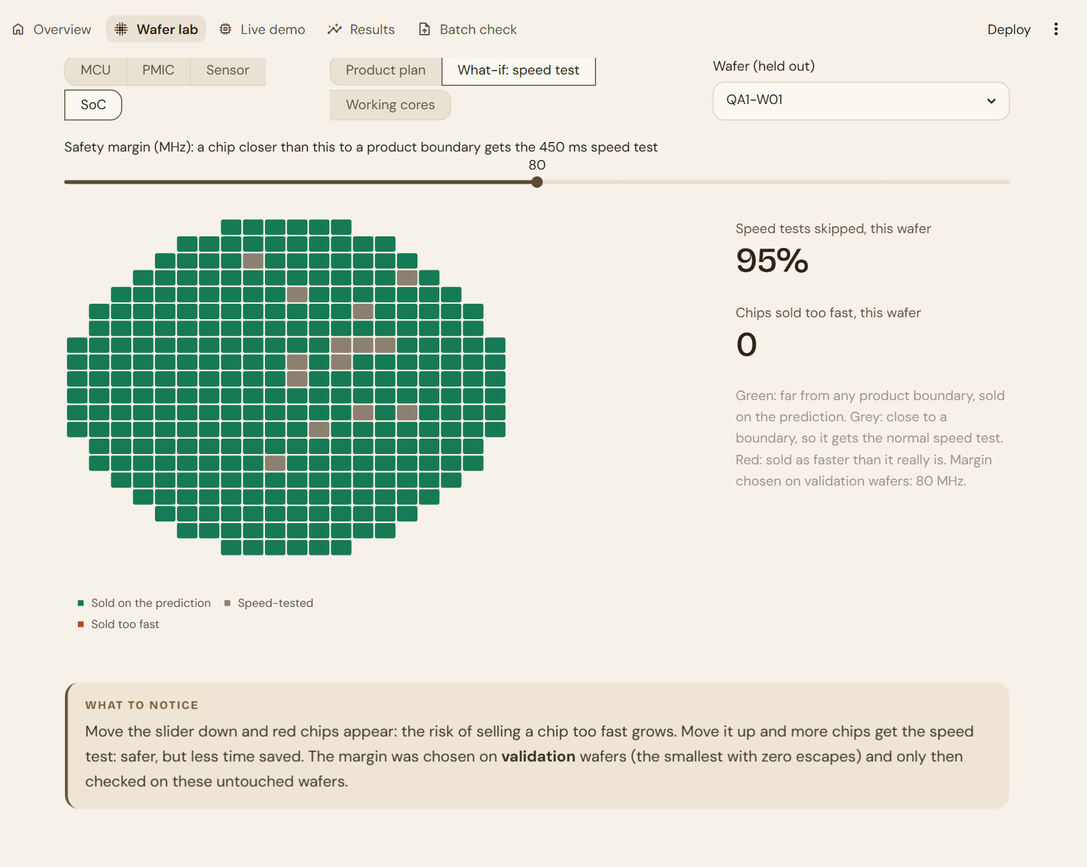

LIVE DEMO
Let's tune
a chip together
1 Wafer lab: move the slider
2 Live demo: typical vs tricky
3 Batch check: a whole file
Prototype on synthetic data · simulated results, not real-world savings · definitions: RESULTS_SOURCE_OF_TRUTH.md
Notes:
Let me show you the website. First the Wafer lab: every square is a chip. On the SoC what-if view I move the safety-margin slider: lower it and chips sold too fast appear in red; raise it and more chips get the speed test. Then the live demo: a typical chip, then a tricky one where the AI is off and the fallback takes over, in four steps. Last, the batch check, where I upload a test file and every chip gets a result.

Slide 14
Thank you
Notes:
To wrap up: predict the setting, check it once, and let fixed rules protect the fuses. Tuning gets about four times faster, the SoC sells 35% more from the same chips, and nothing wrong gets burned. The data is synthetic, so my next step would be real wafers in shadow mode. Thank you for your time; I'd be happy to answer any questions.

