Slide 1
MySQL Joining Tables
A JOIN clause is used to combine rows from two or more tables,
based on a related column between them.

Slide 2
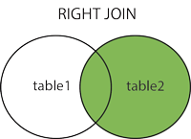

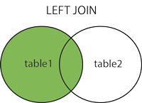
Supported Types of Joins in MySQL There are three types of MySQL joins:
MySQL INNER JOIN (or sometimes called simple join)
MySQL LEFT OUTER JOIN (or sometimes called LEFT JOIN)
MySQL RIGHT OUTER JOIN (or sometimes called RIGHT JOIN)

Slide 3
MySQL INNER JOIN (or sometimes called simple join)
The MySQL INNER JOIN is used to return all rows from multiple tables where the join condition is satisfied. It is the most common type of join.
INNER JOIN Syntax
SELECT column_name(s) FROM table1 INNER JOIN table2 ON table1.column_name = table2.column_name;

Slide 4
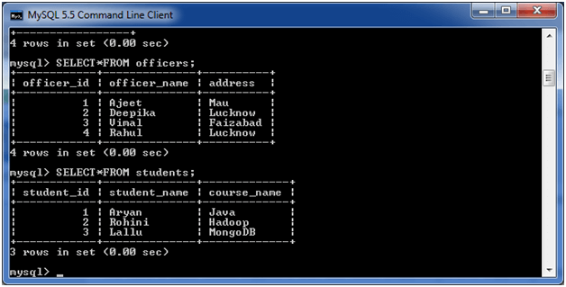
Let's take an example:
Consider two tables "officers" and "students", having the following data.

Slide 5
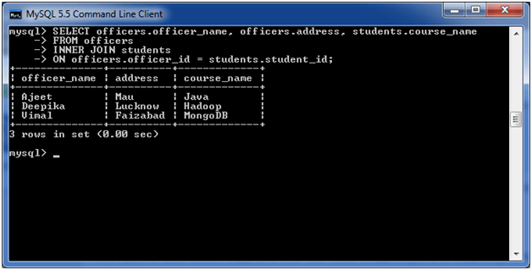
Execute the following query:
SELECT officers.officer_name, officers.address, students.course_name
FROM officers
INNER JOIN students
ON officers.officer_id = students.student_id;
Output:

Slide 6
MySQL LEFT OUTER JOIN (or sometimes called LEFT JOIN)
The LEFT OUTER JOIN returns all rows from the left hand table specified in the ON condition and only those rows from the other table where the join condition is fulfilled.
LEFT JOIN Syntax :
SELECT column_name(s) FROM table1 LEFT JOIN table2 ON table1.column_name = table2.column_name;

Slide 7
Let's take an example:
Consider two tables "officers" and "students", having the following data.

Slide 8
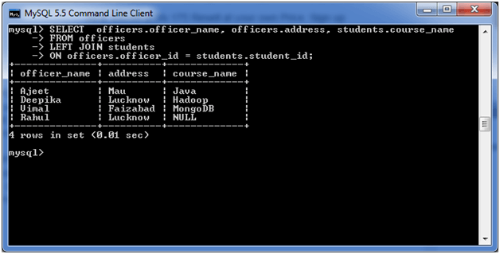
Execute the following query:
SELECT officers.officer_name, officers.address, students.course_name
FROM officers
LEFT JOIN students
ON officers.officer_id = students.student_id;
Output:

Slide 9
MySQL RIGHT OUTER JOIN (or sometimes called RIGHT JOIN)
The MySQL Right Outer Join returns all rows from the RIGHT-hand table specified in the ON condition and only those rows from the other table where he join condition is fulfilled.
RIGHT JOIN Syntax :
SELECT column_name(s) FROM table1 RIGHT JOIN table2 ON table1.column_name = table2.column_name;

Slide 10
Let's take an example:
Consider two tables "officers" and "students", having the following data.

Slide 11
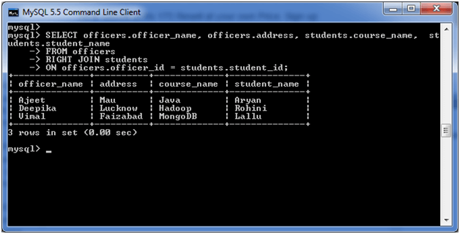
Execute the following query:
SELECT officers.officer_name, officers.address, students.course_name, students.student_name
FROM officers
RIGHT JOIN students
ON officers.officer_id = students.student_id;
Output:

