Slide 1
STUDY GROUP MANAGER - STUDIOUS
Team Members:
Darshan Vijayaraghavan
Ruban Chakaravarthi
Vignesh Kumar Karthikeyan

Slide 2
Presentation Outline
Proposal
Software and Hardware components
Architectural Diagram – description of interactions
Working System
Infrastructure Pipeline
Real-Time Chat Application
Email Notifications
User Features Overview
Debugging
Workload capacity
Potential Bottlenecks

Slide 3
Overview
Key Objectives:
Create a platform to facilitate seamless study group formation and management.
Match students with similar academic interests and schedules for collaborative learning.
Enable virtual sessions using Zoom.
Provide features like real-time chat, email notifications, friend management, and help with group events.

Slide 4
Software and Hardware components
Frontend:
React.js (Container in gke)
Backend:
Node.js (REST API development)(Container in gke)
RabbitMQ (Message Queue) (VM instance)
Redis(Container in gke)
Infrastructure:
Terraform: For automating infrastructure setup on Google Cloud.

Slide 5
Software and Hardware components
External APIs:
Zoom API for video conferencing.
Databases and Storage:
Firestore for dynamic user and group data.
Google Cloud Storage for storing media assets.
Hardware:
GKE
VM instance for rabbit MQ
Firestore
Google Cloud storage

Slide 6
Building the infrastructure
Create a service account with the required credentials and download the key.
Add google cloud service credentials to terraform cloud varible
Use terraform plan and terraform apply to run deploy the infrastructure.
Deploy the frontend, backend, redis and worker containers in the gke cluster created using k8s deployments and services.
Configure DBs and collections.

Slide 7
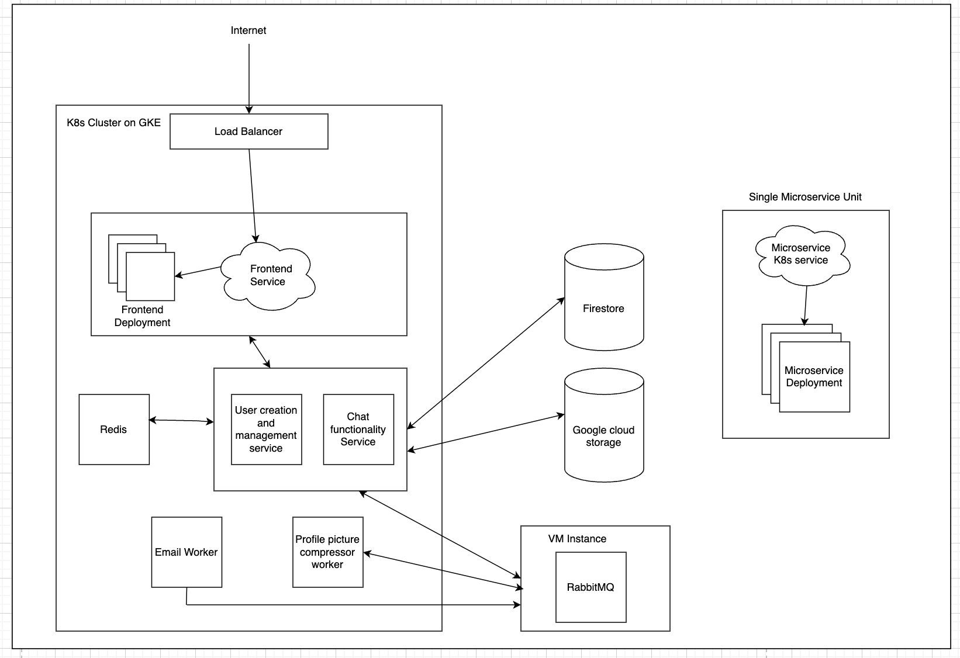
Architecture Diagram

Slide 8
General flow
Users signup and login. Create study groups as online or offline.
Once the study group is created it is visible for all. Other members can join the groups.
Emails are sent on signups ,group creation and joining.
Once you join the group you can view it in upcoming events with the location description. If online zoom links are generated.
You can now use the group to chat, or can chat privately using the private messaging built-in.

Slide 9
Important interactions within App
Profile Picture Processing Pipeline:
Frontend: User uploads a profile picture.
Backend:
Picture URL sent to RabbitMQ.
Worker compresses the picture.
Compressed picture stored in Google Cloud Storage bucket.
Storage URL saved in Firestore.

Slide 10
Infrastructure Pipeline - Contd
Real-Time Chat Application:
WebSocket Implementation using socket.io:
Each user maintains a WebSocket connection with a backend pod.
Session Affinity: Ensures connections remain routed to the same pod.
Use socket.io rooms to work with group chats.
Scaling Mechanism:
Publish message info to other pods if a particular pod does not have the connection with the recipient.

Slide 11
Email Notifications:
RabbitMQ queues email tasks, consumed by workers running NodeMailer.
Workers send emails for account verification and group invitations.
User Features Overview:
Friend Requests:
Send, accept, or reject friend requests in real-time.
Joining Groups:
Users can join or leave groups with a single click.
Upcoming Events:
Dashboard displays upcoming study sessions.
Login & Signup:
Secure authentication and smooth onboarding process.

Slide 12
Debugging
Logging: Added detailed logs in backend and RabbitMQ workers help trace execution.
Monitoring: Utilized Google Cloud’s Log monitoring for real-time error tracking and system monitoring.
Testing: Used integration tests to catch bugs early in development.
Used Minikube cluster to deploy the clusters locally and tested the integration.

Slide 13
Workload Capacity
RabbitMQ efficiently manages asynchronous tasks like email notifications and file uploads, ensuring smooth user experience even during high traffic.
The WebSocket-based chat system, with Redis as the message broker, supports real-time messaging for both private and group chats across multiple pods.
Kubernetes provides scalability by dynamically scaling pods based on workload demands, ensuring consistent performance.

Slide 14
Potential Bottlenecks
Could implement a pipeline to deploy the application (jenkins or github actions), since it involves some manual work and can lead to errors or mistakes.
Managing a high number of concurrent WebSocket connections could strain resources.

