Slide 1
9th
History
Maharshtra Board
2nd Unit Test
Question paper

Slide 2
Let’s Solve with
Crystal concept

Slide 3

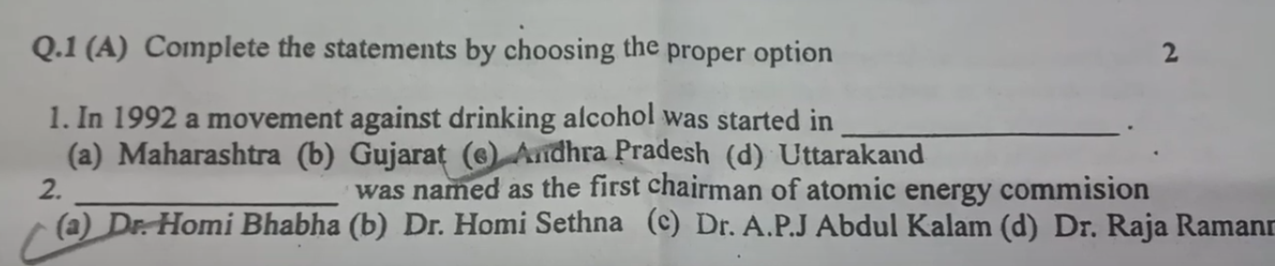
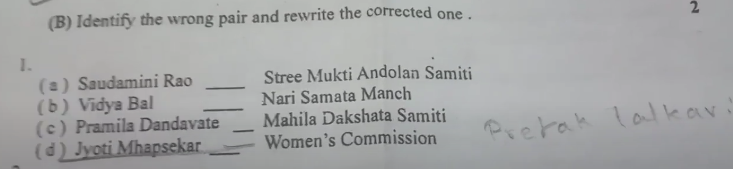
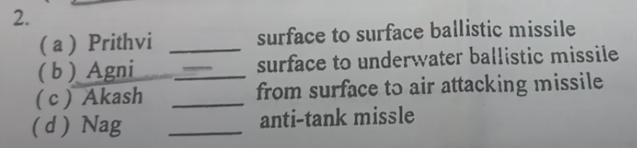
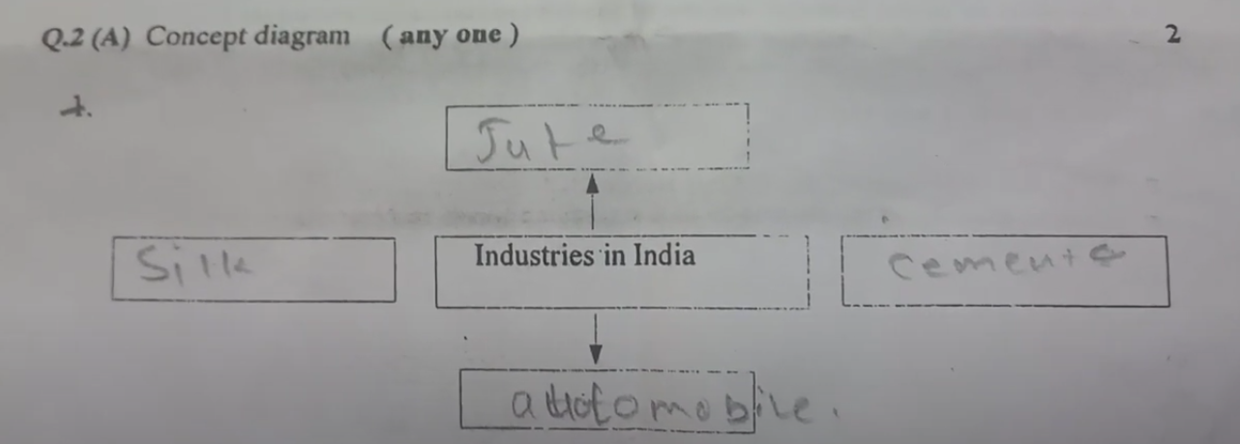
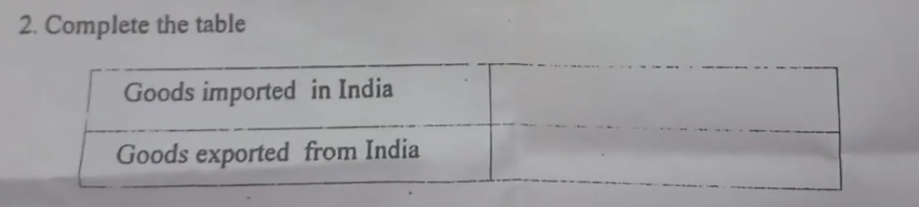
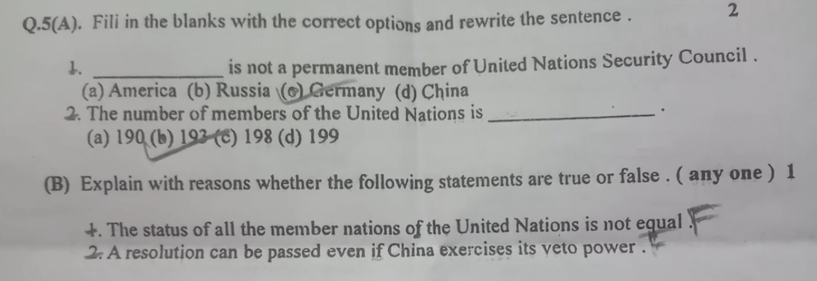

Let’s Solve with
History Question Paper
20 marks
Crystal concept
PAPER PRATICE

Slide 4
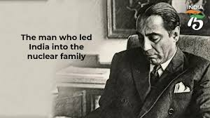
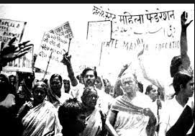
Andhra Pradesh
Dr. Homi Bhabha
SUBSCRIBE

Slide 5
Incorrect Pair :
Jypti Mhapseker - Women’s Commission
Correct Pair :
Jypti Mhapseker - A street Play called “Mulgi Jhaali Ho”
SUBSCRIBE

Slide 6
Let’s Solve with
Crystal concept
Wrong Pair :
Agni - Surface to Underwater Ballistic Missile
(Develop DRDO)
SUBSCRIBE

Slide 7
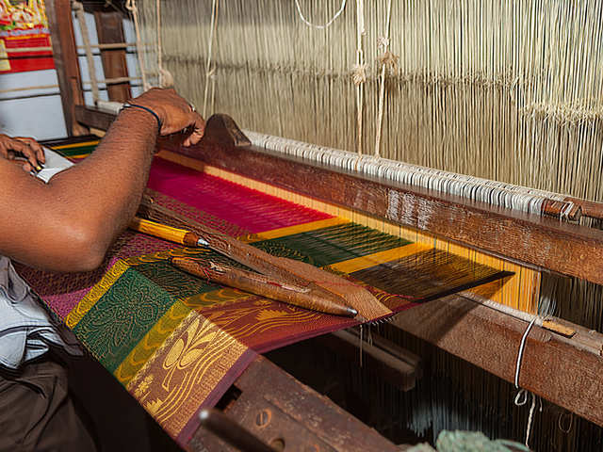
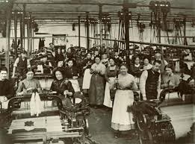

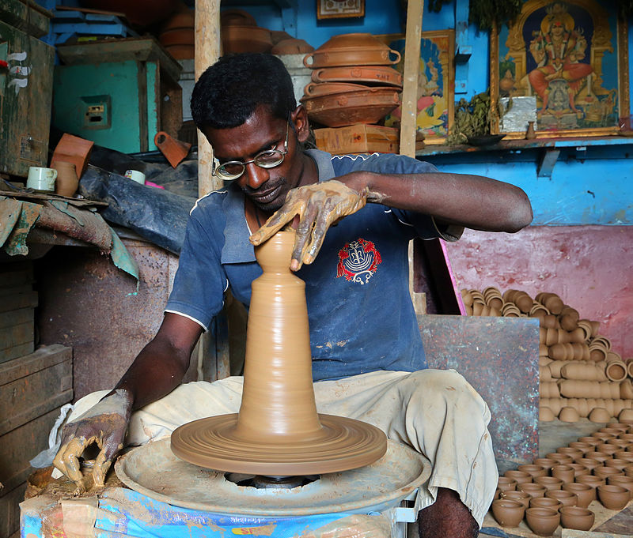
Textile industry :
Hand sculpting :
Silk industry :
Automobile industry :
SUBSCRIBE

Slide 8
India’s imports included
machines, iron, mineral oil, fertilisers, medicines, etc.
India’s exports included tea, coffee, spices, cotton textiles, leather, footwear, pearls, precious stones, etc.
SUBSCRIBE

Slide 9
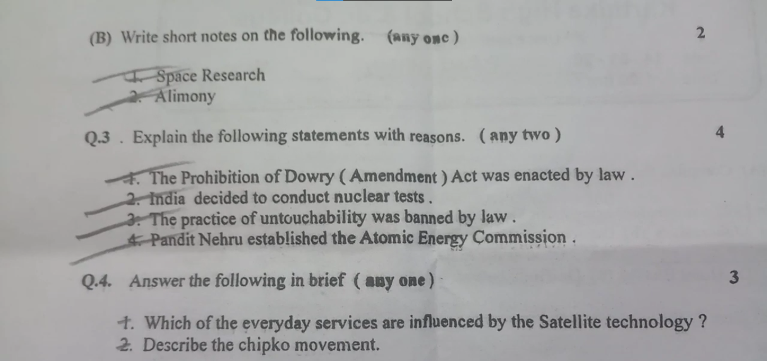
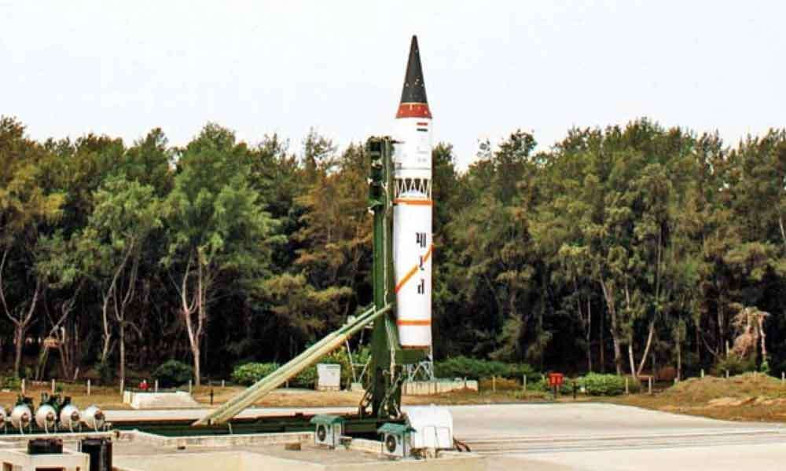
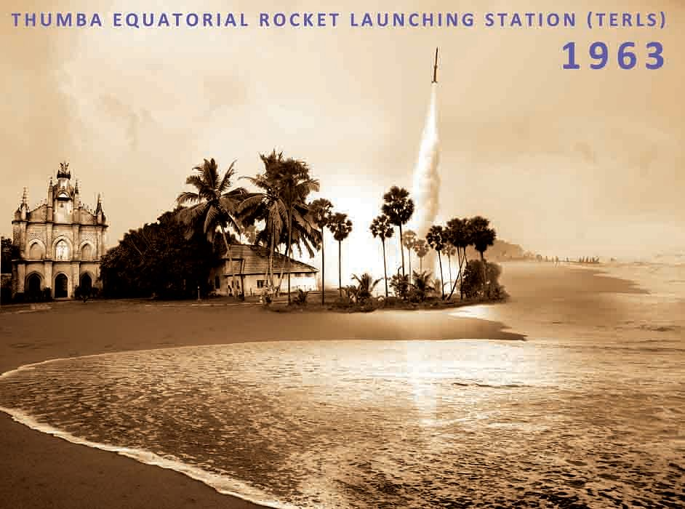
In 1969, our indigenously built rocket Rohini-75 was successfully launched. The next stage was the successful launch of the first Indian satellite Aryabhatta in 1975 with help from the Soviet Russia.
Space research : In 1961, Indian National Committee for Space Research
(NCSR) launched India’s first research rocket from Thumba Equatorial Launch Center in Thumba in the State of Kerala.
This success proved that Indian scientists can indigenously build and launch a satellite. Indian scientists were confident that they could acquire the technology for sending a message from the Earth Station and to assess the working of the satellite.
SUBSCRIBE

Slide 10

fixed amount paid to a married woman
for her upkeep by the husband who has
divorced her, is called alimony
SUBSCRIBE

Slide 11
(i) Even after the enactment of the anti-dowry law, incidents like ‘Woman bums to death as sari pallu catches fire while cooking’ and ‘Woman slips into well while washing clothes, drowns and dies’ continued to be reported.
(ii) Investigations still revealed dowry to be the most frequent cause of such deaths.
(iii) The role of the police, the administration and judiciary were highlighted. This created greater awareness. (iv) As a result, the Dowry Prohibition (Amendment) Act came into force in 1984.
SUBSCRIBE

Slide 12
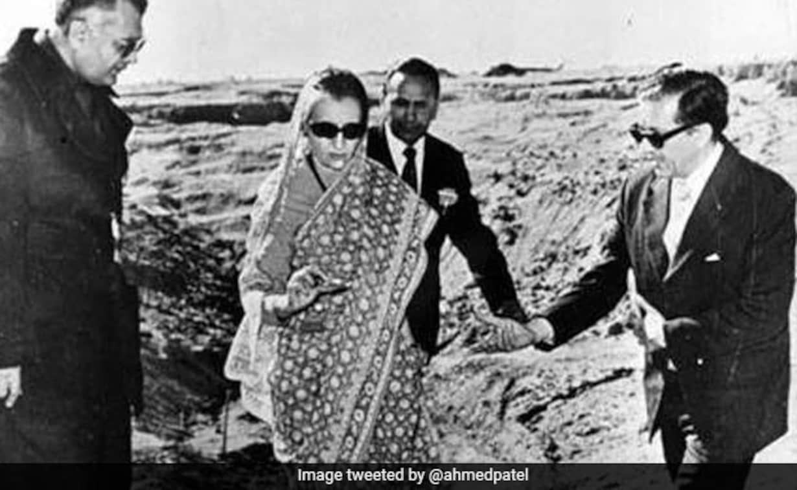
(i) India successfully performed her first nuclear test at Pokharan in Rajasthan on 18th May, 1974 in consonance with the policy of using nuclear energy for peaceful purposes and for self sufficiency.
(iii) Dr Homi Sethna, the chairman of the Indian Atomic Energy Commission and Dr Raja Ramanna, Director of the Bhabha Atomic Research Centre played a major role in conducting this nuclear test.
(iv) Prime Minister Indira Gandhi took the decision of carrying out a ‘nuclear explosion’. Pokharan was chosen on the basis of the required criteria for the location of the nuclear tests : far away from human settlement and no ground water reserves.
(ii) The reason why India took this decision was China’s nuclear capability and Pakistan’s desperate efforts to acquire nuclear weapons with China’s help.

Slide 13
(i) In the post-independence period, our Constitution adopted the values of freedom, equality, fraternity and social justice. (ii) In accordance with this, the practice of untouchability was banned by law. (iii) Untouchability was removed by the 17th paragraph of the Constitution and this class was included in the Scheduled Castes.
SUBSCRIBE

Slide 14
With the objective of nurturing a scientific temper for national progress, Prime Minister
Pt. Jawarharlal Nehru established the Atomic Energy Comission in 1948 Under
chairmanship of Dr. Homi Bhabha
SUBSCRIBE

Slide 15
Everyday services that are influenced by satellite technology are telecommunication, navigation, defence security, internet, television, radio, etc.

Slide 16
The Chipko Movement – During the Chipko Movement women took a crucial role by holding hands and encircling each tree to prevent their chopping for commercial purposes.
SUBSCRIBE

Slide 17
SUBSCRIBE

Slide 18
SUBSCRIBE

Slide 19
Answer 3: The objectives of the United Nations are as follows:
To establish friendly relations among nations.
To enhance international security by solving international disputes.
To safeguard and foster human rights and freedom.
The United Nations also aims at enhancing economic cooperation at the international level.
SUBSCRIBE

