Slide 1
1.
A Project Report On
Student attendance management system
Submitted in partial fulfillment of the
requirement for the award of the degree
Bachelor of Computer Application (BCA)
Academic Year 2026 – 27
<Nikhil maru>
<92300527258>
<Darshan kannar>
<92300527139>
<Darshan humbal>
<92300527140>
Github link:-https://github.com/darshan170404/student-attendance-management-sysem
Internal Guide
(Prof.Vipul Bambhaniya)

Slide 2


Faculty of Computer Applications (FoCA)
This is to certify that the project work entitled
Translator
submitted in partial fulfillment of the requirement for
the award of the degree of
Bachelor of Computer Application
of the
Marwadi University
is a result of the Bonafide work carried out by
< Nikhil maru
(92300527258)>
< Darshan kannar (92300527139)>
< Darshan Humbal (92300527140)>
during the academic year 2025-26
Vipul Bambhaniya Dr.Sunil Bajeja Dr. R Sridaran
Faculty Guide
HOD
Dean

Slide 3
DECLARATION
I/We hereby declare that this project work entitled Student
attendance management system is a record done by me.
I also declare that the matter embodied in this project is genuine work
done by me and has not been submitted whether to this University or
to any other University / Institute for the fulfillment of the
requirement of any course of study.
Place: Rajkot
< Nikhil maru
(92300527258)>
< Darshan kannar (92300527139)>
< Darshan Humbal (92300527140)>

Slide 4
ACKNOWLEDGEMENT
It is indeed a great pleasure to express our thanks and gratitude to all those who
helped us. No serious and lasting achievement or success one can ever achieve
without the help of friendly guidance and co-operation of so many people
involved in the work.
We are very thankful to our guide <Prof. Vipul Bambhaniya >, the person who
makes us to follow the right steps during our project work. We express our deep
sense of gratitude to for his /her guidance, suggestions and expertise at every
stage. A part from that his/her valuable and expertise suggestion during
documentation of our report indeed help us a lot.
Thanks to our friend and colleague who have been a source of inspiration and
motivation that helped to us during our project work.
We are heartily thankful to the Dean of our department Dr. R. Sridaran sir and
HoD Dr. Sunil Bajeja sir for giving us an opportunity to work over this project
and for their end-less and great support to all other people who directly or
indirectly supported and help us to fulfil our task.
< Nikhil maru
(92300527258)>
< Darshan kannar (92300527139)>
< Darshan Humbal (92300527140)>

Slide 5

CONTENTS
Chapters
Particulars
Page No.
1
SYNOPSIS
6
2
PREAMBLE
6
2.1
2.2
General Introduction
Module description
3
REVIEW OF LITERATURE
6
7
4
4.1
TECHNICAL DESCRIPTION
Hardware Requirement
4.2
Software Requirement
5
SYSTEM DESIGN AND DEVELOPMENT
(Only applicable diagrams)
Architectural Design
8
5.1
● Class Diagram
Dynamic Modeling
5.2
5.2.1
5.3
5.3.1
5.3.2
5.3.3
5.4
5.4.1
5.4.2
● Use Case Diagram
● Sequence Diagram
● Activity Diagram
● Any other applicable diagram (applicable)
Database Design (If applicable)
Relationship Diagram (ER)
Menu Design
6
7
Screen Design
15
15
CONCLUSION
LEARNING DURING PROJECT WORK
8
BIBLIOGRAPHY
16
8.1
Online References
8.2
Offline References

Slide 6
1. SYNOPSIS:
This project is a web-based Student Attendance Management
System implemented using PHP for server-side logic and MySQL
database for storage. It provides authentication for teachers, student
record management, attendance marking, and report generation.
2. PREAMBLE:
2.1 General Introduction:
Traditional manual attendance systems are error-prone,
time-consuming, and difficult to maintain. The proposed
system automates this process, allowing teachers to mark
attendance online, store records securely, and generate
reports.
2.2 Module Description:
- Authentication Module – Teacher login/logout
- Student Management Module – Add/update student details
(roll no, name, age, class, etc.)
- Attendance Module – Mark daily attendance, view history
- Report Module – Generate reports by class, student, or date
- Database Module – Manages storage and retrieval in MySQL
3. REVIEW OF LITERATURE:
A review of existing attendance systems reveals that
many institutions still use manual or Excel-based
methods. Recent research shows web-based systems using
PHP/MySQL are effective for automation. Compared to
biometric systems, this project provides a low-cost,
simple solution using LAMP stack.

Slide 7
4. TECHNICAL DESCRIPTION:
4.1 Hardware Requirement:
-PC/Laptop with min. 4GB RAM
- 2GHz Processor
- 1GB free disk space
4.2 Software Requirement:
- OS: Windows/Linux
- Server: Apache/Nginx with PHP
- PHP 7.4+
- MySQL / MariaDB
- Browser: Chrome/Firefox
5. SYSTEM DESIGN AND DEVELOPMENT:
5.1 Architectural Design:
Browser → Web Server (PHP) → Database (MySQL)
5.2 Dynamic Modeling:
- Use Case: Teacher logs in → selects class → marks attendance →
system
saves
to
DB
→
report
generated.
- Sequence: Login → Verify → Attendance Entry → Save →
Confirmation.
-
Activity:
Step-by-step
attendance
marking.
- DFD: Level 0 (Teacher → System → DB), Level 1 (Authentication,
Student Mgmt, Attendance, Reports).

Slide 8
5.3Databas Diagram:
+-------------------+
| User |
+-------------------+
| ↑ |
Register/Login| |Add id |mark attendance
v | v
+---------------------------+
| Student Attendance management System
|
| (PHP Web Application) |
+---------------------------+
| ↑
Atttendance Mgmt | | Query/Update
v |
+-------------------+
| Database |
| (MySQL/MariaDB) |
+-------------------+
^
|
+-------------------+
| Admin |
+-------------------+

Slide 9
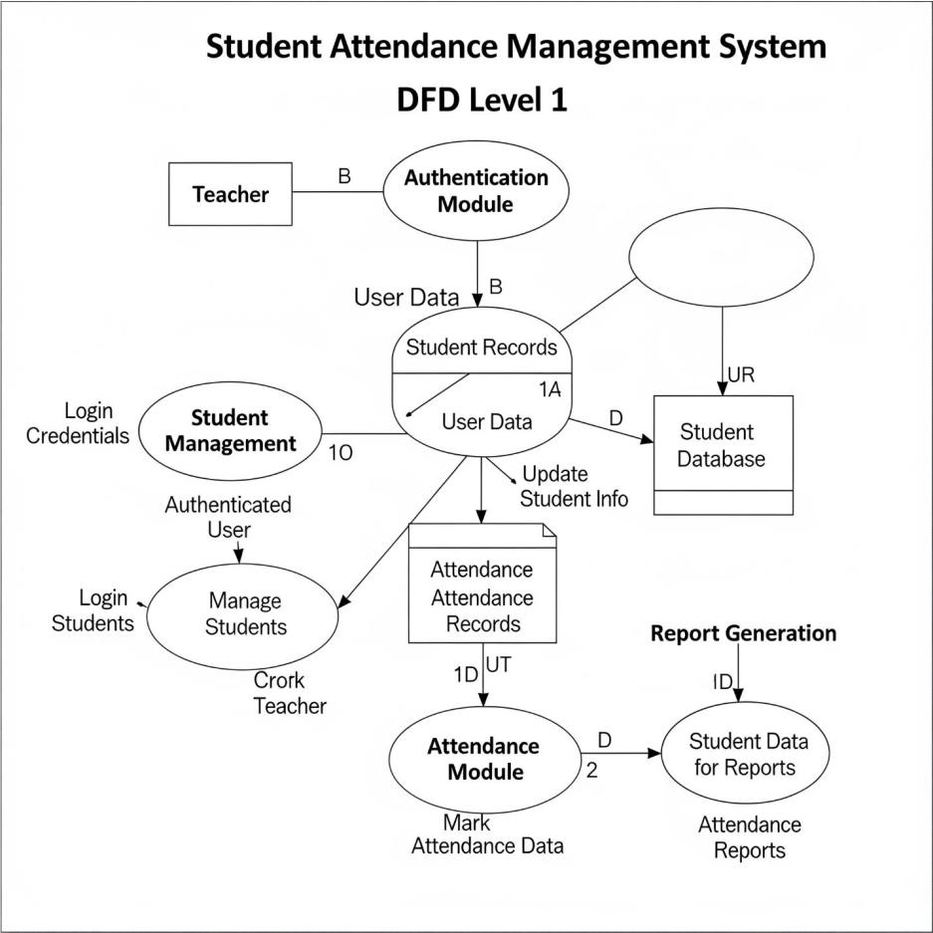
DFD Level 1 – Student Attendance
Management System
Here is a visual representation of the Level 1 DFD for the Student
Attendance Management System. This diagram provides a high-level
overview of the entire system, showing how the main processes interact
with the Teacher (External Entity) and the Student Database (Data
Store).

Slide 10
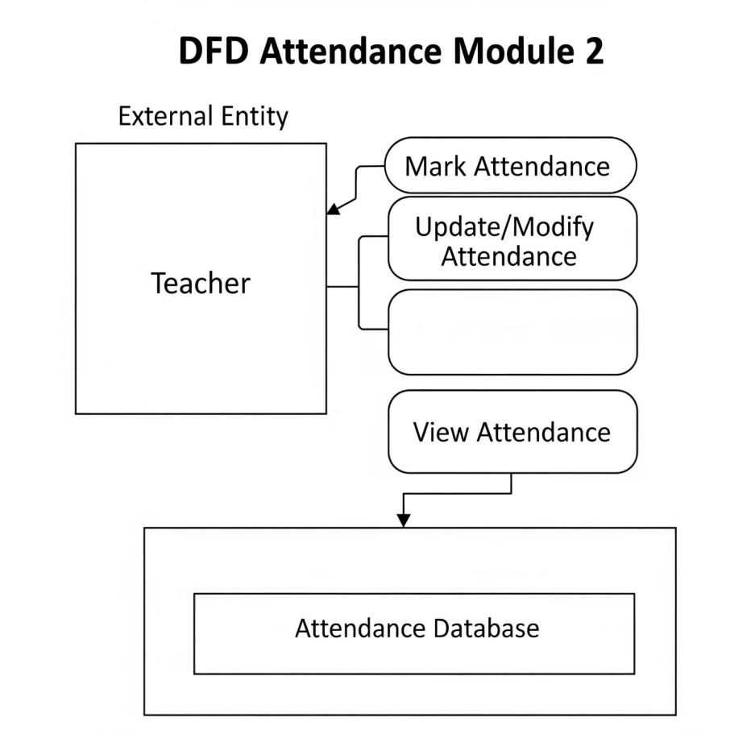
DFD Level 2 – Attendance Module
Here is the DFD Level 2 for the Attendance Module, which breaks down
the "Attendance Module" process from the Level 1 diagram into more
specific functions.

Slide 11
Design:
• teachers(id PK, name, email, password_hash,
created_at)
• students(id PK, name, student_id_number, email)
• courses(id PK, name, course_code, teacher_id FK)
• enrollments(id PK, student_id FK, course_id FK)
• attendance_statuses(id PK, status_name)
• attendance_records(id PK, enrollment_id FK, date,
status_id FK, recorded_by_teacher_id FK, created_at)

Slide 12
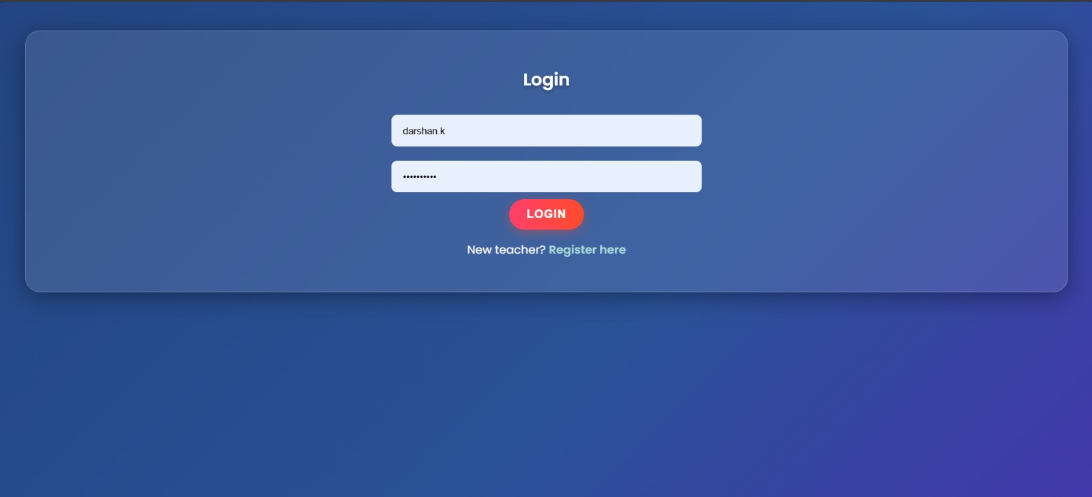
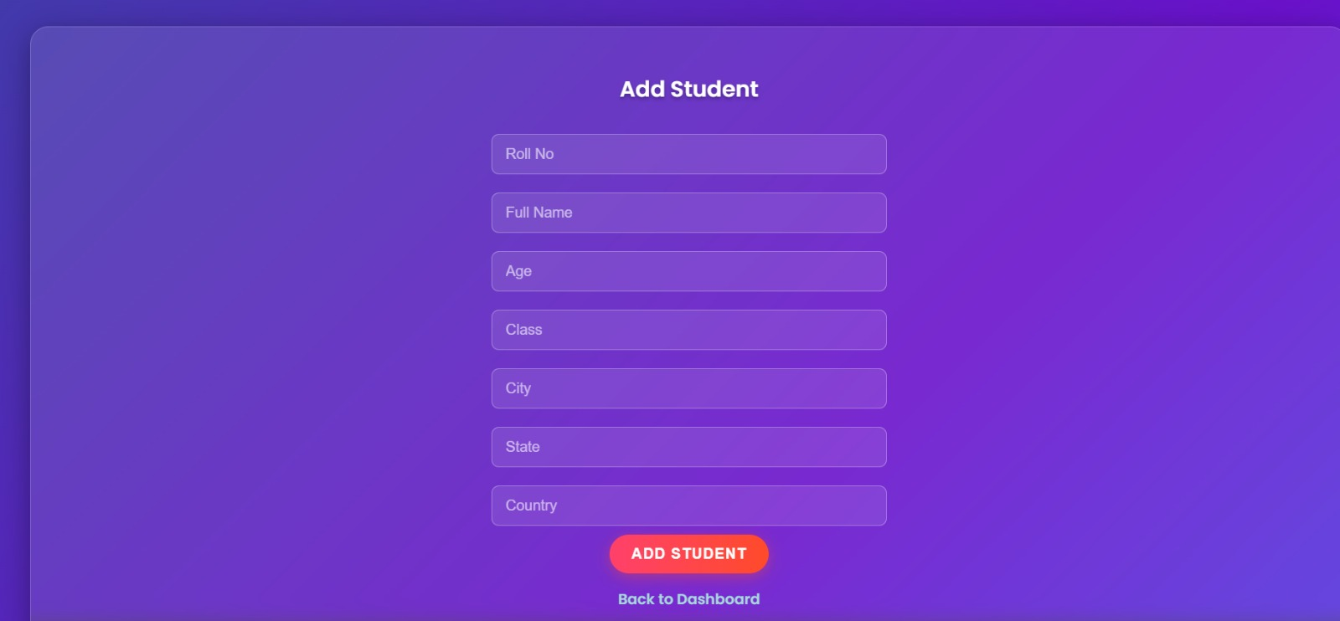
OUTPUT
1) LOGIN PAGE
2) ADD DETAILS OF STUDENT

Slide 13
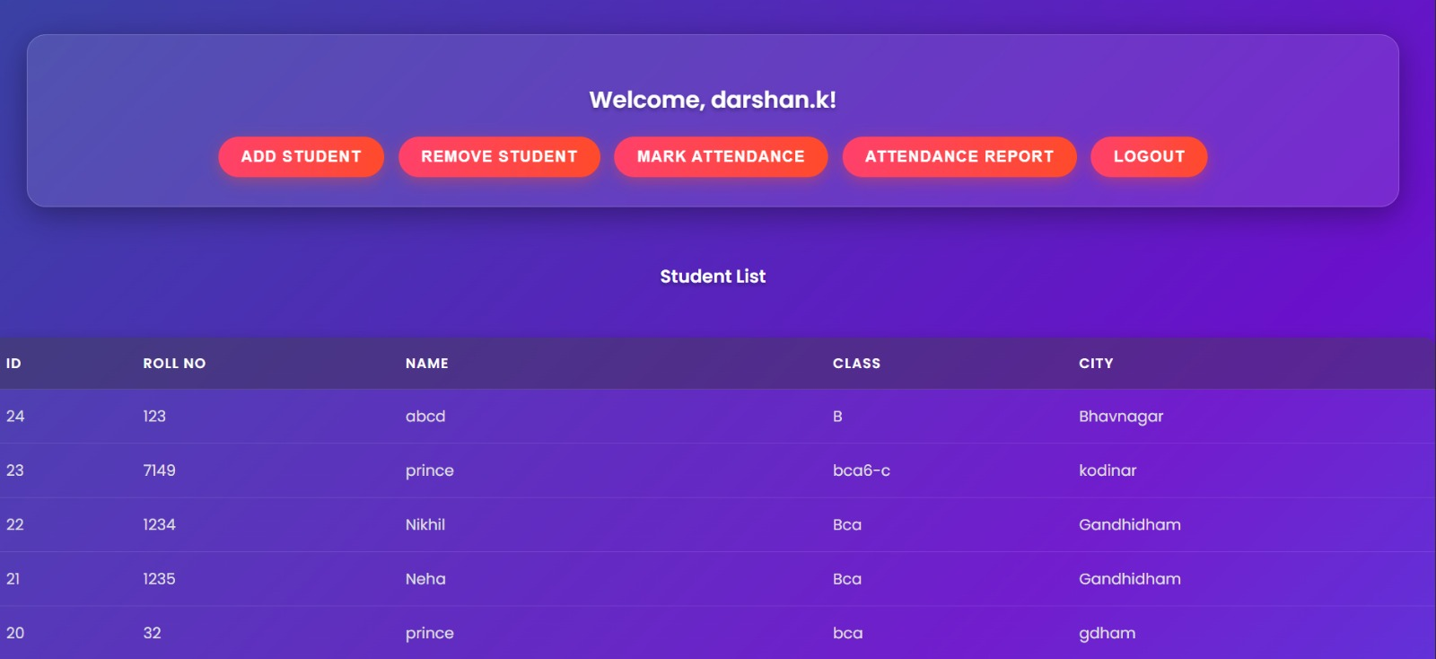
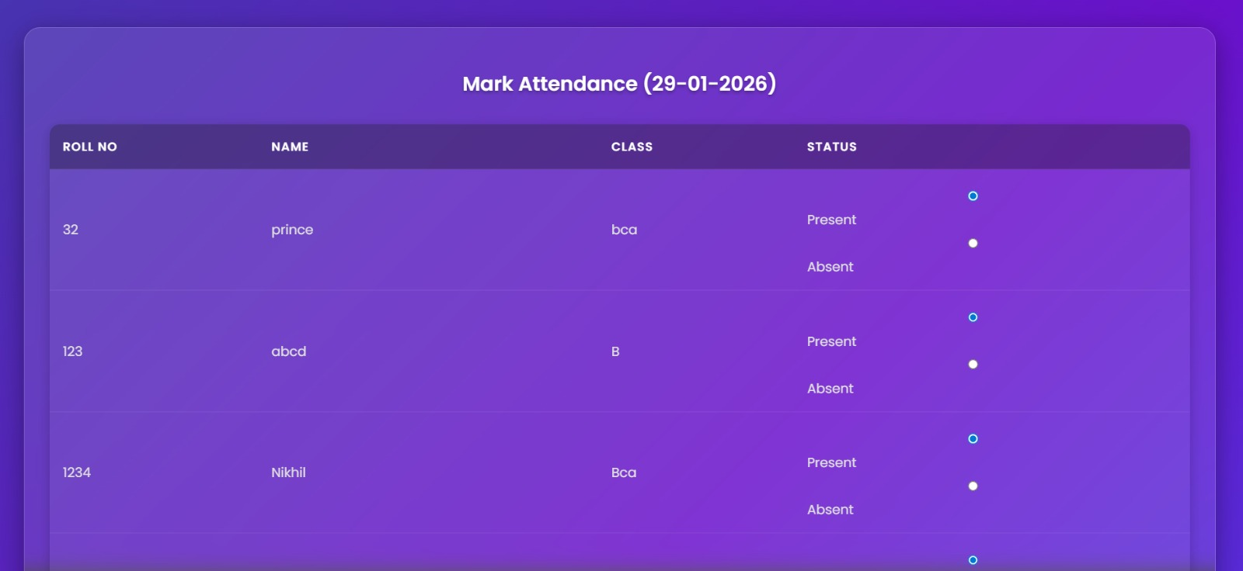
3)INTERFACE
4)MARKS ATTENDANCE

Slide 14
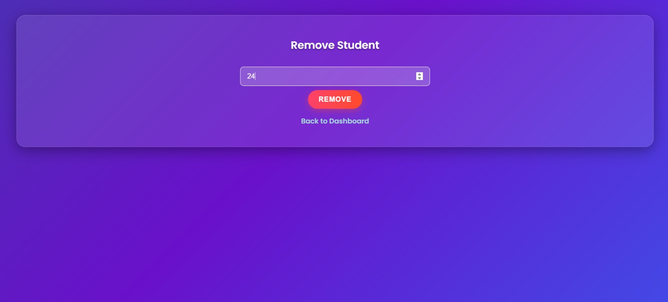
6)REMOVE STUDENT

Slide 15
6. CONCLUSION
The Student Attendance Management System provides an
efficient way to manage attendance digitally. It reduces
paperwork, ensures accuracy, and provides quick reporting.
7. LEARNING DURING PROJECT WORK
- PHP server-side scripting
- Session handling & authentication
- MySQL CRUD operations
- Designing ER diagrams & DFDs
- Secure coding (prepared statements)
8. BIBLIOGRAPHY
Online References:
- PHP Official Documentation
- MySQL Reference Guide
- Tutorials on PHP/MySQL projects
Offline References:
- University lecture notes
- Classroom materials

Slide 16


