Slide 1


Rajeev Institute of Technology,
Hassan.
DEPARTMENT OF ARTIFICIAL INTELLIGENCE AND MACHINE LEARNING
“LICENSE PLATE DETECTOR”

Slide 2
Contents
Introduction
Problem Statement
Literature Review
System Architecture
System Requirements
Methodology
Result Snapshots
Application
Conclusion
Reference

Slide 3
Introduction
What is License Plate Detection?
A technology to detect and recognize license plates from images or video.Used in surveillance, traffic management, toll collection, etc.
Objective of the Project:
Build an automated system for detecting and recognizing license plates accurately.

Slide 4
Problem Statement
Challenges in manual detection and monitoring of vehicles.
Need for automation to improve efficiency and accuracy.
Examples of real-world applications (e.g., smart cities, traffic enforcement).

Slide 5
Literature Review
Authors: Kumar A, Sharma A.
Title: "A survey of recent advances in image steganography." Security and Privacy. 2023
Authors: Idakwo MA, Muazu MB, Adedokun AE, Sadiq BO.
Title: "An Extensive Survey of Digital Image Steganography”
Authors: Cheddad A, Condell J, Curran K, McKevitt P.
Title: . "Digital image steganography: Survey and analysis of current methods."Signal Processing. 2010
Authors: Kadhim I, Premaratne P, Vial P, Halloran B.
Title: "Comprehensive survey of image steganography: Techniques, Evaluations, and trends in future research." Neurocomputing. 2019
Authors: Hussain M, Wahab AWA, Idris YI, Ho AB, Jung K, Khan S
Title: "Image steganography in spatial domain: A survey."

Slide 6
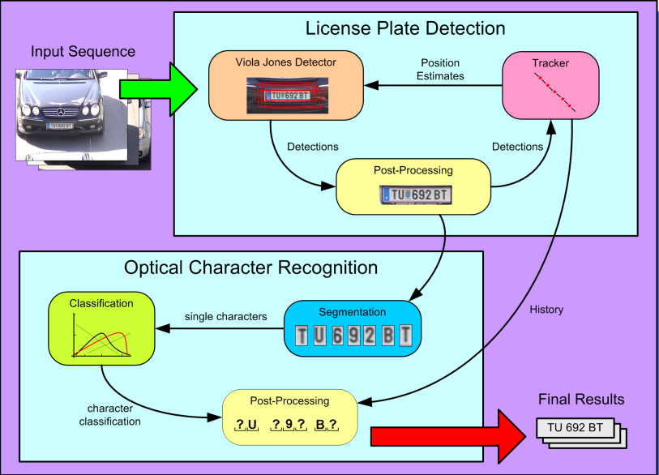
System Architecture

Slide 7
SYSTEM REQUIREMENTS
1. Hardware Requirements:
Intel Core i5/i7 or equivalent (Quad-core, 2.5 GHz or higher).
RAM: 4GB and higher.
Disk Space: At least 8 GB (16 GB recommended for better performance).
High-resolution camera for capturing areca nut images.
Internet connectivity for data transfer.
2. Software Requirements:
Programming Language: Python 3.x
Libraries: pytesseract, Tesseract-OCR, OpenCV, NumPy, Matplotlib.
Development Tools: VS Code.

Slide 8
Methodology
Step 1: Data Acquisition
Collection of images/videos with diverse scenarios.
Step 2: Preprocessing
Techniques: Grayscale conversion, histogram equalization, etc.
Step 3: License Plate Detection
Algorithms: Edge Detection.
Step 4: OCR for Character Recognition
Libraries: Tesseract OCR.
Step 5: Validation and Post-processing

Slide 9
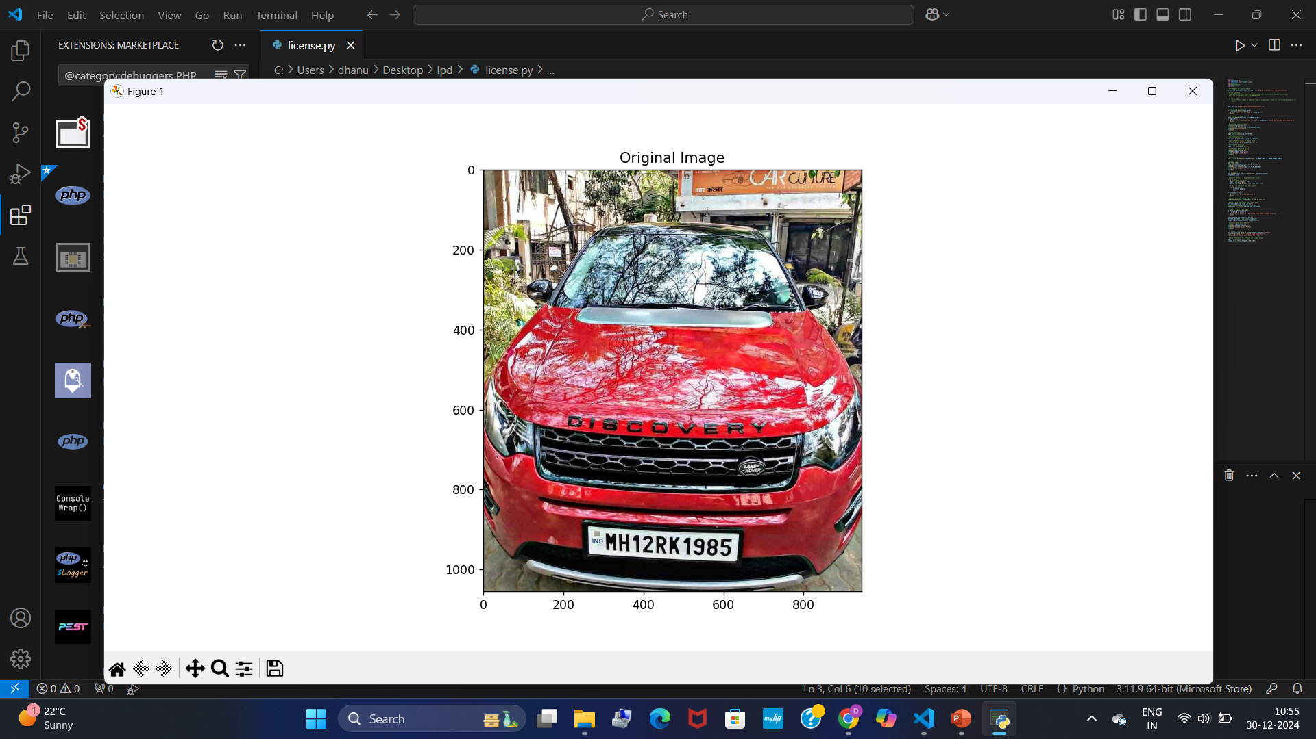
SNAPSHOTS Step 1:Original Image
Displays the original image loaded from the specified path. It allows you to visually inspect the input image before any processing is applied. This is useful for confirming that the image has been loaded correctly

Slide 10
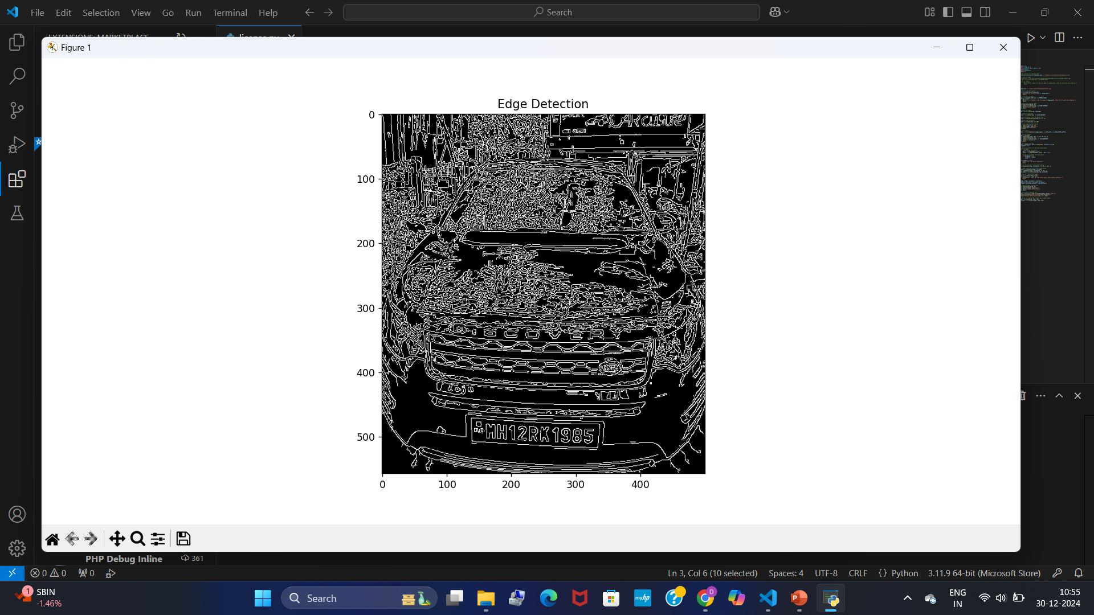
SNAPSHOTS Step 2:Edge Detection
The edge detection of the car image, after applying edge detection with the Canny algorithm, this plot shows the edges detected in the grayscale image. The edges represent boundaries in the image.

Slide 11
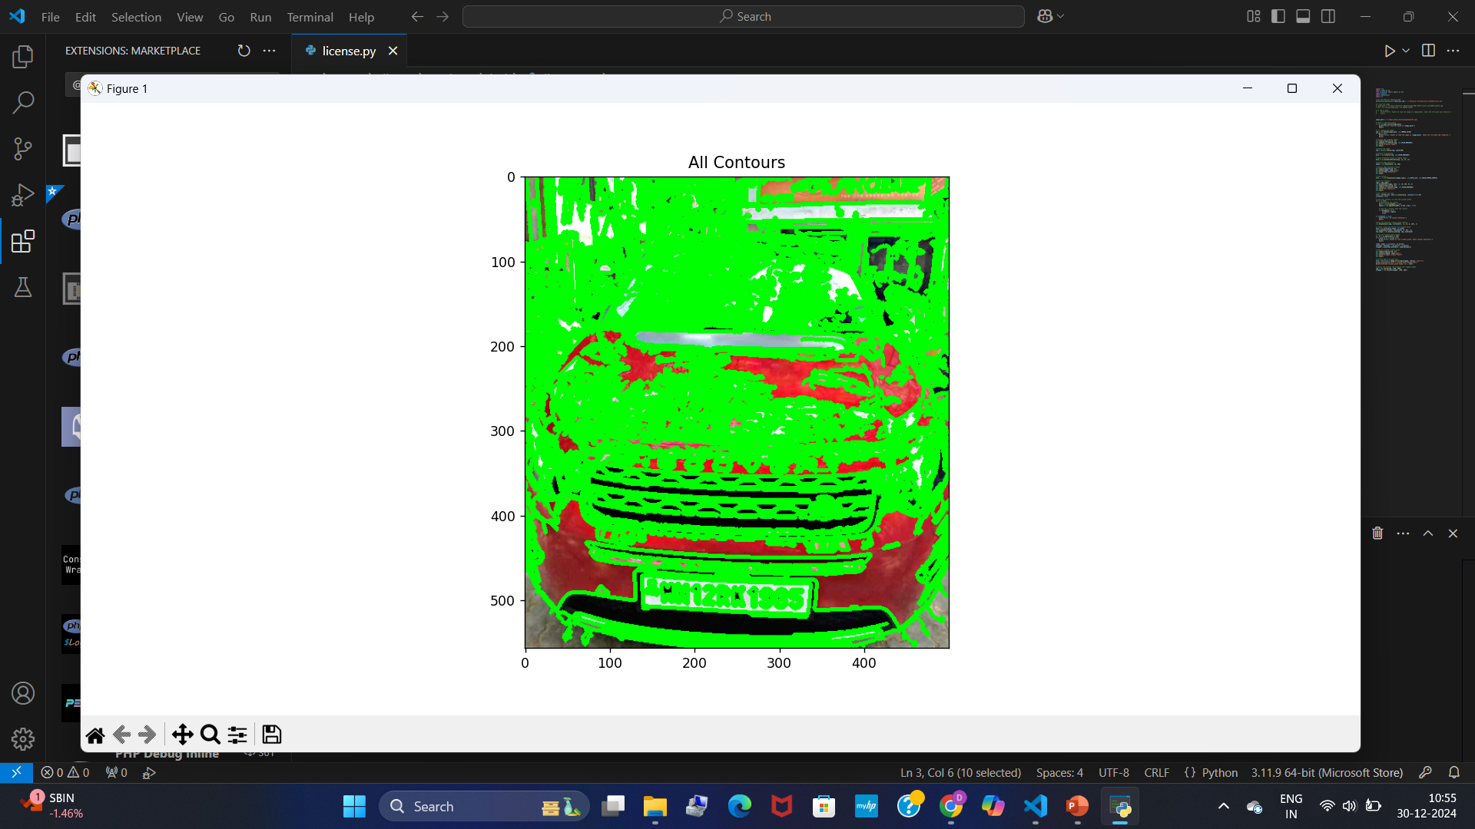
SNAPSHOTS Step 3:All Contours
This plot shows all the contours detected in the edge-detected image. Contours represent the boundaries of detected shapes, and this helps to identify potential areas where the license plate might be located.

Slide 12
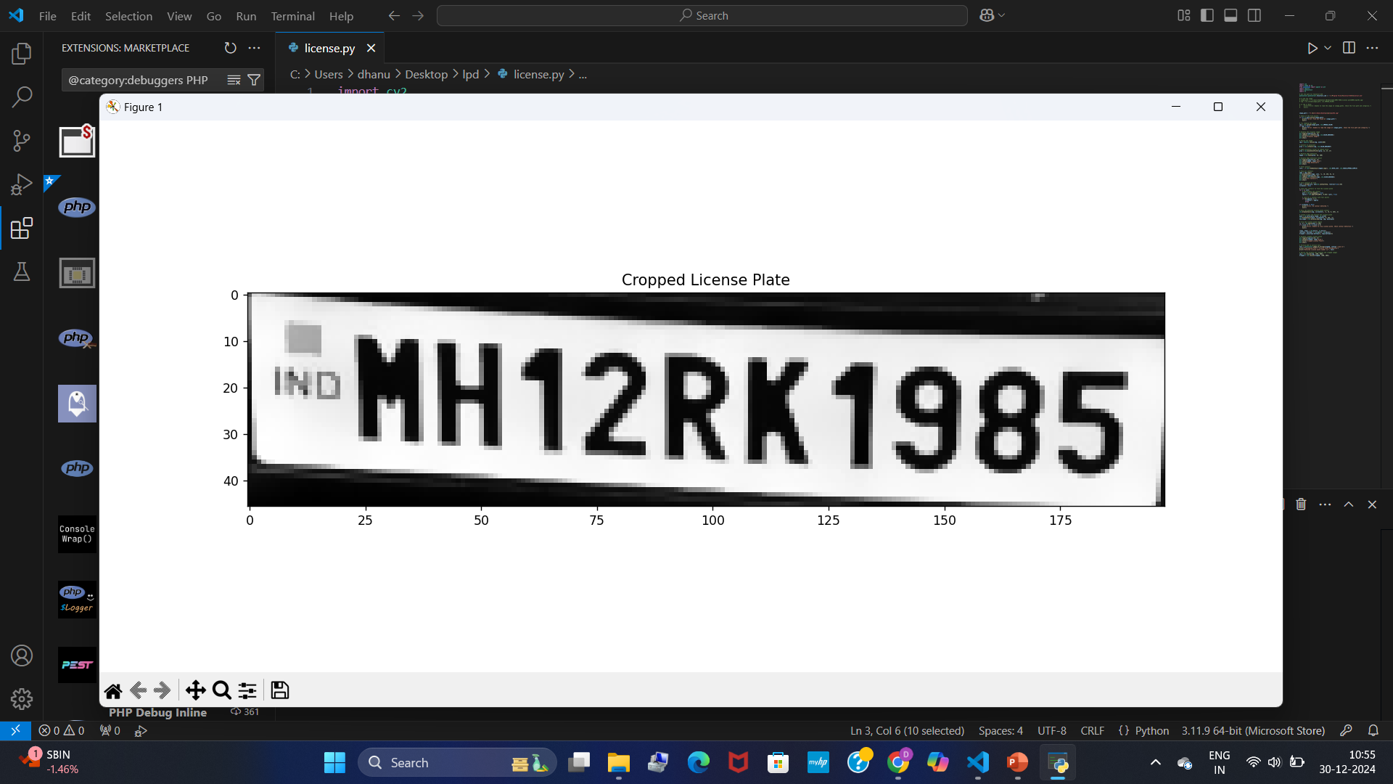
SNAPSHOTS Step 4:License plate Detection
After detecting and cropping the region containing the license plate, this plot displays the cropped area, which should ideally show just the license plate region. This helps in verifying that the license plate area has been correctly extracted before running OCR.

Slide 13
Applications
Traffic surveillance and law enforcement.
Automated toll collection systems.
Parking management systems.
Vehicle entry/exit control in secured areas.

Slide 14
Conclusion
The license plate detector project successfully demonstrated the ability to detect and recognize license plates with a high degree of accuracy and efficiency. By employing advanced computer vision techniques, such as image preprocessing, object detection algorithms (e.g., YOLO, SSD), and Optical Character Recognition (OCR), the system achieved reliable performance under various conditions, including diverse lighting, angles, and plate designs.
This project can serve as a foundation for real-world applications such as traffic monitoring, toll collection, parking management, and law enforcement. However, there are opportunities for further improvement, such as enhancing performance in challenging weather conditions, accommodating non-standard license plate formats, and optimizing computational efficiency for real-time processing.

Slide 15
Reference
1. Authors: Kumar A, Sharma A. "A survey of recent advances in image steganography." Security and Privacy(2023).
2. Authors: Idakwo MA, Muazu MB, Adedokun AE, Sadiq BO. "An Extensive Survey of Digital Image Steganography.
3. Authors: Cheddad A, Condell J, Curran K, McKevitt P. "Digital image steganography: Survey and analysis of current methods." Signal Processing (2010).
4. Authors: Kadhim I, Premaratne P, Vial P, Halloran B. "Comprehensive survey of image steganography: Techniques, Evaluations, and trends in future research." Neurocomputing(2019).
5. Authors: Hussain M, Wahab AWA, Idris YI, Ho AB, Jung K, Khan S. "Image steganography in spatial domain: A survey." Signal Processing.

Slide 16
Thank You!

