Slide 1

SQL Script for Hospital and Blood Bank Management
This presentation will guide you through a comprehensive SQL script for managing hospital and blood bank data. We'll cover basic operations like creating tables, inserting data, and querying information, as well as more advanced techniques for data analysis and manipulation.

Slide 2

Introduction
This SQL script is designed for managing and analyzing data related to hospitals and blood banks. It includes table creation, data insertion, and a wide variety of queries to perform basic and advanced operations. These queries are tailored to extract meaningful insights, update data, and maintain the relationships between hospitals and blood banks.

Slide 3

Description
Table Structure: The script defines two tables:
Hospital: Stores information about hospitals, including their name, location, contact details, and unique identifiers.
BloodBank: Contains details about blood banks, such as name, location, nodal officer, and email.
Data Insertion: Sample records for both tables are provided, simulating real-world scenarios for testing and demonstration.
Basic Queries: Operations like selecting all records, filtering by specific attributes, updating fields, and deleting records are included.
Advanced Queries: These include aggregate functions, joins, subqueries, and grouping to derive deeper insights. Examples include finding states with the most hospitals, identifying duplicate provider IDs, and calculating the average length of hospital names.
Relationships: Queries establish connections between hospitals and blood banks, such as finding hospitals with associated blood banks or retrieving records for hospitals and blood banks in the same district.
View Creation: A view named HospitalBloodBankView consolidates hospital and blood bank details, enabling easy retrieval for reporting.

Slide 4


Purpose
Database Management: Provides a foundation for organizing and managing hospital and blood bank data efficiently.
Data Analysis: Facilitates analysis of key metrics, such as the number of hospitals and blood banks per state, duplication of provider IDs, and location-based insights.
Operational Use: Supports tasks like updating contact details, adding new records, and maintaining data integrity.
Decision Support: Enables stakeholders to identify regions with insufficient healthcare facilities or blood banks, aiding resource allocation and policy-making.

Slide 5

Data Overview
Hospital Table:
Columns: hospital_index, provider_id, hospital_name, address, city, state, zip_code, county_name, phone_number, and email.
Sample Data:
TAWAS ST JOSEPH HOSPITAL, located in Michigan (MI).
MEMORIAL HEALTHCARE, located in Owosso, MI.
BloodBank Table:
Columns: blood_bank_index, blood_bank_name, state, district, city, address, pincode, email, nodal_officer.
Sample Data:
G.B. Pant Hospital Blood Bank in Port Blair, Andaman and Nicobar Islands.
Red Cross Blood Bank in Mumbai, Maharashtra.
Relationships:
The script assumes a potential mapping between hospitals and blood banks through a HospitalBloodBank table (not explicitly created in this script but referenced in queries).
Insights Possible:
Number of facilities in each region.
States with no hospitals or blood banks.
Patterns of healthcare resource distribution.

Slide 6

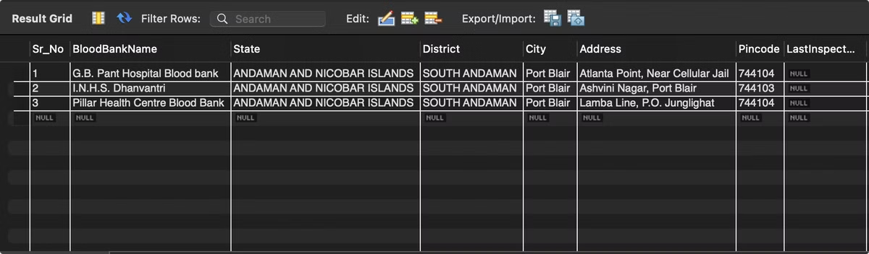
-- Retrieve all blood banks in a specific state
SELECT * FROM BloodBanks WHERE State = 'Andaman And Nicobar Islands';

Slide 7

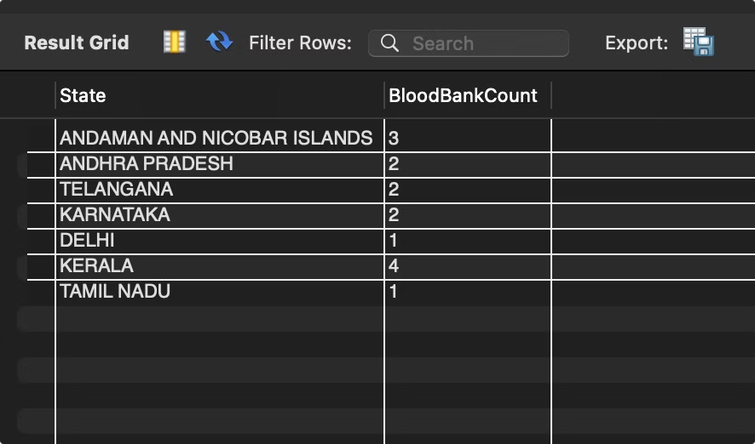
-- Count the number of blood banks in each state
SELECT State, COUNT(*) AS BloodBankCount FROM BloodBanks GROUP BY State;

Slide 8

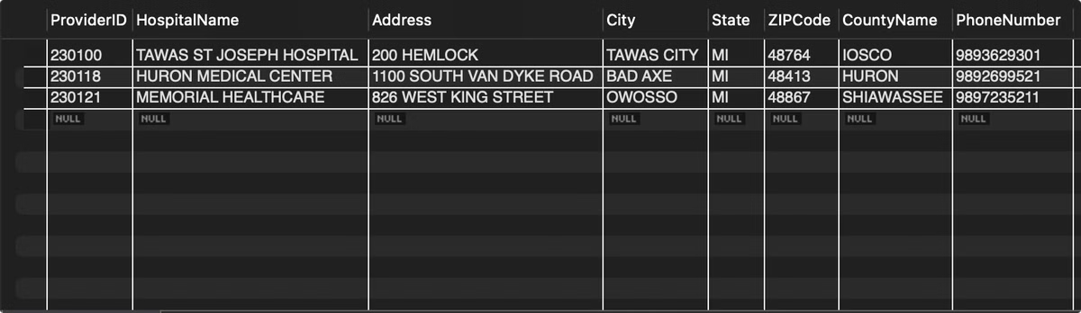
-- Find hospitals with ZIP codes starting with '48'
SELECT * FROM Hospitals WHERE ZIPCode LIKE '48%';

Slide 9

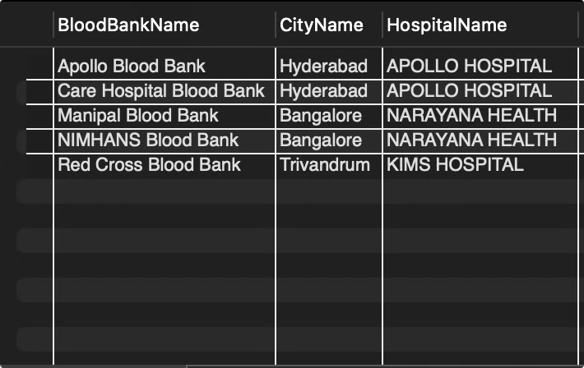
-- Join query to find blood banks and hospitals in the same city
SELECT bb.BloodBankName, bb.City AS CityName, h.HospitalNameFROM BloodBanks bb JOIN Hospitals h ON bb.City = h.City;

Slide 10

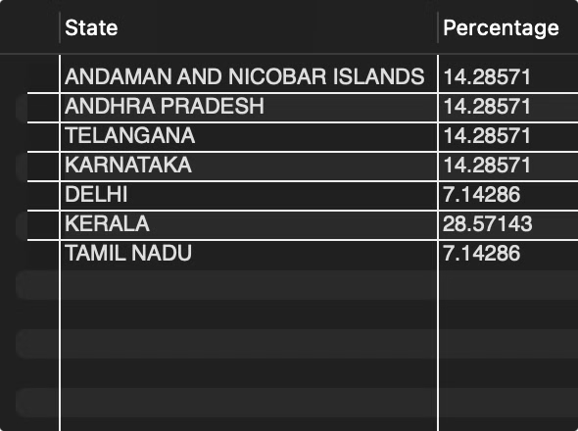
Calculate the percentage of blood banks in each state
SELECT State, COUNT() * 100.0 / (SELECT COUNT() FROM BloodBanks) AS Percentage FROM BloodBanks GROUP BY State;

Slide 11

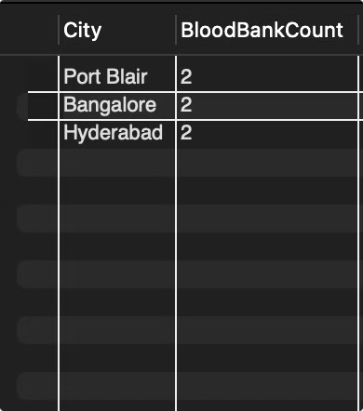
-- Retrieve the top 3 cities with the most blood banks
SELECT City, COUNT(*) AS BloodBankCount FROM BloodBanks GROUP BY City ORDER BY BloodBankCount DESC LIMIT 3;

Slide 12

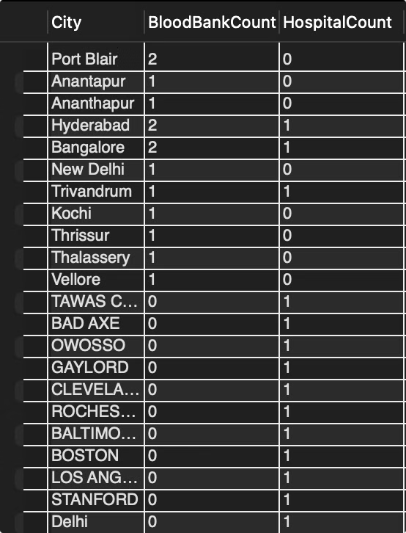
-- Retrieve the total count of blood banks and hospitals per city
SELECT City, SUM(CASE WHEN Type = 'BloodBank' THEN 1 ELSE 0 END) AS BloodBankCount, SUM(CASE WHEN Type = 'Hospital' THEN 1 ELSE 0 END) AS HospitalCount FROM CombinedData GROUP BY City;

Slide 13

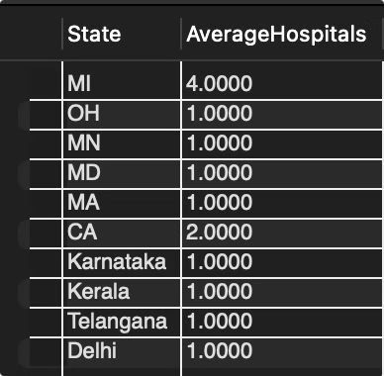
-- Find the average number of hospitals per state
SELECT State, AVG(HospitalCount) AS AverageHospitals FROM ( SELECT State, COUNT(*) AS HospitalCount FROM Hospitals GROUP BY State ) AS StateHospitalCounts GROUP BY State;

Slide 14

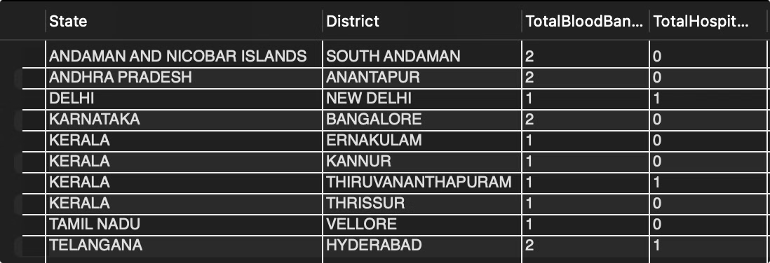
-- Generate a report of blood banks and hospitals grouped by state and district
SELECT bb.State, bb.District, COUNT(DISTINCT bb.BloodBankName) AS TotalBloodBanks, COUNT(DISTINCT h.HospitalName) AS TotalHospitals FROM BloodBanks bb LEFT JOIN Hospitals h ON bb.State = h.State AND bb.District = h.CountyName GROUP BY bb.State, bb.District;

Slide 15

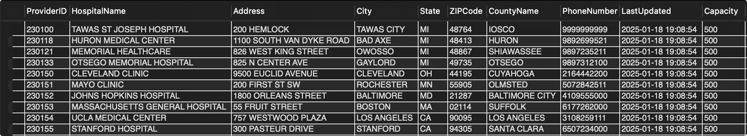
Identify hospitals with no associated blood banks in the same city
SELECT * FROM Hospitals h WHERE NOT EXISTS ( SELECT 1 FROM BloodBanks bb WHERE bb.City = h.City );

Slide 16

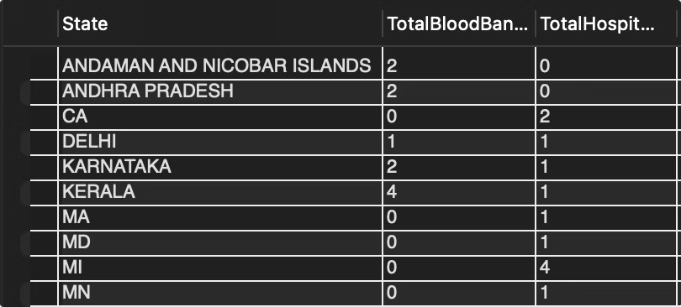
-- Generate a report of blood banks and hospitals grouped by state
SELECT State, COUNT(DISTINCT BloodBankName) AS TotalBloodBanks, COUNT(DISTINCT HospitalName) AS TotalHospitals FROM ( SELECT State, BloodBankName, NULL AS HospitalName FROM BloodBanks UNION ALL SELECT State, NULL AS BloodBankName, HospitalName FROM Hospitals ) AS StateEntities GROUP BY State;

Slide 17

Thank You

