Slide 1

SVKM’s Institute of Technology, Dhule Department of Information Technology
Mini Project Presentation
On
“ Diabetes Prediction ”
By
Priyanshu Vilas Chaudhari (60)
Aadtiya Devendra Khandelwal (61)
Darshan Parag Badgujar (02)
Nilesh Bhausaheb Wankhede (33)
Guide
Prof. Rubi Mandal

Slide 2
SVKM’s Institute of Technology, Dhule Department of Information Technology
Contents
Group Details
Project Motivation
Problem Statement
Abstract
Approach / Technology Stack
References

Slide 3
SVKM’s Institute of Technology, Dhule Department of Information Technology
Motivation
To help in early detection of Diabetes disease.
To contribute to the field of medical analytics.
To classify gestational diabetic or non-gestational diabetic.
To develop a cheap tool for diagnosis of Diabetes.
To detect diabetes in less painful method .
To learn more about how can machine learning be used for benefit of society.

Slide 4
SVKM’s Institute of Technology, Dhule Department of Information Technology
Problem Statement
Design and Develop a machine learning model, to predict whether a woman is gestational diabetic or not , based on the data of patient Age, BMI , blood pressure,Insulin level and Pregnancies.

Slide 5
SVKM’s Institute of Technology, Dhule Department of Information Technology
Abstract
Most pregnant Indian women have gestational diabetes, which can result in birth abnormalities if left untreated. Diabetes is brought on by an increase in Several modern gadgets can detect blood glucose levels from blood samples. Undiagnosed diabetes can lead to a number of dangerous conditions, including renal damage and heart attacks. Thus, there is a need for strong research and the improvement of learning models in the field of identifying and analysing gestational diabetes.

Slide 6
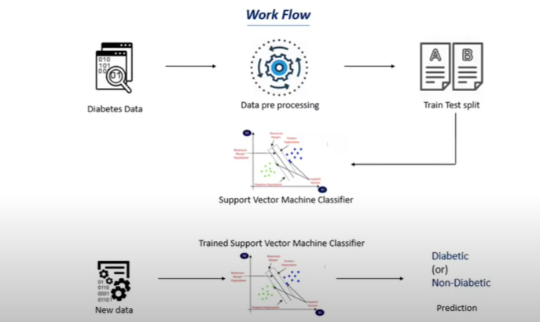
SVKM’s Institute of Technology, Dhule Department of Information Technology
Approach / Technology Stack

Slide 7
SVKM’s Institute of Technology, Dhule Department of Information Technology
References
Sajida Perveena, Muhammad Shahbaza, Aziz Guergachib, Karim Keshavjeec, "Performance Analysis of Data Mining Classification Techniques to Predict Diabetes" Procedia Computer Science 82 (2106) 115 –121.
Deepti Sisodia, Dilip Singh Sisodia, "Prediction of Diabetes using Classification Algorithms", International Conference on Computational Intelligence and Data Science (ICCIDS2018)
A Mary Posonia , S Vigneshwar , D Jamuna Rani, “Machine Learning Based Diabetes Prediction Using Decision Tree J48” Third International Conference on Intelligent Sustainable Systems [ICISS 2020].

Slide 8
SVKM’s Institute of Technology, Dhule Department of Information Technology
References
4. M. A. Hearst, S. T. Dumais, E. Osuna, J. Platt and B. Scholkopf, "Support vector machines," in IEEE Intelligent Systems and their Applications, vol. 13, no. 4, pp. 18-28, July-Aug. 1998.
5. Aishwarya, Gayathri, Jaisankar, “A Method for Classification Using Machine Learning Technique for Diabetes”, International Journal of Engineering and Technology 2013.
6. Dhomse Kanchan B., M.K.M., 2016. Study of Machine Learning Algorithms for Special Disease Prediction using Principal of Component Analysis, in: 2016 International Conference on Global Trends in Signal Processing, Information Computing and Communication, IEEE.

Slide 9

.
.

