Slide 1
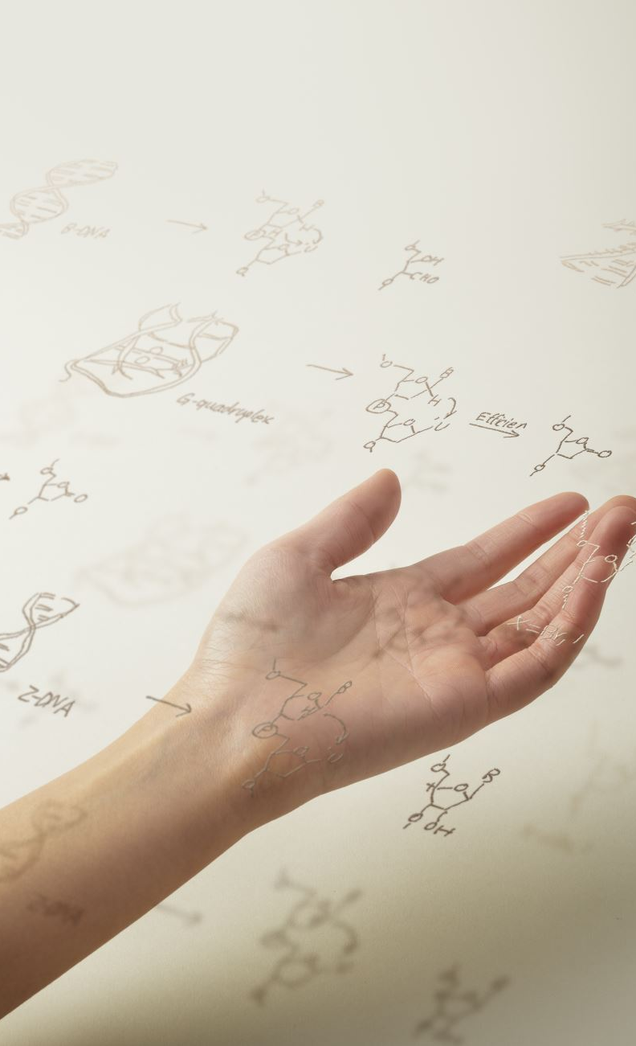
CLIPDraw: Exploring Text-to-Drawing Synthesis through Language-Image Encoders
Presentation by: Darshan Uttam Mistry (030701513)
(https://youtu.be/GihDbbOYrbA)
Guided by: Dr. Moon

Slide 2
Outline
Introduction
Objective
Related Work
Methodology
Results
Limitations and Future Directions
Conclusion

Slide 3
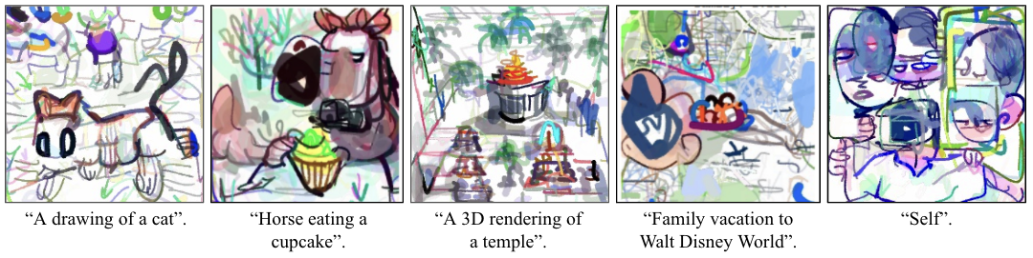
Introduction:
CLIPDraw is an algorithm that synthesizes novel drawings based on natural language input, using a pre-trained CLIP model as a metric for maximizing similarity between the given description and a generated drawing^{[1]}. It optimizes vector strokes rather than pixel images, biasing drawings towards simple human-recognizable shapes.
Fig 1. Various drawings synthesized by CLIPDraw^{[1]}
Notes:
CLIPDraw is an algorithm that synthesizes novel drawings based on natural language input, using a pre-trained CLIP model as a metric for maximizing similarity between the given description and a generated drawing^{[1]}. It optimizes vector strokes rather than pixel images, biasing drawings towards simple human-recognizable shapes.

Slide 4
Objective:
To explore the problem of generating drawings from text descriptions. A system called "CLIPDraw" which utilizes a combination of language and image encoders to generate realistic images given textual descriptions.
Notes:
To explore the problem of generating drawings from text descriptions. A system called "CLIPDraw" which utilizes a combination of language and image encoders to generate realistic images given textual descriptions

Slide 5
Related Work:
Text-to-Image Synthesis.
Synthesis Through Optimization.
Vector Graphics.
Follow Up Work to CLIPDraw.
Notes:
text_to_image_synthesis: This work draws from text-to-image synthesis, which aims to generate images that correctly match a given textual description. GAN-based methods have enabled progress towards photorealistic image synthesis, while strong autoregressive models have achieved similar quality results. This work follows the framework of synthesis through optimization.
Synthesis Through Optimization: Activation maximization is an alternative method of image synthesis, where a random image is optimized to increase certain neuron activations of a pretrained network. CLIPDraw builds off a set of methods to minimize the distance between the produced image and a given description phrase. This constraint results in stroke-based images, which must capture larger features such as shapes and outlines.
Differentiable renderers can be used to bypass vector-based dataset limitations and generate drawings using RGBA Bézier curves instead of pixels.
A draft of this work was previously released to the public research community, and a number of follow-up papers have since been published. StyleCLIPDraw (Schaldenbrand et al., 2021) introduces an explicit image-based style loss to the CLIPDraw framework.CLIP-CLOP (Mirowski et al., 2022) extends CLIPDraw to use image patches rather than strokes,and CLIPasso (Vinker et al., 2022) uses CLIP to extract sketches from photos. Tian and Ha (2022) pursure optimization via evolutionary strategies rather than gradient descent

Slide 6
Methodology:
The objective of CLIPDraw is to synthesize a drawing that matches a given description prompt, using a pre-trained CLIP model as a judge.
Drawings are represented by a set of differentiable RGBA Bézier curves, each parametrized by 3-5 control points, thickness and an RGBA color vector.
The algorithm works by running evaluation-time gradient descent, and the goal of the image augmentation is to force drawings to remain recognizable when viewed through various distortions.

Slide 7
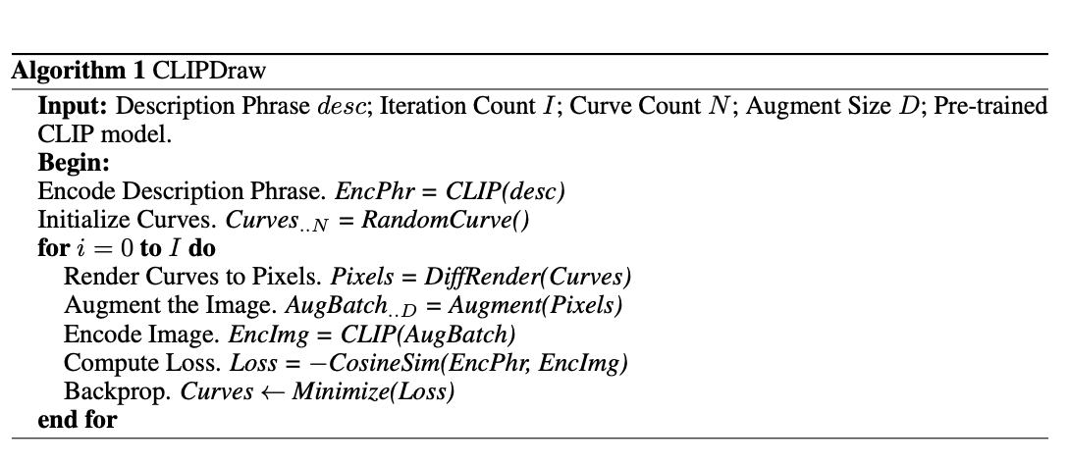
Algorithm
Fig 2. CLIPDraw Algorithm
Notes:
The algorithm consists of the following steps:
Input: The algorithm takes as input a textual description phrase (desc), the number of iterations (I), the number of curves (N), the augment size (D), and a pre-trained CLIP model.
Encode Description Phrase: The input description phrase is encoded using the pre-trained CLIP model to obtain an encoded phrase (EncPhr).
Initialize Curves: A set of N curves is randomly initialized.
Render Curves to Pixels: The curves are rendered to pixels using a differential renderer (DiffRender) to obtain the initial image.
Augment the Image: The image is augmented using a data augmentation method to obtain D augmented images.
Encode Image: Each augmented image is encoded using the pre-trained CLIP model to obtain an encoded image (EncImg).
Compute Loss: The cosine similarity between the encoded description phrase and the encoded image is computed to obtain the loss.
Backpropagation: The loss is used to backpropagate through the curves to optimize them. The curves are updated to minimize the loss.
Iteration: Steps 4-8 are repeated for I iterations to refine the curves and generate the final image.

Slide 8
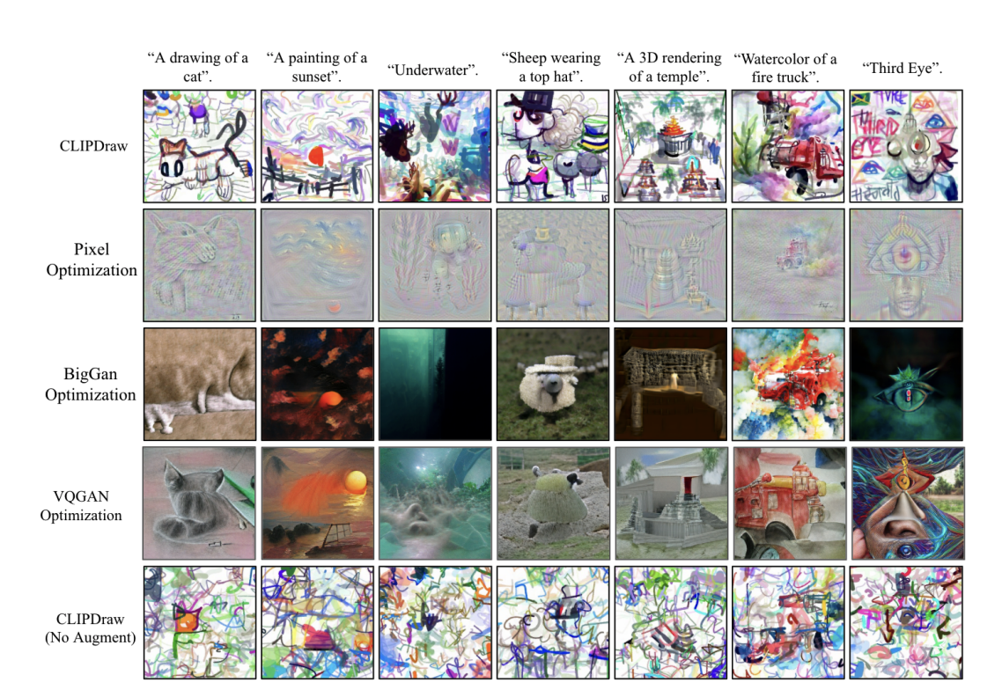
Results:
Fig 3. Images synthesized via various synthesis-through-optimization methods^{[1]}
Notes:
CLIPDraw tends to result in a diverse set of human-recognizable doodles. Pixel Optimization creates interesting textures but fails to compose colors and shapes. BigGAN and VQGAN Optimization synthesize high-resolution images, but are constrained to the set of images the generator can produce. Images from CLIPDraw without image augmentation score high numerically, but are nonsense to the human eye.

Slide 9
Limitations and Future Directions:
The authors acknowledge several limitations of the CLIPDraw system, including its inability to generate highly detailed or photorealistic images, its reliance on the quality of the input textual descriptions, and its susceptibility to producing biased or stereotypical images based on the training data.
They suggest several avenues for future research, including exploring new methods for generating high-resolution images and addressing issues of bias and fairness in image synthesis systems.

Slide 10
Conclusion:
The paper describes a system called "CLIPDraw" which explores the problem of generating drawings from text descriptions. The system utilizes a combination of language and image encoders, specifically the Contrastive Language-Image Pretraining (CLIP) model and the Deep Convolutional Generative Adversarial Networks (DCGANs) model, to generate plausible images given a textual description.

Slide 11
Conclusion(Contd.):
The paper presents experimental results showing the effectiveness of the CLIPDraw system in generating realistic images, as well as a user study demonstrating the usefulness of the generated images for creative tasks such as brainstorming and prototyping.

Slide 12
References:
[1] Frans, K., Soros, L., & Witkowski, O. (2022). Clipdraw: Exploring text-to-drawing synthesis through language-image encoders. Advances in Neural Information Processing Systems, 35, 5207-5218.

Slide 13
Thank You

