Slide 1
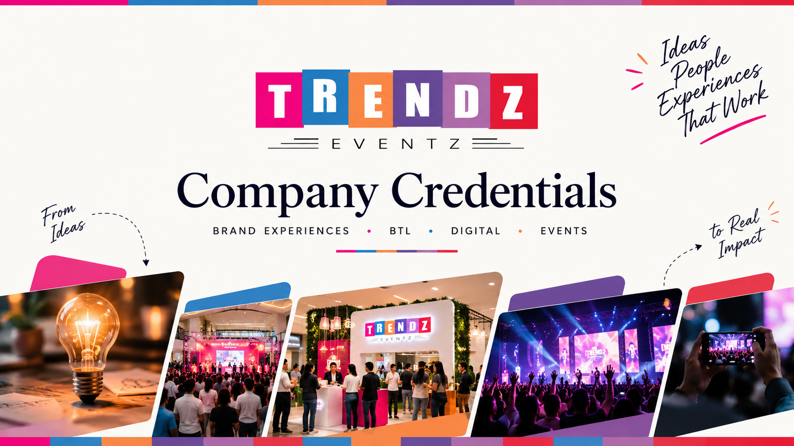

Slide 2
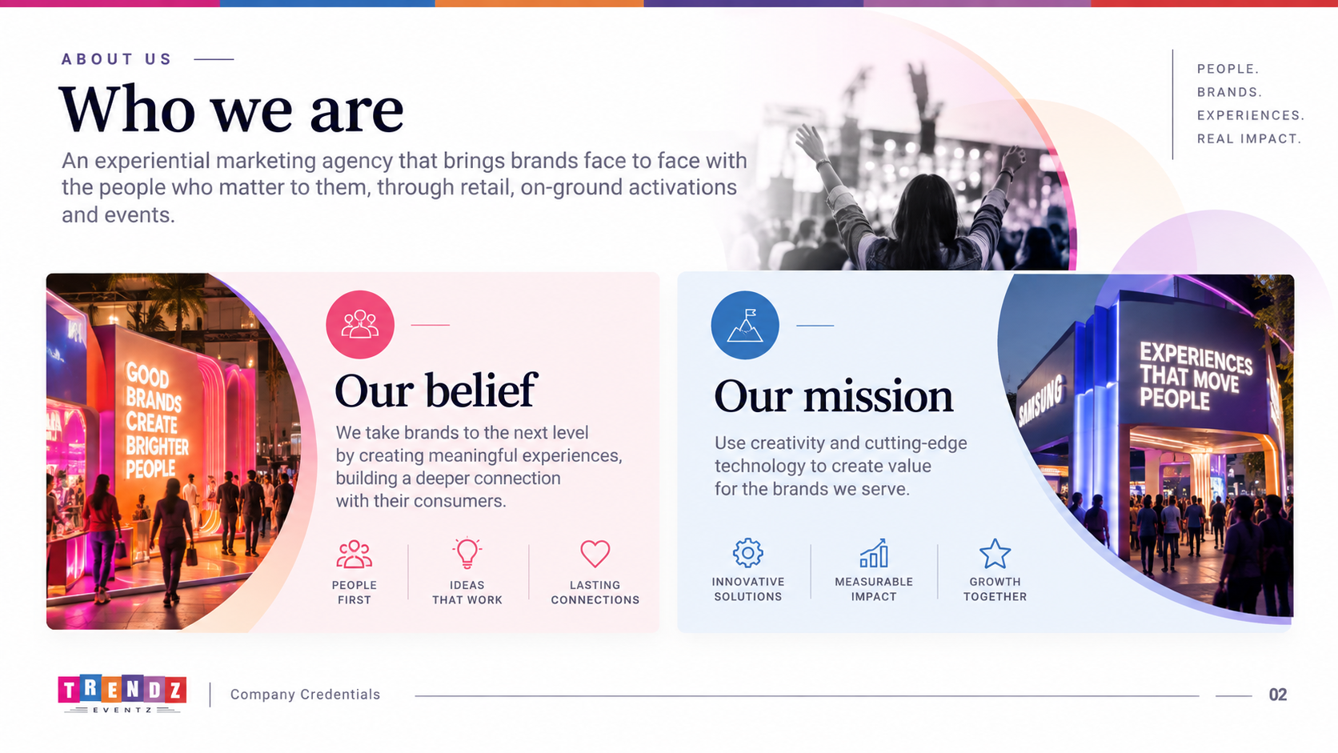

ABOUT US
Who we are
An experiential marketing agency that brings brands face to face with the people who matter to them, through retail, on-ground activations and events.
Our belief
Our mission
We take brands to the next level by creating meaningful experiences, building a deeper connection with their consumers.
Use creativity and cutting-edge technology to create value for the brands we serve.
02
Company Credentials
02

Slide 3
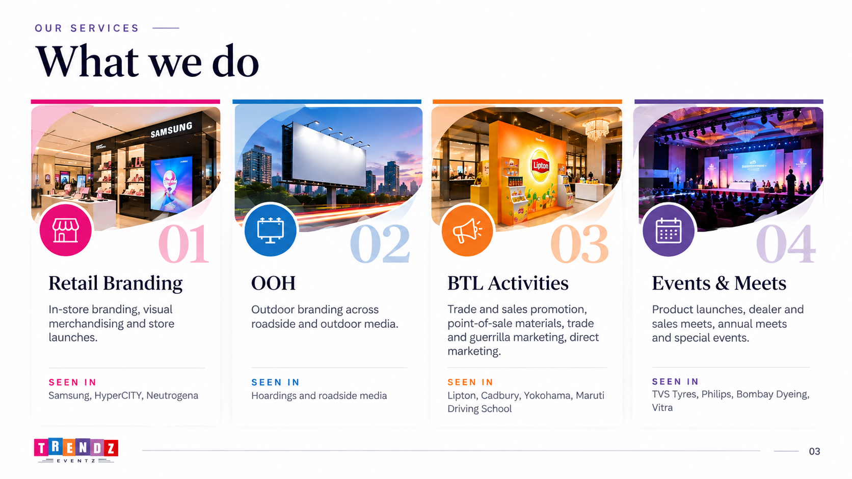
OUR SERVICES
What we do
03
Company Credentials
03

Slide 4
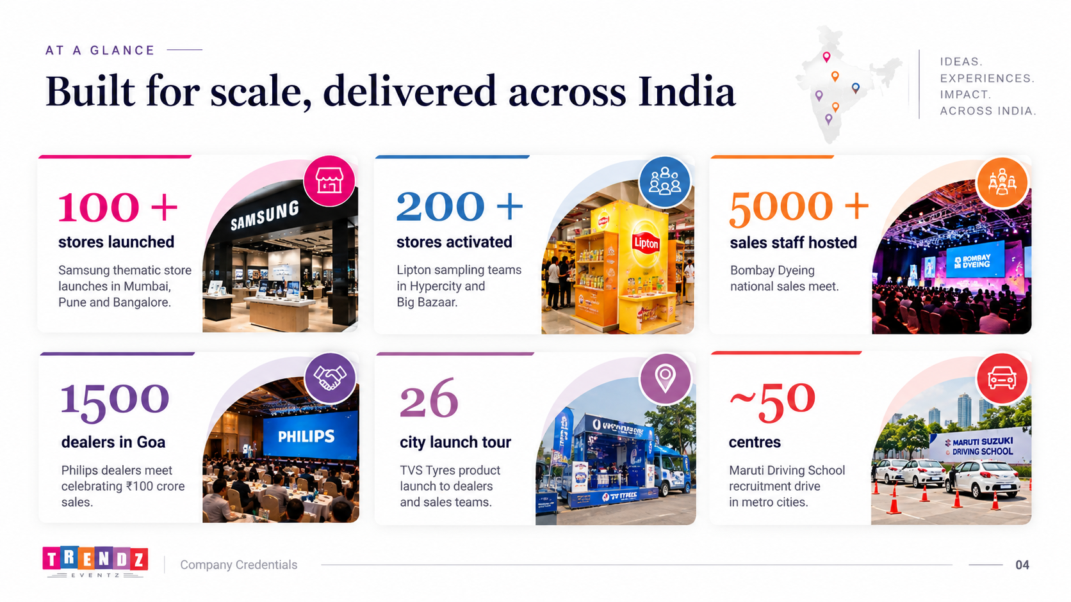

AT A GLANCE
Built for scale, delivered across India
100 +
200 +
5000 +
stores launched
stores activated
sales staff hosted
Samsung thematic store launches in Mumbai, Pune and Bangalore
Lipton sampling teams in Hypercity and Big Bazaar
Bombay Dyeing national sales meet
1500
26
~50
dealers in Goa
city launch tour
centres
Philips dealers meet celebrating ₹100 crore sales
TVS Tyres product launch to dealers and sales teams
Maruti Driving School recruitment drive in metro cities
04
Company Credentials
04

Slide 5
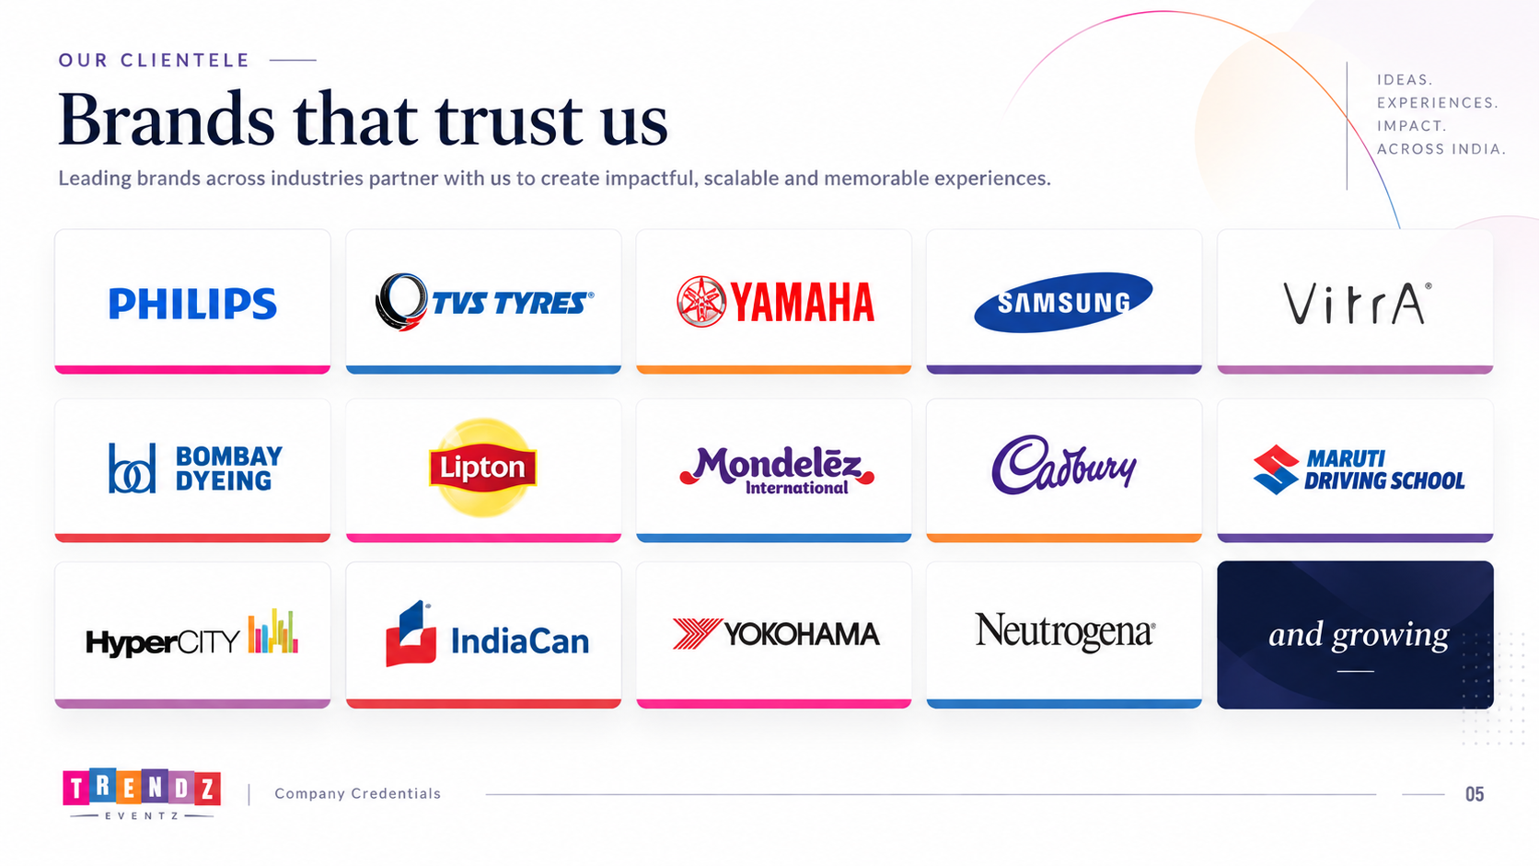
OUR CLIENTELE
Brands that trust us
Philips
TVS Tyres
Yamaha
Samsung
Vitra
Bombay Dyeing
Lipton
Mondelez
Cadbury
Maruti Driving School
HyperCITY
IndiaCan
Yokohama
Neutrogena
and growing
05
Company Credentials
05

Slide 6
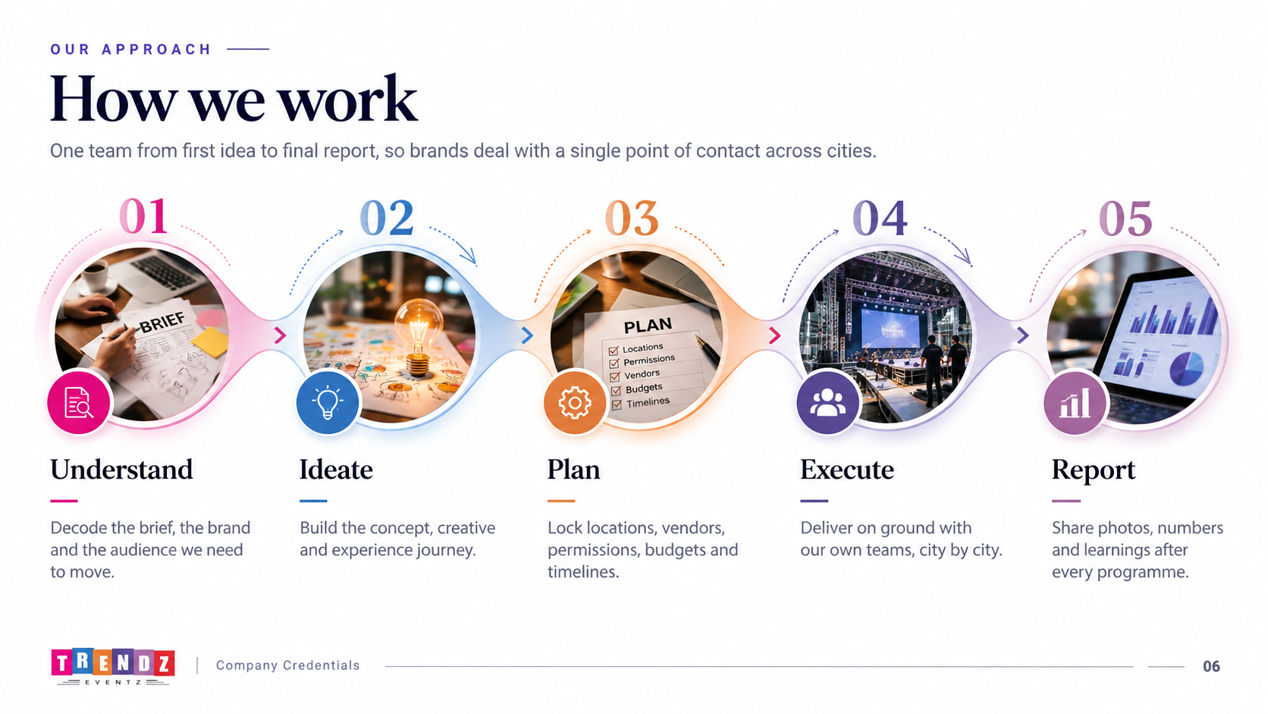
OUR APPROACH
How we work
One team from first idea to final report, so brands deal with a single point of contact across cities.
1
2
3
4
5
Understand
Ideate
Plan
Execute
Report
Decode the brief, the brand and the audience we need to move.
Build the concept, creative and experience journey.
Lock locations, vendors, permissions, budgets and timelines.
Deliver on ground with our own teams, city by city.
Share photos, numbers and learnings after every programme.
06
Company Credentials
06

Slide 7
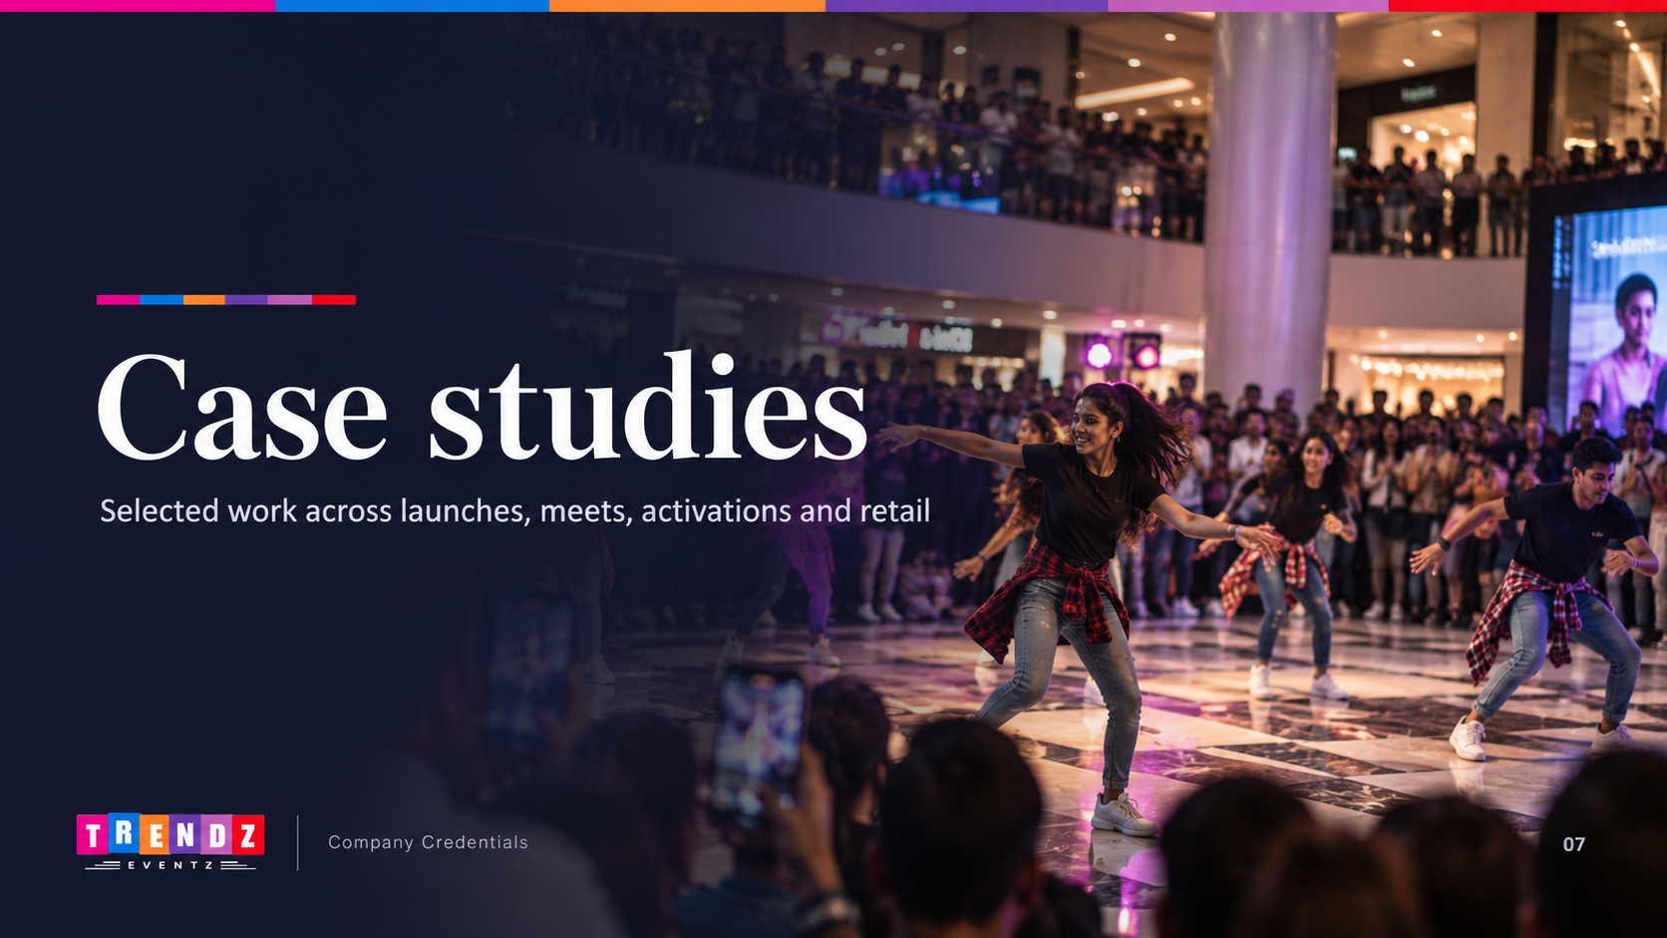
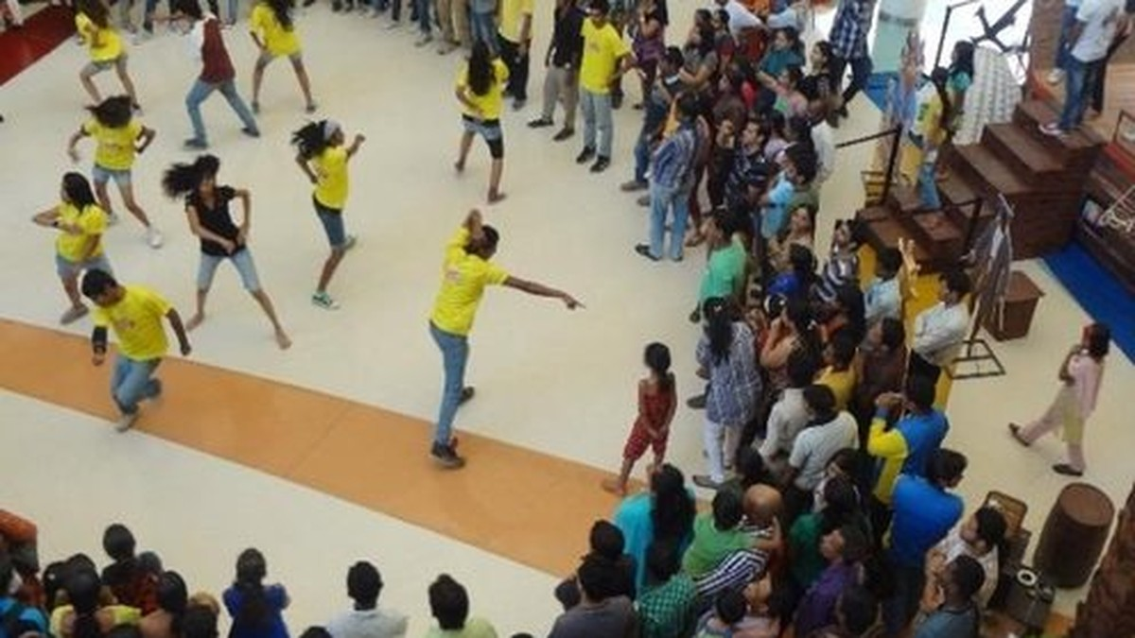
Case studies
Selected work across launches, meets, activations and retail
07
Company Credentials
07

Slide 8
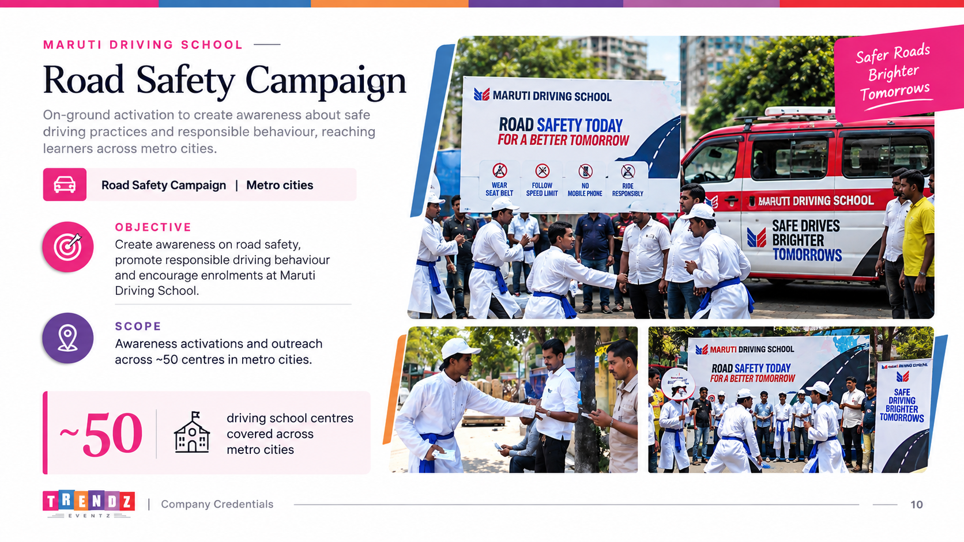
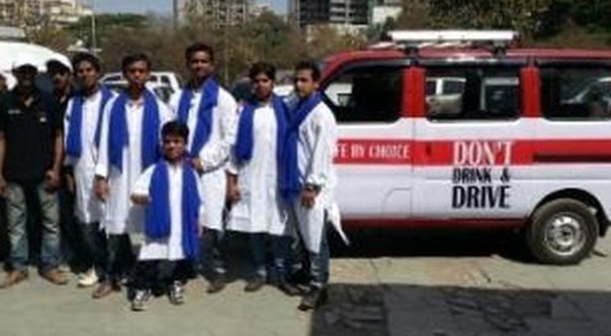
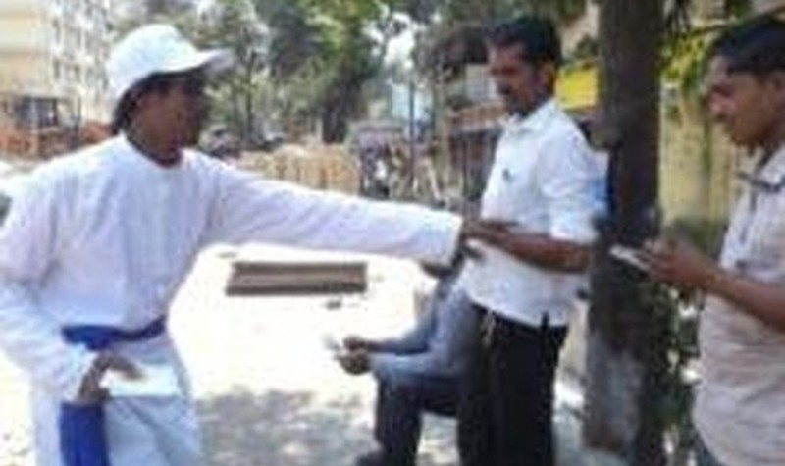
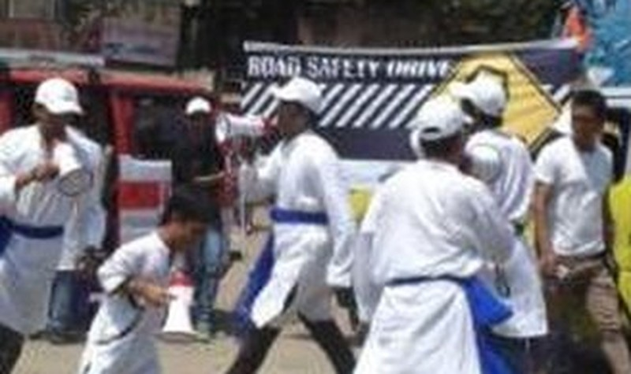
MARUTI DRIVING SCHOOL
Recruitment Drive
Recruitment | Metro cities
OBJECTIVE
Create awareness of MDS amongst the target group, then recruit, onboard and register them.
SCOPE
Around 50 MDS centres across metro cities.
~50
driving school centres covered
08
Company Credentials
10

Slide 9
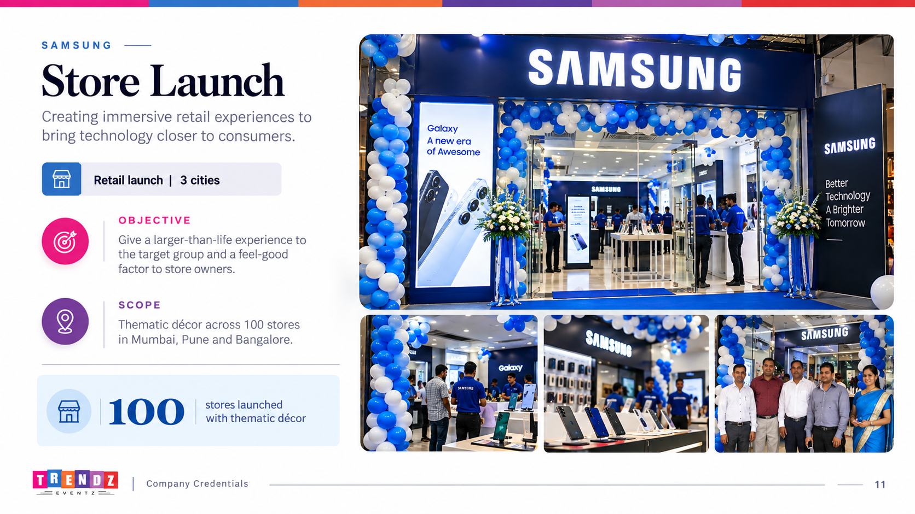
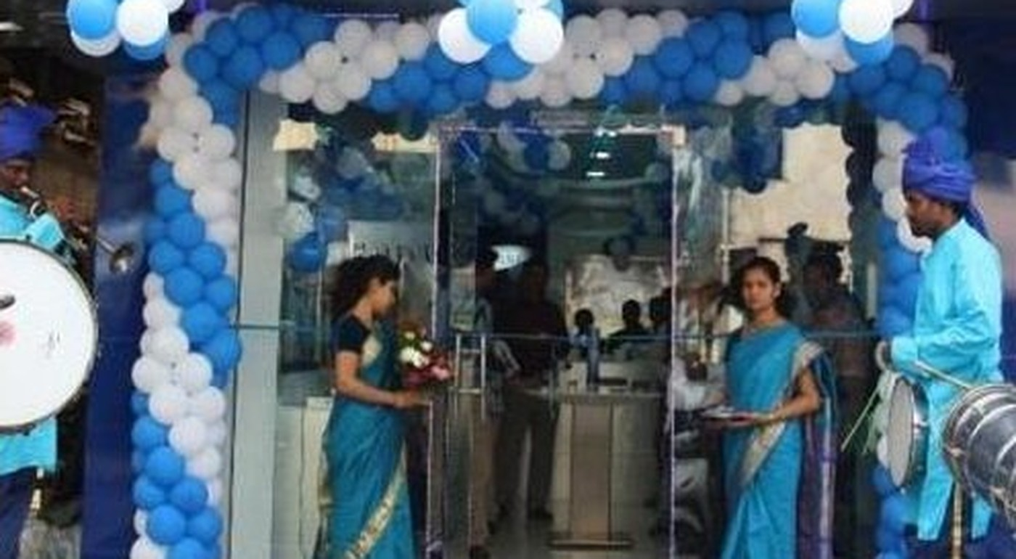
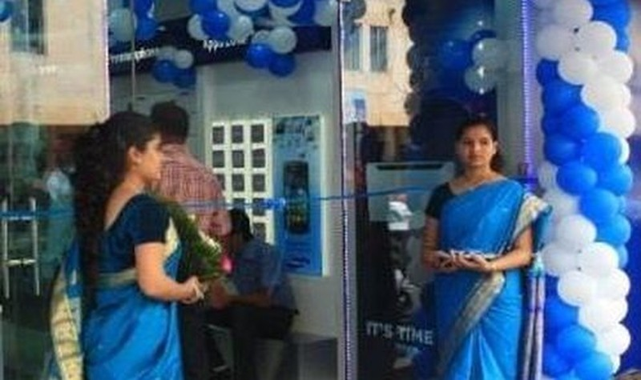
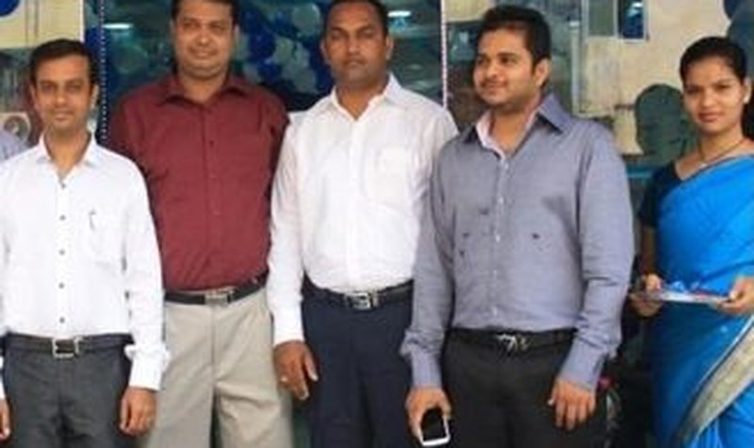
SAMSUNG
Store Launch
Retail launch | 3 cities
OBJECTIVE
Give a larger-than-life experience to the target group and a feel-good factor to store owners.
SCOPE
Thematic décor across 100 stores in Mumbai, Pune and Bangalore.
100
stores launched with thematic décor
09
Company Credentials
11

Slide 10
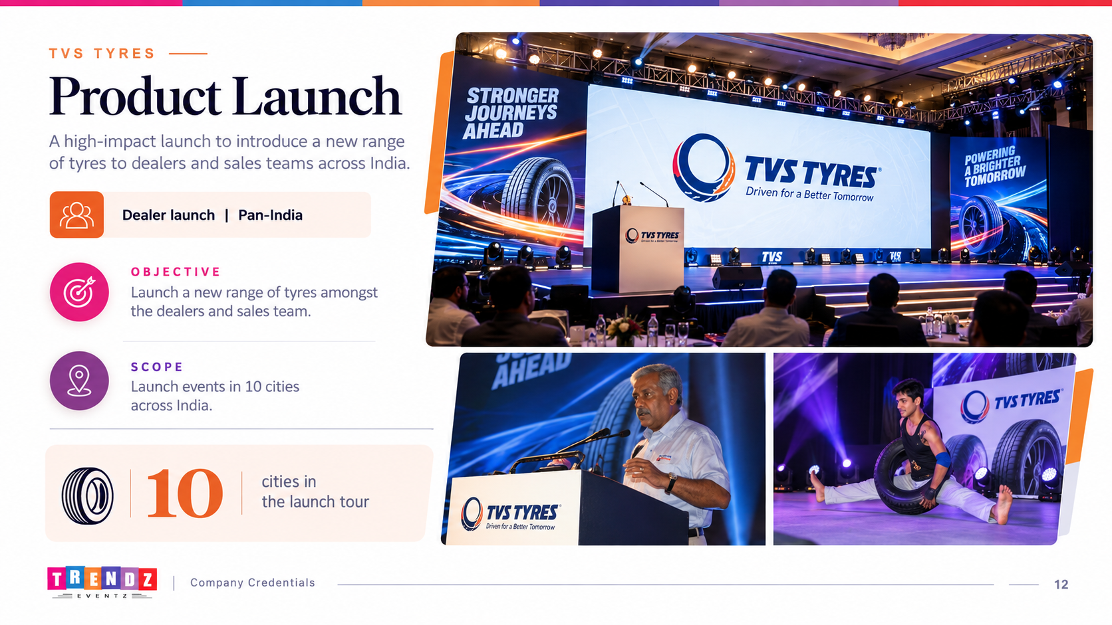
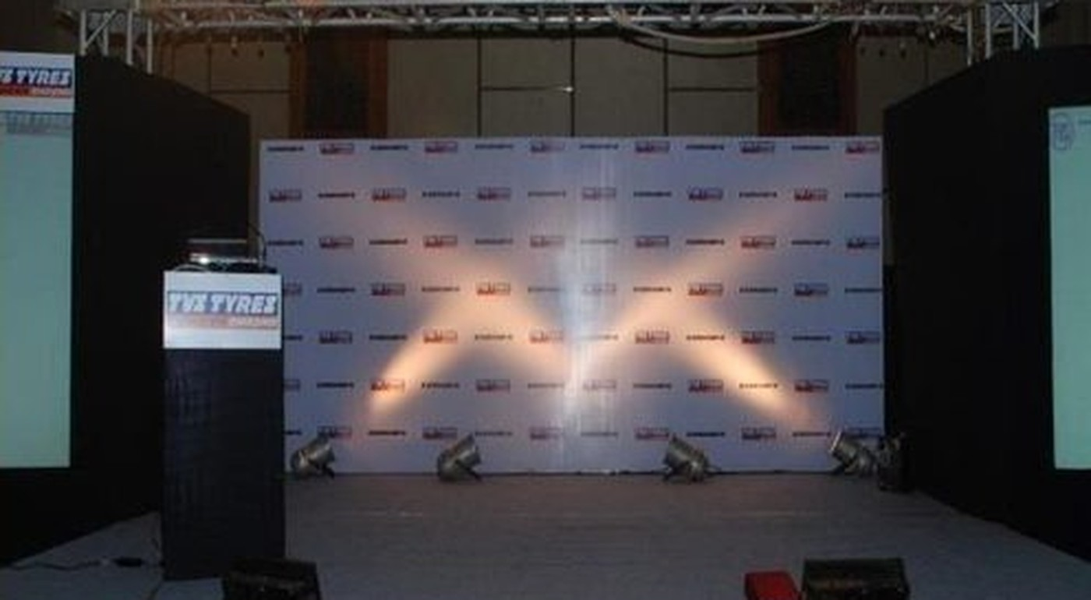
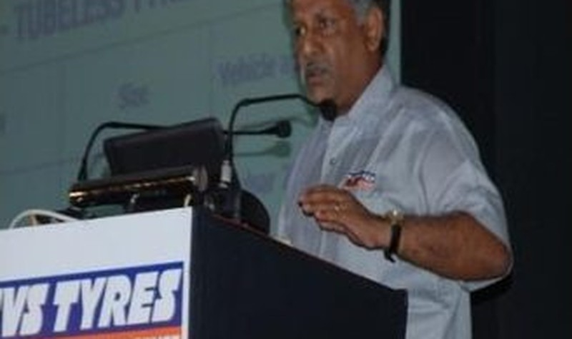
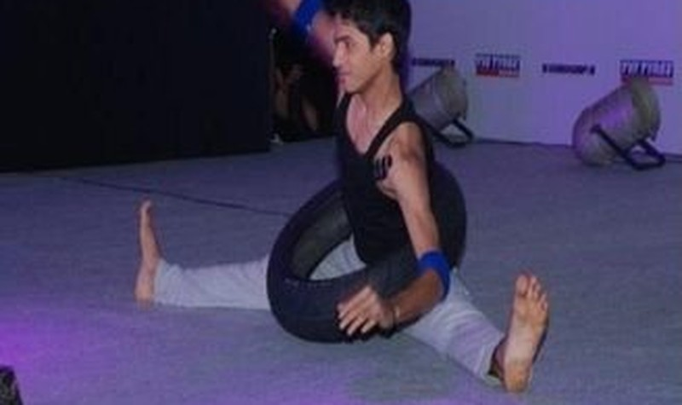
TVS TYRES
Product Launch
Dealer launch | Pan-India
OBJECTIVE
Launch a new range of tyres amongst the dealers and sales team.
SCOPE
Launch events in 10 cities across India.
10
cities in the launch tour
10
Company Credentials
12

Slide 11
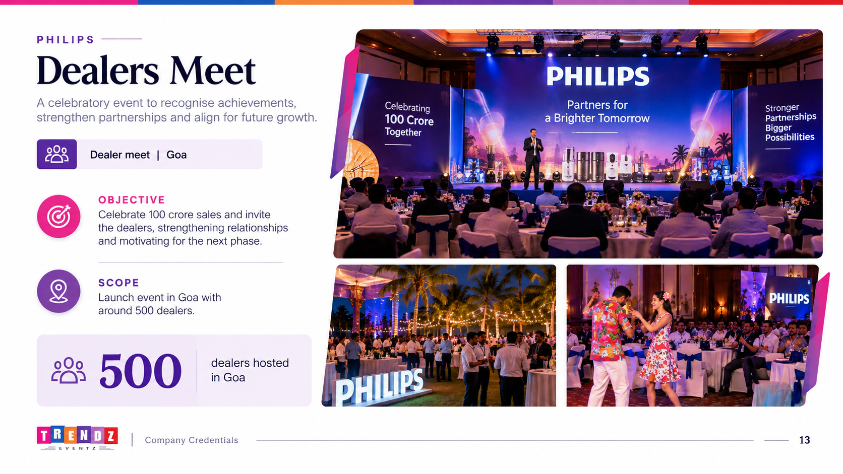
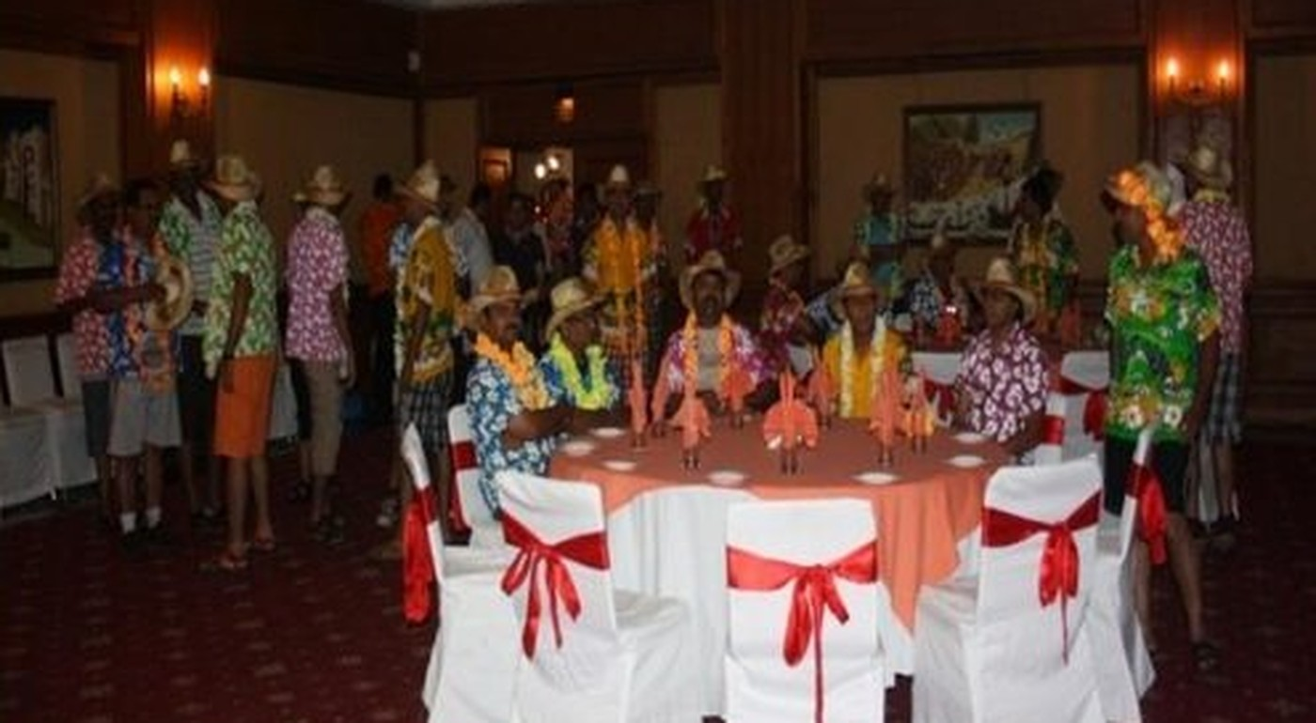
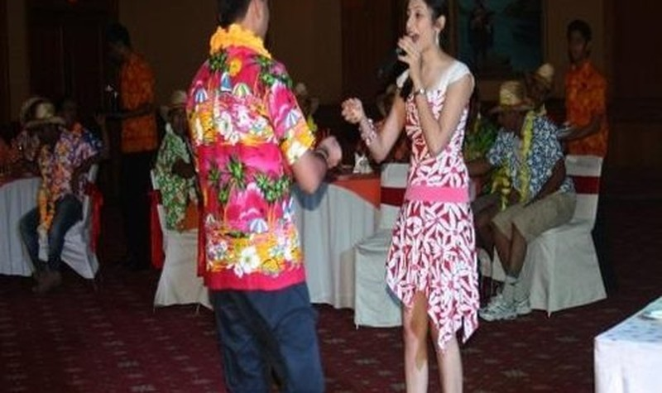
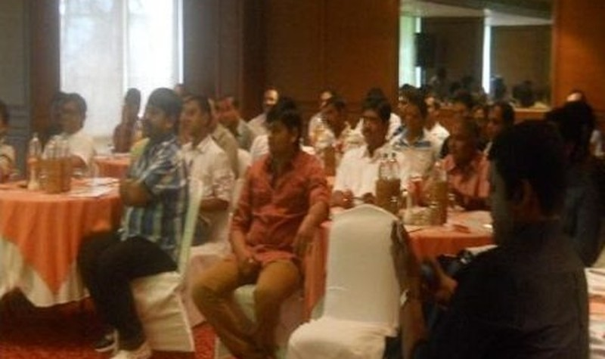
PHILIPS
Dealers Meet
Dealer meet | Goa
OBJECTIVE
Celebrate 100 crore sales and invite the dealers.
SCOPE
Launch event in Goa with around 500 dealers.
500
dealers hosted in Goa
11
Company Credentials
13

Slide 12
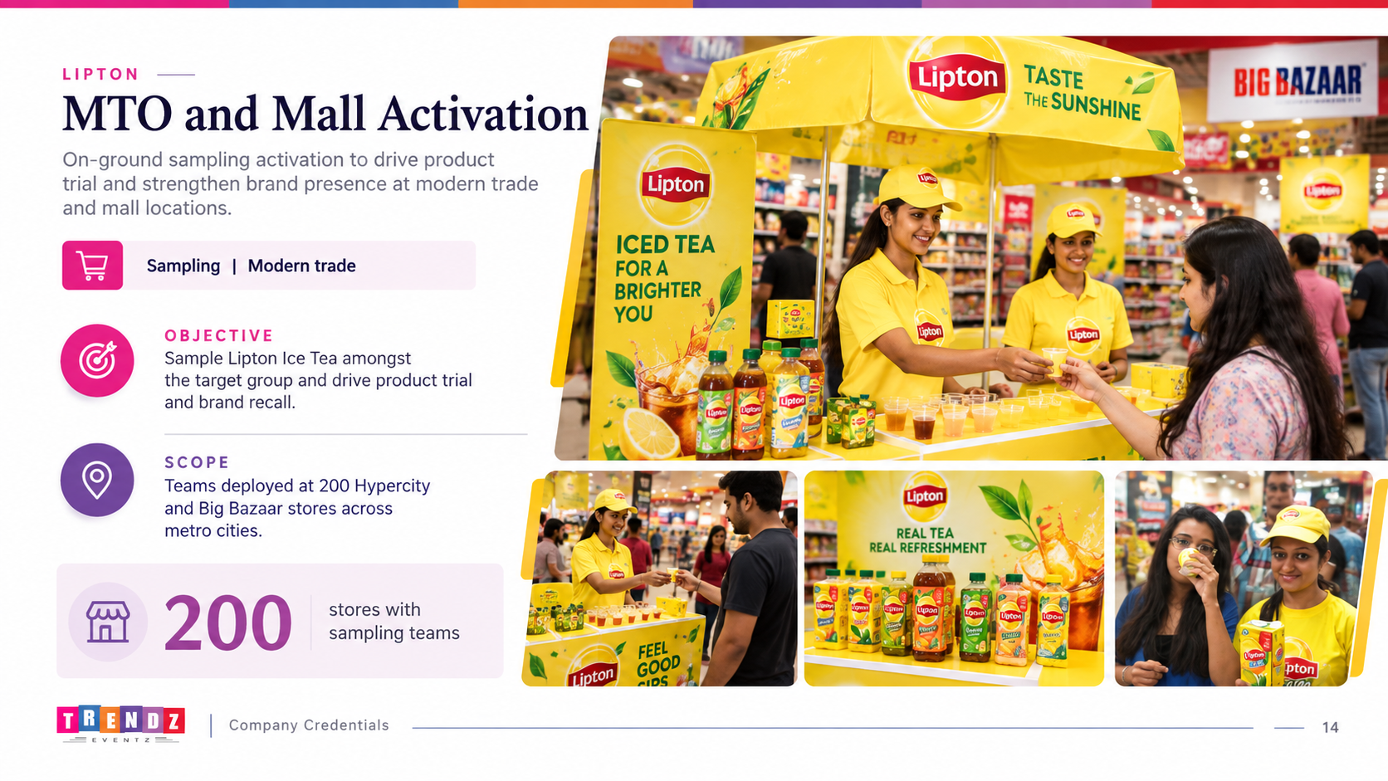
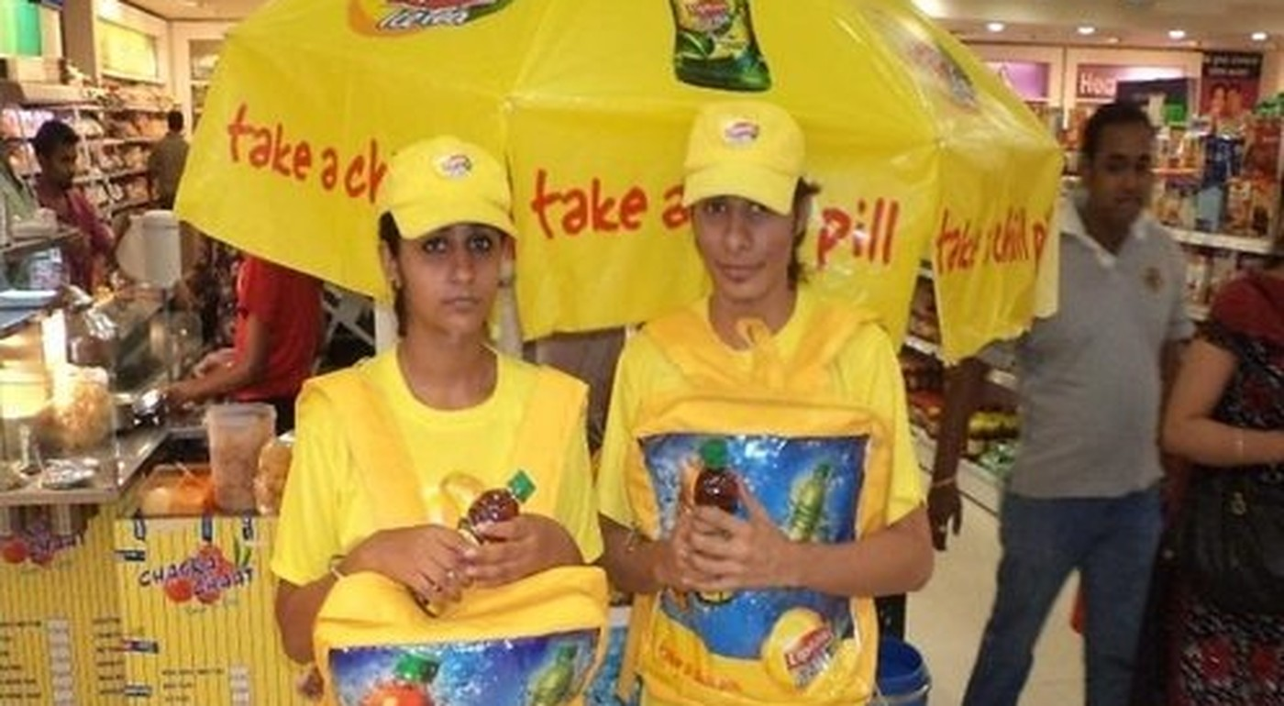
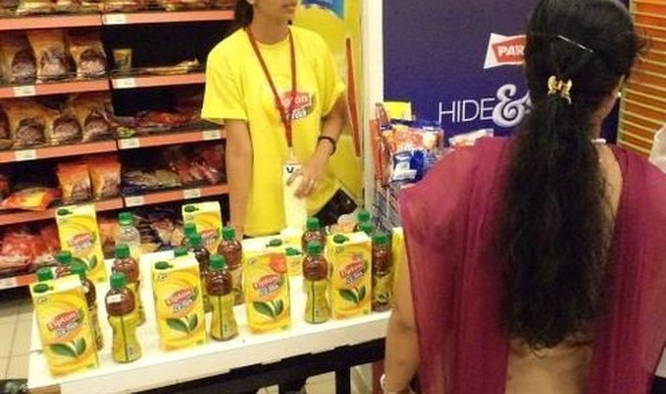
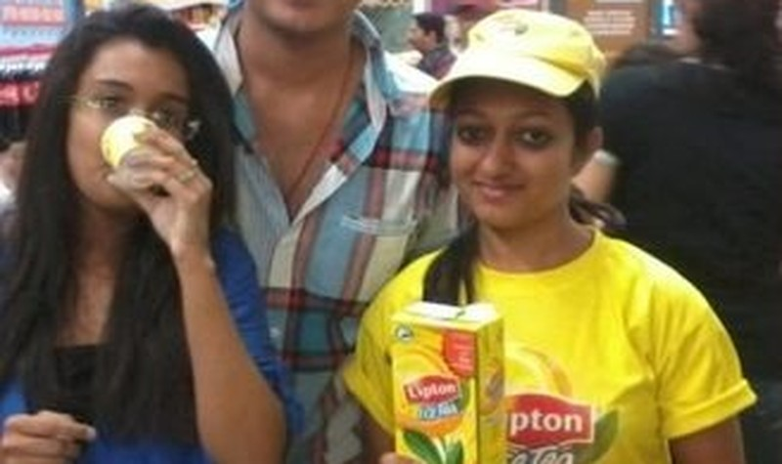
LIPTON
MTO and Mall Activation
Sampling | Modern trade
OBJECTIVE
Sample Lipton Ice Tea amongst the target group.
SCOPE
Teams deployed at 200 Hypercity and Big Bazaar stores across metro cities.
200
stores with sampling teams
12
Company Credentials
14

Slide 13
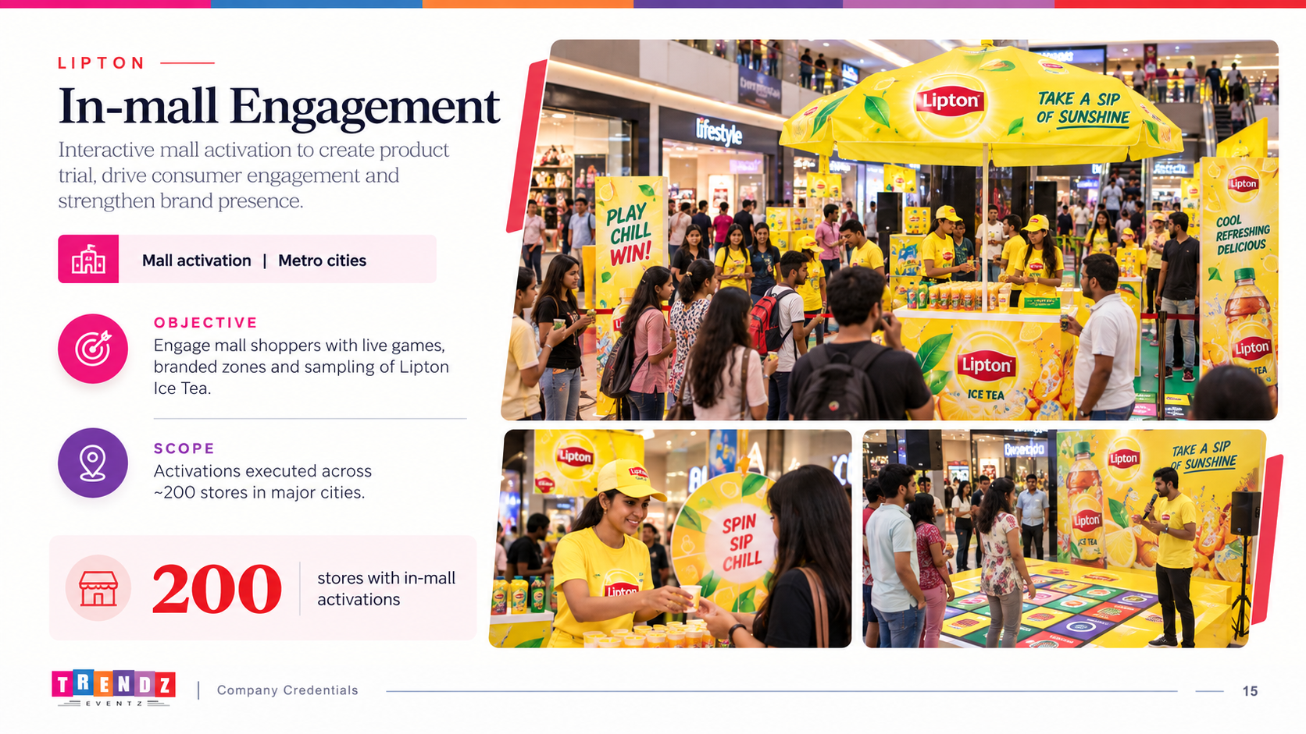
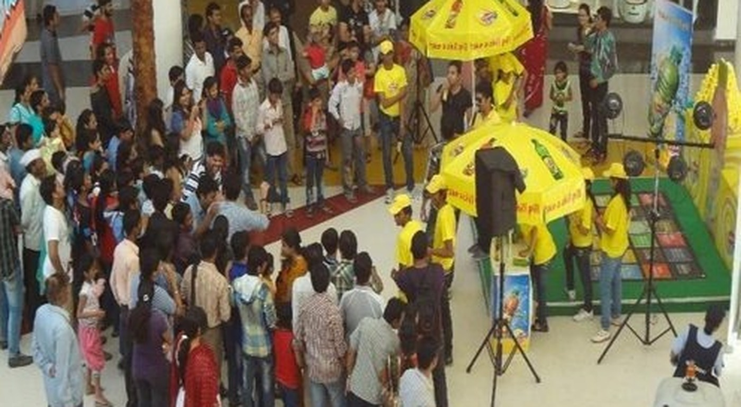
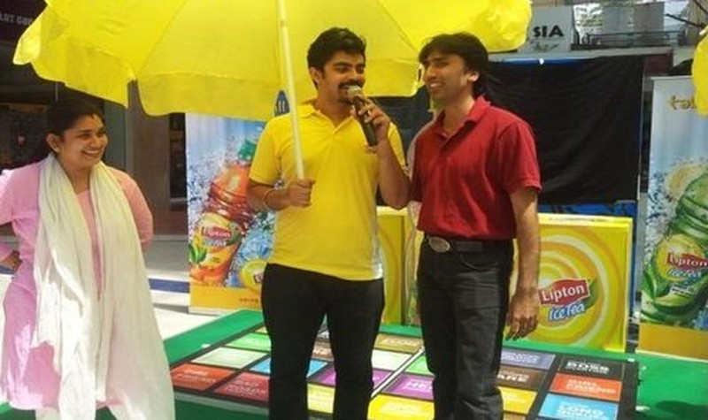
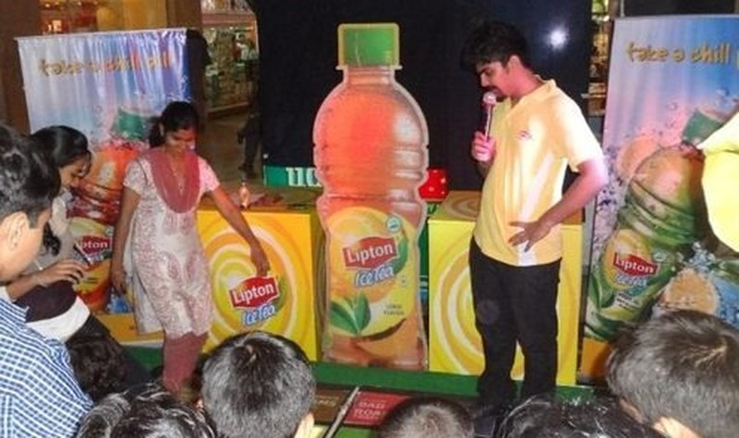
LIPTON
In-mall Engagement
Mall activation
OVERVIEW
Live games and branded zones that bring Lipton Ice Tea to mall shoppers.
Part of the Lipton Ice Tea programme across 200 stores
13
Company Credentials
15

Slide 14
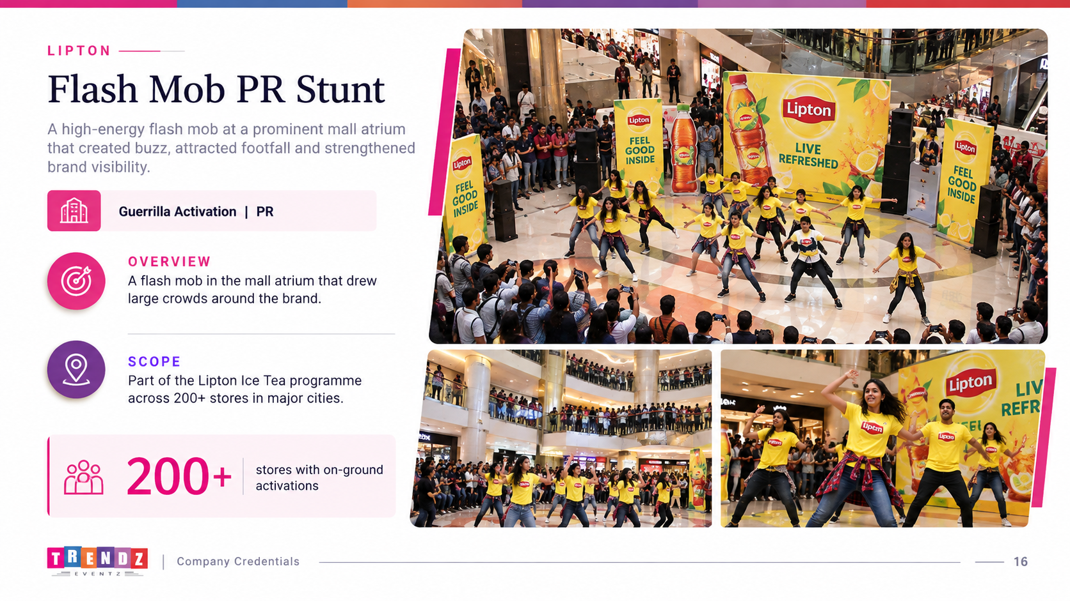
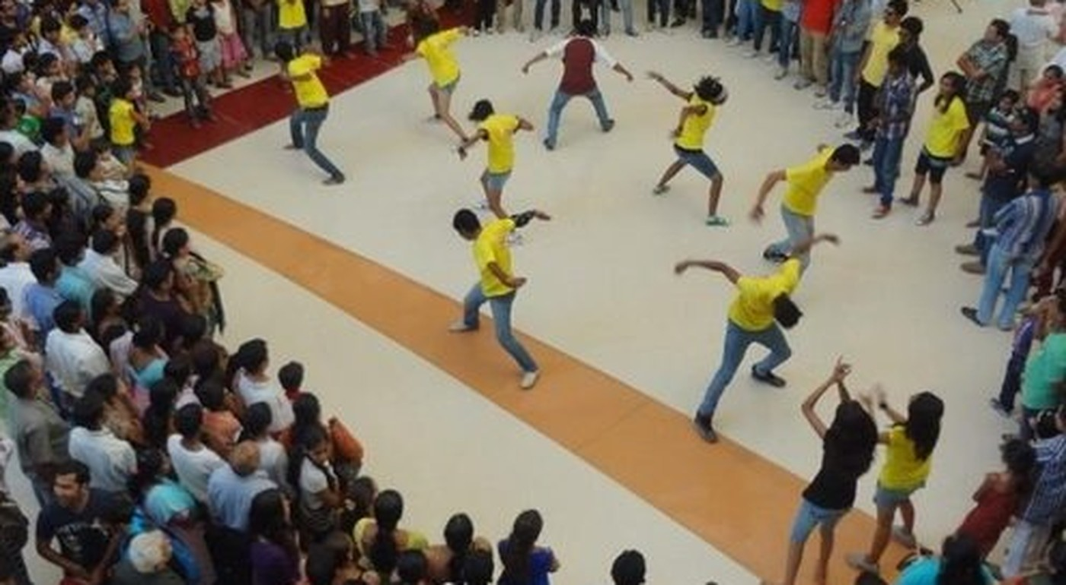
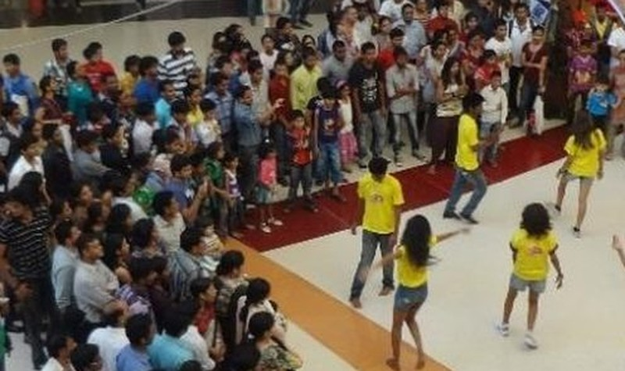
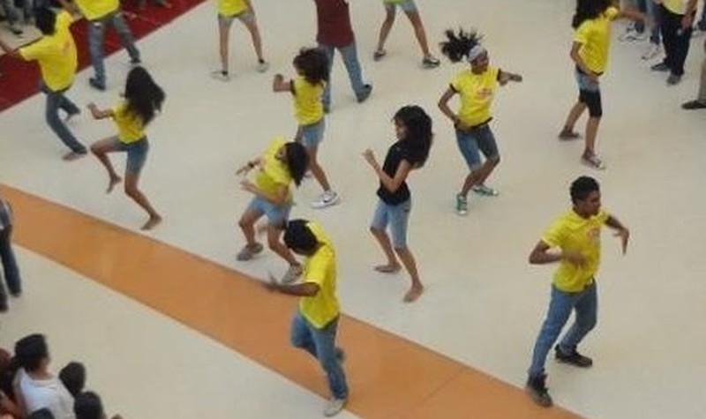
LIPTON
Flash Mob PR Stunt
Guerrilla | PR
OVERVIEW
A flash mob in the mall atrium that drew crowds around the brand.
Part of the Lipton Ice Tea programme across 200 stores
14
Company Credentials
16

Slide 15
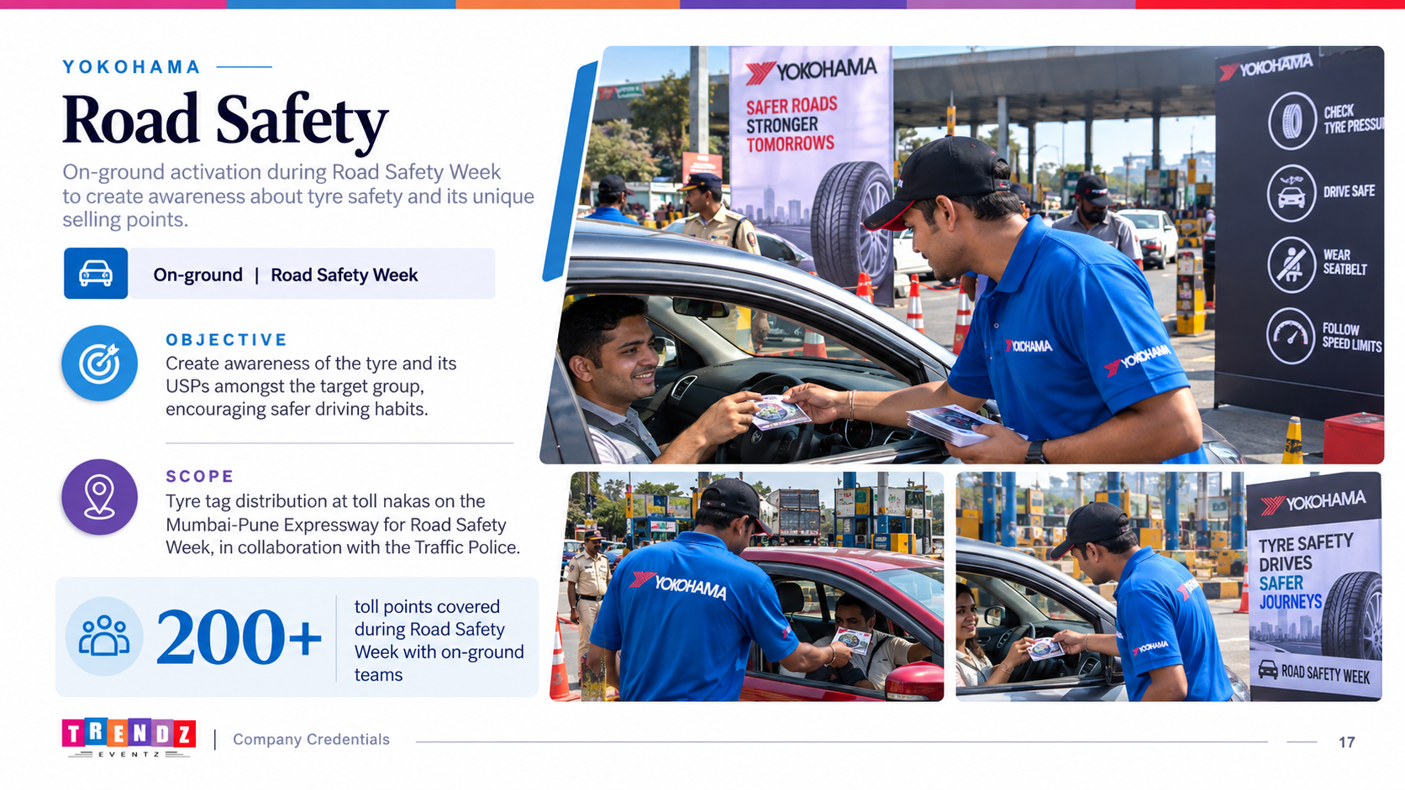
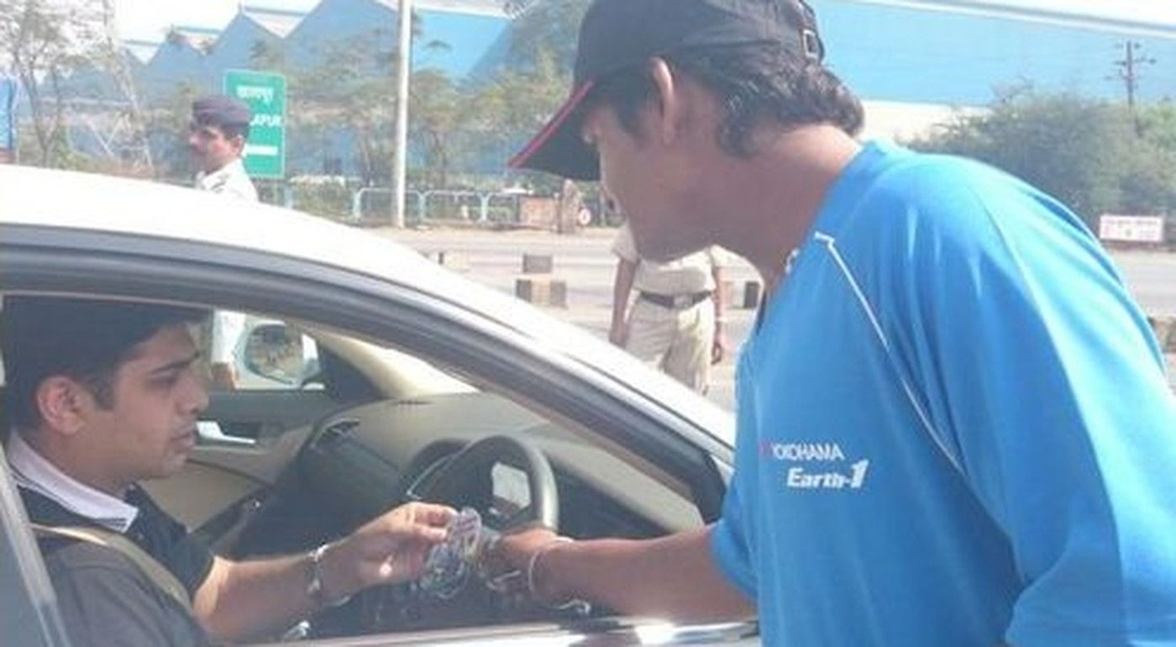
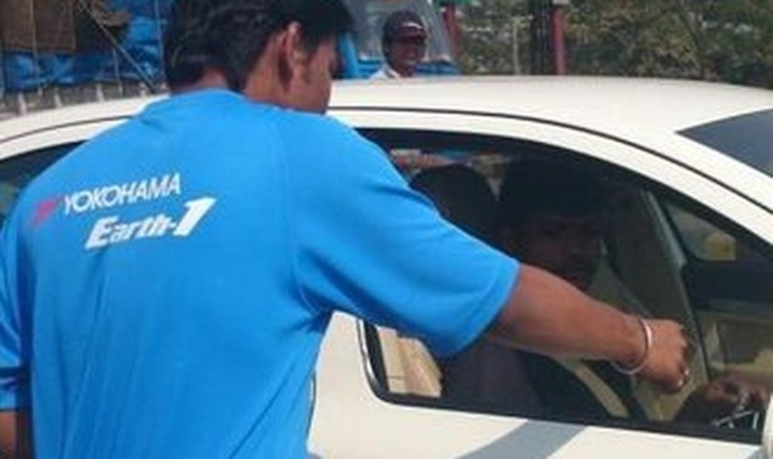
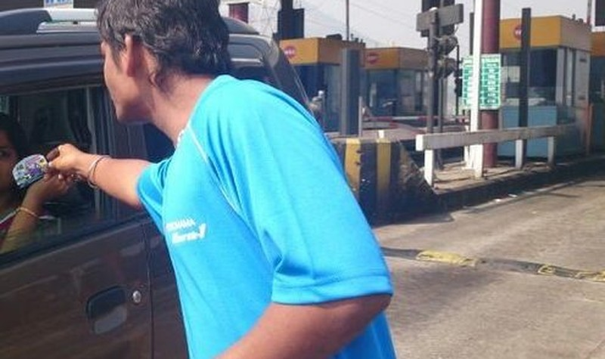
YOKOHAMA
Road Safety
On-ground | Road Safety Week
OBJECTIVE
Create awareness of the tyre and its USPs amongst the target group.
SCOPE
Tyre tag distribution at toll nakas on the Mumbai-Pune Expressway for Road Safety Week, with the Traffic Police.
Run with the Traffic Police during Road Safety Week
15
Company Credentials
17

Slide 16
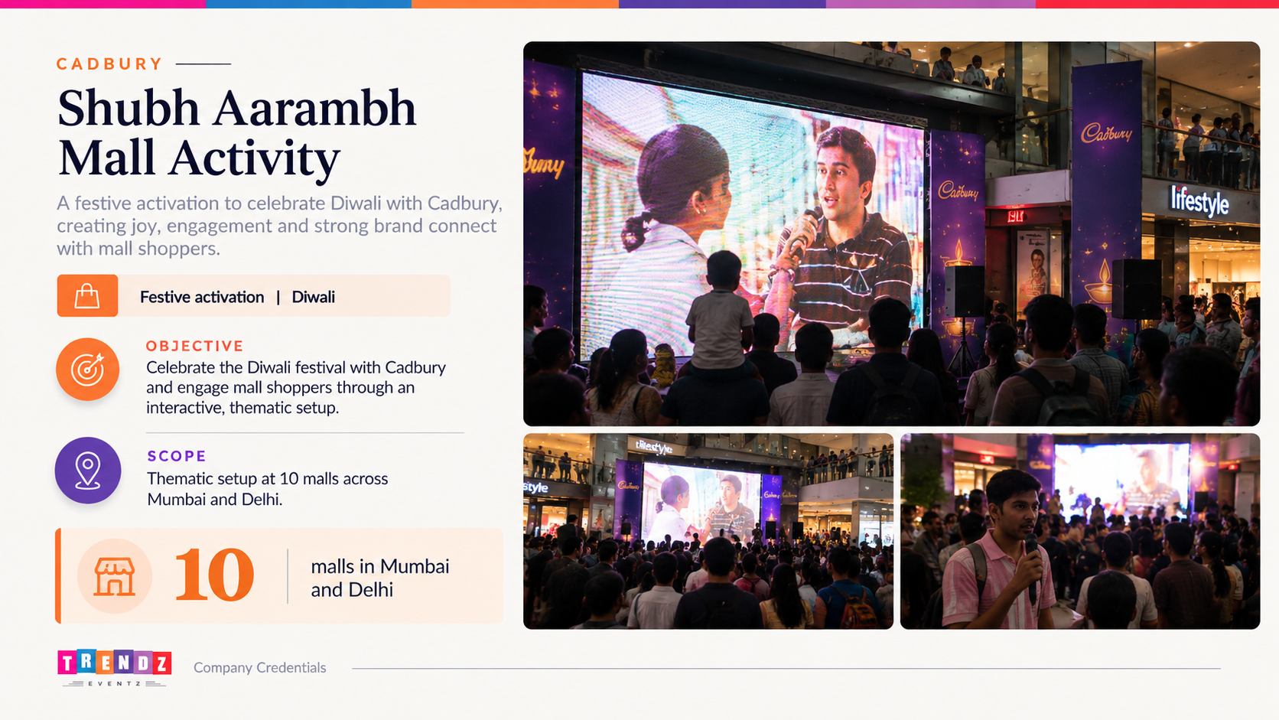
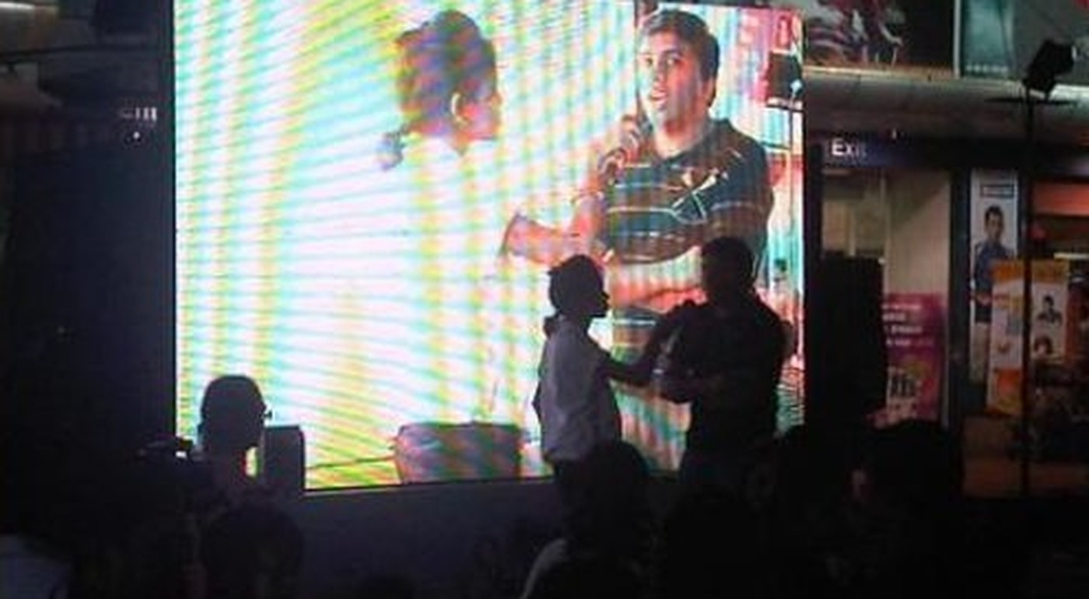
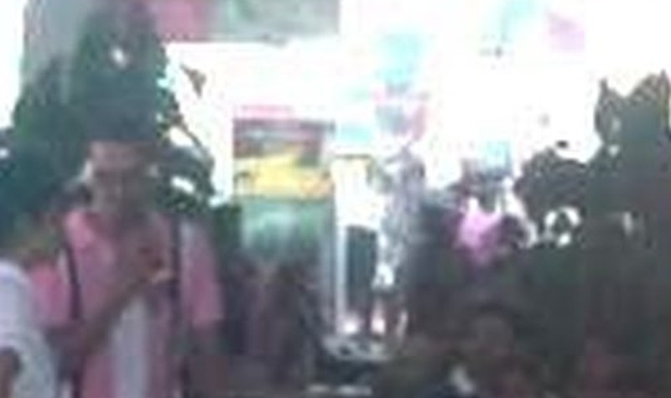
CADBURY
Shubh Aarambh Mall Activity
Festive activation | Diwali
OBJECTIVE
Celebrate the Diwali festival with Cadbury.
SCOPE
Thematic setup at 10 malls across Mumbai and Delhi.
10
malls in Mumbai and Delhi
16
Company Credentials
18
16

Slide 17
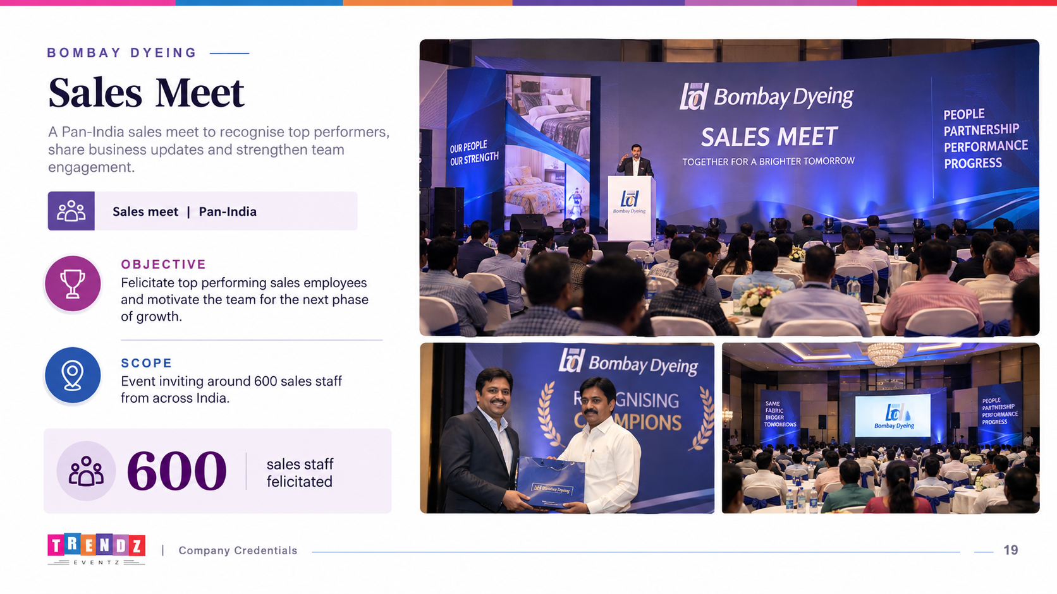
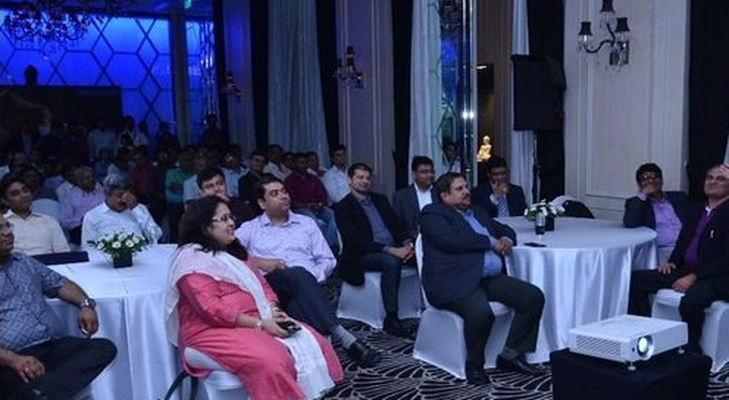
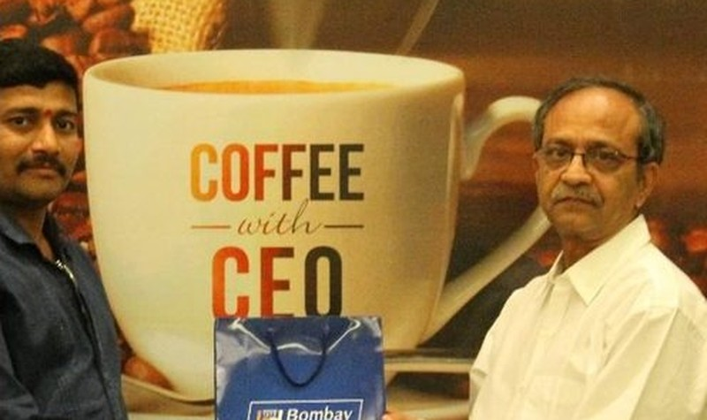
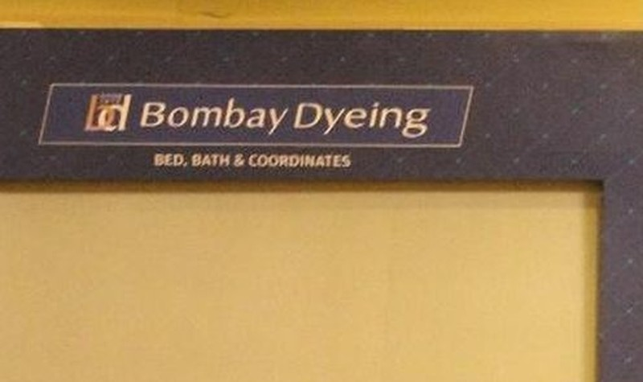
BOMBAY DYEING
Sales Meet
Sales meet | Pan-India
OBJECTIVE
Felicitate the top employees.
SCOPE
Event inviting around 600 sales staff across India.
600
sales staff felicitated
17
Company Credentials
19

Slide 18
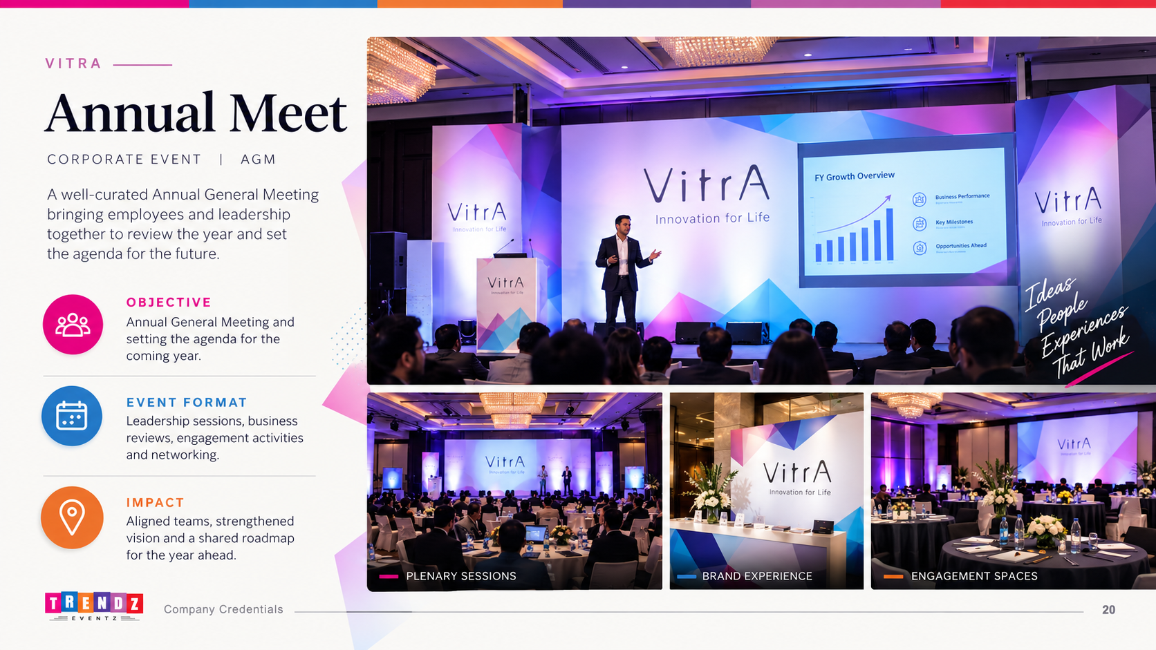
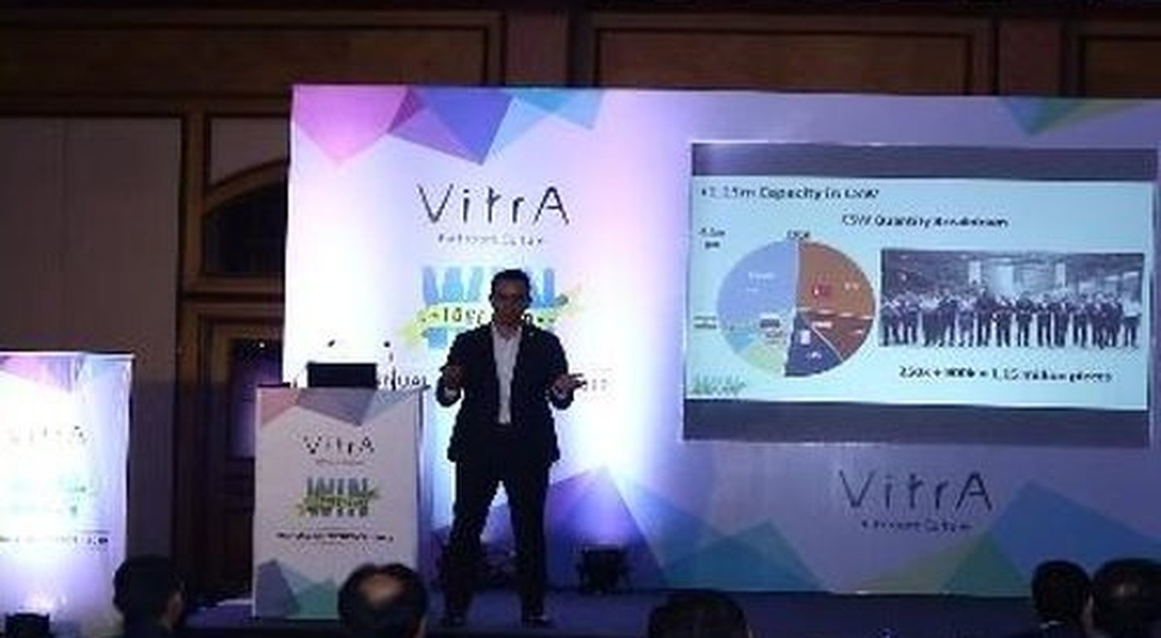
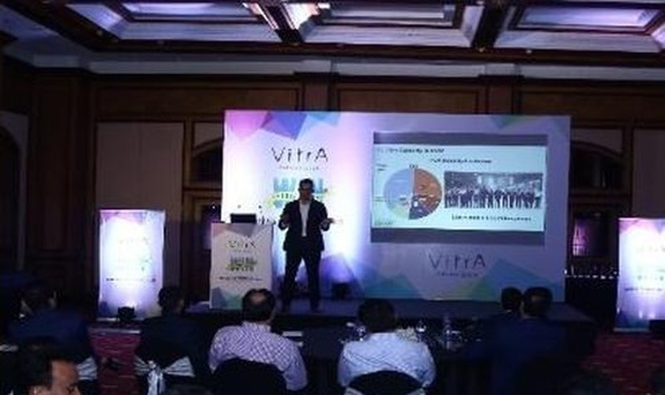

VITRA
Annual Meet
Corporate event | AGM
OVERVIEW
Annual General Meeting and setting the agenda for the coming year.
AGM
annual meet with agenda for the year ahead
18
Company Credentials
20

Slide 19




HYPERCITY
Branding and Relaunch
Retail branding | Pan-India
OVERVIEW
Store branding and relaunch activity across India.
Store branding rolled out across India
19
Company Credentials
21

Slide 20

20

Slide 21




NEUTROGENA
Visual Merchandising
Retail | In-store
OVERVIEW
In-store display units and shelf merchandising.
Display units and shelf merchandising in store
21
Company Credentials
22

Slide 22

WHY TRENDZ EVENTZ
What brands get when they work with us
01
Pan-India reach
02
Built for scale
Programmes run across 10 cities, around 50 centres and 200 stores at the same time.
From 500-dealer meets in Goa to 600-strong national sales felicitations.
03
End to end, one team
04
Creativity with technology
Retail branding, OOH, BTL and events delivered under one roof.
Ideas that connect brands with people, powered by the latest technology.
22
Company Credentials
23

Slide 23


