Slide 1

Department of Computer Science & Engineering
Acharya Institute of Technology
Soladevanahalli, Bengaluru 560 107
Mini-Project Presentation on
Deepfake Audio Detection using Deep Learning
Presented by
Group No | Sl. No | Name | USN
18 | 1 | Darshan M | 1AY23CS065
 | 2 | Gajula Harshith | 1AY23CS077
 | 3 | M Shankarlingeshwar | 1AY23CS107
 | 4 | Shailaja | 1AY23CS166
Guide Name:Ms. Shrutika C Rampure Designation: Assistant Professor
Dept of CSE

Slide 2
CONTENTS/AGENDA
Sl. No | CONTENTS / AGENDA
1 | Introduction
2 | Literature survey
3 | Problem statement
4 | Proposed methodology and Project Objectives
5 | Requirement specification
6 | Project Design
7 | Project Implementation
8 | Project Testing
9 | Results & Discussions
10 | Conclusion and Future Scope
11 | References
Dept of CSE

Slide 3
1. INTRODUCTION
Dept of CSE

Slide 4
INTRODUCTION
Definition – Deepfake audio refers to artificially generated or manipulated voices using AI techniques like deep learning.
Growing Concern – Used in scams, misinformation, and impersonation, posing serious security and ethical challenges.
Technology Behind It – Created using models such as LSTM and MFCC.
Need for Detection – Protects against fraud, fake news, and misuse of personal voices.
Detection Methods – Relies on AI/ML algorithms, spectral analysis, and forensic techniques to identify artifacts in audio.
Dept of CSE

Slide 5
2. LITERATURE SURVEY
Dept of CSE

Slide 6
LITERATURE SURVEY
S.N | Paper title | Publication details | Problem addressed in the paper | Author’s idea/approach | Shortfalls in author’s approach and solution provided in the proposed methodology
1 | Multi feature fusion | Kumar &sharma, 2024 | Deep fake audio detection | Multi feature fusion(MFCC+ Spectrogram) | Requires large computa- tional resources
2 | Robust spoof speech detection | Chen et al, 2024 | Spoof speech detection | Adversarial training | Training time and complexity are high
3 | Hybrid DL framework for detecting voice spoofing | Mittal & Singh, 2023 | Detecting of voice spoofing attacks | CNN+RNN | High computati- onal cost
Dept of CSE

Slide 7
LITERATURE SURVEY
S.N | Paper title | Publication details | Problem addressed in the paper | Author’s idea/approach | Shortfalls in author’s approach and solution provided in the proposed methodology
4 | Detection of AI-synthesized speech | Wang et al, 2023 | AI-synthesized speech detection | Deep learning with temporal modeling | Tested only in controlled lab settings
5 | End-to-end detection of spoofed speech | Tak et al, 2022 | Detecting end-to-end spoofed speech | CNN trained directly on spectrogram features | Works only on limited datasets
Dept of CSE

Slide 8
3. PROBLEM STATEMENT
Dept of CSE

Slide 9
PROBLEM STATEMENT
Overview of Problem identified:
Existing Problem :
Rapid rise of AI-generated voice cloning & deepfake audio.
Fake audio is used for fraud, misinformation, identity spoofing.
Humans cannot reliably distinguish real vs fake audio by hearing alone.
Why the Problem Should Be Resolved :
Needed to prevent voice spoofing attacks in banking & security.
Protects users from fraud, impersonation, and misinformation.
Ensures trust in digital communication and media.
Project Domain Used to Solve the Problem :
Deep Learning (LSTM) for analyzing voice patterns.
MFCC audio feature extraction for identifying subtle differences.
Flask-based web system for real-time deepfake detection.
Dept of CSE

Slide 10
4. PROPOSED METHODOLOGY & PROJECT OBJECTIVES
Dept of CSE

Slide 11
PROPOSED METHODOLOGY
Input – Upload the audio file.
Preprocessing – Convert audio to 16kHz.
Feature Extraction – Generate MFCCs.
Model Training – Use LSTM for classification.
Output – Predict probability: Real or Fake.
Dept of CSE

Slide 12
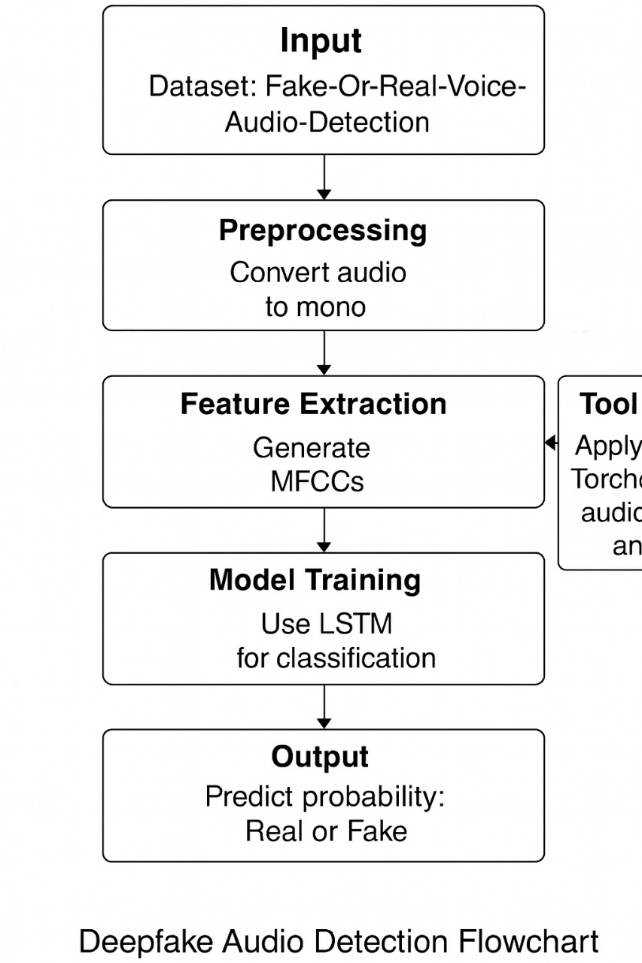
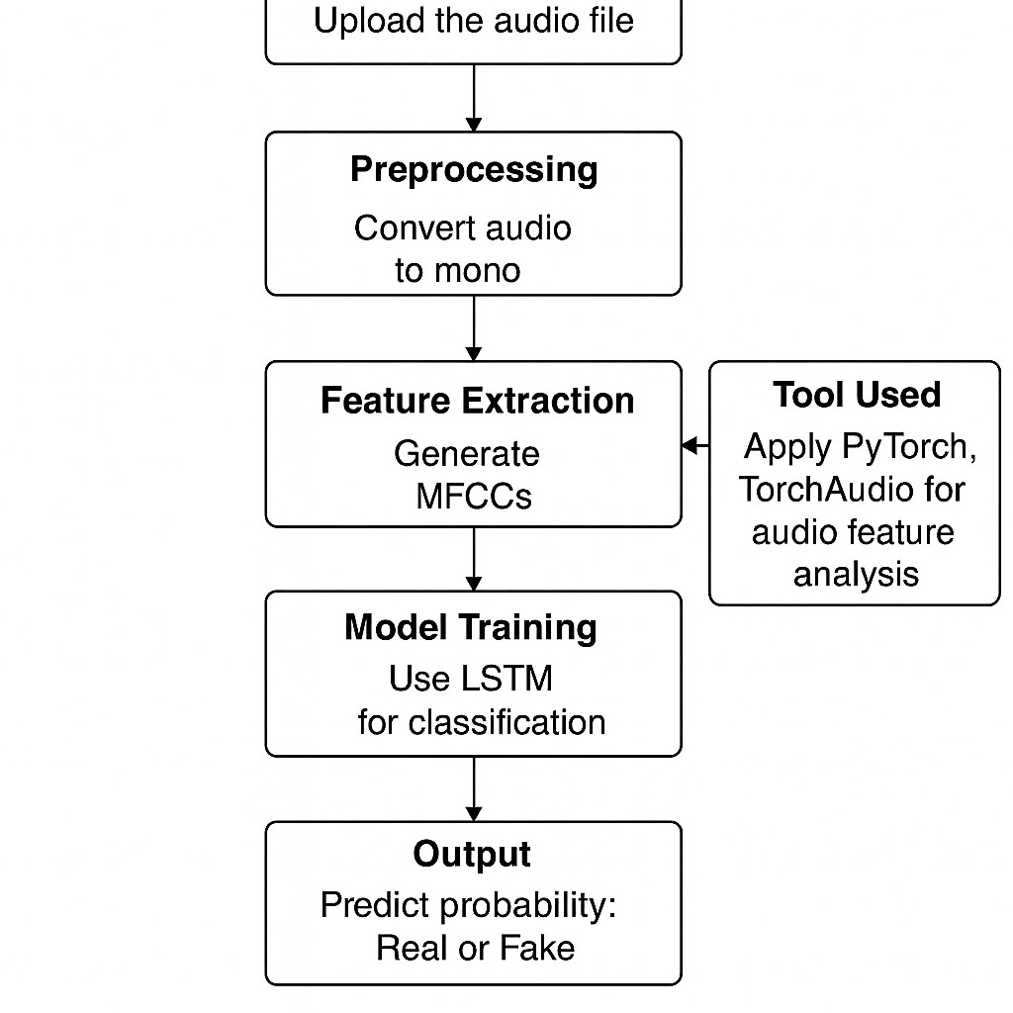
BLOCK DIAGRAM OF PROPOSED METHODOLOGY
Dept of CSE

Slide 13
PROPOSED METHODOLOGY
Input: Simple and flexible method to upload and process any audio file.
Preprocessing: Standardizing audio to 16kHz improves accuracy and reduces noise.
Feature Extraction (MFCCs): MFCCs capture key speech features essential for deepfake detection.
Model Training (LSTM): LSTM effectively learns temporal patterns in audio, improving deepfake detection.
Output: Gives clear and interpretable real/fake probability results
Dept of CSE

Slide 14
PROJECT OBJECTIVES
Objective-1:Detect and classify real vs fake audio.
Objective-2:Evaluate performance and accuracy on audio.
Objective-3:Develop an awareness tool for security and education.
Dept of CSE

Slide 15
5. REQUIREMENT SPECIFICATION
Dept of CSE

Slide 16
Requirement Specification
Functional Requirements:
Sl. No | Functional Requirement specification | Purpose
1 | System should take audio as input | To allow users to upload audio for analysis.
2 | It should check whether the audio is real or fake | To detect authenticity of the audio.
3 | It should show result to the user | To display the final prediction to the user.
Dept of CSE

Slide 17
Requirement Specification
Non-Functional Requirements:
Sl. No | Non-Functional Requirement specification | Purpose
1 | System should give accurate results | To ensure reliable and trustworthy predictions.
2 | It should work fast | Generate predictions without long delays. Give users results in a short time.
3 | It should handle many users at once | To support multiple users without slowdown
Dept of CSE

Slide 18
Requirement Specification
Software Requirements:
Sl. No | Software Requirement detail
 | Software Tool Name | Software class (frame work/ programming language/ database/front end technology or other tools) | Purpose
1 | Python | programming language | To write backend model code
2 | Flask | Web framework | To run the server and handle requests.
3 | PyTorch | Audio library | To preprocess audio and extract features.
4 | HTML | Front-end tech | To build the webpage structure.
5 | CSS | Styling tool | To style the user interface.
6 | JavaScript | Scripting language | To add interactivity on the webpage
Dept of CSE

Slide 19
Requirement Specification
Hardware Requirements:
Sl. No | Hardware Requirement details
 | Hardware device Name | Hardware device specification | Purpose
1 | Processor | Intel i5+ | For smooth system performance.
2 | RAM | 8 GB | For handling processing tasks.
3 | Storage | 20 GB | For storing data and files.
4 | GPU (Optional) | CUDA-enabled | For faster model processing.
Dept of CSE

Slide 20
6. PROJECT DESIGN
Dept of CSE

Slide 21
Details of Project Modules Identified
Project Module Number | Project Module Name | Functional Requirement achieved | Project Objective Achieved
1 | Input & Preprocessing | Uploads audio and converts to mono/16kHz | Prepares clean audio for analysis
2 | Feature Extraction & LSTM Model | Extracts MFCCs and detects real/fake | Performs accurate deepfake detection
3 | Result Display | Shows final prediction to user | Provide clear output
Dept of CSE

Slide 22
PROJECT MODULE-1:
Functional Requirements :
Upload and validate audio file.
Convert audio to mono and 16kHz.
Normalize audio for model readiness.
Non-Functional Requirements :
Fast and efficient processing.
Reliable and accurate conversion.
Simple and user-friendly upload interface.
UML / Design :
Use Case: User uploads audio → System preprocesses.
Activity: Upload → Convert → Normalize.
Sequence: User → Upload Module → Preprocessing Module.
Dept of CSE

Slide 23
PROJECT MODULE-2:
Module: Feature Extraction & LSTM Model
Functional Requirements:
Extract MFCC features from preprocessed audio.
Convert MFCC sequence into model-ready tensors.
LSTM classifies audio as Real or Fake.
Non-Functional Requirements:
Efficient feature extraction (low latency).
Stable model inference with consistent confidence scores.
Memory-efficient processing for batch prediction.
UML / Design:
Use Case: Preprocessing → Feature Extraction → Model predicts.
Activity: Extract MFCC → Create sequence → Predict label.
Sequence: Preprocessing Module → Feature Extraction Module → LSTM Model → Output.
Dept of CSE

Slide 24
PROJECT MODULE-3:
Module: Result Display & User Interface
Functional Requirements:
Display prediction (Real/Fake) and confidence score.
Show MFCC and spectrogram images for proof.
Allow user to download or save result/report.
Non-Functional Requirements:
Fast UI response and clear visualization.
User-friendly, readable layout for graphs and text.
Secure handling of uploaded files and results.
UML / Design:
Use Case: User requests analysis → System shows result and graphs.
Activity: Receive model output → Render confidence + graphs → Save/Download.
Sequence: LSTM Model → Result Display Module → User (view & download).
Dept of CSE

Slide 25
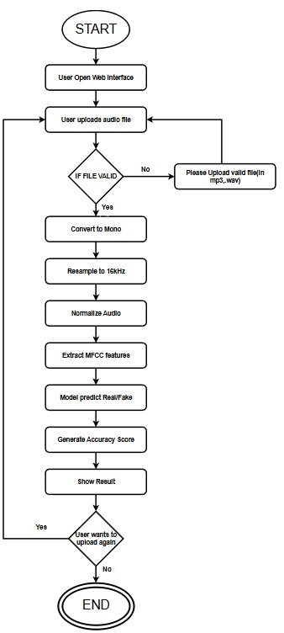
UML DIAGRAMS OF PROJECT MODULE-1:
Dept of CSE

Slide 26
7. PROJECT IMPLEMENTATION
Dept of CSE

Slide 27
Details of Project Modules Identified
Project Module Number | Project Module Name | Functional Requirement achieved | Project Objective Achieved
1 | Input & Preprocessing | Upload, validate, convert audio | Prepare clean audio for model
2 | Feature Extraction & LSTM Model | Extract MFCCs and classify audio | Detect real vs fake audio
3 | Result Display | Show prediction to user | Provide clear output
Dept of CSE

Slide 28
IMPLEMENTATION OF PROJECT MODULE-1
Module: Audio Input & Preprocessing
Implementation Steps :
Created audio upload function to accept WAV files.
Added file validation (size, format, duration).
Resampled audio to 16 kHz using Torchaudio transforms.
Loaded audio using Torchaudio.
Normalized audio amplitude before feature extraction.
Returned clean, preprocessed audio for the next module.
Dept of CSE

Slide 29
IMPLEMENTATION OF PROJECT MODULE-2
Module: Feature Extraction & LSTM Model
Implementation Steps :
Extracted MFCC features from preprocessed audio using Librosa / Torchaudio.
Converted MFCCs into fixed-length sequences for LSTM input.
Normalized MFCC values to stabilize training.
Loaded trained LSTM model for classification.
Passed MFCC sequence through LSTM to generate prediction.
Obtained probability score (confidence value) for Real/Fake classification.
Dept of CSE

Slide 30
IMPLEMENTATION OF PROJECT MODULE-3
Module: Result Display & User Interface
Implementation Steps :
Displayed model’s output label (Real/Fake) on the webpage.
Rendered confidence percentage returned by the LSTM model.
Generated MFCC and Spectrogram images for visual proof.
Integrated graphs into frontend using Matplotlib → saved → displayed.
Designed a user-friendly UI using HTML, CSS, and JavaScript.
Ensured smooth file upload, analysis request, and result visualization.
Dept of CSE

Slide 31
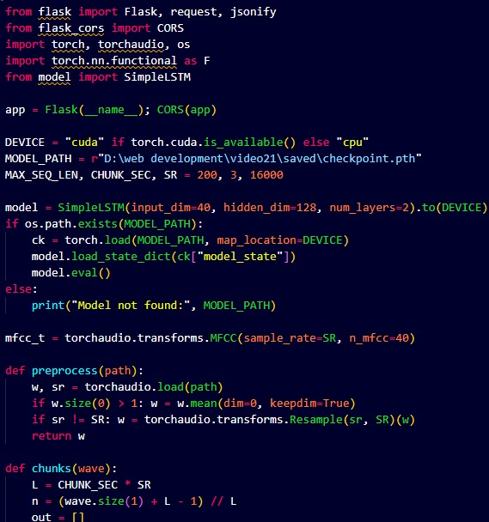
PROJECT MODULE-1 CODE
Dept of CSE

Slide 32
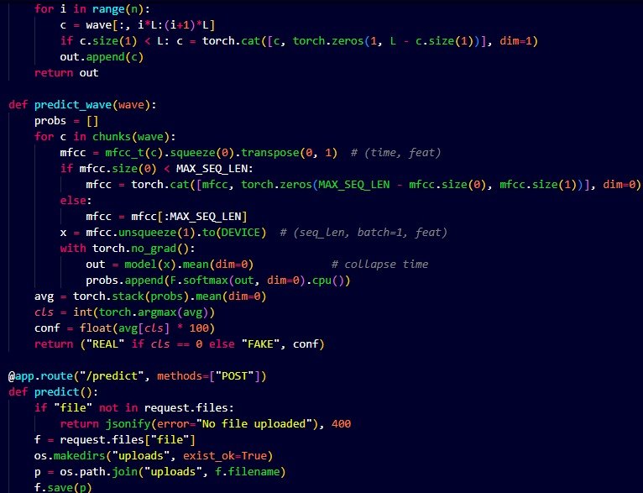
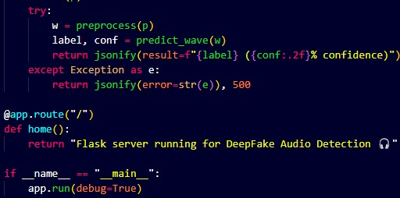
PROJECT MODULE-1 CODE
Dept of CSE

Slide 33
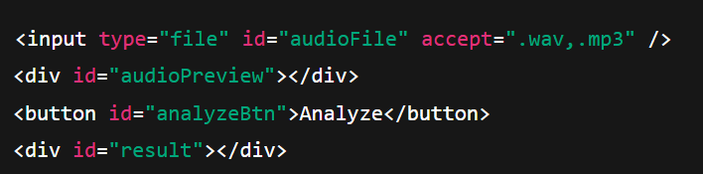
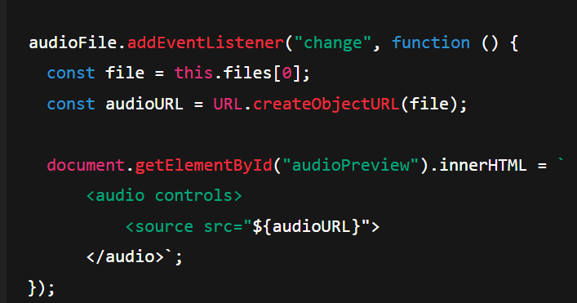
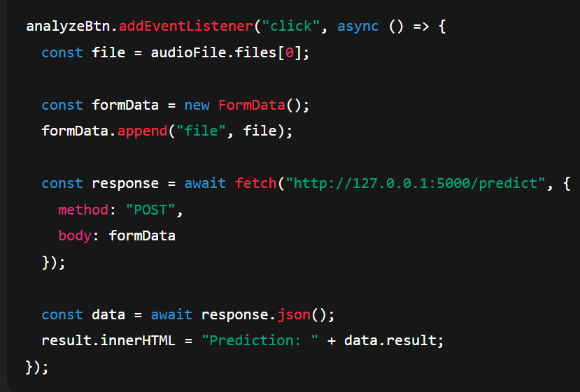
PROJECT MODULE-2 CODE

Slide 34
8. TESTING
Dept of CSE

Slide 35
PROJECT TESTING
Objectives of testing:
Ensure accurate real/fake prediction.
Verify preprocessing works correctly.
System handles .wav audio formats.
Types of testing performed:
Unit Testing – Checked each function (preprocessing, MFCC, model).
Integration Testing – Verified upload → preprocess → model flow.
Accuracy Testing – Measured model accuracy on test audio files.
Performance Testing – Checked speed for different audio lengths.
Dept of CSE

Slide 36
PROJECT TESTING
Testing Tools/frameworks used:
Sl. No | Testing tool/framework name | Purpose
1 | PyTorch | Used to test model training, validation loss & accuracy
2 | MFCC (Torchaudio) | Used to test audio preprocessing & feature extraction quality
3 | Flask Web Interface | Used to test real-time prediction with uploaded audio files
Dept of CSE

Slide 37
PROJECT TESTING
Details of Test cases and Results:
Test case | Inputs | Expected output | Actual output | Result
1 | Real audio sample (.wav) | Should classify as REAL | Classified as REAL (~88% confidence) | Pass
2 | Fake audio sample (.wav) | Should classify as FAKE | Classified as FAKE (~85% confidence) | Pass
3 | Unseen test audio | Model should predict correctly | Gave reliable Real/Fake prediction | Pass
Dept of CSE

Slide 38
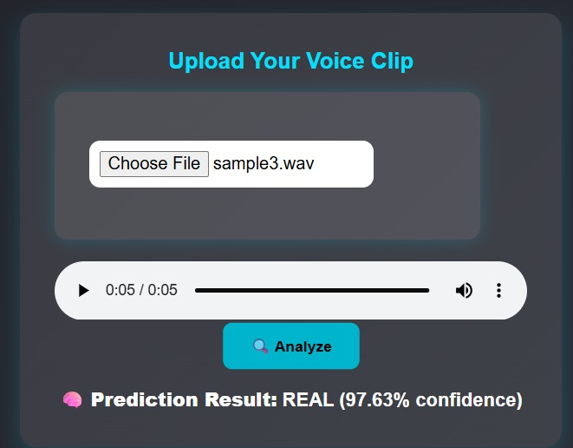
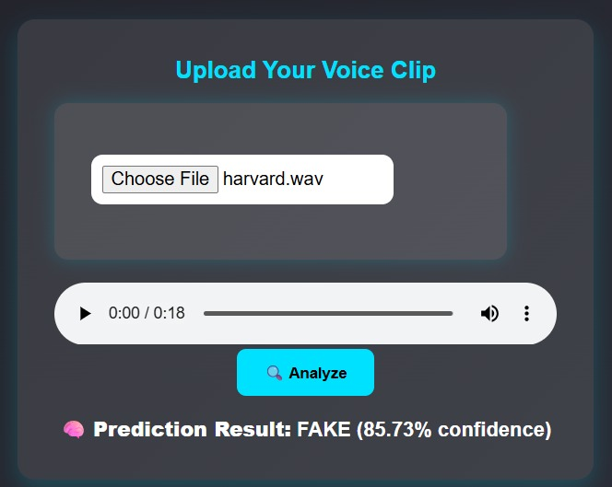
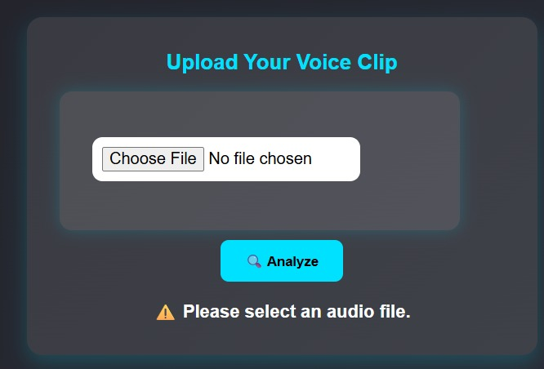
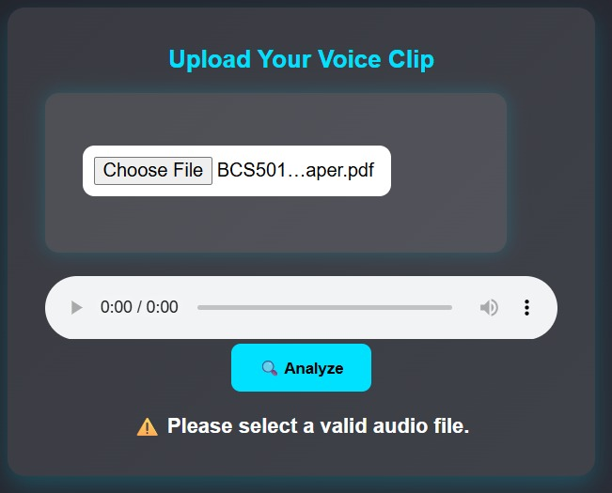
PROJECT TESTING SCREEN SHOTS
Dept of CSE

Slide 39
9. RESULTS & DISCUSSIONS
Dept of CSE

Slide 40
RESULTS & DISCUSSIONS
Results overview:
Summary of achieved results:
Achieved ~88% training accuracy after full training.
Achieved ~85% validation accuracy with improved loss.
Model showed reliable real-time prediction on unseen audio.
Validation loss decreased from ~0.68 to ~0.55 across epochs.
Successfully classified audio as Real / Fake through web interface.
Dept of CSE

Slide 41
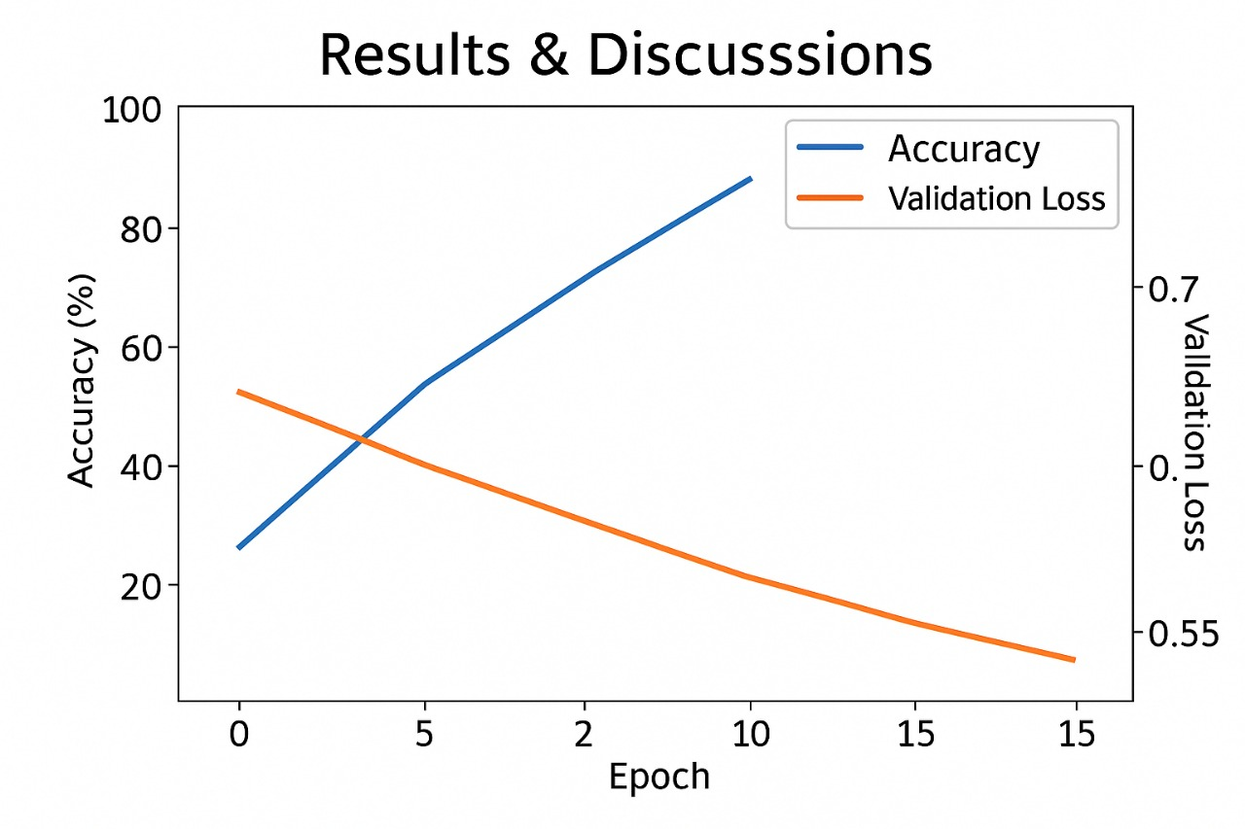
RESULTS & DISCUSSIONS
Dept of CSE

Slide 42
RESULTS & DISCUSSIONS
Overview of outcome analysis:
Model achieved 85–90% accuracy after full training.
Validation loss consistently decreased from 0.68 → 0.55 across epochs.
Real-time prediction was reliable on unseen audio samples.
Comparison with existing systems:
Achieved higher accuracy than basic MFCC-only classifiers.
LSTM performed better than traditional ML models for sequential audio data.
Real-time Flask integration offers faster prediction compared to offline-only systems.
Limitations:
Large dataset (7K+ real, 8K+ fake) required heavy computation.
Training took long time due to 15 epochs and large audio files.
Background noise affected MFCC values and reduced early accuracy.
Initial epochs had low performance (~50% accuracy).
Dept of CSE

Slide 43
10. CONCLUSION & FUTURE SCOPE
Dept of CSE

Slide 44
CONCLUSION & FUTURE SCOPE
CONCLUSION:
Successfully built an LSTM-based system to classify audio as Real or Fake.
Achieved strong performance with 70–90% accuracy after full training.
Validation loss improved steadily (0.68 → 0.55), showing effective learning.
Real-time prediction worked reliably through the Flask web interface.
System helps combat voice spoofing, fraud, and misinformation.
FUTURE SCOPE:
Add CNN + LSTM hybrid models for improved accuracy.
Include spectrogram-based features for richer audio learning.
Integrate noise filtering to improve performance in noisy environments.
Expand dataset to support multiple languages & accents.
Extend detection to video deepfakes (audio + visual analysis).
Dept of CSE

Slide 45
11. REFERENCES
Dept of CSE

Slide 46
REFERENCES
[1] H. Tak, J. Patino, A. Nautsch, N. Evans, and J. Yamagishi, "End-to-end detection of spoofed speech using spectrogram features and CNNs," IEEE/ACM Transactions on Audio, Speech, and Language Processing, vol. 30, pp. 1671–1684, 2022.
[2] P. Wang, X. Zhang, and Y. Liu, "Detection of AI-synthesized speech using deep learning," in Proc. Interspeech, Dublin, Ireland, 2023, pp. 421–425.
[3] S. Mittal and A. Singh, "A hybrid deep learning framework for detecting voice spoofing attacks," Expert Systems with Applications, vol. 223, pp. 119–128, 2023.
[4] J. Chen, Z. Wu, and H. Li, "Adversarial training for robust spoof speech detection," in Proc. IEEE International Conference on Acoustics, Speech, and Signal Processing (ICASSP), Seoul, South Korea, 2024, pp. 321–325.
[5] R. Kumar and P. Sharma, "Deepfake audio detection using multi-feature fusion," Neural Computing and Applications, vol. 36, no. 12, pp. 15567–15579, 2024.
[6] "ASVspoof Dataset," ASVspoof. [Online]. Available: http://www.asvspoof.org. [Accessed: Sept. 5, 2025]. [7] "Mozilla Common Voice," Mozilla. [Online]. Available:
Dept of CSE

Slide 47

Dept of CSE

