Slide 1
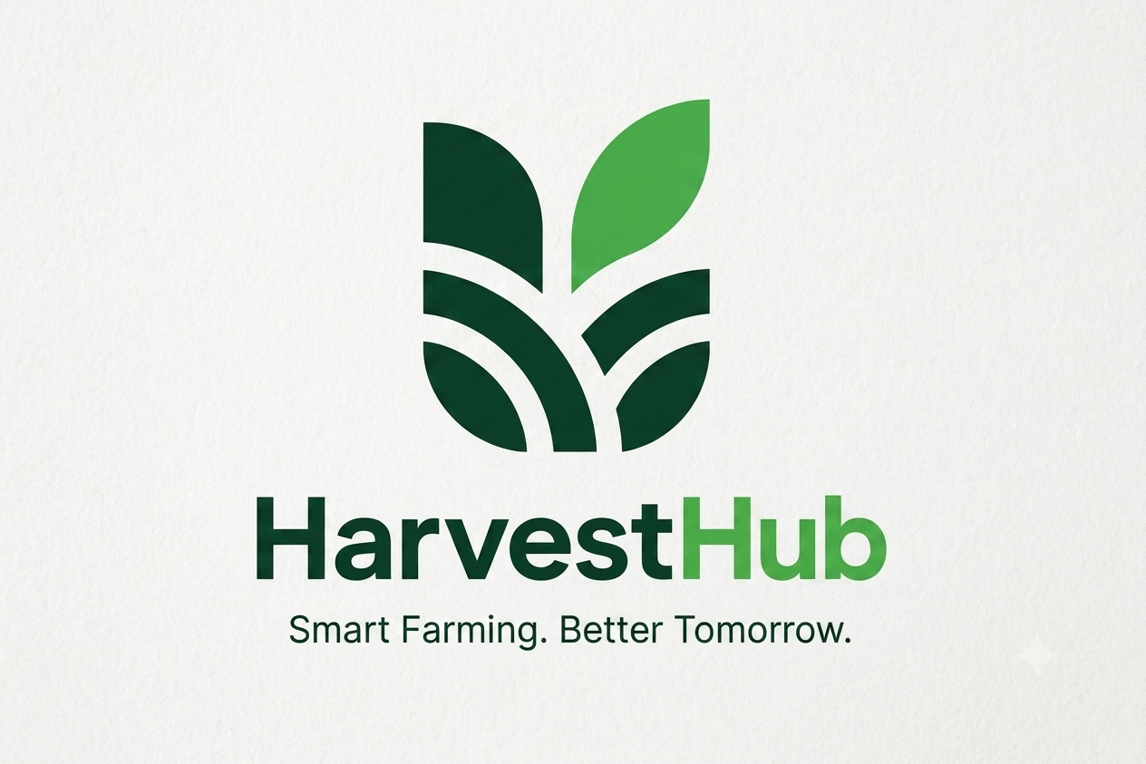
Integrated Agricultural Marketplace and
Logistics Management System
75% Progress Evaluation Presentation Project ICT 2212
Group 12 – CodeX
Bachelor of Information and Communication Technology (BICT)
Rajarata University of Sri Lanka, Mihintale
Notes:
Welcome the panel. Introduce Group 12 - CodeX and the project title. (Time budget: 15 min total; roughly 1 min per content slide, 6-7 min for the demonstration.)

Slide 2

Introduction
Agriculture is the primary livelihood in the North Central Province (Rajarata), yet a wide gap separates rural farmers from urban buyers.
Our Solution: HarvestHub
A digital ecosystem that bypasses middlemen through a "Bidirectional Marketplace", directly connecting Farmers, Buyers, Transporters and Agricultural Officers.
The current situation
1
Middlemen dominate the supply chain, reducing farmer profits.
Officer-verified crop quality before listing
2
Large amount of vegetable waste are thrown away after harvesting, before the vegetables reach the market.
Automated transport cost and vehicle assignment
3
No trusted way for distant buyers to deal directly with farmers.
Payment-first escrow with 2-way delivery confirmation
HarvestHub | Group 12 - CodeX
2
Notes:
Set the context: Rajarata farmers, the farmer-buyer gap, middlemen and waste. HarvestHub is a verified, trust-based supply chain.

Slide 3
Problem Statement
01
02
03
04
Information Asymmetry
The Trust Gap
Logistical Inefficiency
Financial Risk & Uncertainty
Farmers harvest without knowing real market demand, causing oversupply and price crashes.
Distant urban buyers cannot verify crop quality, so they prefer middlemen over small-scale farmers.
Transport for small harvests is hard to find and expensive, so fresh produce spoils before reaching the market.
No secure system for advance payments; farmers and buyers fear dealing with strangers.
HarvestHub | Group 12 - CodeX
3
Notes:
Four problems: information asymmetry, trust gap, logistics, payment risk. Each maps to a HarvestHub feature on the next slides.

Slide 4
Proposed Solution
A four-user platform: Farmers, Buyers, Agricultural Officers and Transporters.
1
Bidirectional Marketplace
2
Verified Quality Assurance
Farmers list available harvest (Supply) while Buyers post specific "Wanted" ads (Demand).
Department of Agriculture Officers review visual evidence on a desktop dashboard and assign quality grades before listings go live.
3
Built-In Logistics Coordination
4
End-to-End Tracking & Escrow
An automated engine calculates transport fees from distance and weight and assigns the most suitable vehicle.
A strict payment-first policy with a 2-way digital handshake confirms delivery and releases escrow funds automatically.
HarvestHub | Group 12 - CodeX
4
Notes:
Walk through the four solution pillars, matching each to the problems on the previous slide.

Slide 5
Project Objectives
Aim: Develop a trusted agricultural marketplace and logistics ecosystem connecting farmers directly with buyers.
Smart Listing System
Officer Verification Panel
1
2
Farmers create listings using a guided real-time camera with GPS location checks.
Officers view pending listings and manually assign a Quality Grade (e.g., Grade A).
Negotiation & Scheduling
Logistics Dispatch & Cost Calculator
3
4
In-app chat to negotiate prices and lock in a pickup date.
Assigns vehicles by weight capacity and calculates fees automatically.
Digital Proof-of-Loading
Automated Final Settlement
5
6
Geotagged photos of loaded crops trigger release of the advance payment.
2-way confirmation by buyer and transporter releases final payment and updates trust ratings.
HarvestHub | Group 12 - CodeX
5
Notes:
Six measurable objectives. Objectives 1-3 are complete (Increments 01 and 02); 4-6 are Increment 03, currently scaffolded.

Slide 6
Functional & Non-Functional Requirements
Functional Requirements
Non-Functional Requirements
Guided real-time camera: gallery uploads disabled; wide-angle and close-up evidence of the harvest is captured live.
Security
All REST API communication secured with Spring Security and JWT authentication.
Automatic transport cost: Cost = (Distance km × Rate per km) + (Load Weight × Rate per kg).
Data Management
MongoDB Atlas cloud database for scalable, real-time synchronization.
Listing lock: a listing becomes "Under Review" when an officer claims it, preventing duplicate grading.
Integration
Automatic advance release: paid to the Farmer the moment the Transporter sets the status to "Start Journey".
Logistics calculator uses the Google Maps API for accurate distances.
HarvestHub | Group 12 - CodeX
6
Notes:
Highlight one functional requirement per role (camera, cost formula, listing lock, advance release) and the three technical constraints.

Slide 7
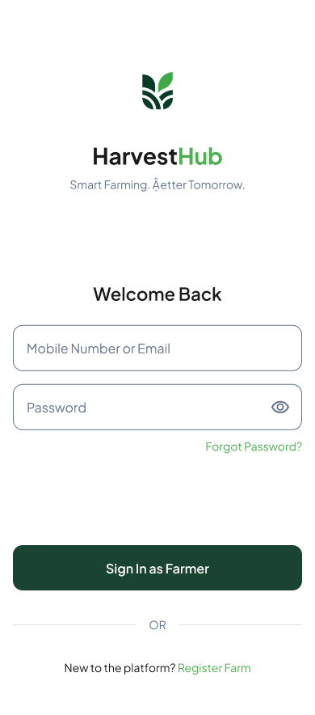
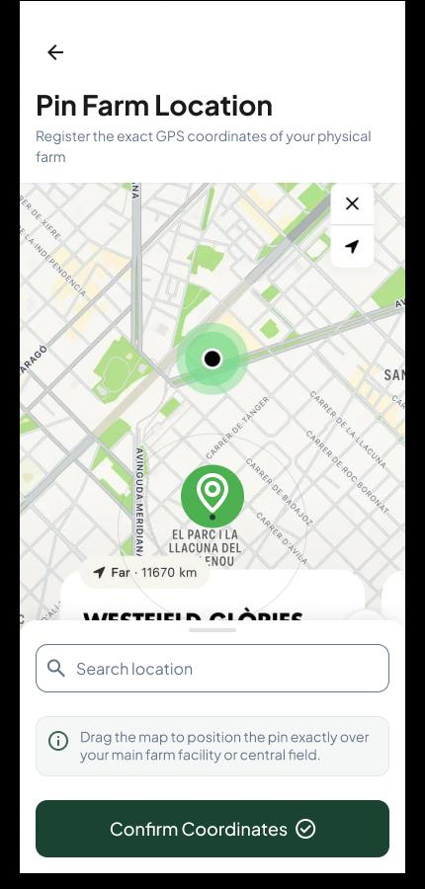
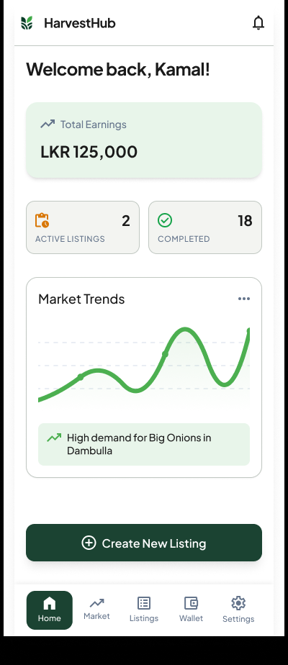
Project Demonstration
75% milestone completed - Increments 01 and 02 delivered, Increment 03 architecturally ready.
Live Demo: Farmer App
100%
Increment 01: Trust & Verification
Android farmer app: location-locked initiation, smart guided camera, submission to cloud database. JavaFX officer portal: pending queue, geotagged media review, approve and grade.
100%
Increment 02: Marketplace
Buyer app: search and filter verified crops, post demand requests, real-time chat for price negotiation and scheduling.
Ready
Increment 03: Logistics Ecosystem
Login
Pin Farm Location
Market Dashboard
Transporter API endpoints and UI views (Job Queue, Proof-of-Loading Camera) scaffolded for the final 25% dispatch logic.
HarvestHub | Group 12 - CodeX
7
Notes:
Run the live demo: farmer login, pin farm location and guided capture, officer portal grading, buyer search/filter and chat. Then note Increment 03 scaffolding and the plan for the remaining 25%.

Slide 8
Thank You
Questions & Answers
HarvestHub | Group 12 - CodeX
Notes:
Thank the panel and invite questions (15-minute Q&A session).

