Slide 1

Weather Data Analysis & Prediction
India Weather Dataset (8766 records)

Slide 2
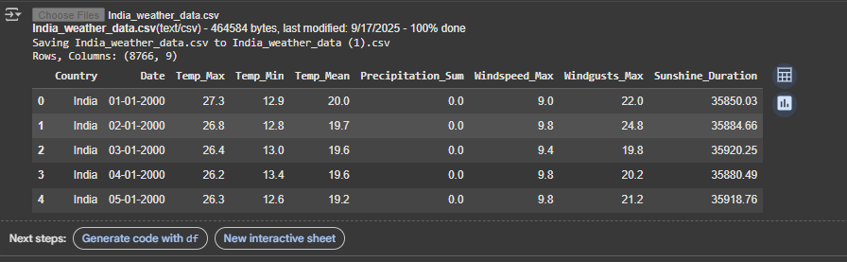
Introduction
Weather data analysis helps in understanding climate patterns.
Dataset: 8766 rows (daily weather data).
Goal: Analyze trends and predict next year’s values.

Slide 3
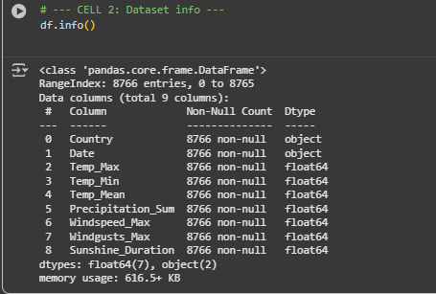
Dataset Overview
Contains columns like:
Year, Month, Day
Temperature (Max, Min, Mean)
Precipitation Sum
Sunshine Hours
Covers multiple years of daily observations.

Slide 4
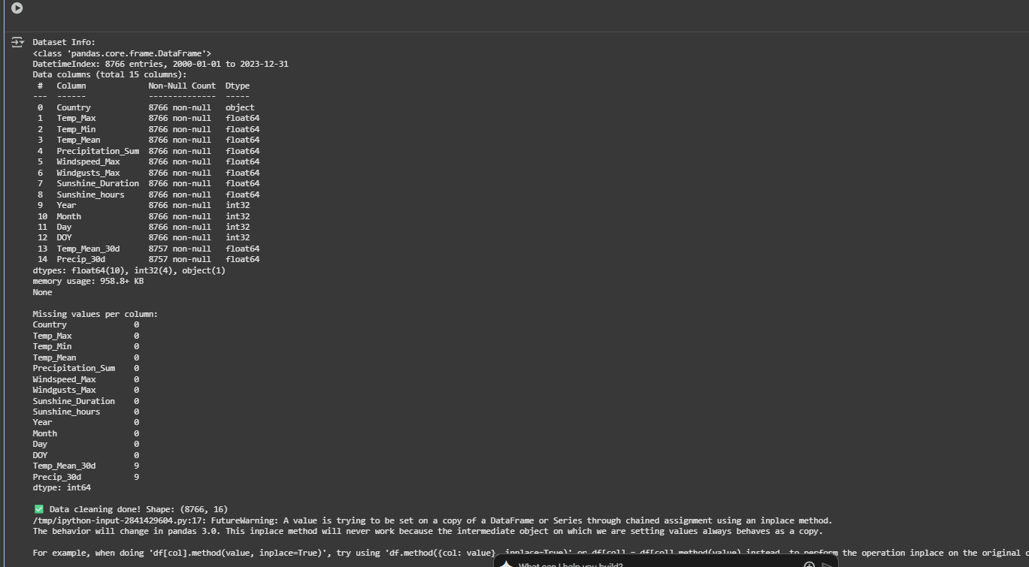
Data Cleaning
Checked for missing values.
Converted date fields into datetime format.
Ensured numerical fields were valid.
Prepared dataset for visualization and modeling.

Slide 5
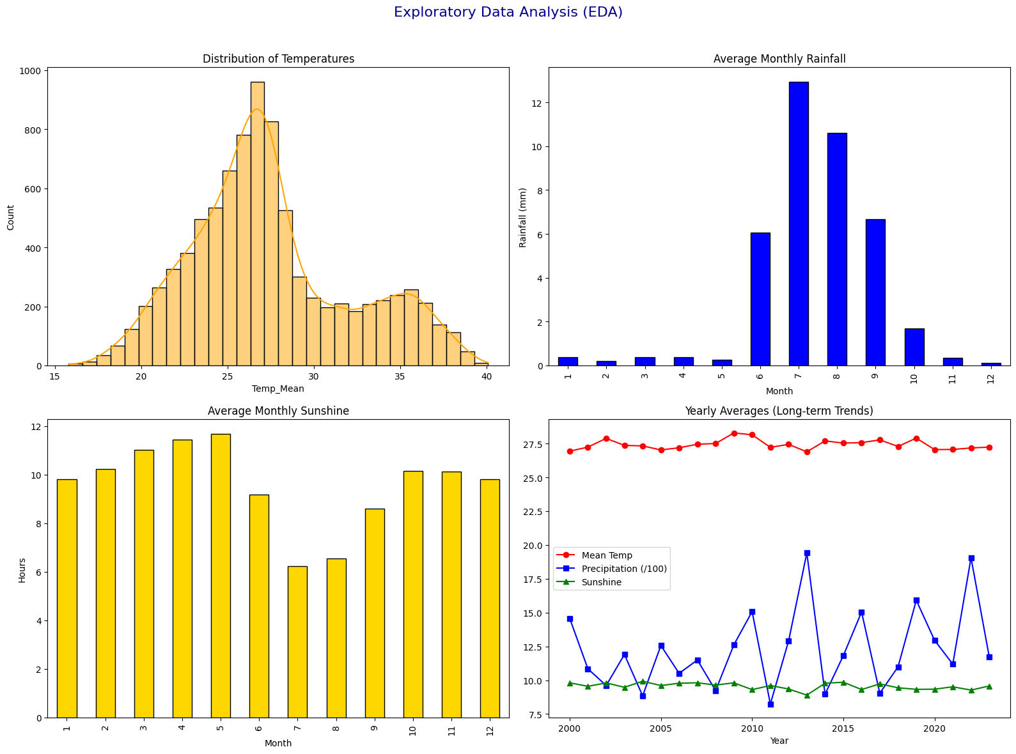
Exploratory Data Analysis
Distribution of temperatures across years.
Seasonal rainfall and sunshine patterns.
Yearly averages show long-term climate shifts.

Slide 6
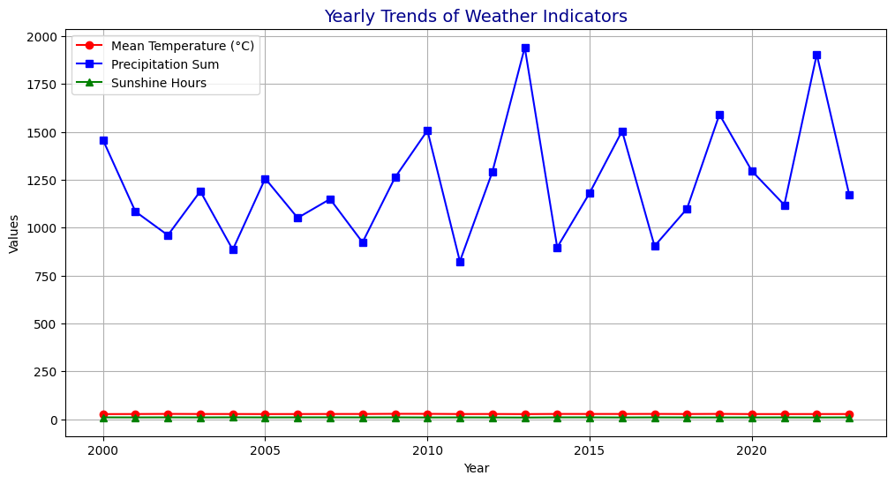
Yearly Trends
Yearly averages were calculated:
Mean Temperature
Precipitation Sum
Sunshine Hours
Trends reveal climate variability across years.

Slide 7
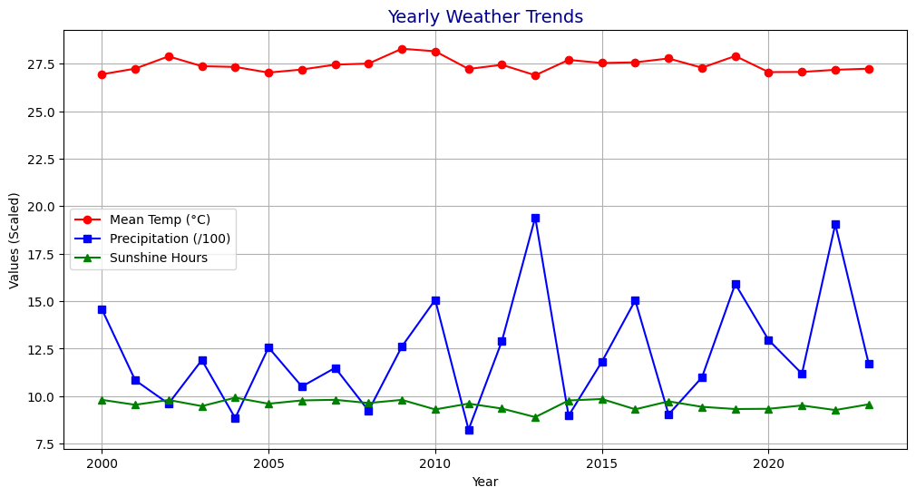
Visualization
Line charts plotted for yearly trends.
Clear fluctuations in temperature and rainfall.
Sunshine hours show seasonal consistency.

Slide 8
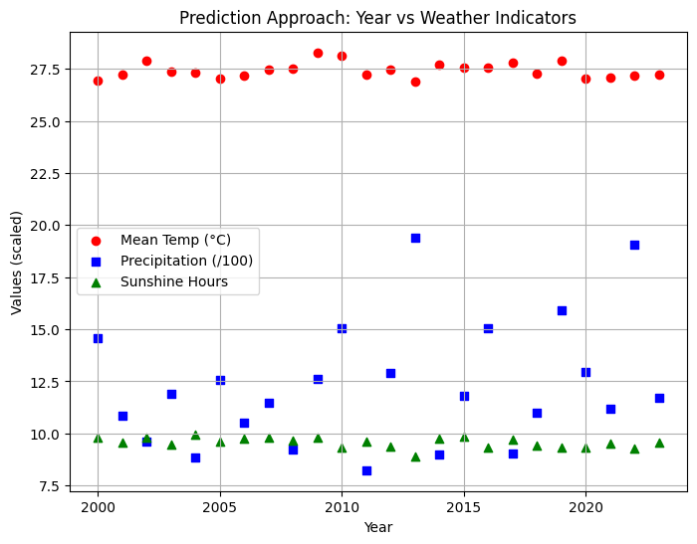
Prediction Approach
Machine Learning model: Linear Regression.
Independent Variable: Year.
Target Variables:
Mean Temperature
Total Precipitation
Sunshine Hours

Slide 9
Model Training
Data grouped by year.
Trained separate regression models:
Temperature
Precipitation
Sunshine Hours
Simple and interpretable model.

Slide 10
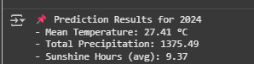
Prediction Results
Predicted next year’s values:
Mean Temperature (°C)
Total Precipitation
Sunshine Hours
Forecast shows continuation of past trends.

Slide 11
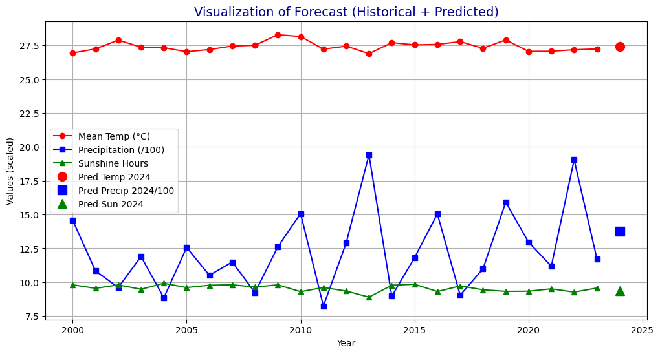
Visualization of Forecast
Historical values plotted alongside predictions.
Red markers highlight forecasted values.
Helps in understanding expected climate change.

Slide 12
Conclusion
Weather data analysis provides insights into climate patterns.
Yearly averages reveal trends in temperature, rainfall, and sunshine.
Prediction models estimate future climate conditions.
Useful for agriculture, planning, and disaster management.

