Slide 1
SALESTORM
TEAM
Team_8
High-Scale E-Commerce Flash Sale System
MEMBERS
Boopana M
Darshan AR
Priyanka TM
Nitin M
10,000 Customers. 100 Units. Zero Overselling.
HACKATHON
SALESTORM – SYSCRAFTERS 2026
Design-First, AI-Assisted System Design Hackathon

Slide 2
Problem Statement
10,000 concurrent customers
WHAT CAN GO WRONG
Massive traffic spike
Limited inventory
BUY NOW
Concurrent requests on the same stock
Risk of overselling
Only 100 units available
Duplicate orders
Payment and service failures
How do we decide which requests succeed without compromising inventory or transaction correctness?

Slide 3
A Real Industry Problem
Normal traffic
Flash sale starts
Traffic spike
System pressure
Browse, cart, checkout at a steady rate
Sale opens at a fixed time
Everyone clicks Buy together
DB locks, slow payments, growing queues
WHERE IT BREAKS
BUSINESS IMPACT
Database contention on one stock row
Lost revenue
Payment gateway delays
Customer dissatisfaction
Downstream services failing
Overselling
Duplicate transactions
Failed orders
Jury question: Why can't a normal checkout handle this? → Every request touches stock, so correctness breaks under contention.

Slide 4
Business Requirements
BUSINESS NEED
SYSTEM REQUIREMENT
Handle sudden traffic spikes
Edge absorption, rate limiting, horizontal scale
No overselling
Concurrency-safe inventory reservation
No duplicate payment
Idempotency keys on purchase and payment
Held stock must not get stuck
Temporary reservation with expiry
Reliable processing
Retry + reconciliation + events
Traceable transactions
Audit logs + correlation IDs
Jury question: Which requirement matters most? → No overselling. Every other choice protects it.

Slide 5
Functional + Non-Functional
FUNCTIONAL
NON-FUNCTIONAL
Product discovery
Cart
Inventory check
Scalability
Availability
Consistency
Reservation
Checkout
Payment
Low latency
Security
Fault tolerance
Order
Shipment
Notification
Observability
MEASURABLE CONSTRAINTS
10,000
concurrent purchase attempts
100
available units
0
overselling
Safe
duplicate requests
Release
reservation on payment failure
Jury question: How do we know the design is correct? → Each requirement is measurable and can be checked with a test.

Slide 6
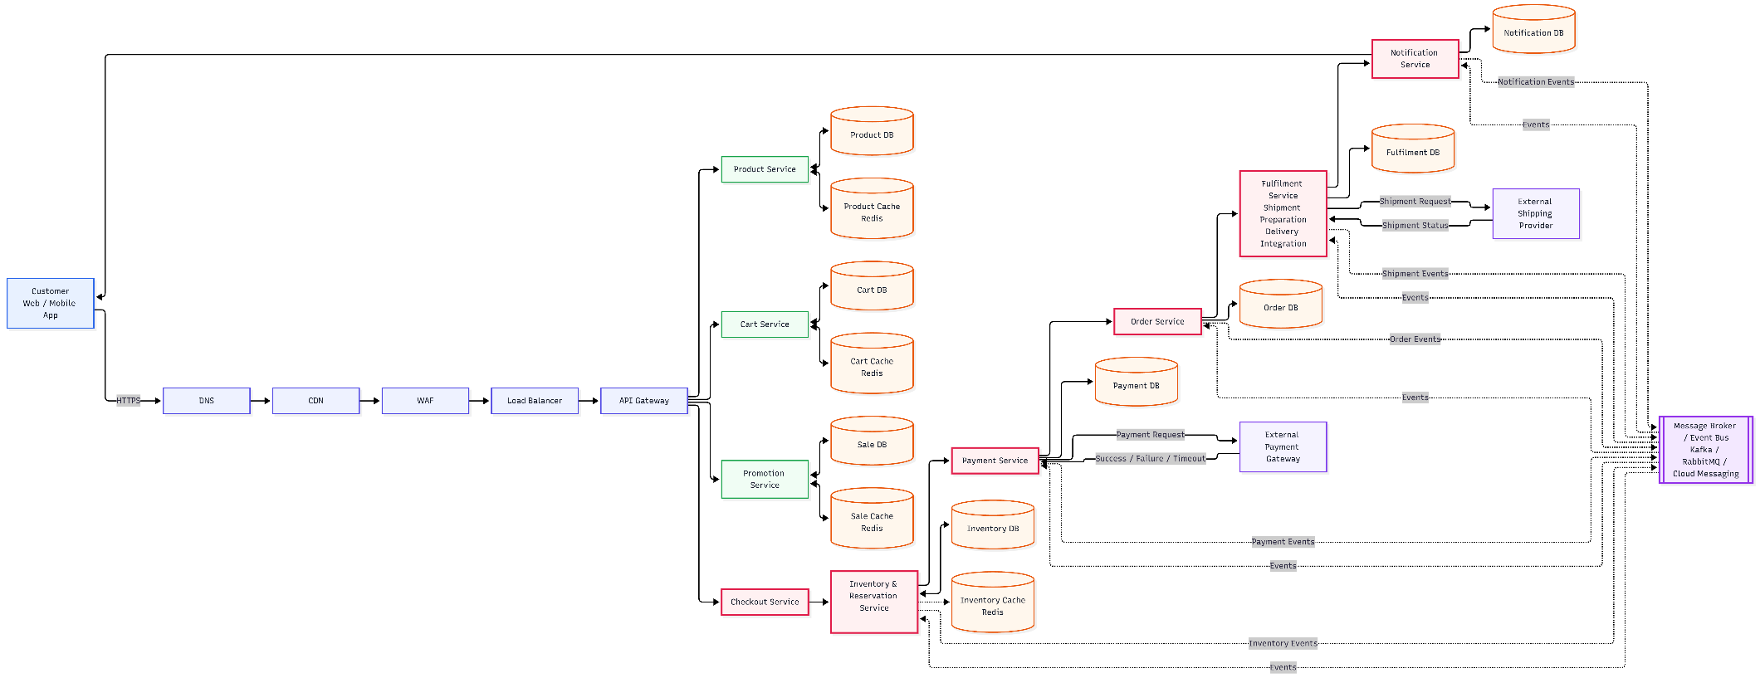
Architecture Overview
Users
CDN / WAF
Load Balancer
API Gateway
Product / Cart / Sale
absorbs and filters edge traffic
spreads requests over instances
routing + rate limiting
cached, read-heavy
Shipment / Notify
Order Service
Payment Service
Checkout
Inventory + Reservation
async, off the critical path
created from a payment event
adapter to the gateway
owns the purchase flow
consistency boundary
SUPPORTING INFRASTRUCTURE
Cache
Message Queue
Database
Monitoring
Logging
Tracing
cuts DB reads; not stock truth
absorbs async load
source of truth
Async (events, queue)
Sync (critical path)
Jury question: Why do we need an API Gateway? → One entry point for routing, auth and rate limits.

Slide 7
10,000 → 100
10,000 BUY REQUESTS
Traffic Absorption
CDN · WAF · LB
Queue / Rate Limit
Inventory Service
Concurrency Control
atomic reserve
ONLY 100 SUCCESSFUL RESERVATIONS
critical inventory path
10,000
requests
100
successful
9,900
rejected / failed safely (sold out)
The system does not allow all requests to directly modify inventory.
Jury question: Where exactly is overselling prevented?
At the inventory reservation boundary, using concurrency-safe atomic reservation logic.
Counts show the design target for the scenario, not measured results.

Slide 8
Inventory Reservation
AVAILABLE
RESERVED
PAYMENT_PENDING
CONFIRMED
SOLD
RESERVED
PAYMENT_FAILED
RELEASED
available + reserved + sold = total inventory
RESERVED
TIMEOUT
RELEASED
Every reservation carries: reservation_id · expires_at · idempotency_key · version
LAST UNIT EXAMPLE (INVENTORY = 1)
Customer A
A → RESERVED
Target outcome
Sold = 100
Oversold = 0
Inventory Service
(atomic, versioned)
Customer B
B → OUT OF STOCK
Jury question: How can 10,000 requests produce only 100 reservations? → Only a versioned atomic update can take stock.

Slide 9
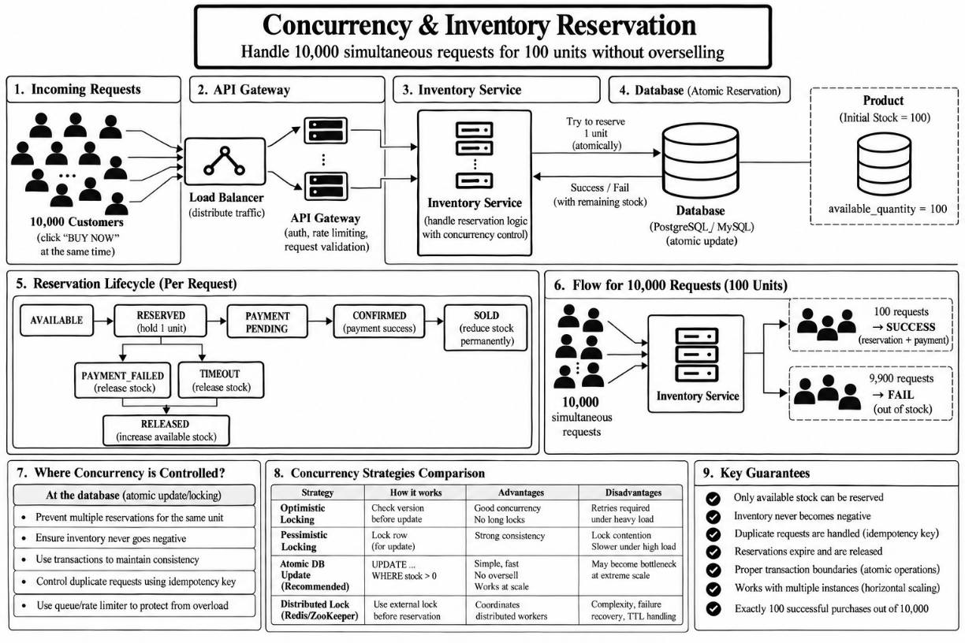

Slide 10
Payment + Order Reliability
CASE 1 · Payment success
Reservation → Payment → Order → Confirmed
CASE 2 · Payment failure
Reservation → Payment failed → Release reservation
CASE 3 · Payment timeout
Payment → Timeout → Safe retry / reconcile → No duplicate payment
CASE 4 · Payment ok, Order Service down
Payment success → Event in queue → Retry → Order created
IDEMPOTENCY
Already
processed?
YES
Return existing result
Idempotency key
Process request once
NO
Jury question: What if payment succeeds but Order Service fails? → The event is retried until the order exists.

Slide 11
Database Design
CUSTOMER
CART
ORDER
PAYMENT
SHIPMENT
PRODUCT
INVENTORY
RESERVATION
critical concurrency path
INVENTORY
RESERVATION
WHY THESE FIELDS MATTER
inventory_id
product_id
available_quantity
reserved_quantity
sold_quantity
version
updated_at
reservation_id
inventory_id
status
expires_at
idempotency_key
version → concurrency control
expires_at → reservation cleanup
idempotency_key → duplicate prevention
Order and Payment store the same key.
Jury question: Why do we need version and idempotency fields? → One stops lost updates, the other stops repeats.

Slide 12
API + Event Design
Endpoint | Service | Purpose
POST /checkout | Checkout | Start purchase, validate session
POST /reservations | Inventory | Atomic reserve, returns reservation_id
POST /payments | Payment | Needs idempotency key
POST /orders | Order | Create order after payment
GET /orders/{id} | Order | Read order status
EVENTS
ReservationCreated
PaymentSucceeded
PaymentFailed
OrderCreated
ReservationExpired
ShipmentCreated
SYNC
Checkout
Inventory
Why async here?
To prevent downstream failure from blocking the critical transaction path.
ASYNC
Payment
Event bus
Order
Jury question: Why is this operation asynchronous? → Order creation can retry without holding up checkout.

Slide 13
LLD + SOLID + Patterns
INVENTORY MODULE
SOLID
PATTERNS: WHAT THEY SOLVE
InventoryService
reserve(), release(), confirm()
SRP
InventoryService only orchestrates reservation
State
Reservation lifecycle; blocks illegal jumps like SOLD → RESERVED
Strategy
Swap reservation or payment rules without editing the service
ReservationManager
state transitions, expiry
DIP
Service depends on a repository interface, not SQL
Repository
Hides the DB behind an interface; tests use a fake
«interface» InventoryRepository
tryReserve(id, version)
Adapter
Wraps the external payment provider API
OCP
New reservation strategies plug in without edits
SqlInventoryRepository
conditional UPDATE
Circuit Breaker
Stops calling a provider that keeps failing
Jury question: Why this design pattern? → Each one removes a specific failure or coupling problem.

Slide 14
Failure Handling & Recovery
Scenario | Failure | Recovery
Payment declined | Gateway returns failure | Release reservation; stock back to AVAILABLE
Payment timeout | No answer from gateway | Retry with same idempotency key; reconcile
Order Service down | No order after payment | Event stays in queue; retry until created
Database blip | DB briefly unavailable | Retry with backoff; fail safe, never guess stock
Message fails | Consumer errors repeatedly | Retries, then dead-letter queue + alert
External service down | Provider keeps failing | Circuit breaker opens; fail fast
A reconciliation job compares payments, reservations and orders, and repairs any drift.
Failure is expected. Incorrect state is not.
Jury question: How does the system recover? → Retries, dead-letter queues and reconciliation restore correct state.

Slide 15
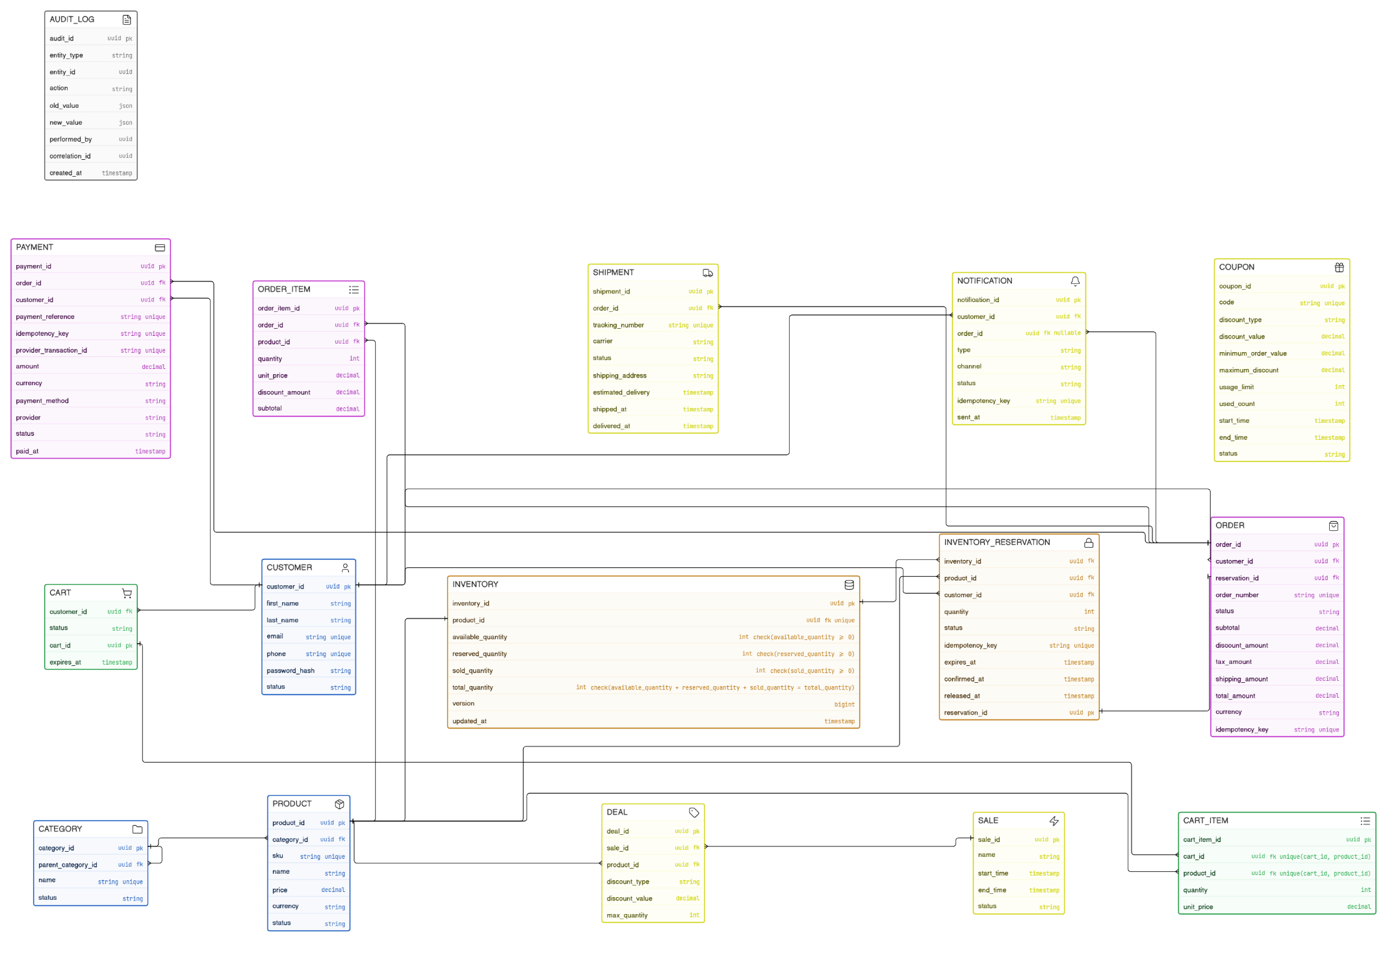
ER Diagram

Slide 16
Scalability, Security & Observability
SCALABILITY
SECURITY
OBSERVABILITY
10K req/s → 500K req/s (50×)
HTTPS everywhere
Authentication
Authorization
Rate limiting
Input validation
Secrets management
Secure payment handling
Audit logs
Request rate, latency, error rate
Payment failures
Reservation failures
Queue backlog
Distributed tracing
Structured logging
Stateless services scale out
Load balancing across instances
Cache read-heavy product data
Queues absorb async work
DB read replicas, partition by product
Hot stock stays behind one reservation boundary
How do we know the system is healthy?
Low errors, flat queue backlog, reconciliation finds no drift.
Jury question: What changes when traffic increases 50×? → Scale out stateless layers; protect the inventory write path.

Slide 17
Prototype + Final Impact
Concurrent requests
10,000
test input
Available units
100
test input
Successful reservations
[ fill after run ]
target: 100
Overselling
[ fill after run ]
target: 0
Duplicate orders
[ fill after run ]
target: 0
Reservation expiry
[ verify ]
handled by expiry job
Problem
Architecture
Concurrency control
Reliable transactions
Failure recovery
Scalable system
100 units must produce at most 100 successful sales, regardless of how many customers compete for them.
Design first. Validate with evidence. Defend every decision.
Jury question: How did we validate the design? → Load test with fixed inputs; results recorded as measured.

