Slide 1

RubyOnRails
A web-application framework that includes everything needed to create database-backed web applications according to the Model-View-Controller(MVC) pattern.
magician

Slide 2
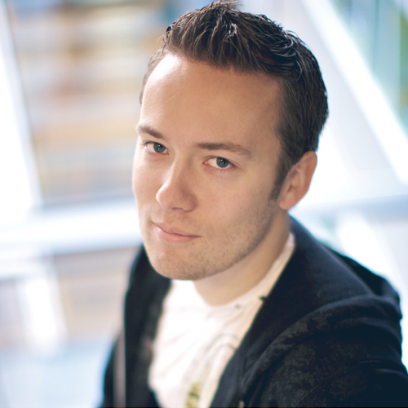
David Heinemeier Hansson - DHH

Slide 3
MVC
Model-View-Controller

Slide 4
Philosophy 1
DRY
(Don't Repeat Yourself)
"Every piece of knowledge must have a single, unambiguous, authoritative representation within a system."

Slide 5
Philosophy 2
Convention Over Configuration

Slide 6
Router
Routing decides which controller receives which requests

Slide 7
Verbs
GET
POST
PUT/PATCH
DELETE

Slide 8
CRUD
Create
Read
Update
Delete

Slide 9
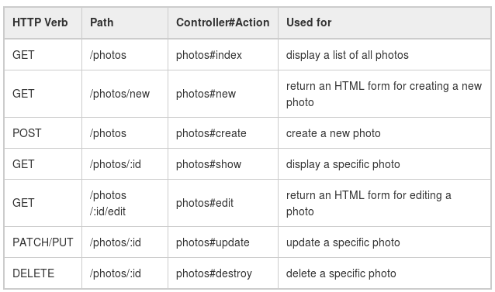
Resources
resources :photos

Slide 10
Controller
A controller's purpose is to receive specific requests for the application

Slide 11
action/method
Each action's purpose is to collect information to provide it to a view.

Slide 12
Model
Active Record is smart enough to automatically map column names to model attributes, which means you don't have to declare attributes inside Rails models, as that will be done automatically by Active Record.

Slide 13
Model - association
One-to-one
One-to-many
Many-to-many

Slide 14
View
A view's purpose is to display this information in a human readable format.

Slide 15
ERB – Embedded Ruby
<% %> Evaluated
<%= %> Display

Slide 16
Dharshan
dharshandj@gmail.com
darshan@fsmk.org
dharshan4help@gmail.com
LinkedIn - Dharshan Bharathur
Github – darshand
Telegram - @dhar5han

