Slide 1

RUBY

Slide 2
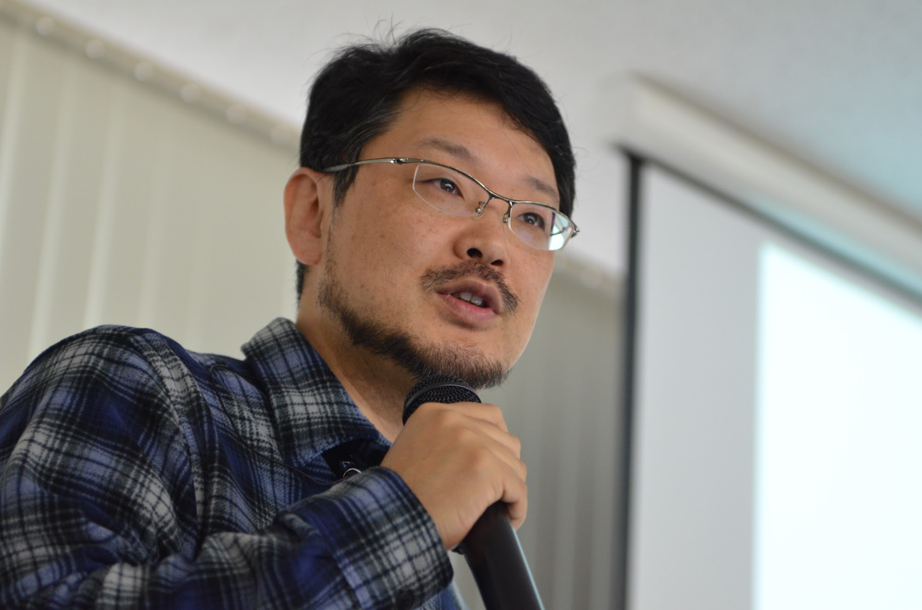
Yukihiro Matsumoto
“Ruby is simple in appearance, but is very complex inside, just like our human body."

Slide 3
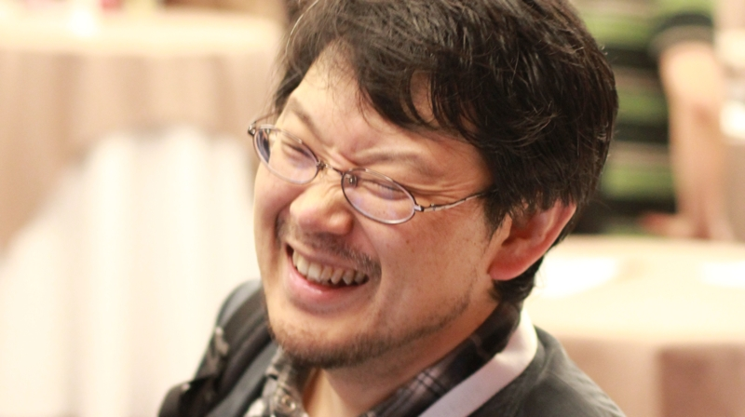
Matz : Programming Difficult?
3.times { print ‘awesome’ }

Slide 4
1994
2000
2005
    TODAY
FUTURE

Slide 5
Interpreted

Slide 6
OOPS its PURE!

Slide 7
IRB vs CL
InteractiveRuby vs CommandLine

Slide 8
Variables
Any Variable = Any Data

Slide 9
Variables
Always starts with lowercase letter
Have no spaces
No special characters in between

Slide 10
Variables
BAD Practice
  camelCase
  1st_lesson
  students_array
  pts
GOOD Practice
  snake_case
  first_lesson
  students
  points

Slide 11
Variables
Types:
    Constant
    Global
    Class
    Instance
    Local

Slide 12
Variables
Constant
  MY_CONSTANT = “I am available throughout your app.”

Slide 13
Variables
Global
  $i_am_global = “I am also available throughout your app.”

Slide 14
Variables
Class
  @@class_variable = 0

Slide 15
Variables
Instance
  @instance_var = “I am available throughout current instance.”

Slide 16
Variables
Local
  i_am_local = “I obey scopes”

Slide 17
Local Variable
What is the output of this code?
def change
x = 5
end
x = 8
change
puts x

Slide 18
global
$x = 42
def change
$x = 8
end
change
puts $x

Slide 19
Variables
puts
- print stuff to screen with newline character at end
print
- print stuff to screen without newline character at end

Slide 20
Variables
Taking input from user
gets
gets.chomp

Slide 21
Exercise
Write a program called name.rb that asks the user to type in their name and then prints out a greeting message with their name included.
Write a program called age.rb that asks a user how old they are and then tells them how old they will be in 10, 20, 30 and 40 years. Below is the output for someone 20 years old.
Modify name.rb again so that it first asks the user for their first name, saves it into a variable, and then does the same for the last name. Then outputs their full name all at once.

Slide 22
self-assignment
x += y # x=x+y
x -= y # x=x-y

Slide 23
Parallel Assignment
x, y, z = 10, 20, 30
a, b = b, a (swapping)

Slide 24
Operator Precedence
PEMDMAS
P=parenthesis,E=exponential,M=multiplication,D=division,M=Modulus,A=addition,S=subtraction

Slide 25
5 – 2 * 3 + 3

Slide 26
Strings
‘Single Letter | Word | Sentence’

Slide 27
‘ vs “
Singel quotes inside single quotes
Double quotation marks can also include the \n escape sequence

Slide 28
String Interpolation
Embed any Ruby expression inside a double quote string using #{ }

Slide 29
Concatenation
Strings can be joined using the + in a process called concatenation

Slide 30
Strings
Methods
  length
  split
  sub | gsub
  upcase | downcase | capitalize
  include?

Slide 31
Exercise

Slide 32
BANG !

Slide 33
Numbers
Integers
Floats

Slide 34
Numbers
Methods
  zero?
  round
  eql?
  round | ceil | floor
  odd? | even?
  positive? | negative?

Slide 35
Exercise

Slide 36
Flow Control
Conditionals
IFTTT – If This Then That

Slide 37
Logical Operators
Comparison : <=, <, >, >=
Equality : ==, !=
Logical : && (AND), || (OR), ! (NOT)

Slide 38
If
It executes code when a conditional is TRUE.
If <condition>
# statement
end

Slide 39
if-else-end
if <condition>
# statement
else
# statement
end

Slide 40
if-elsif-else-end
if <condition>
# statement
elsif <condition>
# statement
else
# statement
end

Slide 41
unless
The unless expression is the opposite of an if expression. It executes code when a conditional is false.
unless <condition>
# statement
else
#statement
end

Slide 42
single line condition
puts "greater" if 20 > 10
puts "not equal" unless 10 == 20

Slide 43
Flow Control
Tertiary
<condition> ? true : false

Slide 44
Flow Control
Case Statement
combination of case, when, else, and end

Slide 45
Exercise
Write a program that takes a number from the user between 0 and 100 and reports back whether the number is between 0 and 50, 51 and 100, or above 100.
Rewrite your program using a case statement. Wrap the statement from exercise 3 in a method and wrap this new case statement in a method. Make sure they both still work.

Slide 46
Loops & Iterators
Simple Loop
loop do
# something
end
loop {
# something
}
infinite

Slide 47
Loops & Iterators
Controlling
loop do
# something
break
end
loop {
# something
break on condition
}

Slide 48
Loops & Iterators
Skip
loop {
# something
next on condition
}

Slide 49
Loops & Iterators
while
while condition
# something
end

Slide 50
Loops & Iterators
Untill
until condition
# something
end
Opposit of while

Slide 51
Loops & Iterators
for
for i in collection do
# something
end

Slide 52
Loops & Iterators
Each
collection.each do | i |
# something
end

Slide 53
Exercise
Write a looping program that takes input from the user, performs an action, and only stops when the user types "STOP". Each loop can get info from the user.

Slide 54
ranges
A range represents a sequence.
''..'' - inclusive range
''...'' - excludes the specified high value
(1..6).to_a
(78...93).to_a
(‘a’..’d’).to_a

Slide 55
Array
List of heterogeneous elements
[ , , ]

Slide 56
Array
Access array element using index value
puts a[0]
puts a[0..1]
Set array element using index value
A[0] = ‘new value’

Slide 57
Array
Inserting
                Push()
                <<
                insert(index,value)

Slide 58
Array
Removing Element
                pop
                delete(element)
                delete_at(position)
                shift

Slide 59
Array
Methods
  first | last
  count | length
  index()
  include?
  sort
  uniq
  reverse
  freeze

Slide 60
Array Manipulation
array + array
array – array
array & array
array | array

Slide 61
Exercise
Write a program that iterates over an array and builds a new array that is the result of incrementing each value in the original array by a value of 2. You should have two arrays at the end of this program, The original array and the new array you've created. Print both arrays to the screen using the p method instead of puts.

Slide 62
Hash
Key - value pairs
fruits = { apples: 3 }
ages = { "David" => 28, "Amy"=> 19 }
User = { :name=>"Dave", :age=>28 }

Slide 63
Hash
my_hash = { apples: 3 , bananas: 5 }
add
my_hash[:bananas] = 5
retrieve
puts my_hash[:apples]
Delete
my_hash.delete(:apples)

Slide 64
Hash
Methods
  keys | values
  key(value)
  has_key? | has_value?
  fetch()
  size | length | count
  sort | sort_by
  each { |k,v| }

Slide 65
Exercise
Using some of Ruby's built-in Hash methods, write a program that loops through a hash and prints all of the keys and values inside a string.

Slide 66
Comments
Single line comment starts with #
mutltiline comment starts with any of the symbol!!
  =begin
    anything goes inside is considered as comments
  =end

Slide 67
Methods
def say
# method body goes here
end
def - Reserved word. Meaninig defintion.
say - Method name. Can be anything.
# - Single line comment.
end - End of method.
Invocation/calling: say
* Methods should be defined before calling them

Slide 68
Methods
With params
def say(param)
# method body goes here
end
param - Parameter.
Invocation/calling: say(‘hi’)

Slide 69
Methods
With defaul params
def say(param=’hello’)
# method body goes here
end
Invocation/calling: say(‘hi’) or say

Slide 70
Methods
With optional params
def say(*p)
# puts p
end

Slide 71
Methods
Returns evaluated result of last line by default, unless an explicit return comes before it
def add_three(number)
number + 3
end
def add_three(number)
return number + 3
end
def add_three(number)
return nuber + 3
number + 4
end

Slide 72
Methods
Chaining
"hi there".length.to_s.to_i.times { p “hi” }

Slide 73
Methods
As arguments
multiply(add(20, 45), add(80, 10))

Slide 74
Exercise
Write a program that prints a greeting message. This program should contain a method called greeting that takes a name as its parameter and returns a string.
Write a program that includes a method called multiply that takes two arguments and returns the product of the two numbers.
Write a program that prompts the user to enter a name and then outputs a greeting based on the input. If user input is empty then print “greetings” else print “welcome <username>”.

Slide 75
Exception Handling
begin
# perform some dangerous operation
rescue
# do this if operation fails
# for example, log the error
end

Slide 76
OOPS

Slide 77
Class
States and Behaviors.
  State : attributes for individual objects
  Behaviors : capabilities of objects
A class in Ruby always starts with the keyword class followed by the name of the class. The name should always be in initial capitals. You terminate the class definition with the keyword end
class MyClass
#logic
end

Slide 78
object
Instance of a class
my_object = MyClass.new

Slide 79
Initializing / Constructing
The purpose of the initialize method is to initialize the class/instance variables for a new object. Which gets called when an object is created.
class Dog
def initialize
puts "This object initialized!"
end
end
sparky = Dog.new
class Dog
def initialize(name)
@name = name
end
end
sparky = Dog.new(‘champ’)

Slide 80
Instance Methods
class Person
def initialize(name)
@name = name
end
def speak
"BlahBlahBlah!"
end
end
sparky = Person.new("James")
sparky.speak
#"#{@name} says arf!"

Slide 81
Exercise
Create a ruby program to write a Cat class which has instance variable name and instance method as sound. And demonstrate how instance method can be invoked on cat object.

Slide 82
Accessors
getter
def get_name
@name
end

Slide 83
Accessors
setters
Ruby provides a special syntax for defining setter methods: the method name is followed by an equal sign (=)
def set_name=(name)
@name = name
end

Slide 84
Accessors
In Ruby it is a common practice to name the getter and setter methods using the same name as the instance variable they are accessing
def name
@name
End
def name=(n)
@name = n
end

Slide 85
attr_accessor
Ruby has a built-in way to automatically create these getter and setter methods for us, using the attr_accessor method which takes a symbol of the instance variable name as an argument
attr_accessor :name

Slide 86
Class Methods
can call directly on the class itself, without having to instantiate any objects
class Person
def self.info
puts "A Person"
end
End
Person.info

Slide 87
Class Variables
Class variables are accessible to every object of a class.
class Person
@@count = 0
def initialize
@@count += 1
end
def self.get_count
@@count
end
end
p1 = Person.new
p2 = Person.new
puts Person.get_count

Slide 88
Inheritance
Inheritance is when a class receives, or inherits, attributes and behavior from another class.
The class that is inheriting behavior is called the subclass (or derived class)
The class it inherits from is called the superclass (or base class)

Slide 89
Inheritance
The < symbol is used to inherit a class from another class.
class Dog < Animal
#some code
end

Slide 90
Inheritance
class Animal
def initialize(name, color)
@name = name
@color = color
end
def speak
puts "Hi"
end
end
class Dog < Animal
End
d = Dog.new("Bob", "brown")
d.speak

Slide 91
Inheritance - overriding
class Animal
def initialize(name, color)
@name = name
@color = color
end
def speak
puts "Hi"
end
end
class Dog < Animal
end
class Cat < Animal
attr_accessor :age
def speak
puts "Meow"
end
end
c = Cat.new("Lucy", "white")
c.age = 2
c.speak

Slide 92
super
Ruby has a built-in method called super, which is used to call methods from the superclass
class Animal
def speak
puts "Hi"
end
end
class Cat < Animal
def speak
super
puts "Meow"
end
end
c = Cat.new
c.speak

Slide 93
Module
Like object but not object
Added to class with include, called mixins
Module lookup using ancestors

Slide 94
UFFF!!!!

