Slide 1


Channabasaveshwara Institute of Technology
(Affiliated to VTU, Belgaum & Approved by AICTE, New Delhi)
(NAAC Accredited & ISO 9001:2015 Certified Institution)
NH 206 (B.H. Road), Gubbi, Tumkur – 572 216. Karnataka.
“SMART GYM MANAGEMENT SYSTEM”
Under the guidance of:
Mrs. MALA K ,MTech
Assistant Professor
Department of ISE,
C.I.T,Gubbi
Submitted by:
Name: DARSHAN D NAIK
USN: 1CG22AD011
Name: H R SHAMANTH
USN:1CG22AD014

Slide 2
CONTENTS
ABSTRACT:
Smart Gym Management System, a console-based application designed to streamline gym operations. Featuring member registration, detailed member information display, attendance tracking, and calorie updates, the system provides a user-friendly interface for staff. Staff authentication ensures secure access to sensitive functionalities. The code, while simple, serves as a foundational model for managing gym-related tasks, allowing for educational exploration and potential expansion to meet broader fitness center requirements.

Slide 3
Introduction:
The Smart Gym Management System, encapsulated in this C code, represents a comprehensive approach to efficiently oversee and organize various aspects of a fitness center's operations. Aimed at enhancing user experience and staff management, the system offers a range of functionalities, including member registration, detailed member information display, attendance tracking, and calorie updates. Its intuitive, console-based interface ensures ease of use, while robust staff authentication mechanisms secure sensitive operations. This program serves as a fundamental tool for understanding the essentials of gym management, providing a solid foundation for educational purposes and serving as a potential starting point for the development of more sophisticated fitness center management systems.

Slide 4
Problem Statement:
The absence of a systematic and automated approach to gym management poses significant challenges in fitness centers. Manual tracking of member details, attendance, and calories burnt can lead to operational inefficiencies and hinder the overall effectiveness of the facility. The current lack of a dedicated system results in a disorganized approach to member management, making it difficult for staff to provide seamless services. There is a pressing need for a Smart Gym Management System that streamlines tasks such as member registration, data display, attendance tracking, and calorie updates. This project addresses these challenges by proposing a comprehensive solution to enhance the operational efficiency and overall management of fitness centers.

Slide 5
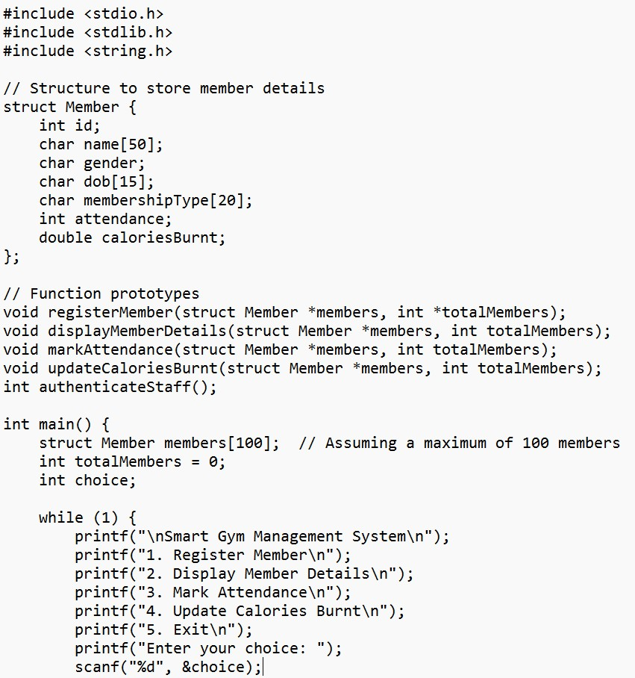
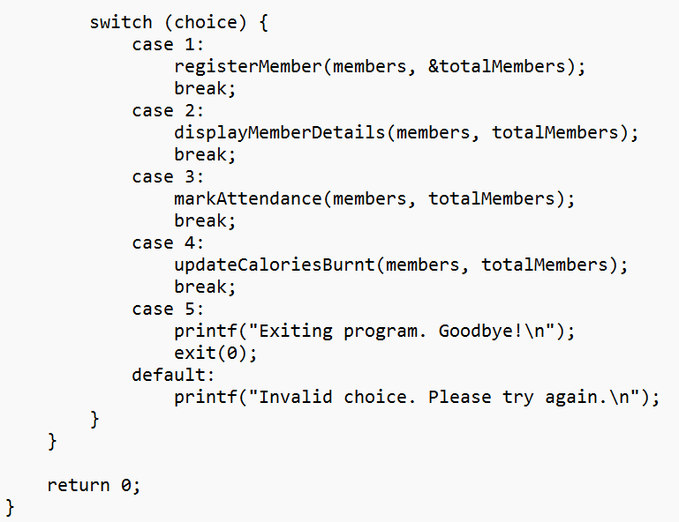
Implementation:

Slide 6
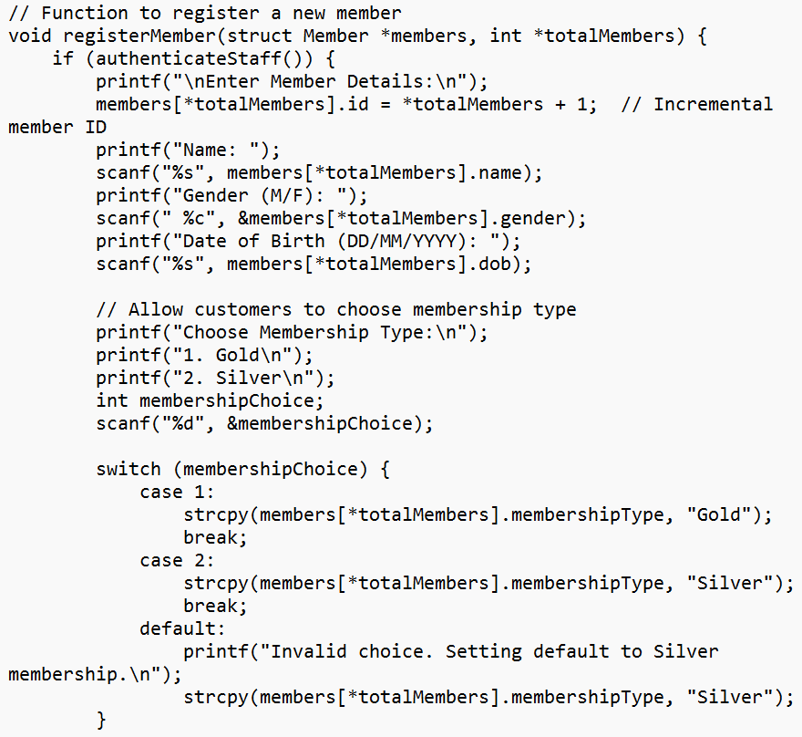
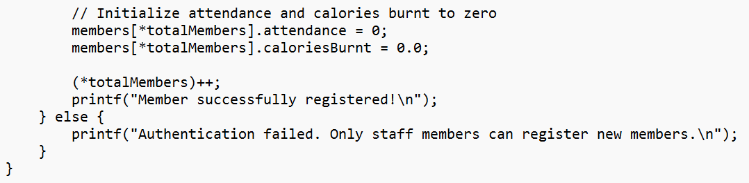

Slide 7
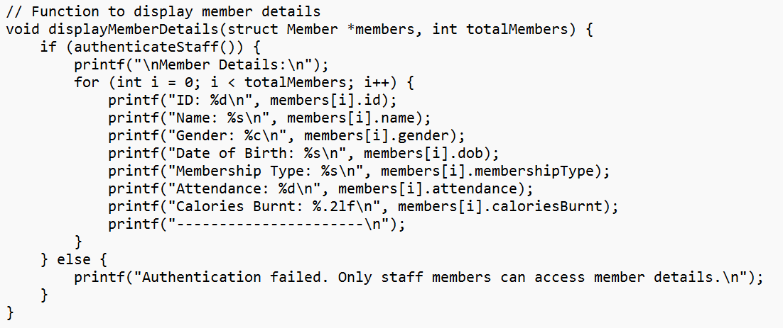
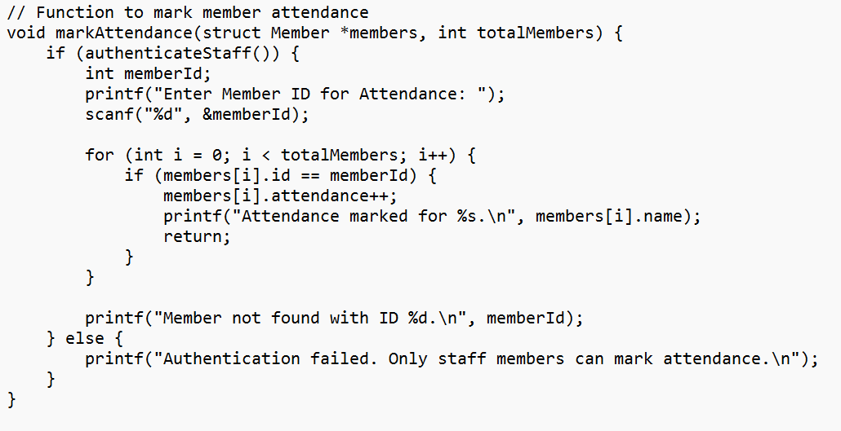

Slide 8
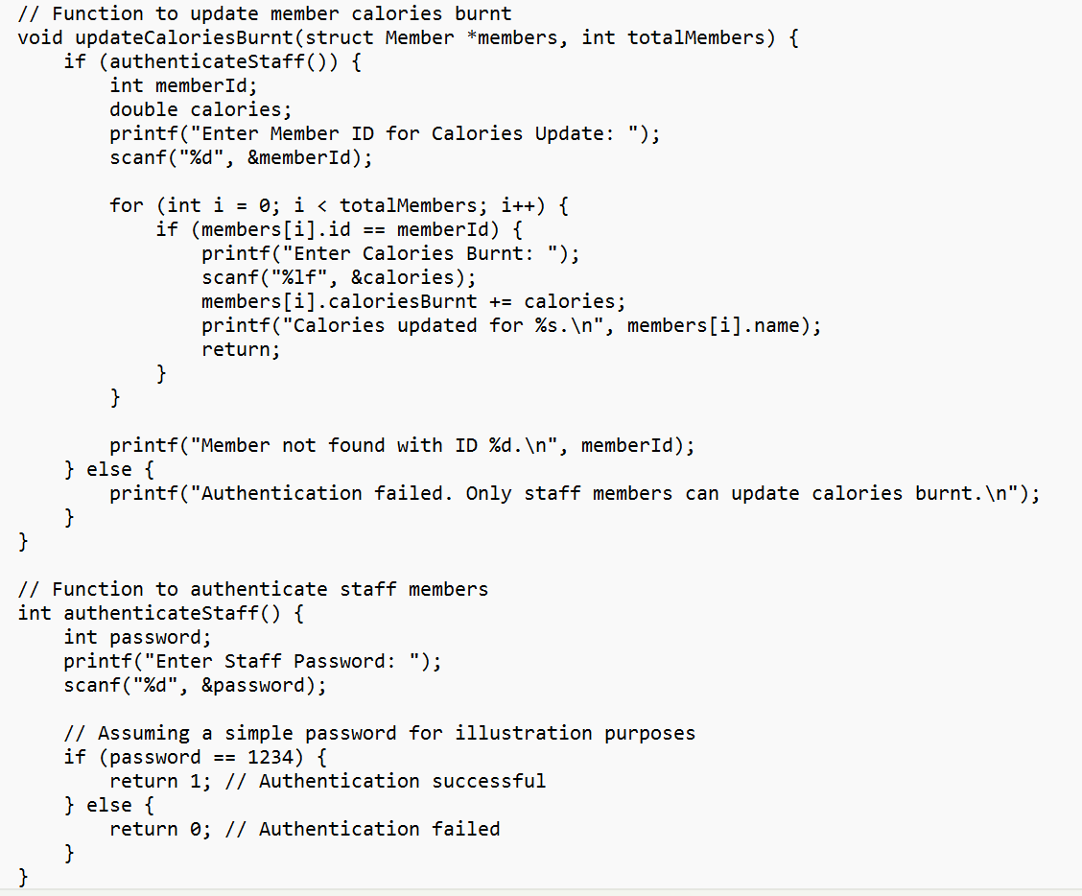

Slide 9
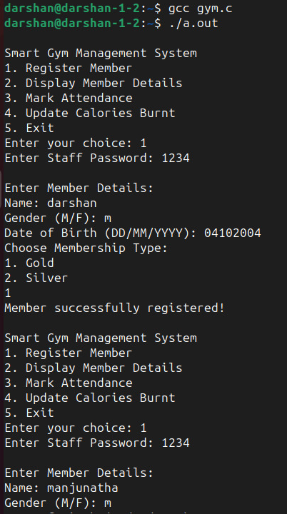
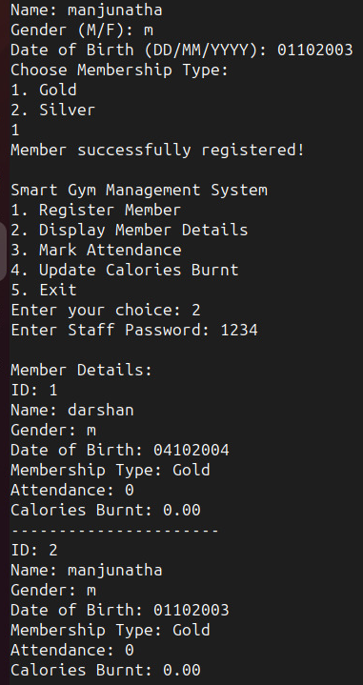
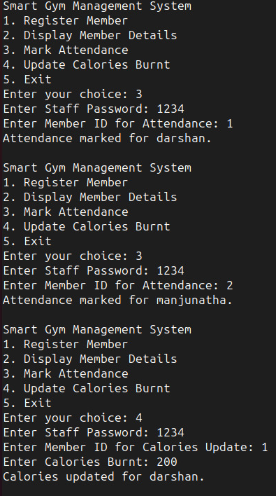
Results/Screen Shot:

Slide 10
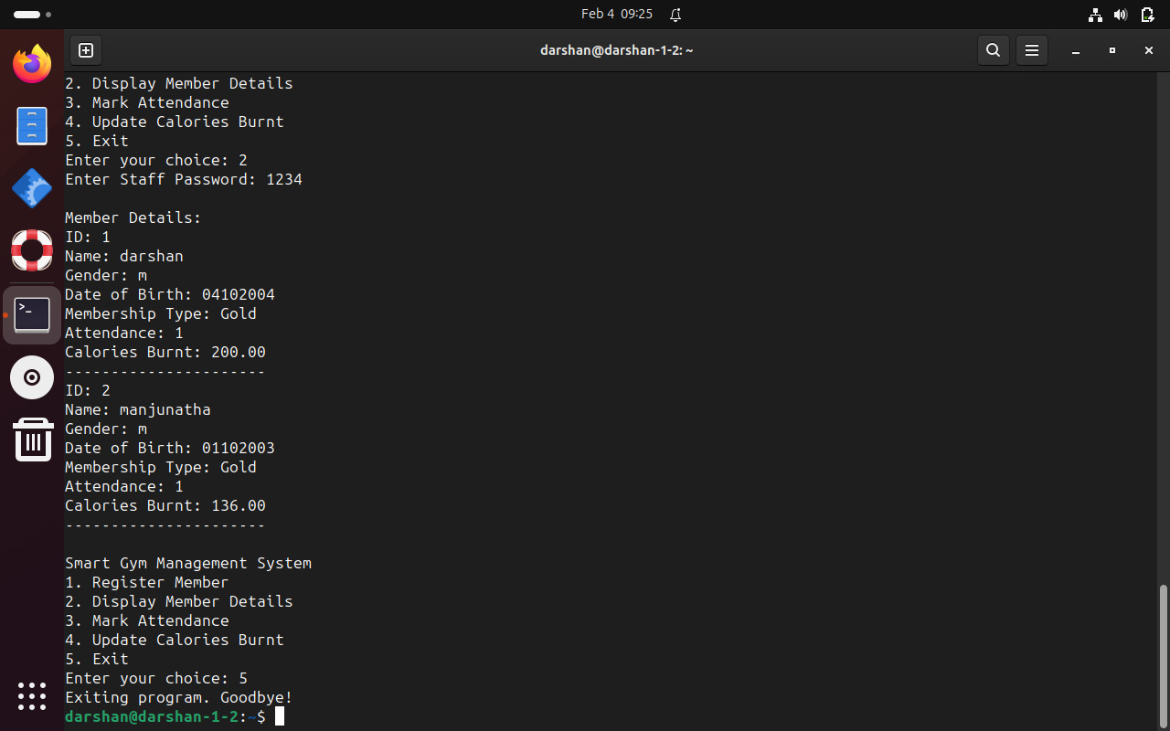

Slide 11
Conclusion:
In conclusion, the Smart Gym Management System implemented in this C code provides a foundational framework for enhancing the operational efficiency of fitness centers. The program's modular design allows for seamless member registration, detailed information display, attendance tracking, and calorie updates. With a user-friendly interface and staff authentication measures, the system ensures both accessibility and security in managing gym-related tasks. While this implementation serves as a fundamental example, its extensibility and adaptability make it a valuable starting point for further development, catering to the evolving needs of fitness center management. Overall, the code exemplifies the potential for creating a robust and organized system to optimize the administration of gym facilities.

Slide 12


