Slide 2
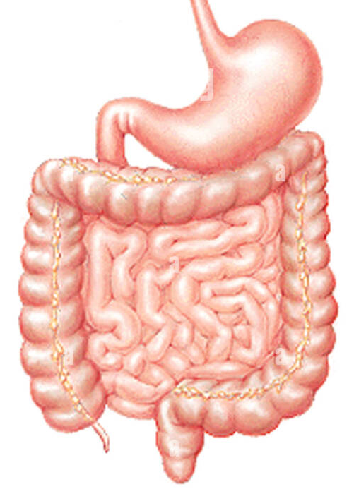
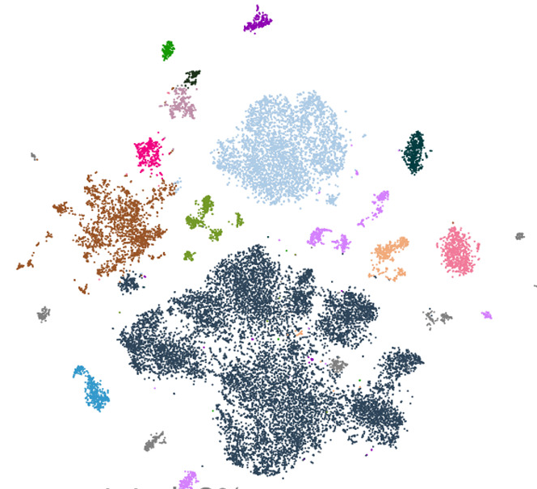
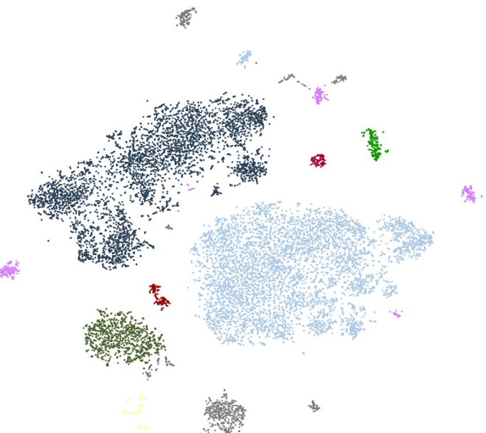
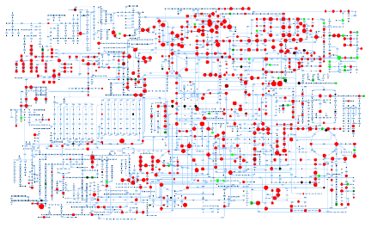


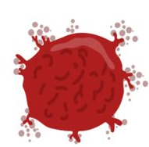
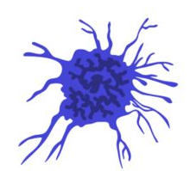


Methodology
Colorectal Cancer patients
scRNA-Seq
Metagenomics
MicrobiomeChanges?
Gut-Microbiome crosstalk
Population structure
Cell types??
What defines the transcriptional state?
Metabolic exchange
Metabolomics
Gut Microbiome
Gut Microbial functions
Metabolite pool
Cell types
Human health

