Slide 1


VISVESVARAYA TECHNOLOGICAL UNIVERSITY
GOVERNMENT ENGINEERING COLLEGE RAMANAGARA
DEPARTMENT OF COMPUTER SCIENCE AND ENGINEERING
Project Phase-2
VISION BASED SMART COMMUNICATION SYSTEM FOR SIGN LANGUAGE
Carried Out By: Under The Guidance of:
Anupama G N (1GG23CS007) Dr Chaya k
Darshan Divakar Naik (1GG23CS016) Assistant professor
Hithaishi M (1GG23CS021) Dept. of CSE
Keerthana H S (1GG23CS026)

Slide 2
INTRODUCTION
  Communication is a fundamental human need, yet deaf and speech-impaired individuals face major barriers due to limited understanding of sign language among the general population.
  Sign Language Recognition (SLR) systems use computer vision and deep learning to interpret hand gestures.
  Our project focuses on real-time bidirectional communication:
  Sign Language → Text + Voice
  Speech/Text → Sign Language
  Advances in Convolutional Neural Networks (CNN) and AI have made gesture recognition more accurate and practical. This system aims to bridge the communication gap and promote inclusivity.

Slide 3
PROBLEM STATEMENT
Develop a Vision-Based Smart Communication System for Sign Language Recognition that
captures hand gestures, recognizes sign language in real time using computer vision and AI, and
converts it into text or speech and also convert speech and text into sign animation to enable
effective communication between sign language users and non-sign language users.

Slide 4
SCOPE OF THE PROJECT
  Develop a real-time sign language detection system
  Convert:
  Hand gestures → Text + Speech
  Speech/Text → Sign Language output
  Features:
  Works using camera (vision-based system)
  No need for external hardware
  Can be deployed as a mobile or web application
  Application Areas:
  Hospitals
  Education
  Public services
  Daily communication

Slide 5
LITERATURE REVIEW
SL NO | YEAR | AUTHORS | PAPER TITLE | METHODOLOGY | MERITS | GAP
1 | 2025 | Thiruthi Siva K, Keerthan TD, Ajaya HV | Two-Stage CNN for Sign Language to Speech | CNN + MediaPipe+ TTS | High accuracy, real-time | Limited to alphabets, lighting issues
2 | 2025 | Dr. K. Haribabu, Pavithra K, Sowmya R | Indian Sign Language Recognition System | CNN with preprocessing | Good accuracy, simple | Only static gestures, background issues
3 | 2025 | Banu A., et al. | Sign Language Classification using Neural Networks | CNN trained on dataset | Very high accuracy, fast | Needs large data, not dynamic

Slide 6
4 | 2025 | Ashwin R., Goutham S. | Smart Assistive Gesture Recognition System | CNN + hardware integration | Real-time, multimodal | Complex hardware, less flexible
5 | 2025 | Gokulkrishnan N | Sign Language Recognition using Machine Learning | ML with video input | Real-time, user-friendly | Limited vocabulary, motion issues
6 | 2024 | Mohamed M., et al. | Real-Time Gesture Recognition System | Deep learning-based model | Low cost, portable | Lower accuracy, poor generalization

Slide 7
EXISTING SYSTEM
1. Glove-Based Systems
Use sensors (flex sensors, accelerometers)
High accuracy but:
  Expensive
  Not user-friendly
2. Vision-Based Systems
Use camera + image processing
Use:
  CNN
  Hand landmarks

Slide 8
EXISTING SYSTEM
Limitations:
  Background noise
  Lighting issues
  Limited gesture vocabulary
3. IoT-Based Systems
Combine hardware + mobile apps
Issues:
  Limited scalability
  Dependency on devices

Slide 9
PROPOSED SYSTEM
Key Idea:
A real-time AI-based bidirectional communication system
Modules:
Sign → Text + Voice
  Capture gesture via camera
  Use CNN / Deep Learning for classification
  Convert to text
  Convert text → speech (TTS)
Speech/Text → Sign
  Speech recognition (voice input)
  Convert to text
  Display as sign animation

Slide 10
PROPOSED SYSTEM
Real-Time Processing
  Fast prediction (low latency)
  Continuous gesture recognition
Technologies Used:
Computer Vision (OpenCV)
Deep Learning (CNN, ResNet, YOLO)
Speech Recognition
Text-to-Speech

Slide 11
FUTURE SCOPE
Support for continuous sentence recognition
Add regional languages (Kannada, Hindi, etc.)
Improve accuracy using:
Transformer models
Multimodal learning
Deploy as:
Mobile App
Wearable device
Integration with:
Smart assistants
AR/VR systems

Slide 12
system DESIGN
Vision-based system for recognizing Indian Sign Language (ISL)
Captures sign gestures through a camera
Processes the captured hand images/frames
Identifies the corresponding sign
Converts the recognized sign into understandable output

Slide 13
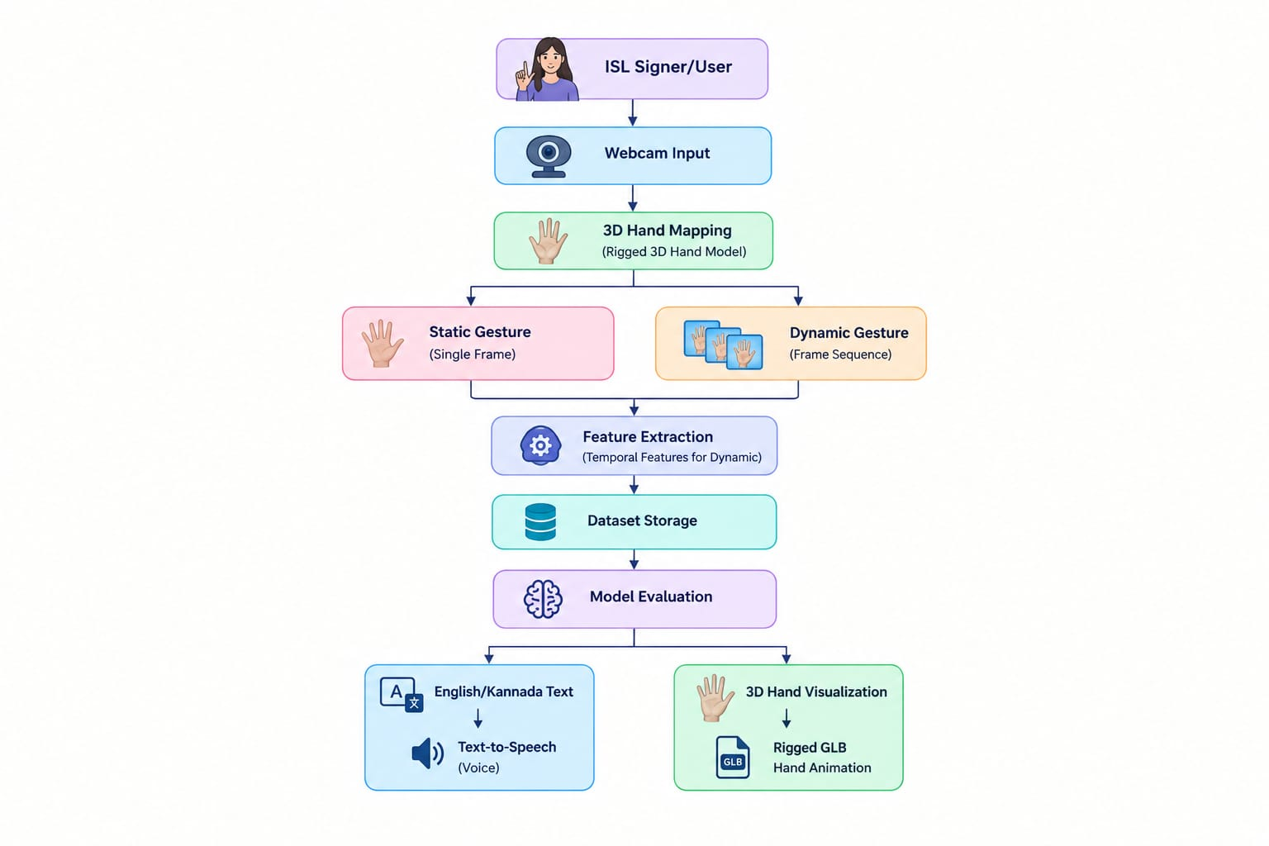
SYSTEM design

Slide 14
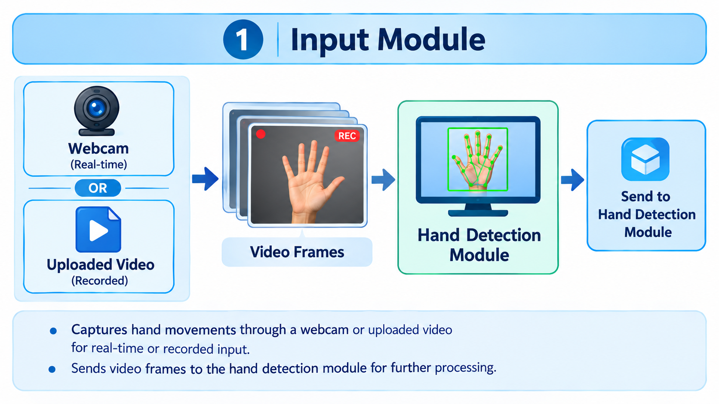
Detail design
1. Input Module
Captures hand movements through a webcam or uploaded video for real-time or recorded input.
Sends video frames to the hand detection module for further processing.

Slide 15
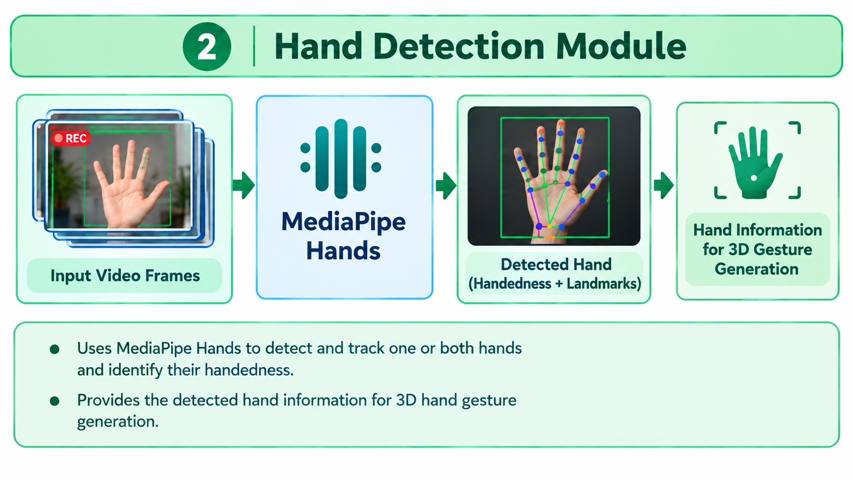
Detail design
2. Hand Detection Module
Uses MediaPipe Hands to detect and track one or both hands and identify their handedness.
Provides the detected hand information for 3D hand gesture generation.

Slide 16
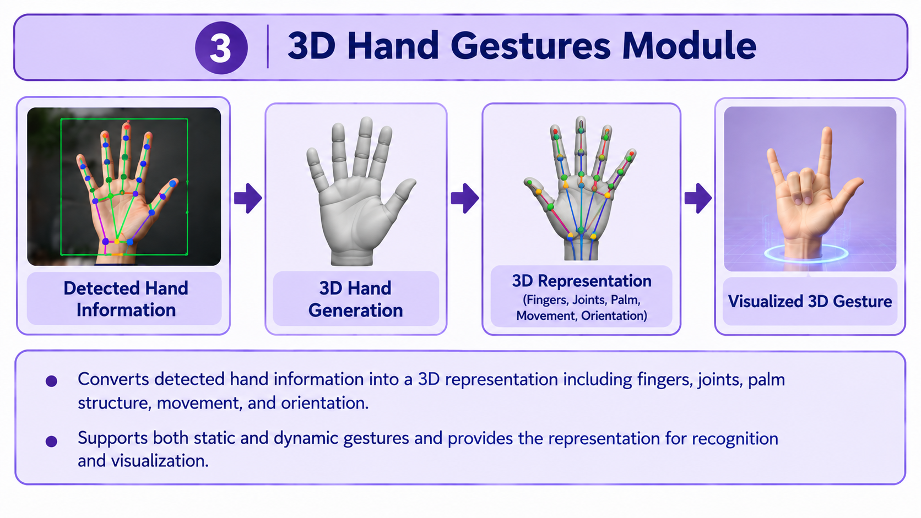
Detail design
3. 3D Hand Gestures Module
Converts detected hand information into a 3D representation including fingers, joints, palm structure, movement, and orientation.
Supports both static and dynamic gestures and provides the representation for recognition and visualization.

Slide 17
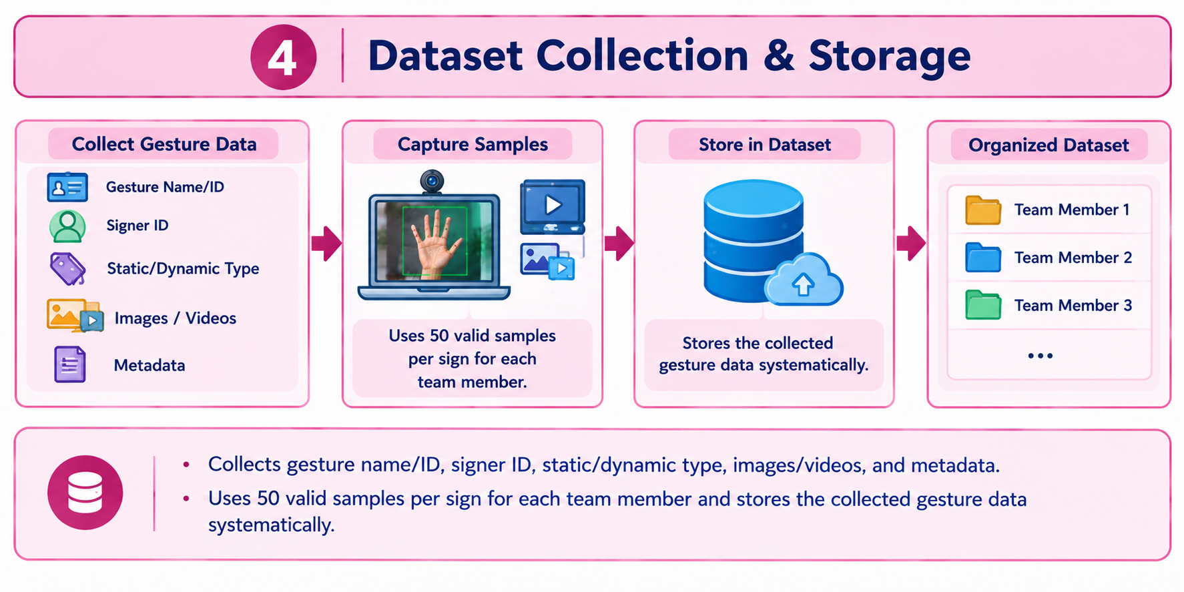
Detail design
4. Dataset Collection & Storage
Collects gesture name/ID, signer ID, static/dynamic type, images/videos, and metadata.
Uses 50 valid samples per sign for each team member and stores the collected gesture data systematically.

Slide 18
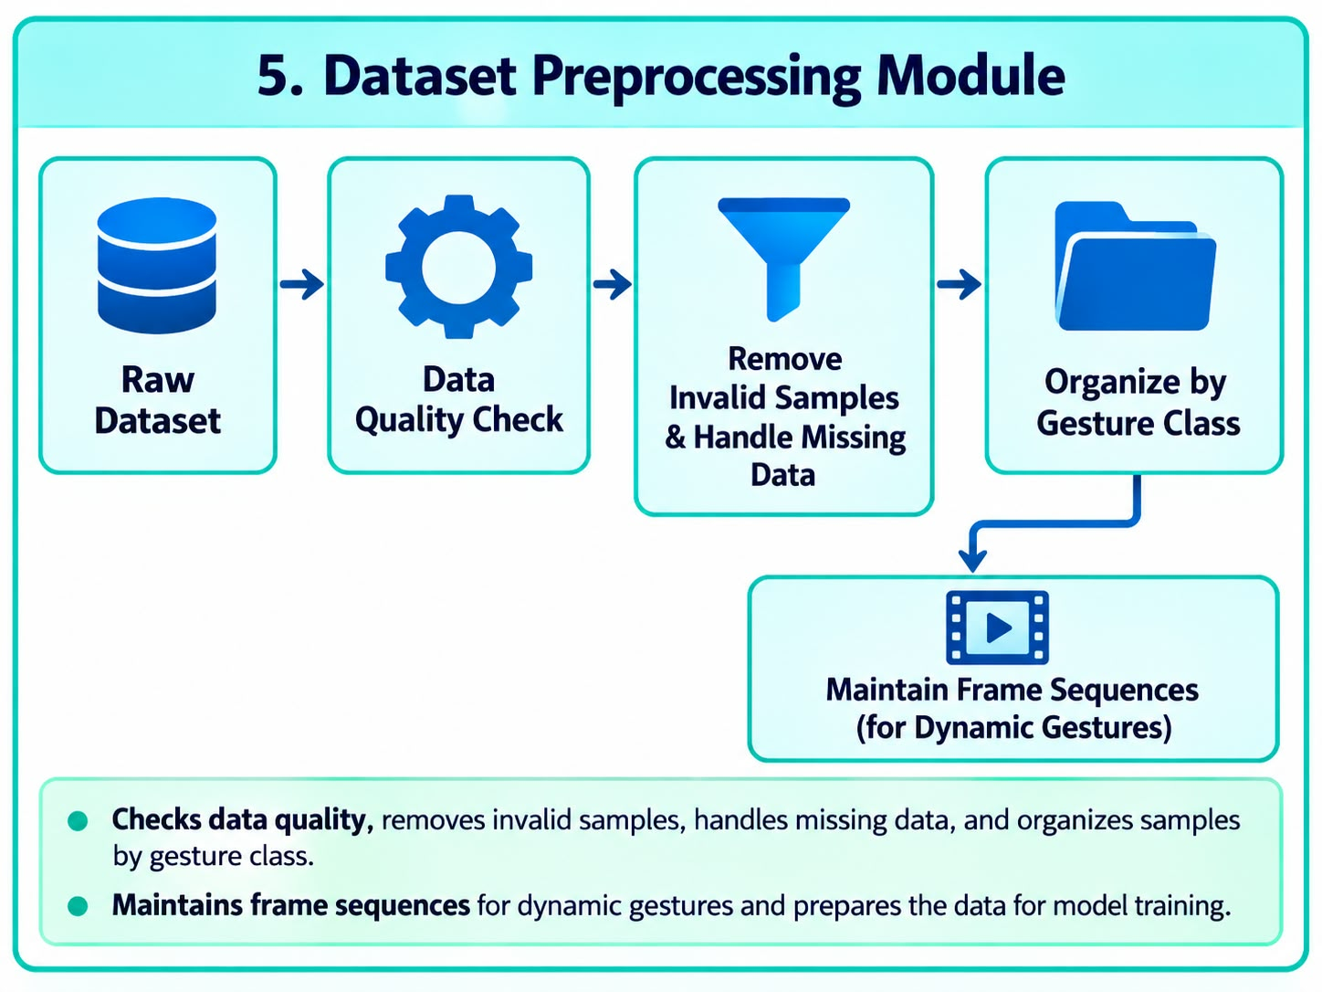
Detail design
5. Dataset Preprocessing
Checks data quality, removes invalid samples, handles missing data, and organizes samples by gesture class.
Maintains frame sequences for dynamic gestures and prepares the data for model training.

Slide 19
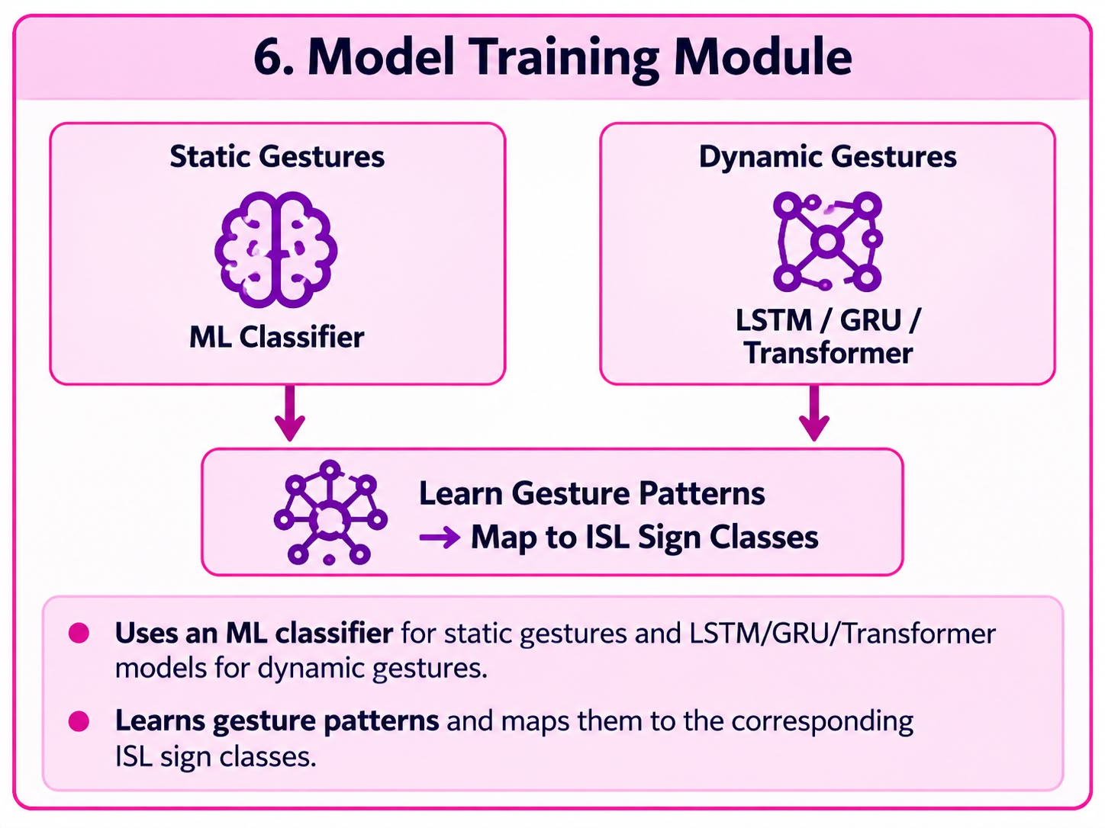
Detail design
6. Model Training
Uses an ML classifier for static gestures and LSTM/GRU/Transformer models for dynamic gestures.
Learns gesture patterns and maps them to the corresponding ISL sign classes.

Slide 20
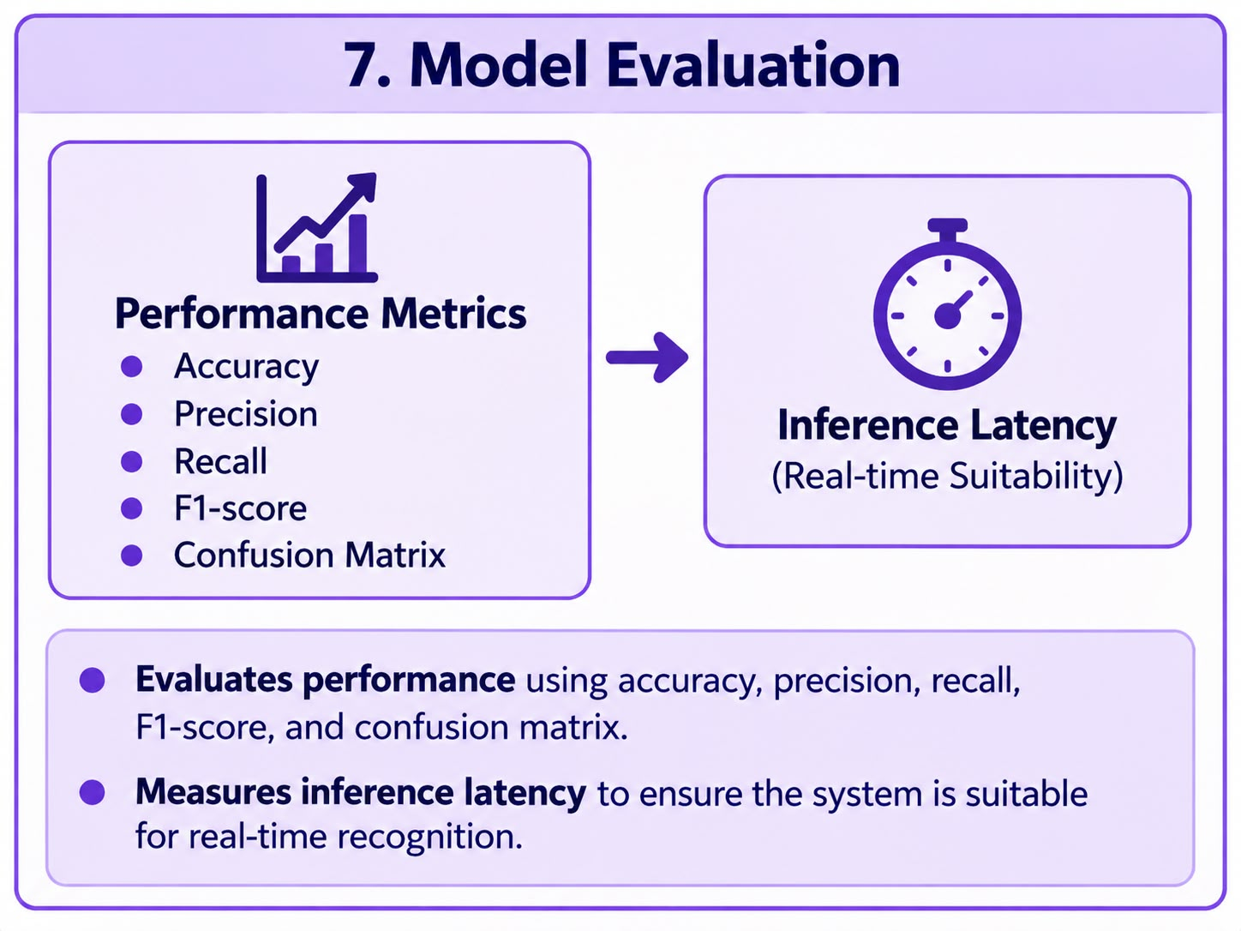
Detail design
7. Model Evaluation
Evaluates performance using accuracy, precision, recall, F1-score, and confusion matrix.
Measures inference latency to ensure the system is suitable for real-time recognition.

Slide 21
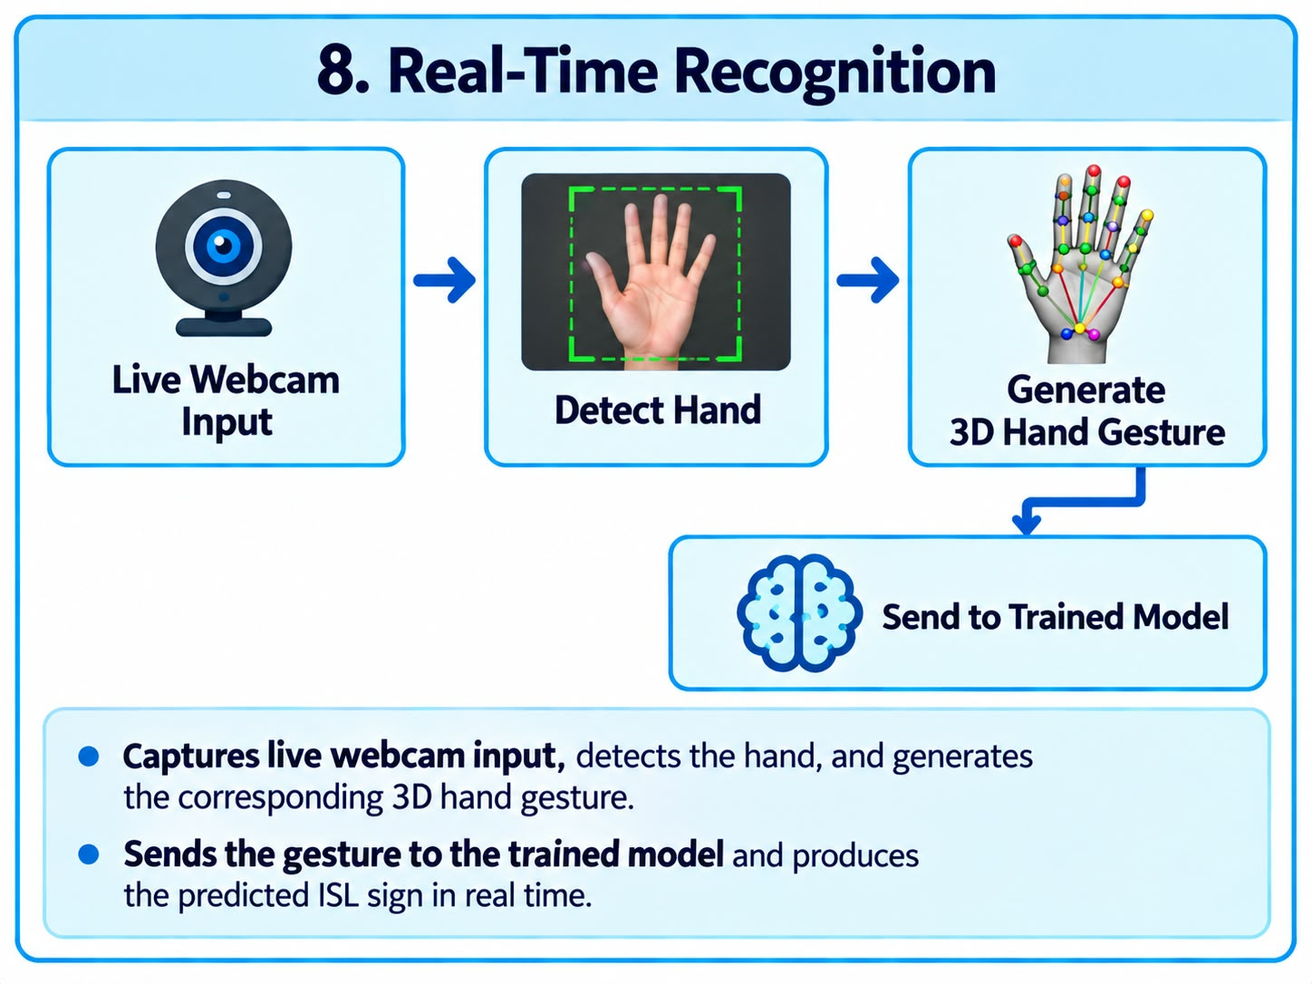
Detail design
8. Real-Time Recognition
Captures live webcam input, detects the hand, and generates the corresponding 3D hand gesture.
Sends the gesture to the trained model and produces the predicted ISL sign in real time.

Slide 22
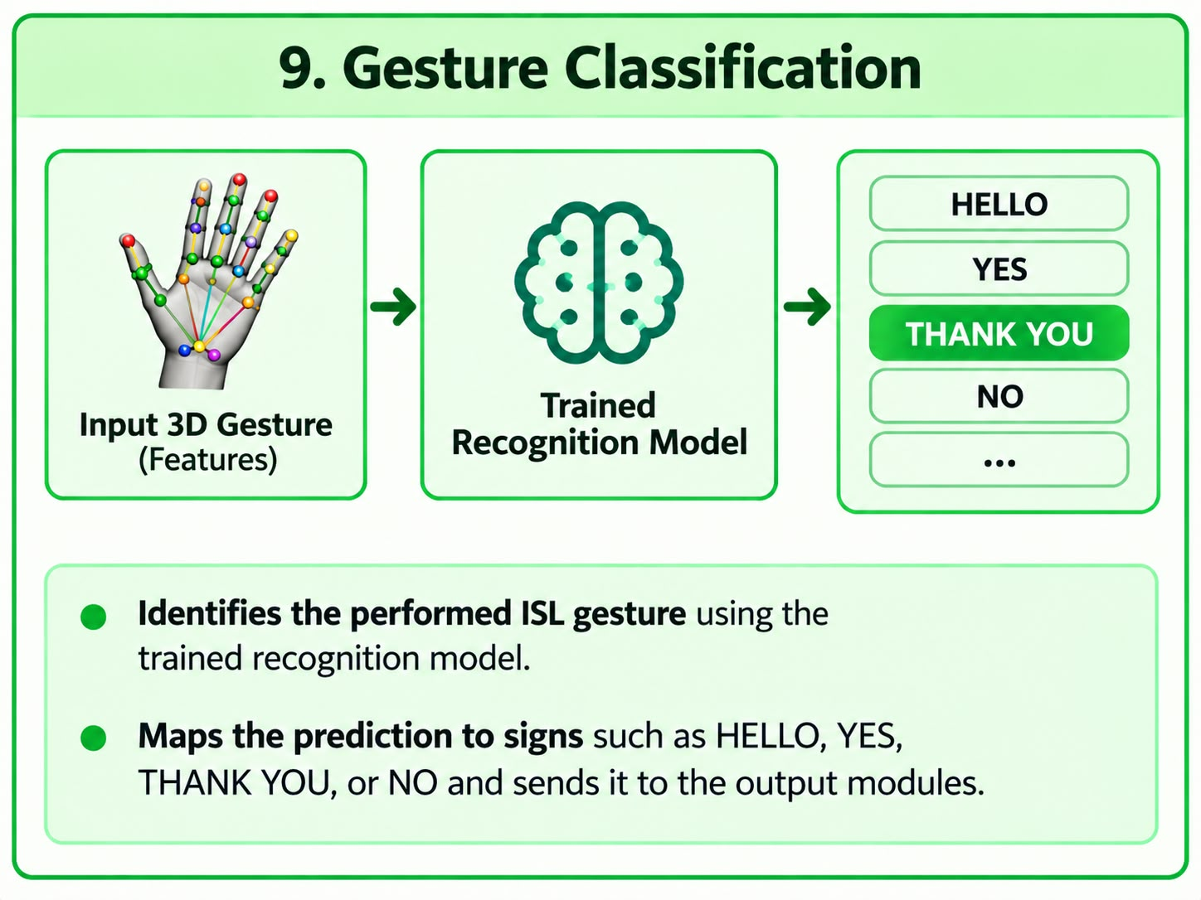
Detail design
9. Gesture Classification
Identifies the performed ISL gesture using the trained recognition model.
Maps the prediction to signs such as HELLO, YES, THANK YOU, or NO and sends it to the output modules.

Slide 23
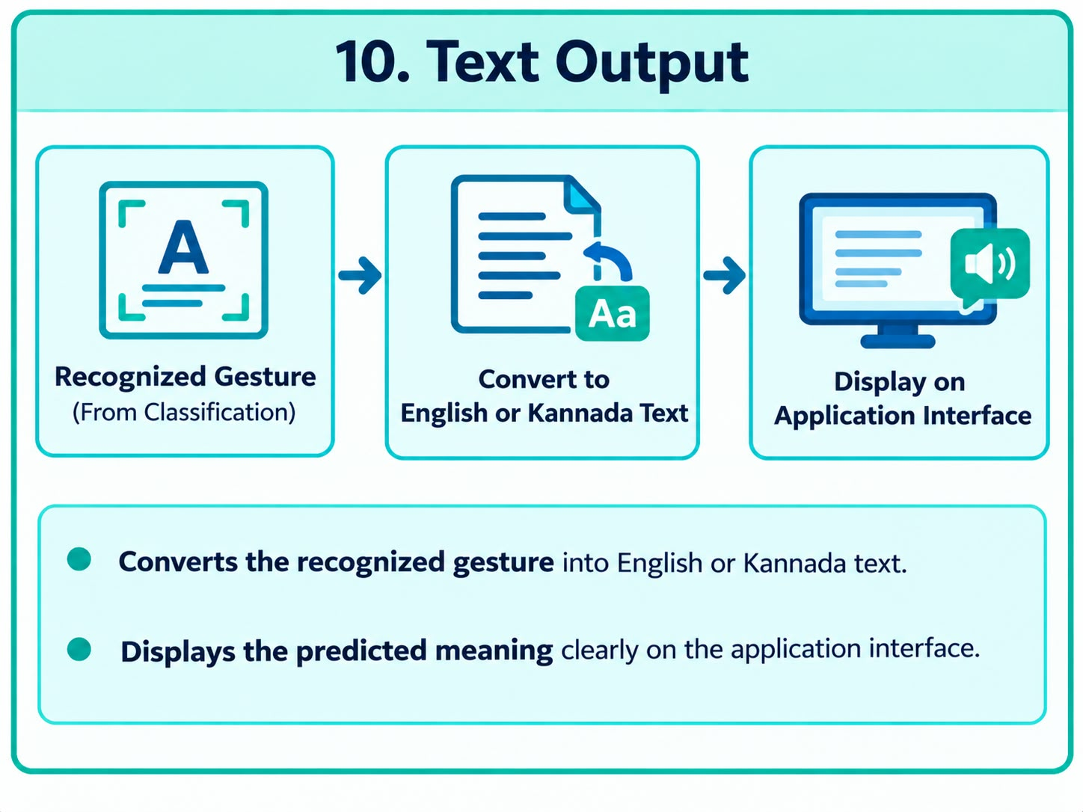
Detail design
10. Text Output
Converts the recognized ISL gesture into English and Kannada text using Google cloud Translation API.
Displays the predicted meaning clearly on the application interface.

Slide 24
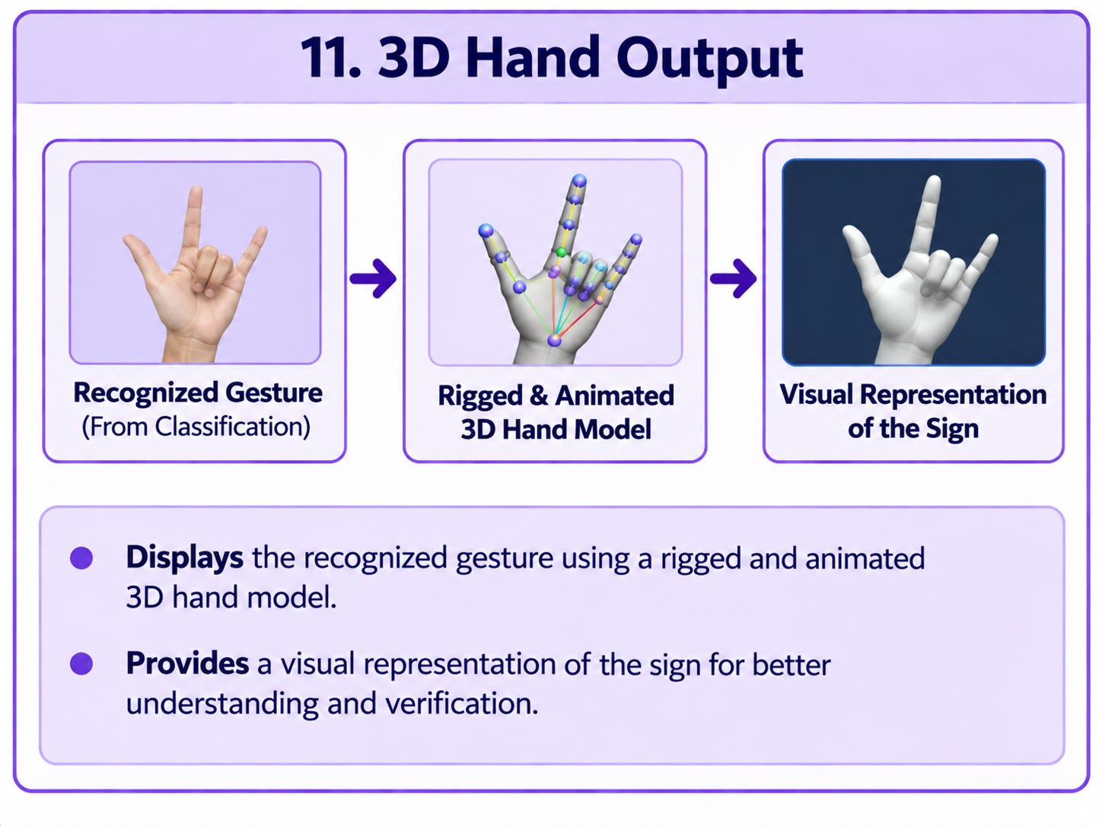
Detail design
11. 3D Hand Output
Displays the recognized gesture using a rigged and animated 3D hand model.
Provides a visual representation of the sign for better understanding and verification.

Slide 25
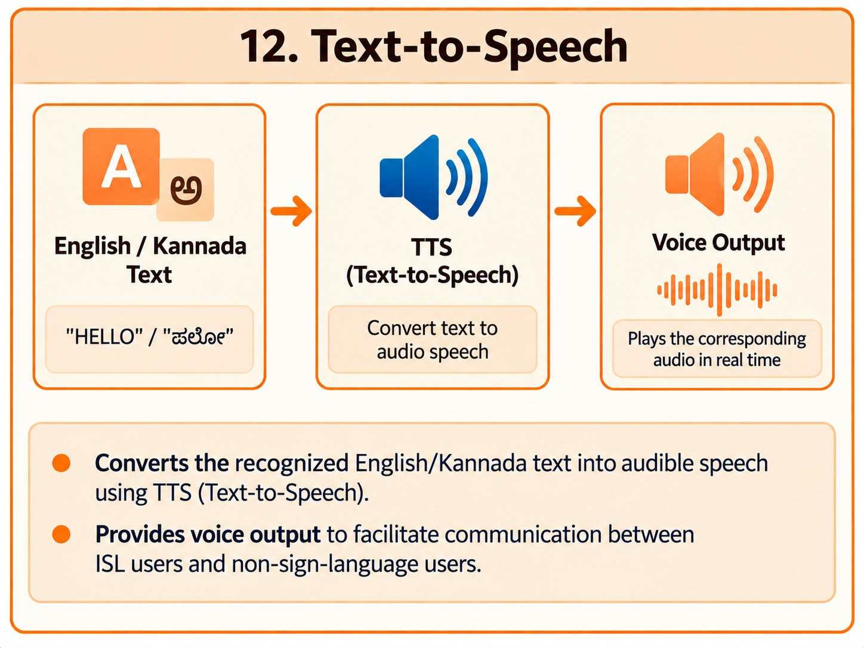
Detail design
12. Text-to-Speech
Converts the recognized English/Kannada text into audible speech using Google Cloud TTS.
Provides voice output to facilitate communication between ISL users and non-sign-language users.

Slide 26
System requirement specification
Model/Technology | What it does | Where we use it
MediaPipe hand landmarker | Detects the hand and extracts 21 landmarks | Input -> landmark extraction
3D hand rig /GLB model | 3D hand model with a bones and joints that allows the fingers and hand to move realistically | 21 landmark -> 3D Hand
Feature normalization | Makes land marks data consistent , improving accuracy | Before training for reduce noise
ML classifier | Learns which landmark pattern corresponds to which ISL sign | Used for static sign recognition

Slide 27
System requirements specification
Long Short-Term Memory(LSTM) / Gated Recurrent Unit (GRU) | Types of RNNs designed to understand sequential data & Learns movement patterns across multiple frames | Used for dynamic-sign recognition
Three.js | JavaScript 3D graphics library used to displays 3D animation directly in the browser | 3D visualization and recognize the hand movement
Google Cloud Text-to-Speech (TTS) | Cloud-based service that converts text into natural-sounding speech using AI-generated voices. | For voicing (text → speech)

Slide 28
System requirement specification
Google cloud Translation API | It can translate the recognized English meaning into kannada text | English – Kannada translation of text

Slide 29
ADVANCED GESTURE SEGMENTATION
Continuous Gesture Communication: Drop-to-Commit
SOLVING THE CONTINUOUS SIGNING CHALLENGE (Guide's Essential Requirement)
Traditional models predict isolated words on single frames, creating repeated character flooding. G2T2G introduces an automated continuous staging buffer that segments multi-word sentences fluently without requiring touch interactions.
1. Multi-Frame Stability Filter
Requires 3 consecutive matching predictions before staging a gesture, filtering transitional hand motion between signs.
2. Anti-Duplication Suppression
Once a gesture is staged, repeated predictions of that sign are suppressed to prevent spamming identical words.
3. Visual Staged Phrase Dock
Renders live interactive badge chips (e.g. [GOOD] + [MORNING]) directly on the camera overlay.
4. Hand Drop-to-Commit Trigger
When hands relax or drop below the camera frame, the buffer auto-commits the full phrase into audio & text.

Slide 30
DATASET SPECIFICATION
Dataset Collection & Multi-Signer Distribution
Subset | Raw DB Rows | Excluded | Retained Samples | Classes Trained
Static Gestures | 4,774 | 11 (book) | 4,763 | 27 (A–Z, super)
Dynamic Gestures | 2,702 | 6 (empty) | 2,696 | 18 Words/Phrases
Total Database | 7,476 | 17 | 7,459 | 45 ISL Gestures
MULTI-SIGNER INTEGRITY
• 1GG23CS007 (Anupama G N)
Master reference signer, 239 static / 132 dynamic test samples.
• 1GG23CS016 (Darshan Divakar Naik)
Static dataset validation contributor.
• 1GG23CS021 (Hithaishi M)
240 static / 133 dynamic test samples.
• 1GG23CS026 (Keerthana H S)
214 static / 140 dynamic test samples.
Rigorous Data Hygiene & Protocol:
• 50 valid samples captured per sign for each team member (as per project methodology).
• Stratified sampling: 70% Training / 15% Validation / 15% Held-Out Test.
• Scaler parameters fitted strictly on training data to avoid data leakage.

Slide 31
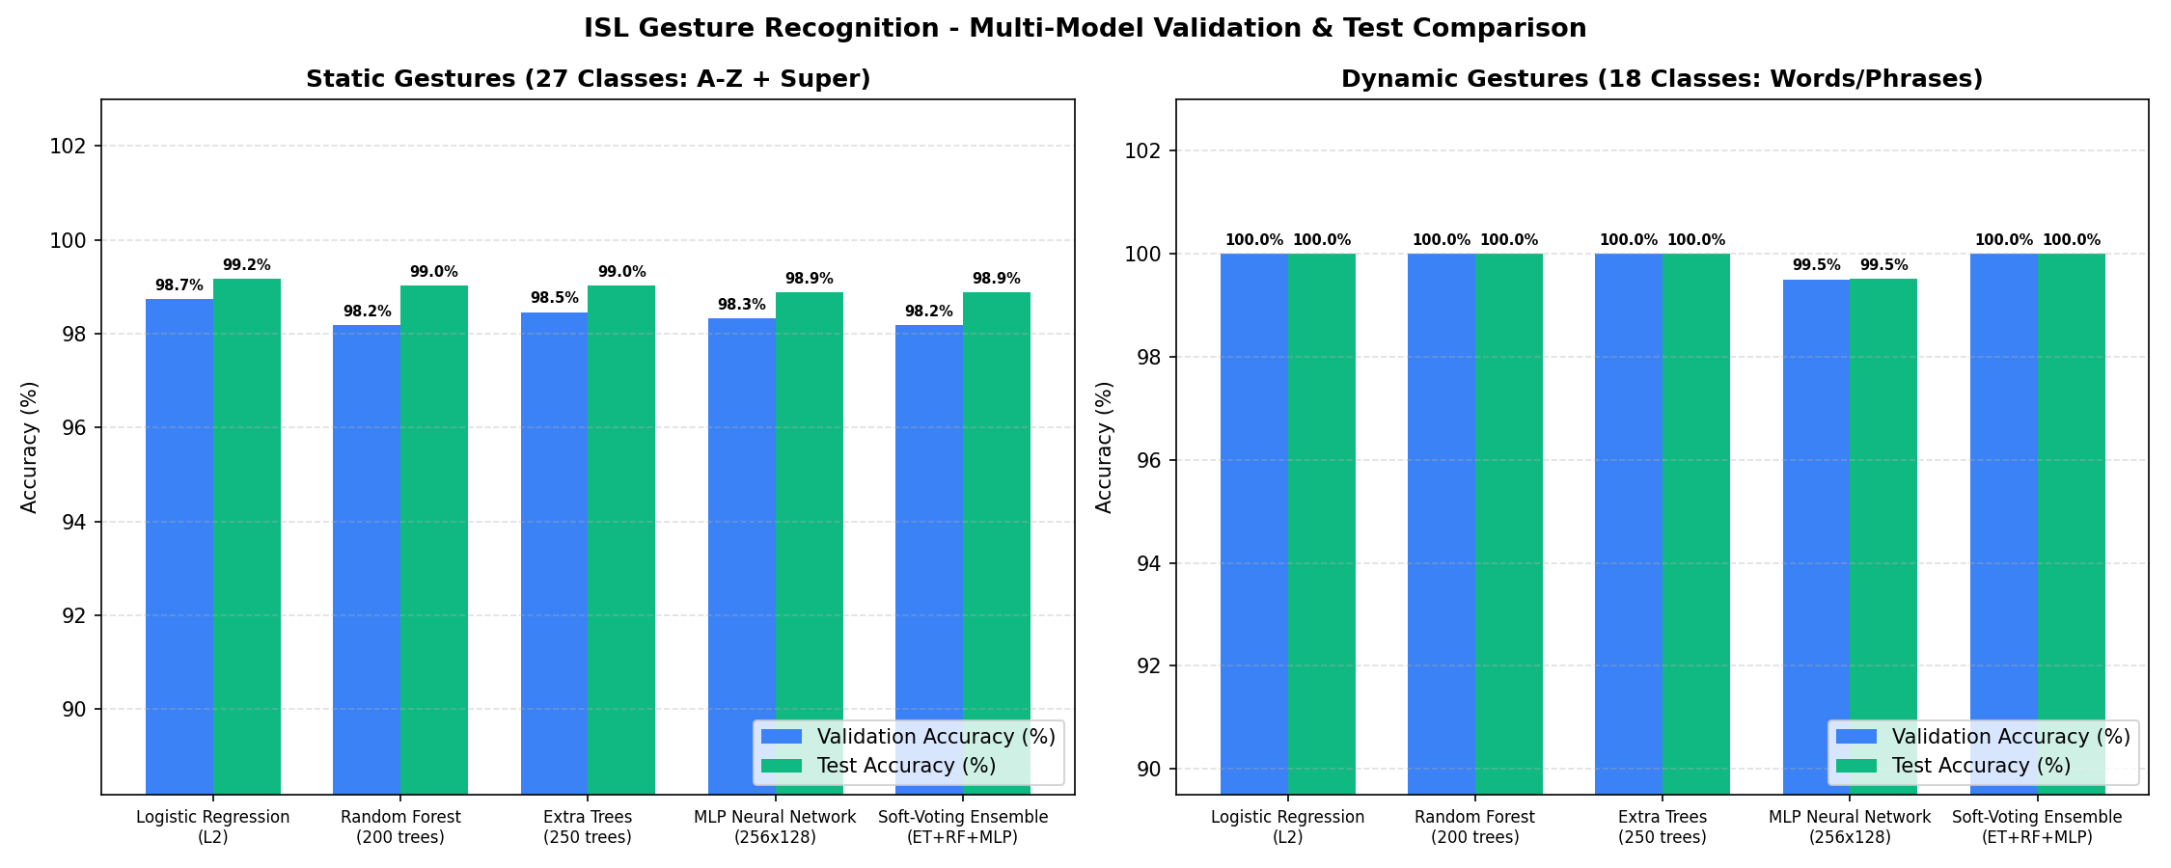
MACHINE LEARNING EVALUATION
Model Training & Multi-Model Comparison
Model Architecture | Static Test Acc | Dynamic Test Acc | Inference Latency | Status
Naive Baseline (Majority) | 5.73% | 5.68% | 0.008 ms | Baseline
Logistic Regression (L2) | 99.16% | 100.00% | 0.006 ms | ★ Champion
Extra Trees (250 trees) | 99.02% | 100.00% | 0.178 ms | Evaluated
Random Forest (200 trees) | 99.02% | 100.00% | 0.141 ms | Evaluated
MLP Neural Net (256x128) | 98.88% | 99.51% | 0.008 ms | Evaluated
Soft-Voting Ensemble | 98.88% | 100.00% | 0.353 ms | Evaluated

Slide 32
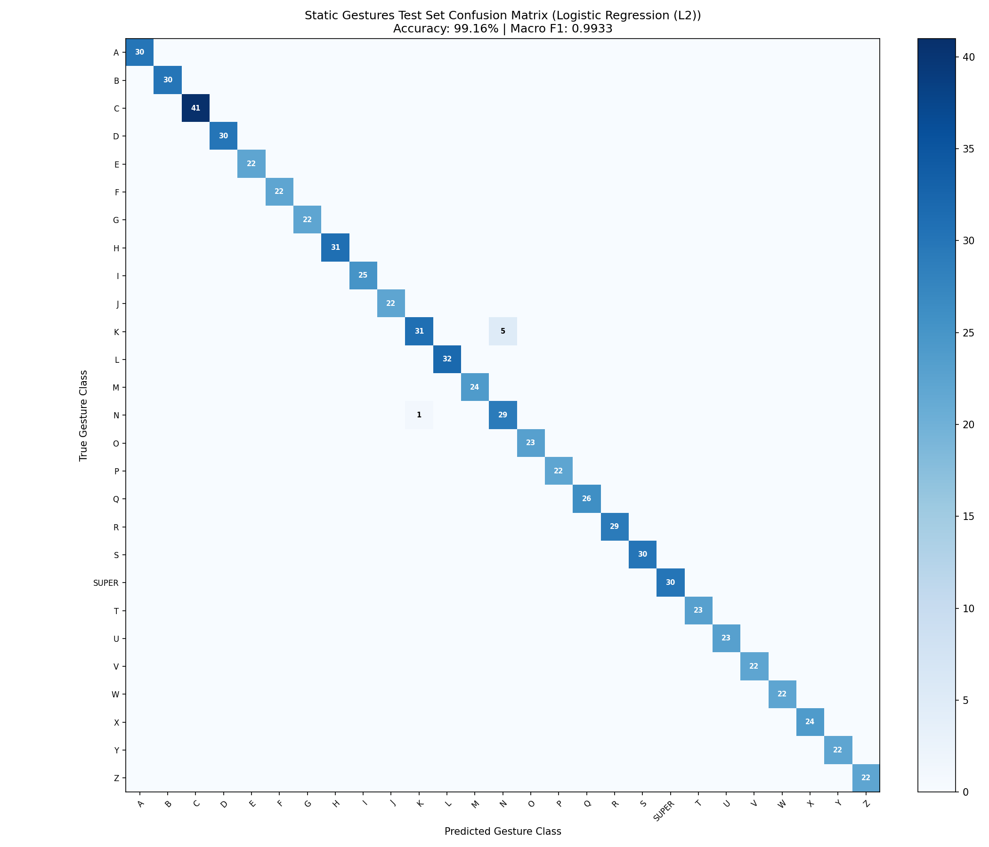
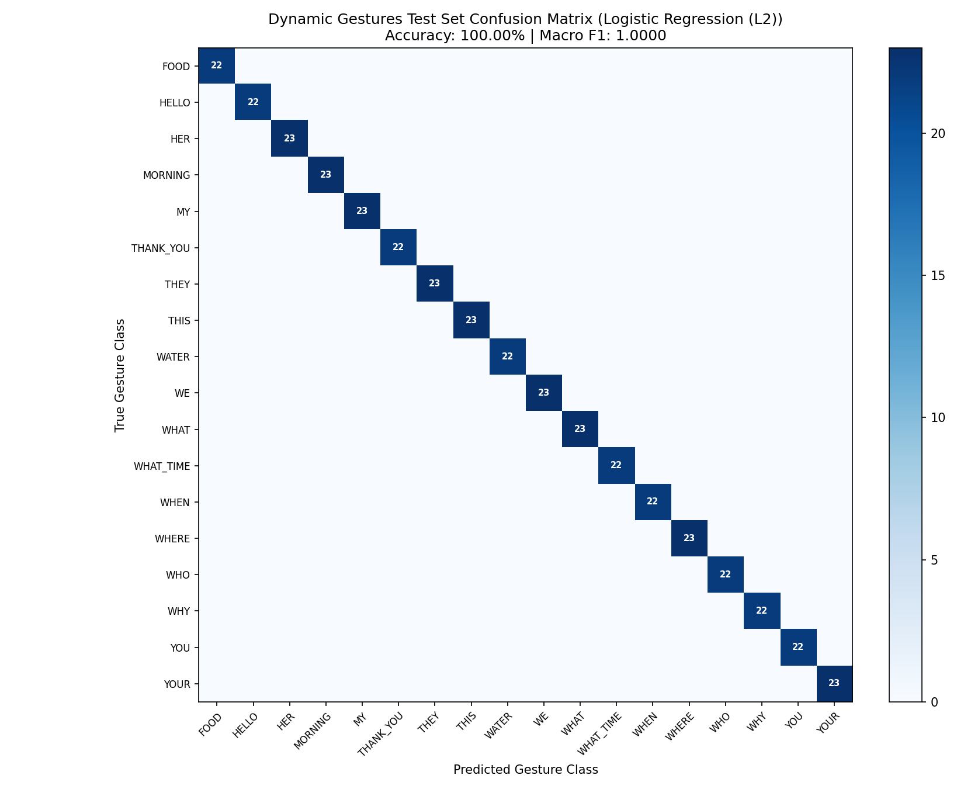
STATISTICAL RIGOR
Model Evaluation & Confusion Matrices
STATISTICAL RIGOR
95% Bootstrap CI:
Static: [98.4%, 99.9%]
Dynamic: [100%, 100%]
Precision & Recall:
Near-zero off-diagonal confusion across 45 classes.
Inference Speed:
0.006 ms static
0.010 ms dynamic
Sub-second real time.

Slide 33
MODEL VALIDATION
Cross-Signer Slice Analysis & Generalization
VERIFYING ZERO DEMOGRAPHIC OR HAND GEOMETRY BIAS
To ensure the system generalizes to new unseen signers, evaluation was sliced across team members on strictly held-out test splits. All signers achieved between 97.5% and 100% accuracy.
Signer ID / Name | Static Samples | Static Acc | Static F1 | Dynamic Samples | Dynamic Acc | Dynamic F1
1GG23CS007 (Anupama G N) | 239 | 100.00% | 1.0000 | 132 | 100.00% | 1.0000
1GG23CS016 (Darshan Divakar Naik) | 22 | 100.00% | 1.0000 | — | — | —
1GG23CS021 (Hithaishi M) | 240 | 97.50% | 0.9815 | 133 | 100.00% | 1.0000
1GG23CS026 (Keerthana H S) | 214 | 100.00% | 1.0000 | 140 | 100.00% | 1.0000

Slide 34
SYSTEM IMPLEMENTATION
Live Application Modules & UI Design
1. Normal / Hearing Studio
• Speech & Text Composition: Type message or speak via live microphone.
• Quick-Phrase Chips: Instant triggers for Hello, Thank you, Food, Morning, Water.
• Dual-Confirmation Output: Shows authentic master signer reference video above, and live 3D skeletal avatar below.
• Missing Gesture Prompt: Alerts if a word is not in dataset and offers to perform it.
2. Sign User Studio
• High-Speed Live Camera: Real-time 21-landmark tracking overlay.
• Continuous Signing Banner: Displays staged phrase badge chips in real time.
• Drop-to-Commit: Automatically transmits text & audio when hands lower.
• Bilingual TTS Voice: Automatically speaks English or Kannada (pitch: 1.15, rate: 1.08).
3. Continuous Live Chat
• Unified Split Screen: Chat thread on the LEFT; visual outputs on the RIGHT.
• Upper Right: Master Signer video & live webcam recognition.
• Lower Right: Interactive 3D Avatar with 0.1x to 1.5x speed controls.
• Unobstructed Canvas: Captions & sequence steppers placed strictly below video canvas.

Slide 35
TESTING & VALIDATION
System Testing & Performance Benchmarks
Unit & Component Testing
• Verified MediaPipe 21-joint extraction across varying lighting conditions.
• Confirmed Web Speech STT and TTS voice output across multiple browsers.
• Tested Three.js WebGL landmark playback at 0.1x, 0.5x, 1.0x, and 1.5x.
Continuous Integration & Regression
• Anti-duplication regression tests: Zero repetitive false-positive triggers.
• Staged phrase buffer verification: Successfully assembles multi-word phrases.
• Drop-to-commit boundary checks: Verified seamless auto-commit on hand exit.
Latency & Frame Rate Benchmarks
• Camera capture & landmark extraction: ~16.6 ms (Steady 60 FPS).
• ML Classification latency: 0.006 ms (Static) / 0.010 ms (Dynamic).
• Total end-to-end pipeline latency: <50 ms (Virtually imperceptible delay).
Cross-Device & Network Verification
• Tested on standard Windows 11 laptop webcam.
• Tested on mobile browsers via Cloudflare secure tunnel.
• Bilingual validation: 100% verified translation accuracy between English and Kannada.

Slide 36
DISTINCT INNOVATIONS
Key Novelties & Advantages of G2T2G
1. Continuous Communication Buffer
Replaces clunky isolated word detection with smooth multi-word sentence formation triggered by natural hand drop-to-commit.
2. Dual Visual Feedback Synthesis
Combines verified human signer video with customizable Three.js 3D avatar skeletons for maximum visual clarity.
3. Truly Accessible & Cost-Free
Zero sensor gloves, zero Kinect depth cameras. Runs in standard web browsers on any commodity laptop or smartphone.
4. Bilingual Inclusivity
Seamlessly supports English and regional Kannada (ಕನ್ನಡ) text and voice, promoting linguistic accessibility.
5. Self-Expanding Vocabulary
In-app missing gesture detection invites users to perform and save new signs, enabling crowd-powered database growth.
6. Production-Grade Sub-Millisecond Speed
Logistic Regression L2 champion model delivers 99.16% test accuracy in 0.006 ms per sample.

Slide 37
SUMMARY OF WORK DONE
Conclusion & Phase-2 Achievements
PHASE-2 OUTCOMES
• Successfully engineered a complete vision-based bidirectional Indian Sign Language communication framework.
• Built a robust, sub-50ms pipeline running directly on standard commodity webcams and browsers.
• Achieved 99.16% static accuracy and 100% dynamic accuracy across 45 ISL classes with zero signer bias.
• Successfully implemented our Guide's recommendation for continuous sentence signing with drop-to-commit segmentation.
FUTURE WORK PLAN
• Facial Expression Tracking: Integrate MediaPipe Face Mesh to capture grammatical markers in ISL.
• Vocabulary Expansion: Scale dataset to 500+ daily conversational signs across multiple regional dialects.
• Native Mobile Application: Package as an offline mobile application (Flutter / PWA) for on-device signing.
• AR Smart Glasses Integration: Projection of 3D ISL avatar onto heads-up displays for hands-free dialogue.

Slide 38
THANK YOU
Questions & Answers / Discussion
VISION BASED SMART COMMUNICATION SYSTEM FOR SIGN LANGUAGE
Government Engineering College Ramanagara | Department of CSE
Under the Guidance of: Dr. Chaya K, Assistant Professor, Dept. of CSE
Team: Anupama G N (1GG23CS007) | Darshan Divakar Naik (1GG23CS016) | Hithaishi M (1GG23CS021) | Keerthana H S (1GG23CS026)
★ Live Interactive Demonstration Ready for Panel Evaluation ★

