Slide 1
Data Analysis: Sales Prospects from Home Mortgage Data

Slide 2
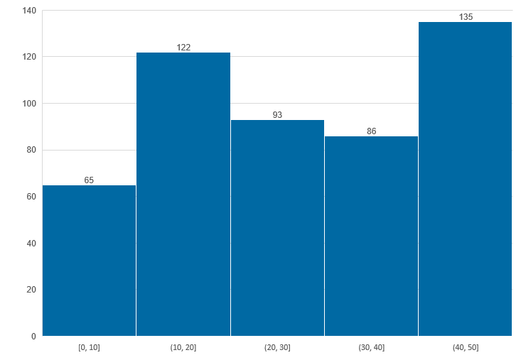
56% of Borrowers have Debt to Income ratio less than 30% this implies they are more like to repay loan

Slide 3
For 117 Borrowers Ratio of Borrower Income to Median Family Income in Locality is less that 0.8, implies they have comparatively less savings

Slide 4
Plot of the average of the ratio of the Amount Paid to the Amount Borrowed versus the Length of Mortgage period shows that loans with longer durations result in the borrower paying a higher total amount.

Slide 5
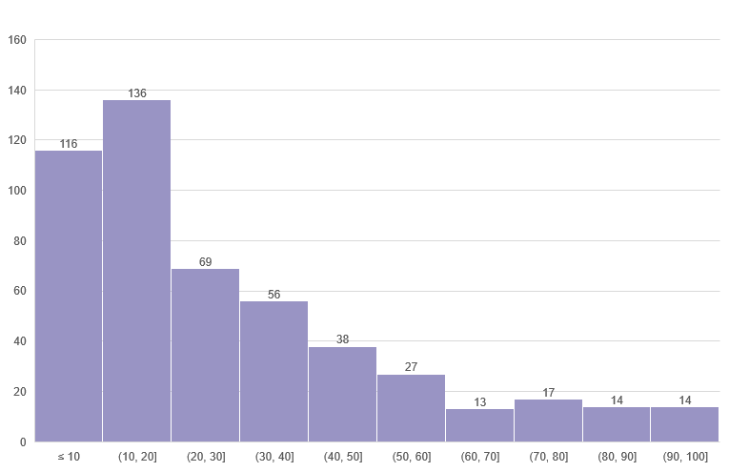
Minority in Locality 85 location have Minority Population Greater than 50%

Slide 6
78% Borrowers have LTV less than 80

Slide 7
Observations and Key Insights
A plot of the average ratio of the amount paid to the amount borrowed versus the length of the mortgage period shows that loans with longer durations result in the borrower paying a higher total amount.
For 117 Borrowers Ratio of Borrower Income to Median Family Income in Locality, implies they have comparatively less savings.
Plot of the average ratio of the Amount Paid to the Amount Borrowed versus the Length of Mortgage period shows that loans with longer durations result in the borrower paying a higher total amount.
Minority in Locality 85 location have Minority Population Greater than 50%.
78% Borrowers have LTV less than 80. If in case they are not able to replay the loan, Bank can easily recover money lended.

Slide 8
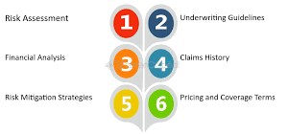
Process Improvement Opportunity: Accelerating Underwriting with NLP, Image Recognition and Machine Learning
Target Stakeholder Group: Senior Leaders

Slide 9

Inefficiencies in Manual Underwriting Processes
Manual Evaluation: Underwriters currently spend weeks manually examining credit reports and other documents, assessing factors such as credit score, payment history, income, and debts.
Time-Consuming: This manual process leads to delays, increasing the time required to finalize lending decisions.
Impact: Lengthy processing times can lead to lost opportunities, increased operational costs, and reduced customer satisfaction.

Slide 10
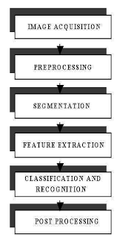
Leveraging NLP, Image Recognition, and ML for Faster Underwriting
NLP and Image Recognition: Automatically read and validate identity proof and other key documents, such as credit reports and income statements, using Natural Language Processing (NLP) and image recognition technologies.
ML Models for Underwriting: Implement machine learning models to analyze credit scores, payment history, and financial data to predict borrower risk and creditworthiness.
Significant Time Reduction: Reduce the underwriting process from several weeks to just a few days, enhancing efficiency and decision-making speed.

Slide 11
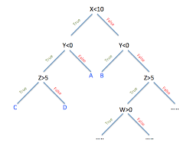
Machine Learning Models for Underwriting
Credit Scoring Models (e.g. Decision Trees): Analyze historical data to predict the likelihood of default based on credit history.
Income and Debt Assessment (e.g. Random Forest): Evaluate an applicant's financial health by analyzing income, investments, and debts.
Fraud Detection (e.g. Support Vector Machines): Identify potential fraud by cross-referencing identity documents and detecting anomalies.
Data Validation and Accuracy (e.g., NLP Models like BERT): Ensure the accuracy of data extracted from documents through advanced NLP techniques.

Slide 12
Summary
Efficiency Gains: Reduce underwriting time by up to 80%, allowing for faster loan processing and higher throughput.
Enhanced Accuracy: Improve decision accuracy through advanced ML models, reducing the risk of defaults and increasing overall portfolio quality.
Customer Experience: Provide quicker loan approvals, enhancing customer satisfaction and loyalty.
Cost Savings: Lower operational costs by automating document processing and reducing the need for manual labor.

Slide 13
Process Mapping:
Simple Mortgage Origination Process

Slide 14
Process Mapping – Commonly Used UML Symbols
Decision Point
Data
Start and End Process
Process Step
Manual Operation
Decision Point
Process Step
Yes
Manual Operation
Symbols are connected to show flow, like this:
No
Process Step

Slide 15
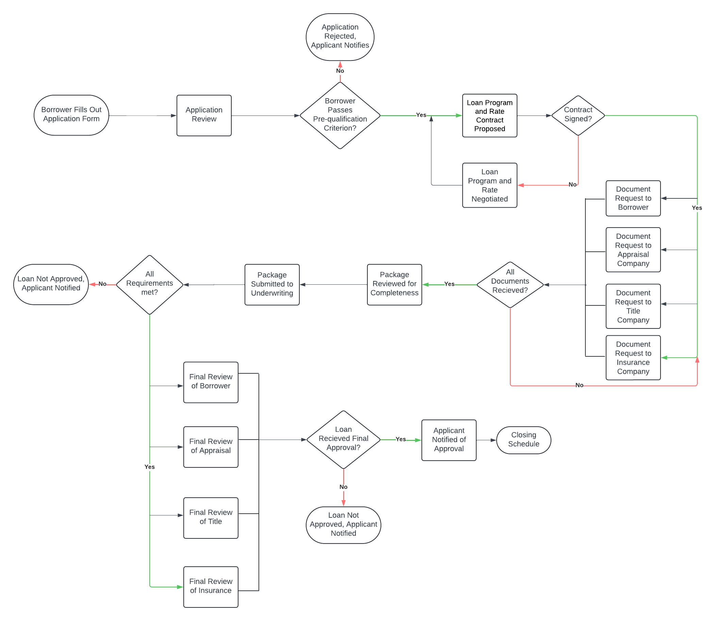
As-Is Process Map:

Slide 16
Opportunities for Process Improvement: [name of process]
Process Improvement Opportunities
Implement AI-Powered Document Processing: Utilize intelligent automation to review and process documents, streamlining operations and reducing manual effort.
Mitigate Underwriting Risk with AI/ML: Apply artificial intelligence and machine learning to identify and mitigate potential underwriting risks more effectively.
Enable Mobile Customer Management: Develop a mobile application that allows customers to manage interactions, track progress, and get answers to their questions from anywhere, at any time.
Digitize Document Handling: Ensure all documents are received, processed, and stored digitally for better efficiency and security.
Integrate IT Systems with Partners: Seamlessly connect IT systems with title and insurance company partners to facilitate smooth, real-time data exchange.

