Slide 1
INCREASING THE RESOLUTION
OF BLURRED IMAGE USING
DEEP LEARNING FOR
SATELLITE SURVILLANCE
DARSHAN.G (171EC137)
HARI GUHAN.P (171EC162)

Slide 2
LIST OF MINI PROJECTS CARRIED OUT:
Classification of dataset and Cat Dog image identification
using machine learning.
Wild plant identification using Deep Learning.
Amplification of sound using walkie talkie
Intruder using tensor flow

Slide 3
PROPOSED SYSTEM
Image noise is random variation of brightness or color information in images,
and is usually an aspect of electronic noise. It can be produced by the sensor and
circuitry of a scanner or digital camera.
Image noise can also originate in film grain and in the unavoidable shot noise
of an ideal photon detector. Image noise is an undesirable by-product of image
capture that obscures the desired information.
In this project we are going to denoise the images of satellite source which
are affected by various signals that tend to corrupt the image and make
it affected by noise.

Slide 4
PROPOSED SYSTEM
The corrupted image contained dataset is first preprocessed by resizing the image in the
dataset to desired size and saving the images to a new folder path created.
The dataset thus obtained is used to train the convolution neural network
containing the desired filter that is specifically used to denoise the image provided.
The model that is trained is first saved and then loaded into the code block that is
used to provide the denoised image.

Slide 5
BM3D FILTER
Collaborative filtering is the name of the BM3D grouping and filtering procedure.
It is realized in four steps:
1) finding the image patches similar to a given image patch and grouping
them in a 3D block.
2) 3D linear transform of the 3D block.
3) shrinkage of the transform spectrum coefficients.
4) inverse 3D transformation.
This 3D filter therefore filters out simultaneously all 2D image patches in the 3D block.

Slide 6
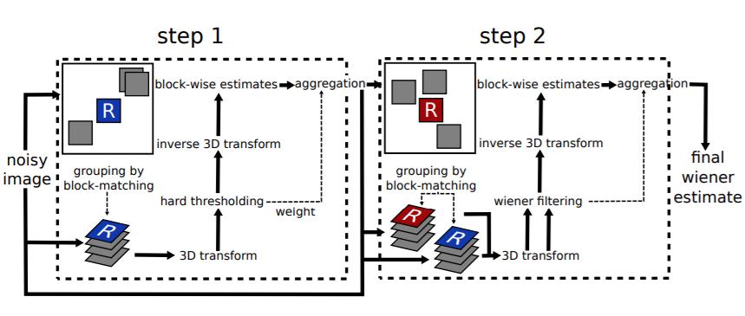
BLOCK DIAGRAM OF BM3D

Slide 7
BM3D
STEP 1
The first step estimates the denoised image using hard thresholding during
the collaborative filtering. Parameters in this step are denoted by the exponent hard.
STEP 2
The second step is based both on the original noisy image, and on the basic estimate
obtained in the first step. It uses Wiener filtering. The second step is therefore
denoted by the exponent wiener.

Slide 8
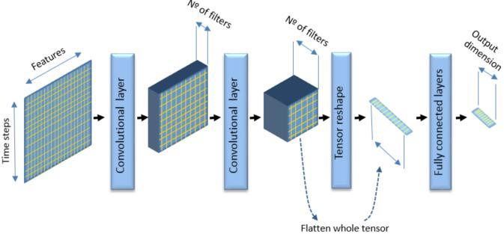
CONVOLUTION NEURAL
NETWORK STRUCTURE

Slide 9
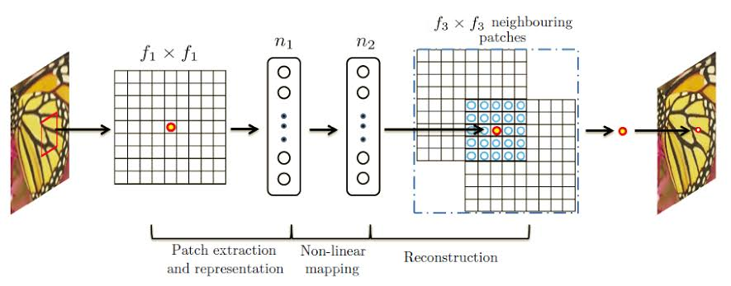
SUPER-RESOLUTION
CONVOLUTION NEURAL
NETWORK

Slide 10
SRCNN
Generating high resolution (HR) image with more details using one or more low resolution (LR) images.
Correspondences between low and high resolution image patches are learned from a database of low and high resolution image.
The SRCNN is a deep convolutional neural network that learns end-to-end mapping of low resolution to high resolution images. As a result, we can use it to improve the image quality of low resolution images.
The goal is to make SRCNN learn how to reconstruct high resolution patches from low resolution input ones.
Thus, we are going to construct two sets of image patches, including a low resolution patch that will be the input to the network, and a high resolution patch that will be target for the network to predict.

Slide 11
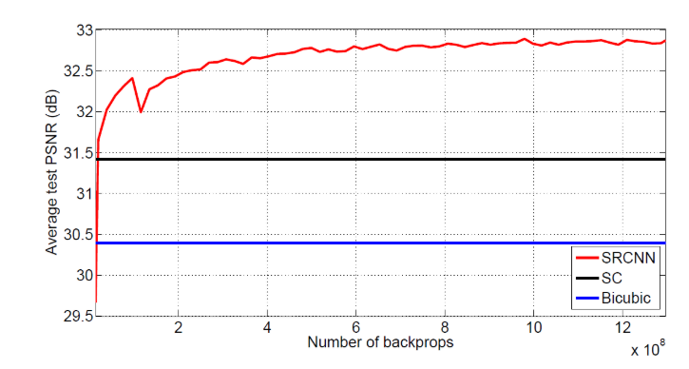
SRCNN VS SC VS BICUBIC
GRAPH COMPARING THE NUMBER OF BACKPROPAGATIONS VS AVERAGE TEST PSNR(dB) FOR SRCNN, SC AND BICUBIC

Slide 12
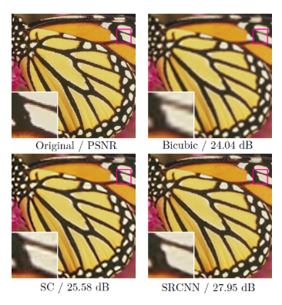
SRCNN VS SC VS BICUBIC
FIGURE COMAPING THE ORIGINAL IMAGE WITH BICUBIC IMAGE, SC IMAGE AND SRCNN IMAGE

Slide 13
IMAGE RESOLUTION INDEXES
We have taken three parameters such as
PSNR
MSE
SSIM

Slide 14


PSNR AND MSE
The term peak signal-to-noise ratio (PSNR) is an expression for the ratio between the maximum possible value (power) of a signal and the power of distorting noise that affects the quality of its representation.
Because many signals have a very wide dynamic range, (ratio between the largest and smallest possible values of a changeable quantity) the PSNR is usually expressed in terms of the logarithmic decibel scale.
OR
MSE = (1/(m*n))*sum(sum((f-g).^2))
PSNR = 20*log(max(max(f)))/((MSE)^0.5)

Slide 15
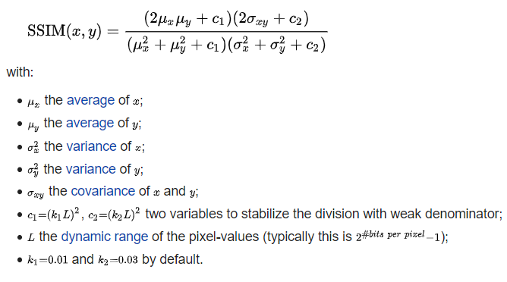
SSIM
The Structural Similarity (SSIM) index is a method for measuring the similarity between two images.
The SSIM index can be viewed as a quality measure of one of the images being compared, provided the other image is regarded as of perfect quality.
It is an improved version of the universal image quality index proposed before.

Slide 16
BLOCK DIAGRAM
NOISY IMAGE
DATA AQUISITION
DATA PREPROCESSING
IMAGE SUPER RESOLUTION
SRCNN
BM3D
OUTPUT IMAGE
RESOLUTION CALCUL
ATION

Slide 17
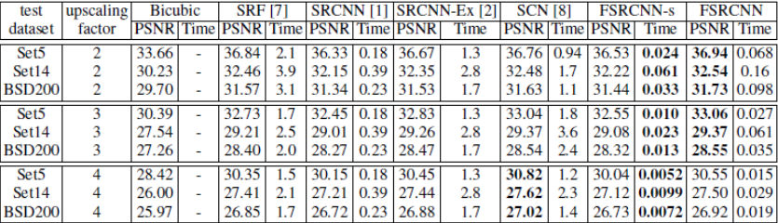
FUTURE WORK
FSRCNN has a relatively shallow network which makes us easier to learn about the effect of each component.
It is even faster with better reconstructed image quality than the previous SRCNN.
By comparing SRCNN and FSRCNN-s, FSRCNN-s (a small model size version of FSRCNN) has a better PSNR (image quality) and much shorter running time, in which 43.5 fps is obtained.

Slide 18
CONCLUSION
The main theme of our project is to denoise the satellite images for surveillances.
In our project we used bm3d which is one of the best filter for noise cancellation\removal.
Then the image from such filter will not be that much sharp. For that we are going to use super resolution technique to enhance the image resolution.

Slide 19
LITERATURE SURVEY
Marc Lebrun worked on “An Analysis and Implementation of the
BM3D Image Denoising Method”.
Bhattacharya, Ranita (2016) had made a study of Color Image Denoising Filters
as a MTech thesis.
Kostadin Dabov, Alessandro Foi, Vladimir Katkovnik, Karen Egiazarian worked on
“Image Denoising by Sparse 3-D Transform-Domain Collaborative Filtering” and
“Color Image Denoising via Sparse 3D Collaborative Filtering with
Grouping Constraint in Luminance-Chrominance Space”.

Slide 20
REFERENCES
scikit-image.org/docs/dev/auto_examples/filters/plot_denoise.html
https://www.ipol.im/pub/art/2012/l-bm3d/article.pdf
https://github.com/ericmjonas/pybm3d
https://en.Wikipedia.org/wiki/Block-matching_and_3D_filtering

