Slide 1
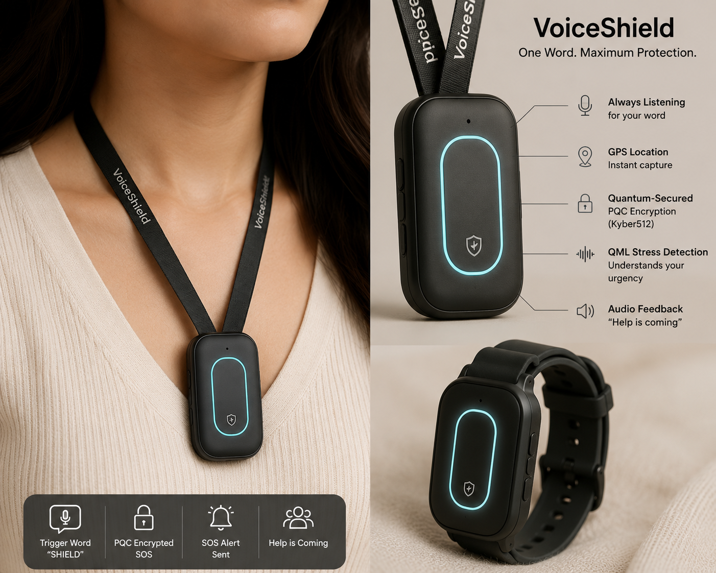
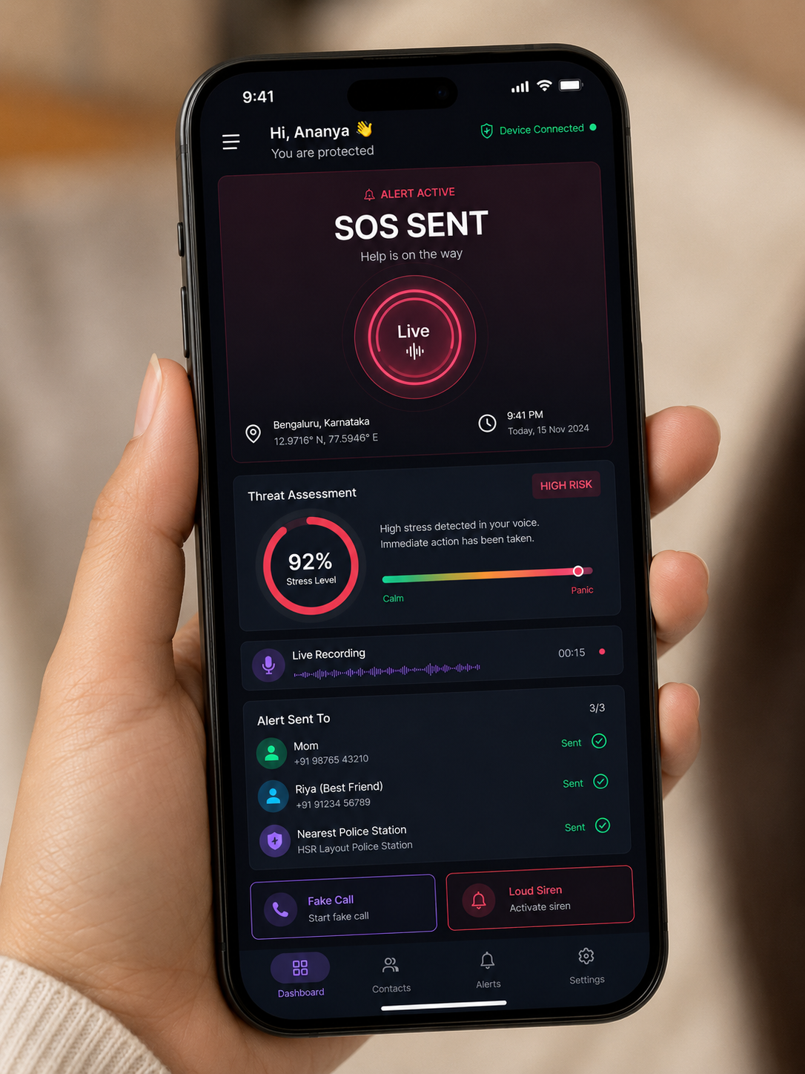

Every 4 minutes.
A crime against a woman is reported in India.
She had a phone.
She couldn't reach it in time.

Slide 2
THE PROBLEM
Safety apps assume she has 10 seconds.
In real danger — she has one.
Current Reality
What She Needs
1. Unlock phone
One word.
2. Find the app
3. Press SOS button
That's all.
4. Wait...
~10 seconds
< 1 second

Slide 3
INTRODUCING
KAVACH
Voice-triggered. Quantum-secured. Always ready.
A wearable voice-AI safety device powered by ElatoAI ESP32. She whispers one secret word — Kavach listens, detects threat level using Quantum ML, encrypts her location with Post-Quantum Cryptography, and fires SOS to her contacts and police — all in under 2 seconds.
Built on ElatoAI ESP32 • Quantum ML • Post-Quantum Cryptography

Slide 4






HOW IT WORKS
Six steps. One second.
1
2
3
4
5
6
She whispers
Trigger detected
QML reads stress
PQC encrypts
SOS fires
"Help is coming"
"Kavach"
ElatoAI ESP32
Voice threat level
Kyber512 secured
Contacts + 112
Whispered back

Slide 5


THE QUANTUM EDGE
Not quantum for the sake of it.
Each layer solves what classical systems can't.
Quantum ML (QML)
Post-Quantum Cryptography
Quantum Optimization
PennyLane VQC
Kyber512 — liboqs
Alert Routing
Classical ML hears words.
QML hears fear.
Our Variational Quantum Classifier detects panic in voice stress patterns — even when she says "I'm fine."
Her location, audio, and identity are encrypted with Kyber512 — unhackable today, and unhackable by future quantum computers.
Multiple trusted contacts? Kavach quantum-optimizes who gets alerted first — based on proximity and past response time.

Slide 6
THREAT INTELLIGENCE
QML decides the response — not a button.
Level 1 — Low
Precautionary
Asks if she's safe. Starts background recording. No alert yet.
Level 2 — Medium
At Risk
Silent SOS to 1 contact. Plays fake phone call. GPS tracking begins.
Level 3 — High
Active Danger
SOS to all contacts + 112 police API. Audio recorded + encrypted.
Level 4 — Critical
No Response
Auto-calls 112. Live location every 60s. Encrypted evidence uploaded.
QML Threat Score: 0.0 ──────────────────────────── 1.0

Slide 7
OUR EDGE
No app does all five.
Feature
Every Other App
KAVACH
Needs phone unlock
✗ Yes
✓ Voice only
Visible to attacker
✗ Often
✓ Hidden device
Data encryption
✗ Unencrypted
✓ PQC Kyber512
Alert intelligence
✗ Binary on/off
✓ QML threat levels
Hardware independent
✗ Smartphone only
✓ Standalone ESP32

Slide 8
ESP32 captures voice → Gemini Live converts to structured data → splits into 3 parallel quantum tracks → QML scores threat level, PQC encrypts payload, Optimizer ranks contacts → FastAPI assembles everything → fires to Twilio + 112 API + Evidence Vault simultaneously → dashboard lights up + device whispers back to her
the dashed line on the left = the voice response looping back to the ESP32 speaker.

Slide 9
TECH STACK
Fully buildable. No simulations.
Voice Hardware
ElatoAI ESP32
Trigger + Voice AI
Gemini Live API
QML Stress Detection
PennyLane VQC + RAVDESS Dataset
Post-Quantum Encryption
liboqs — Kyber512
Alert System
Twilio SMS / WhatsApp API
Backend
FastAPI (Python)
Dashboard
Next.js

Slide 10
REAL WORLD IMPACT
Built for India. Deployable today.
500M+
1 word
< 2s
Women in India
To trigger safety
Alert fired
Target market
Zero friction
Quantum speed
Deployment Roadmap
Phase 1 → Pilot on Bengaluru college campuses
Phase 2 → Integrate with 112 India Emergency API
Phase 3 → Apply for Nirbhaya Fund (Govt grant for women's safety tech)
Phase 4 → Scale to 1000+ colleges under NEP 2020 mandate

Slide 11
We didn't build an app.
We built a guardian.
She just has to say one word.
KAVACH — VoiceShield
Quantum ML • Post-Quantum Cryptography • ElatoAI ESP32
https://chatgpt.com/s/m_6a115b3435048191833b02c8e634ba97

