Slide 1
Capstone Project
Predicting Telecom Churn

Slide 2
Agenda
Understanding Data: Creating a data quality report
Variable Profiling: Continuous Variables
Variable Profiling: Categorical Variables
Data preparation: Binning, missing value imputation, derived variables and dummy variable creation
Model Building: Using step wise to select variable
Final model
Creating customer segments
Additional notes

Slide 3
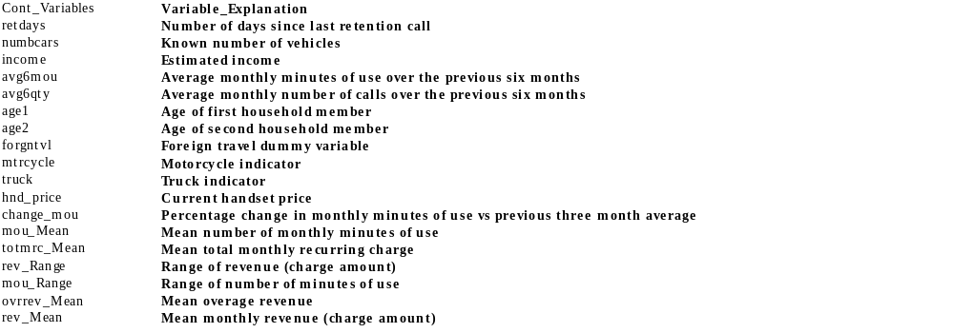
Understanding data: Data Quality Report
Note: Double click on the above OLE Object
60 continuous var and 21 categorical var, based on max missing observation decided to drop
Continuous_Var: (retdays, numbcars, income)
Categorical_Var: (solflag, wrkwoman, div_type, occu1, proptype, cartype, children, mailordr, mailresp, dwllsize, dwlltype)

Slide 4
Variable Profiling: Continuous Variables
Note: Please refer the r code, below methods are followed for Variables profiling
Decile binning should be used to find out event rate (churn rate in this case). If there is a trend (increase in event rate or decrease in event rate), then that variable should be selected for model iterations
For some variables it won’t be possible to do decile binning, one should either divide the data into 8,6,4,3 or 2 equal parts and then look at the event rates. If there is a pattern then, the variable should be chosen for model iterations
Profiling will also aid in data preparation as deciles with similar event rates can be clubbed together into one group and a categorical variable can be created

Slide 5
Variable Profiling: Categorical Variables
Note: Please refer the r code, below methods are followed for Variables profiling
Event rate for each level in a categorical variable can be computed
Ideally there should be good difference between the event rate in each level
If some levels have similar event rate then those labels can be combined in a single group
After Variable profiling for both Continuous and Categorical variable decided to drop few more variables viz.,
forgntvl, mtrcycle, truck, car_buy, age2
Variables like "csa”,”crclscod” had too many levels
Variables like “ethnic” is being sociological variable (Nominal) is said to be the lowest level of measurement do not contain much information and lend to relatively few statistical analysis

Slide 6
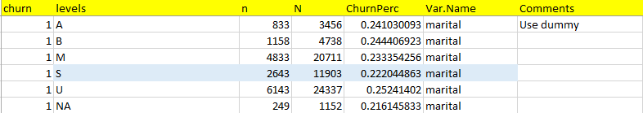
Data Preparation: Missing Value Imputation
Note: Please refer the r code, below methods are followed in Missing Value Imputation
There are several variables with missing values, based on the percentage of missing values in these variables, some variables can be out rightly excluded from analysis
For the variables with a few missing values, imputation can be made by observing the event rate
Here missing values can be imputed as “S”

Slide 7
Data Preparation: Derived Variables
Note: Please refer the r code, of derived variables
To answer some of the issues raised in the case, additional variables will need to be created for example to understand if “Network issues are leading to churn” following variable can be created
Completion_Percentage=Completed Voice Calls/Total Placed Calls
There are several such issues which have been raised in the case study for which new variables will have to be created.
Derived comp_per_vce and comp_per_dat variables from the data
comp_per_vce: Explains % of completed voice calls out of placed calls
comp_per_dat: Explains % of completed data calls out attempted data calls placed

Slide 8
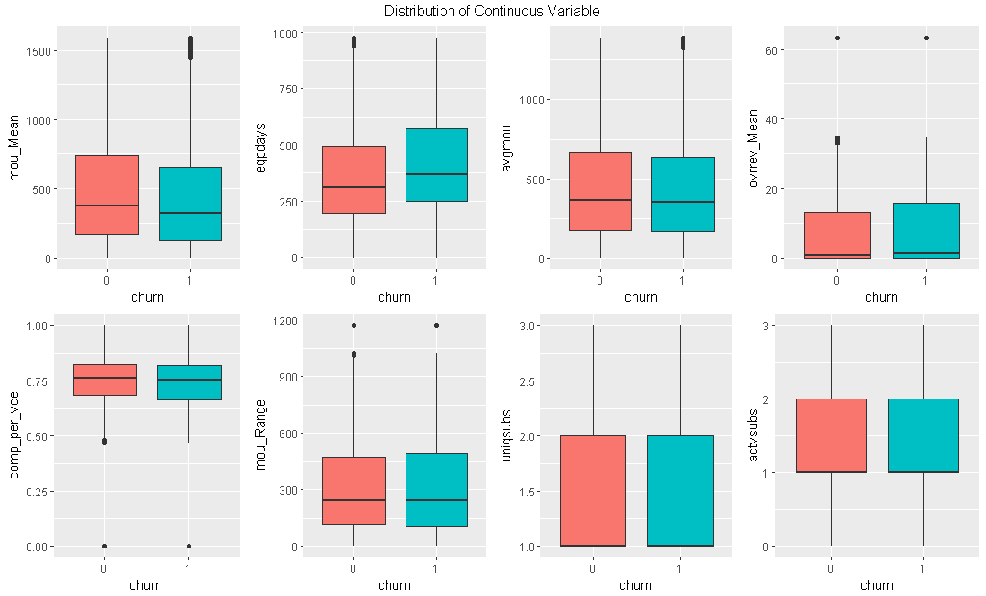
Exploratory Data Analysis
The “telecomfinal” dataset is split into train (46407 obs) and test (19889 obs) of 63 predictor variables and 1 response var(churn=1/0). The proportion of churned customers (churn=1) is close to 25% and is evenly distributed across the 2 sets. Train will be used for data exploration and model building while Test will be used to measure model performance
Explore distributions by continuous predictors

Slide 9
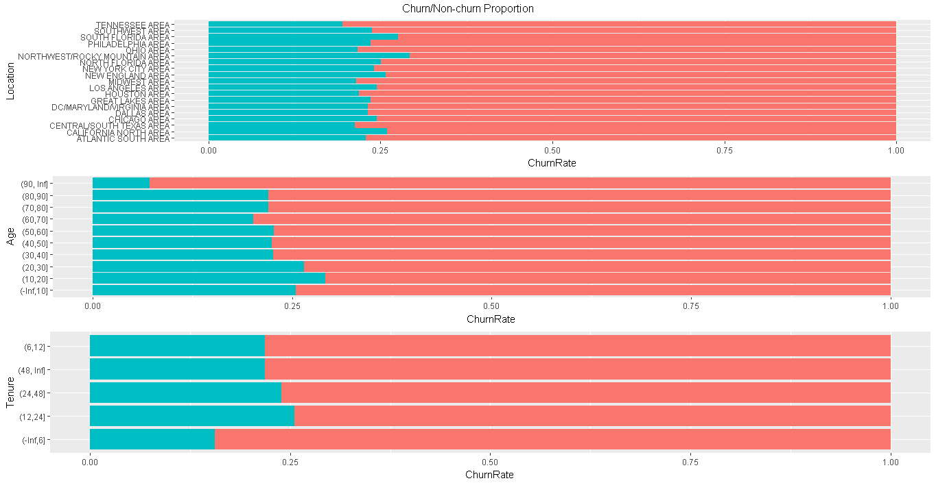
Churn ratio by categorical predictors
The fig above shows the proportion of churn across of the categorical predictors (green = churned).

Slide 10
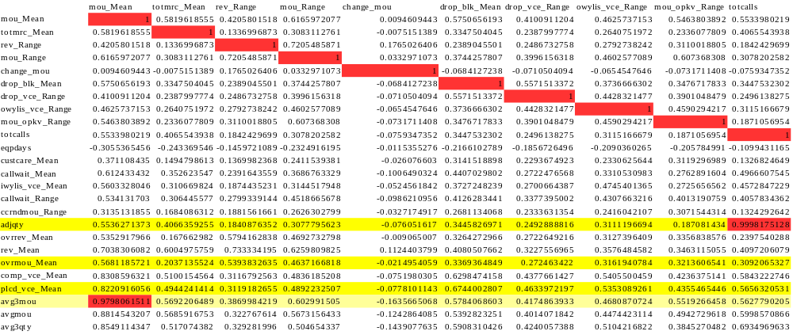
Check for Collinearity
Highly correlated variables adjqty, ovrmou_Mean, plcd_vce_Mean, avg3mou, avg6qty, adjrev, plcd_dat_Mean are removed
Note: Double click on the below OLE Object

Slide 11
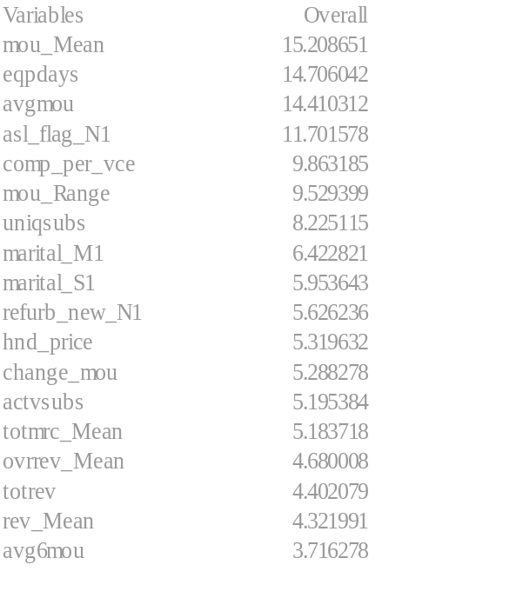
Logistic Regression Model
The exploratory analysis already revealed which area, age_cat and Month_cat have higher than average churn, the area, age_cat and months_cat predictors will not be considered in the model. Instead model will be used to interpret remaining contributors of churn.
Applying step-wise regression method finalized the below model. The logistic model summary reveals the key drivers of churn.
Hypothesis tests, at significance level of 5% and for a sample size of 46407, of the vaiables marked *** in the model summary will conclude that there is a significant relationship between churn and the predictor variable. Specifically, these variables and their degree of importance to churn are: varImp(modelfinal)

Slide 12
set.seed(2019)
model <- glm(train$churn~., data=train, family = "binomial")
modelfinal <- glm(formula = churn ~ mou_Mean + totmrc_Mean + mou_Range + change_mou + eqpdays + ovrrev_Mean + rev_Mean + avgmou + avg6mou + hnd_price + actvsubs + uniqsubs + totrev + marital_M + marital_S + comp_per_vce + asl_flag_N + refurb_new_N, family = "binomial", data = train)
Deviance Residuals:
Min 1Q Median 3Q Max
-1.5414 -0.7731 -0.6530 -0.4507 2.4167
Coefficients:
Estimate Std.Error z value Pr(>|z|)
(Intercept) -1.339e+00 6.986e-02 -19.172 < 2e-16 ***
mou_Mean -1.064e-03 6.998e-05 -15.209 < 2e-16 ***
totmrc_Mean -5.238e-03 1.011e-03 -5.184 2.18e-07 ***
mou_Range 4.962e-04 5.207e-05 9.529 < 2e-16 ***
change_mou -3.699e-04 6.995e-05 -5.288 1.23e-07 ***
eqpdays 9.564e-04 6.504e-05 14.706 < 2e-16 ***
ovrrev_Mean 4.843e-03 1.035e-03 4.680 2.87e-06 ***
rev_Mean 4.160e-03 9.625e-04 4.322 1.55e-05 ***
avgmou 1.081e-03 7.504e-05 14.410 < 2e-16 ***
avg6mou -1.650e-04 4.439e-05 -3.716 0.000202 ***
hnd_price -1.321e-03 2.483e-04 -5.320 1.04e-07 ***
actvsubs -1.727e-01 3.325e-02 -5.195 2.04e-07 ***
uniqsubs 2.308e-01 2.806e-02 8.225 < 2e-16 ***
totrev -1.104e-04 2.507e-05 -4.402 1.07e-05 ***
marital_M1 -1.667e-01 2.596e-02 -6.423 1.34e-10 ***
marital_S1 -1.798e-01 3.020e-02 -5.954 2.62e-09 ***
comp_per_vce -4.514e-01 4.577e-02 -9.863 < 2e-16 ***
asl_flag_N1 4.462e-01 3.813e-02 11.702 < 2e-16 ***
refurb_new_N1 -2.017e-01 3.585e-02 -5.626 1.84e-08 ***
---
Signif. codes: 0 ‘***’ 0.001 ‘**’ 0.01 ‘*’ 0.05 ‘.’ 0.1 ‘ ’ 1
(Dispersion parameter for binomial family taken to be 1)
Null deviance: 50929 on 46406 degrees of freedom
Residual deviance: 49326 on 46388 degrees of freedom
AIC: 49364
Number of Fisher Scoring iterations: 4

Slide 13
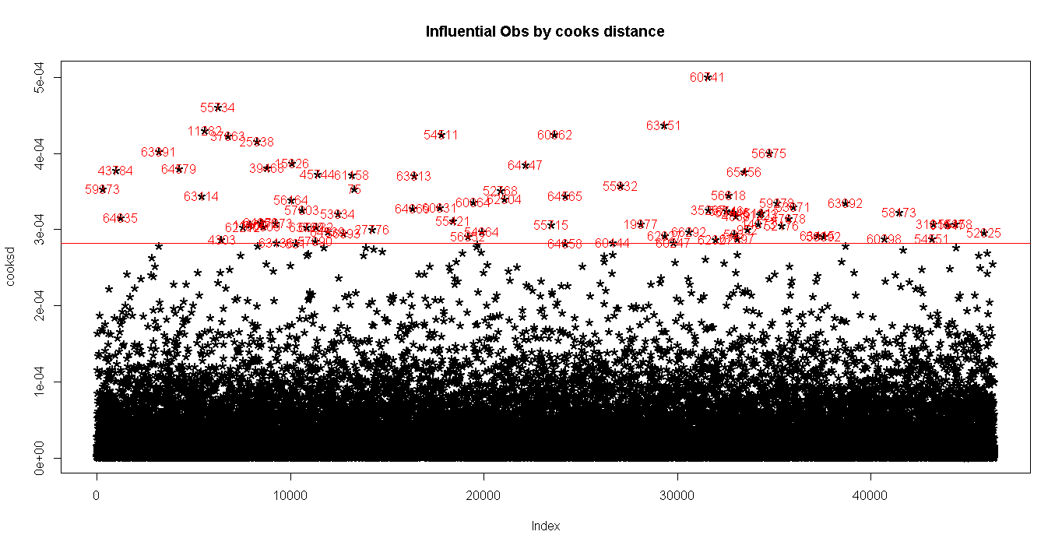
Outlier Analysis of the model using Cook's Distance
Cook's distance measures the influence exerted by each data point (row) on the predicted outcome (churn)
No Studentized residuals with Bonferonni p < 0.05
Largest |rstudent|:
rstudent unadjusted p-value Bonferonni p
37663 2.418341 0.015591 NA
The output suggests that observation in row 37663 is most extreme. Likewise, all outliers can be identified and removed from the data.

Slide 14
Model Performance
The test of any model is to evaluate it against an unseen dataset. Will predict the model against the test dataset and measure the performance
Assume anything with probability of 1 greater than (0.2379598 ~ 0.24) will be 1 else 0. where, 1 is churn and 0 is non-churn
The confusion matrix is used to review the prediction vs actual. It is important to note that while the accuracy of the model appears to be high, a lot that accuracy is driven by disproportionate number of non churn customers predicted correctly.
Reference
Prediction 0 1
0 9642 2231
1 5431 2585
Accuracy : 0.6148
95% CI : (0.608, 0.6215)
No Information Rate : 0.7579
P-Value [Acc > NIR] : 1
Kappa : 0.1439
Mcnemar's Test P-Value : <2e-16
Sensitivity : 0.5368
Specificity : 0.6397
Pos Pred Value : 0.3225
Neg Pred Value : 0.8121
Prevalence : 0.2421
Detection Rate : 0.1300
Detection Prevalence : 0.4030
Balanced Accuracy : 0.5882
'Positive' Class : 1

Slide 15
Odds Ratio and Beta Co-efficient
One of the interesting performance measurements in logistic regression is odds ratio(. Odds ratio is what the odds of an event is happening
OR 2.5 % 97.5 %
(Intercept) 0.2620187 0.2284416 0.3004067 mou_Mean 0.9989363 0.9987992 0.9990733 totmrc_Mean 0.9947754 0.9928087 0.9967494 mou_Range 1.0004964 1.0003942 1.0005984 change_mou 0.9996302 0.9994930 0.9997671 eqpdays 1.0009569 1.0008295 1.0010847 ovrrev_Mean 1.0048548 1.0028196 1.0068960 rev_Mean 1.0041684 1.0022714 1.0060603 avgmou 1.0010820 1.0009349 1.0012294 avg6mou 0.9998350 0.9997471 0.9999211 hnd_price 0.9986802 0.9981942 0.9991661 actvsubs 0.8413584 0.7883596 0.8981118 uniqsubs 1.2595894 1.1919579 1.3305541 totrev 0.9998896 0.9998404 0.9999387 marital_M1 0.8464113 0.8043747 0.8905481 marital_S1 0.8354570 0.7873304 0.8862679 comp_per_vce 0.6367277 0.5822260 0.6966436 asl_flag_N1 1.5623639 1.4502892 1.6841249 refurb_new_N1 0.8173239 0.7619534 0.8769366
Beta Coefficient of the Model
(Intercept) mou_Mean totmrc_Mean mou_Range change_mou eqpdays ovrrev_Mean rev_Mean
-1.33934 -0.00106 -0.00524 0.00050 -0.00037 0.00096 0.00484 0.00416 avgmou avg6mou hnd_price actvsubs uniqsubs totrev marital_M1 marital_S1
0.00108 -0.00016 -0.00132 -0.17274 0.23079 -0.00011 -0.16675 -0.17978 comp_per_vce asl_flag_N1 refurb_new_N1
-0.45141 0.44620 -0.20172

Slide 16
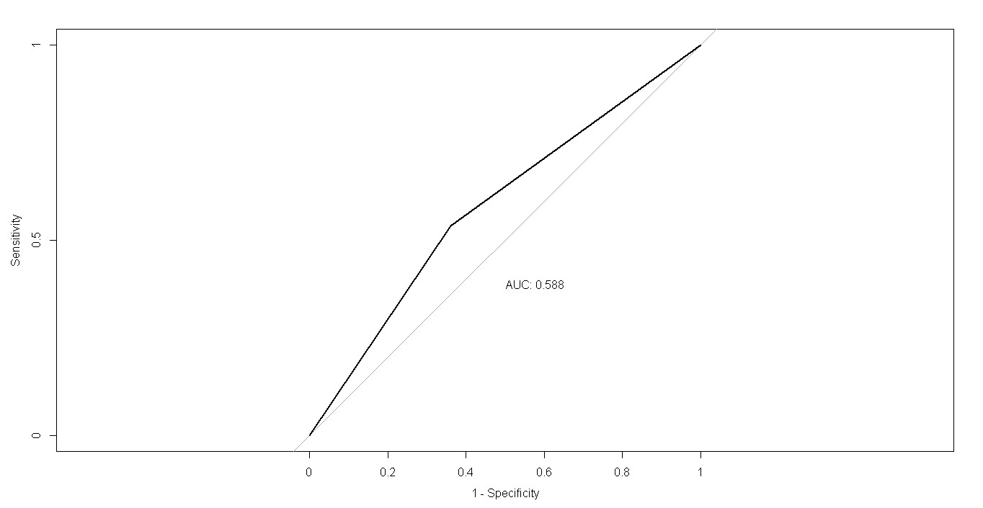
Good fit measured by AUC
The Area Under Curve(AUC) measures the models ability to correctly classify those who churned and those who did not. The higher the AUC the better. Current model is able to classify 59% correctly

Slide 17
Top Line Questions of Interest to Senior Management:
1. What are the top five factors driving likelihood of churn at Mobicom?
A: “asl_flag” = “N” No account spending limit
“uniqsubs” = Number of unique subscribers in the household
“ovrrev_Mean” = Mean overage revenue
“rev_Mean” = Mean monthly revenue (charge amount)
“avgmou” = Average monthly minutes of use over the life of the customer
2. Validation of survey findings.
a) Whether “cost and billing” and “network and service quality” are important factors influencing churn behavior
A: Assuming minutes of use directly proportional to “cost and billing”
From the model; Variables categorized as “cost and billing”: avg6mou, hnd_price, change_mou, mou_Mean, totmrc_Mean, mou_Range, ovrrev_Mean, rev_Mean, avgmou, asl_flag, refurb_new, uniqsubs, actvsubs
Variables categorized as “network and service quality”: eqpdays, comp_per_vce
comp_per_vce = %completion of placed call, is having negative impact on churn
So, we can say cost and billing is the main cause or influencing factor for churn.
b) Are data usage connectivity issues turning out to be costly? In other words, is it leading to churn?
A: No, data usage connectivity is not the issue which is turning out to be costly nor leading to churn.
3. Would you recommend rate plan migration as a proactive retention strategy?
A: Yes,
Features like range of number of minutes of use, Mean overage revenue, Mean monthly revenue, Average monthly min of use over the life of the customer, account spending limit as No are directly influencing for churn.

Slide 18
4. What would be your recommendation on how to use this churn model for prioritization of customers for a
proactive retention campaigns in the future?
A: 1. Release New plan with optimum number of minutes for customers who are churning coz, minutes usage issues.
2. Release CUG connections/bundle packs for unique subscribers in the household.
3. Mobicom should tie-up with mobile company/venture into mobile market and release new mobile with up-gradation plan w.r.t to minutes of use to attract customers.
4. Account spending limit for customers “No” capping of the amount to be optimized
5. From EDA it is observed that, areas like 'Northwest Rocky mountain” and “South Florida” should be prioritized in targeting campaign.
6. From EDA it is observed that, age-group between 10-30 yrs (youngsters) should be targeted with attractive usage plans.
7. From EDA it is observed that, customers between 1-2 yrs of tenure active subscribers to be targeted with better offers.
8. As a low priority for targeting campaign of customers who are married/single, there handset is refurbished/new, number of active subscribers in the household, current handset price, average minutes of use over the past 3-6 months as these are not influencing for customer churn.

Slide 19
5. What would be the target segments for proactive retention campaigns? Falling ARPU forecast is also a concern and therefore, Mobicom would like to save their high revenue customers besides managing churn. Given a budget constraint of a contact list of 20% of the subscriber pool, which subscribers should prioritized if “revenue saves” is also a priority besides controlling churn. In other words, controlling churn is the primary objective and revenue saves is the secondary objective
Probability of Churn Score(y)/Revenue(x) | High | Medium | Low
High | 58 | 9 | 26
Medium | 3362 | 5440 | 3071
Low | 2547 | 2507 | 2869

