Slide 1

REEP
Live portal walkthrough
How the Student, Faculty, Main Admin and Alumni portals work — recorded on the running product, with the workflows that link them.
STUDENT · FACULTY / MENTOR · MAIN ADMIN · ALUMNI · SIX VIDEOS + THIS DECK

Slide 2
What is in this pack
Video | Shows | Length
student.mp4 | The Student portal, every screen, with a certificate claim, a reconciled time sheet, a meeting request and the assistant | 2:34
faculty.mp4 | The Faculty portal: notebook, mentee log, skill verification, the leave form, upskilling, signature | 2:05
admin.mp4 | The Main Admin console: applications, roster, faculty, assignment, leave, jobs, interviews, SWOC, college setup, access, audit | 3:24
interlinked.mp4 | One workflow across three portals — what a student does, what the mentor and the office do about it, and where it lands | 4:01
onboarding.mp4 | A new student's journey: apply → approve → emailed link (address, code, password) → first sign-in → faculty assigned | 3:18
alumni.mp4 | The Alumni portal: first-login profile and the jobs sheet | 0:37
Every video is a real recording of the product: the typing, the clicks and the data are live, and a caption bar explains each screen as it opens. Play them in this order; tools/demo/render.sh also produces reep-full-walkthrough.mp4, all six back to back. The slides that follow use the same screenshots so the deck can be read without the videos.
REEP · live portal walkthrough
2
Notes:
Six videos, one deck. The videos were recorded by a script that drives the real portal in a browser, so nothing is mocked. Play the role videos in order, then the two workflow videos.

Slide 3






REEP in one slide
Student
Faculty / Mentor
Main Admin
Alumni
Readiness stages, jobs with a match %, the badge board, a 24-hour time ledger, the mentor log, the resume, and a speech-to-speech mock interviewer.
A notebook and a mentee log for their own group only, the skill-verification queue, leave on the college form, their own upskilling shelf.
One office account: applications, the roster, faculty, assignments, leave sanction, jobs, interviews, SWOC, college setup, access grants, the audit trail.
A profile with a resume and the jobs sheet — no student record, so no match %.
One product, one front door. An Angular single-page app talks to a FastAPI back end over HTTP on PostgreSQL. Every role signs in on the same login screen; the portal picker is a hint, the role on the account is the decision. Sign-in is Google or password, and an account holds one live session at a time.
Rule 1 — student data stays on the machine
Rule 2 — staff scope is decided by role
A resume brief carries a name, USN, marks and attendance. Any path that sends a student's record to a model goes through one gate; refused, the resume is composed deterministically and says so.
A mentor sees only the students in their own group; a mentor with no group sees nobody. Console screens reach a faculty member only as a grant the Main Admin makes, with a reason, on the audit trail.
REEP · live portal walkthrough
3
Notes:
REEP is a college placement-readiness dashboard. Four portals on one login. Two rules shape every screen you are about to see: student data stays on the machine unless an operator allows otherwise, and what staff can see is decided by role and by the mentor group the office assigned — never by a field that happens to be empty.

Slide 4
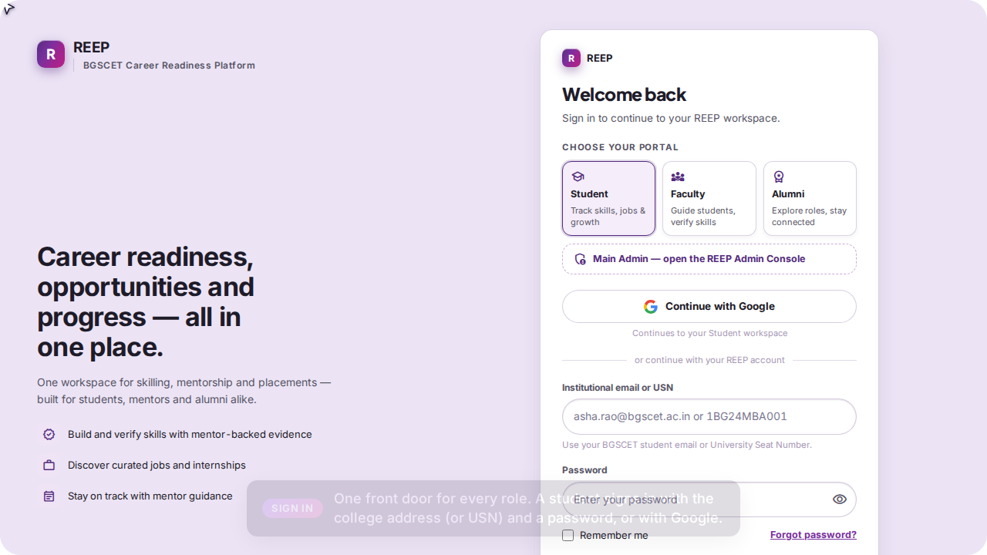
One login for every role
STUDENT
Choose your portal — Student, Faculty, Alumni — or the dashed Main Admin door for the placement office.
The picker only changes the hint on the ID box; the role on the account decides where you land.
Sign in with the college address (students may type the USN) and a password, or with Google — an unknown Google account is refused, nothing self-provisions.
One device at a time: signing in elsewhere signs the older session out and the screen says so.
“Forgot password?” emails a link; a student who never had a password is mailed the three-step setup walk instead.
REEP · live portal walkthrough
4
Notes:
Every video starts here. The same form serves all four roles. The Main Admin door is a hint, not a bypass: it selects the admin portal so the ID field reads “admin email”; the account's role is what opens the console.

Slide 5


Student portal
Home · Jobs · Skilling · Leaderboards · Time Sheet · Faculty / TPO Log · Resume Builder — plus Uploads, Profile, Records, English, Interviews and the assistant dock on every screen.
Signs in as student@bgscet.ac.in (Test Student, MBA 2024-26, Semester 2)
Claims a skill with a certificate, reconciles and submits the day's time sheet, asks the mentor for a meeting
Opens the assistant: Ask REEP answers from the record; the Mock interview room picks a round
Video
student.mp4 · 2:34

Slide 6
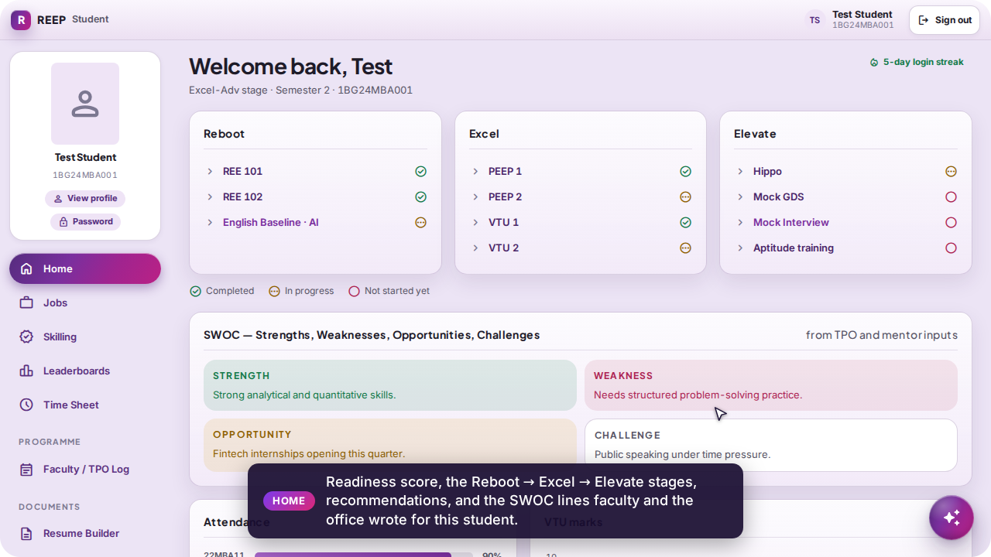
Home — where the student stands today
STUDENT
The three programme stages — Reboot, Excel, Elevate — with each module Completed, In progress or Not started.
SWOC: the Strengths, Weaknesses, Opportunities and Challenges the mentor and the placement office wrote, each signed and dated; the student marks a line as read.
Attendance and VTU marks against the placement criteria; a dash where nothing has been imported yet — never a zero.
A login streak in the header, and the readiness score with its weakest factor and the action that lifts it.
REEP · live portal walkthrough
6
Notes:
Home is the student's landing. Nothing here is typed by the student: stages come from the milestone rows, SWOC from staff, marks and attendance from the office's spreadsheet imports.

Slide 7
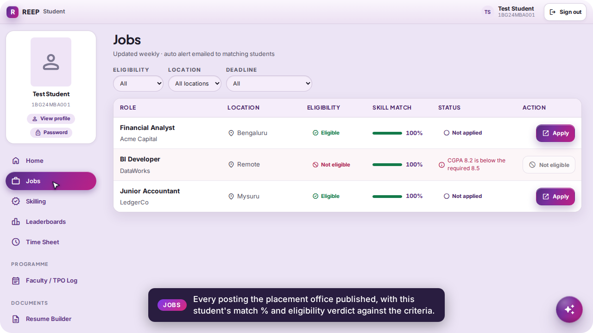
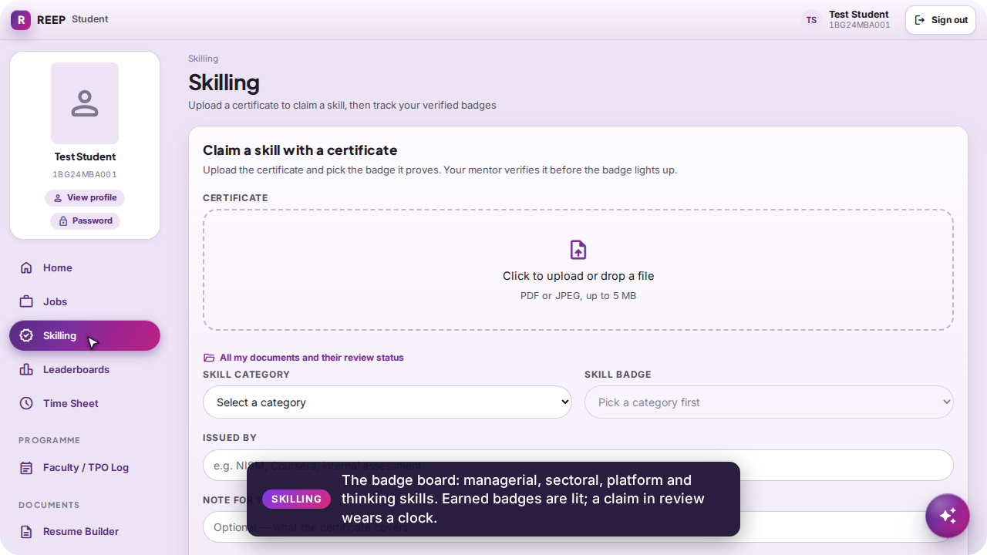
Jobs and Skilling
STUDENT
Jobs: every posting the office published, with this student's match % and an eligibility verdict against the placement criteria (CGPA, backlogs, skills). Skilling: the 48-badge board — managerial, sectoral, platform, thinking and readiness — with earned badges lit and claims in review wearing a clock.
Jobs — match % and eligibility are computed from the student's own record
Skilling — the badge board; a verified badge carries the mentor's blue tick
REEP · live portal walkthrough
7
Notes:
The match % on Jobs and the eligibility verdict are the same criteria the office maintains on Placement. Skilling is where a certificate becomes a badge — but only after a mentor verifies it.

Slide 8
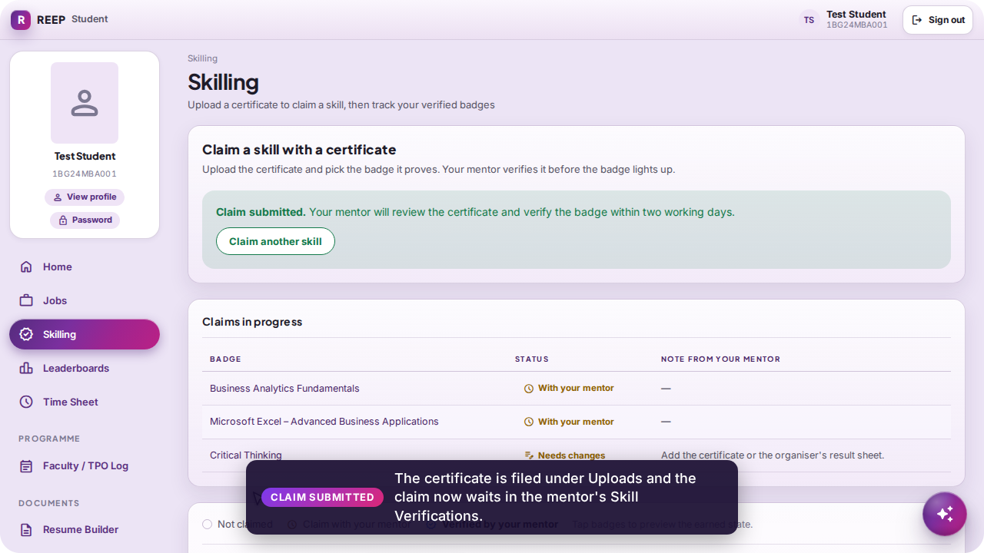
Claim a skill with a certificate
STUDENT
1 · Upload the certificate (PDF or JPEG, up to 5 MB). It is stored under Uploads with its review status.
2 · Pick the skill category and the badge the certificate proves; name the issuer and leave a note for the mentor.
3 · Submit. The claim now waits in the mentor's Skill Verifications queue, and the mentor is emailed.
The badge lights up only when the mentor presses Verify — a certificate is evidence, never a badge by itself.
Request changes or Reject come back with the mentor's note, on screen and by mail.
REEP · live portal walkthrough
8
Notes:
This is the first half of the student–mentor loop the interlinked video shows end to end. The rule enforced by the write path: a certificate is not a badge; only staff approval mints the earned row.

Slide 9
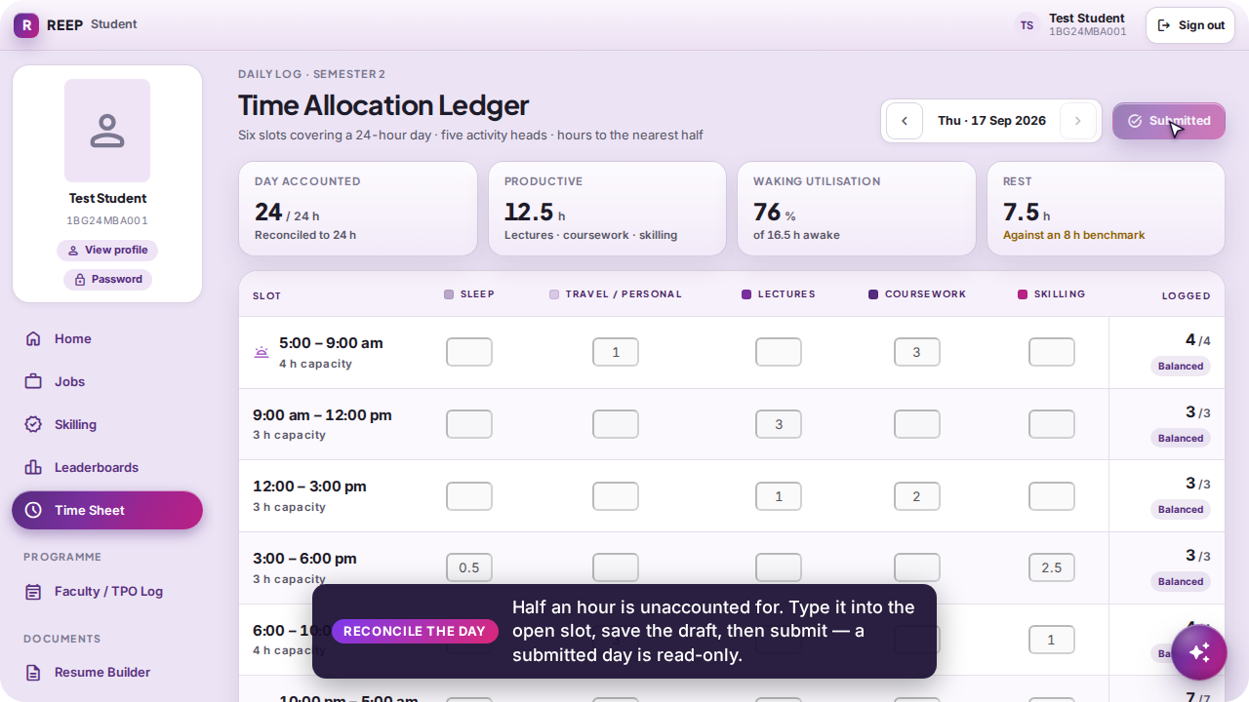
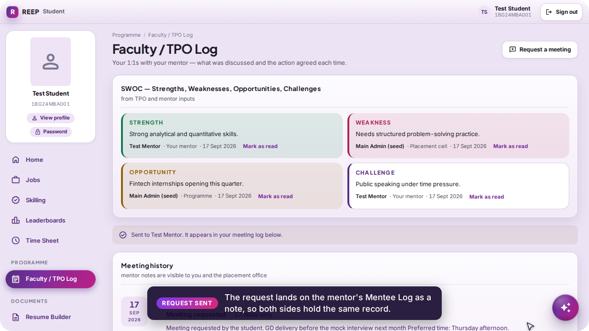
Time Sheet and the Faculty / TPO Log
STUDENT
The Time Allocation Ledger: six slots across the day × five activity heads, in half hours; the day must add to exactly 24 h before Submit is allowed, and a submitted day is read-only. The Faculty / TPO Log is the student's own record of every 1:1, and Request a meeting sends a note straight to the mentor's Mentee Log.
The day reconciled to 24 h and submitted
“Sent to Test Mentor. It appears in your meeting log below.”
REEP · live portal walkthrough
9
Notes:
Half hours are stored as integers, so “does this add up to 24” is exact. The meeting request is a mentor note, so both sides read the same row.

Slide 10
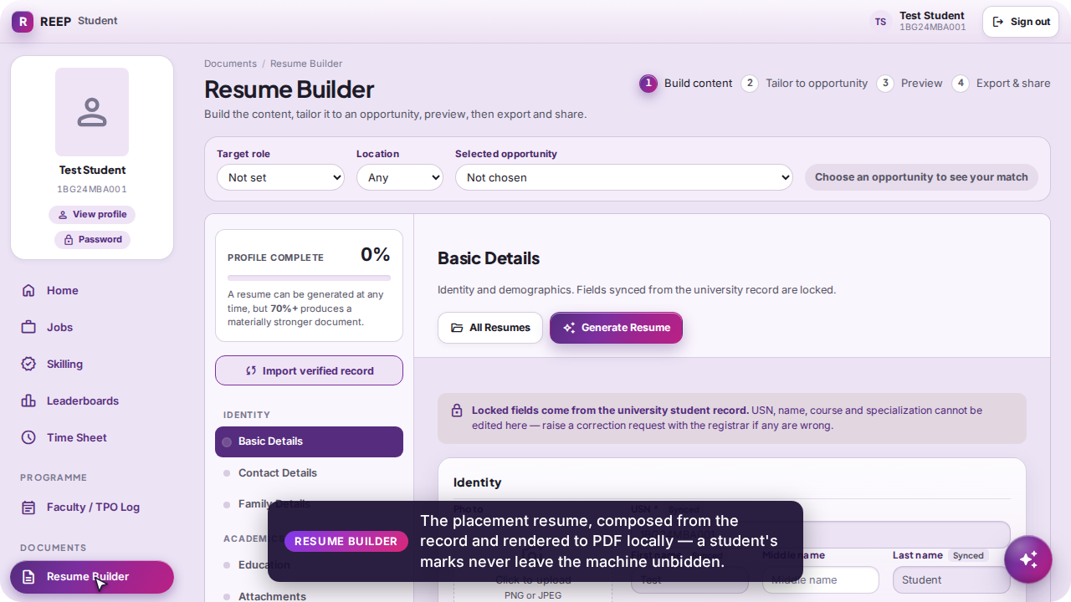
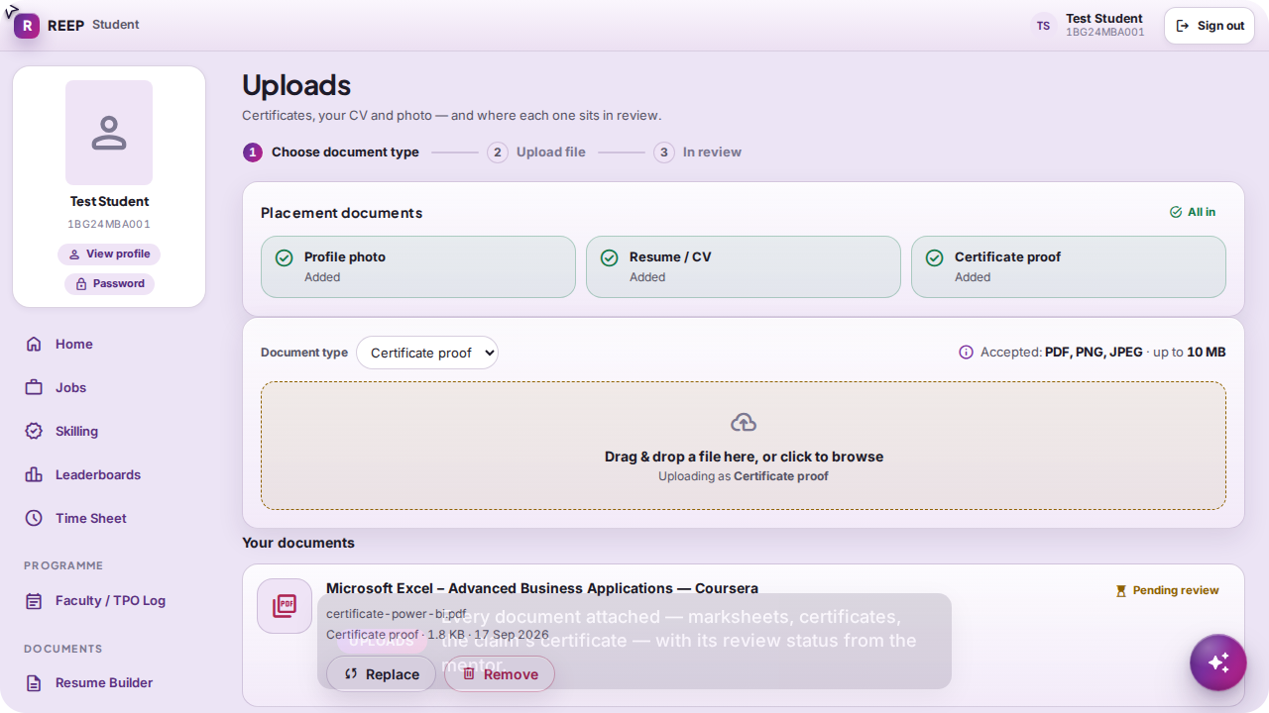
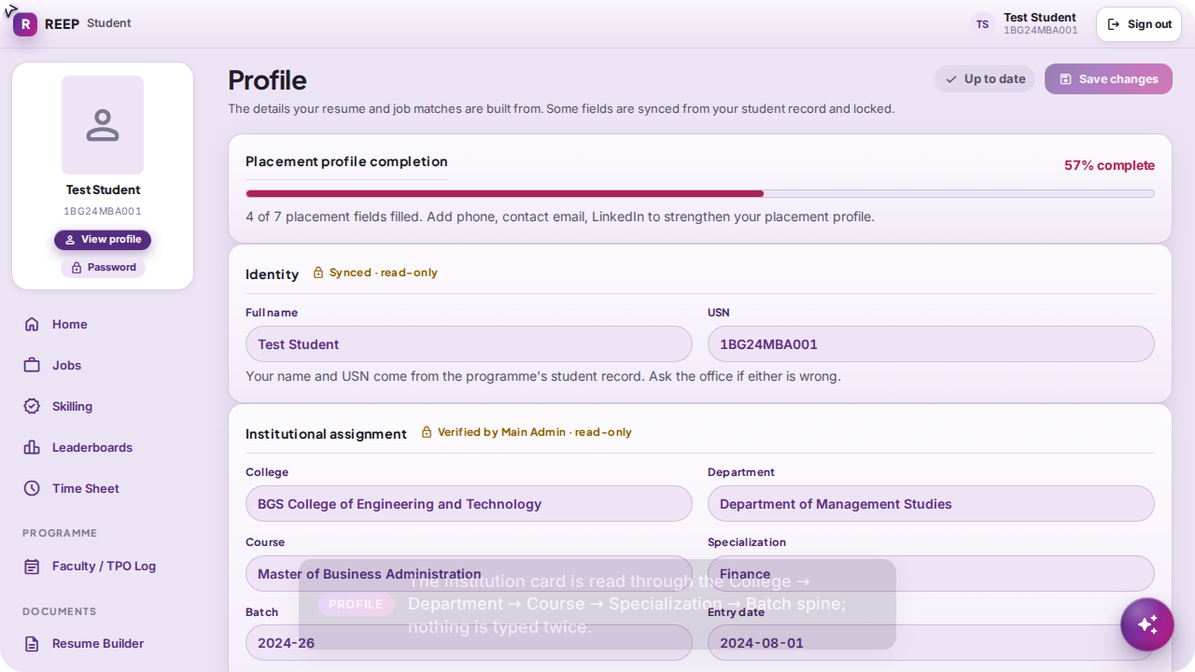
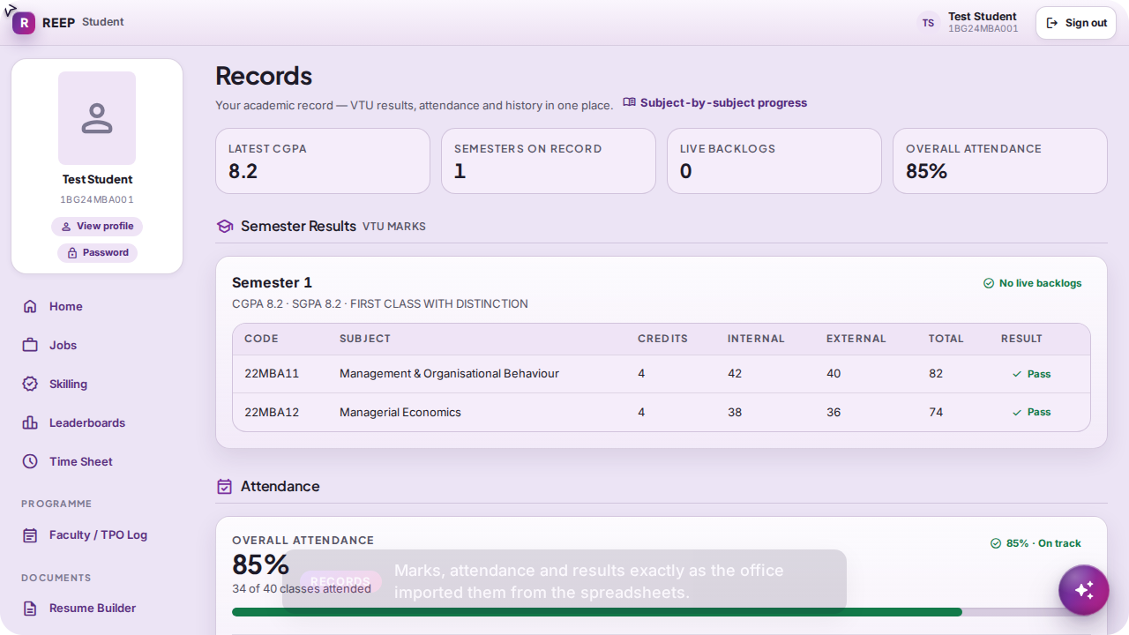
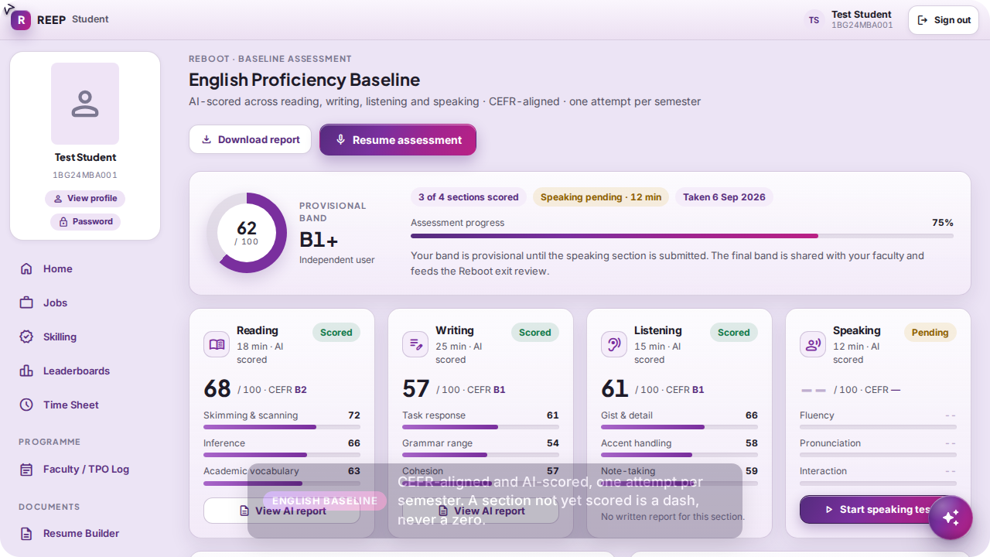
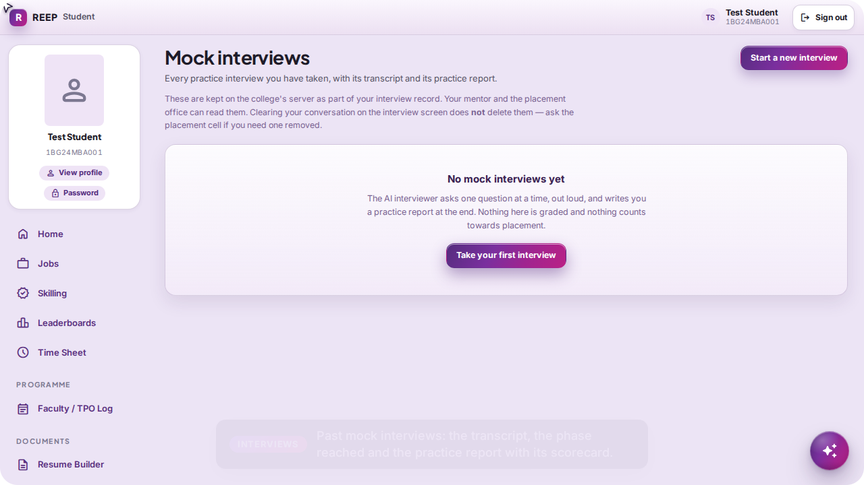
The rest of the student's desk
STUDENT
Reached from Home and the screens that own the work: the resume, every document and its review status, the locked institution card, imported results, the English baseline and past interviews.
Resume Builder — rendered to PDF locally
Uploads — every document and its verdict
Profile — the institution card read through the spine
Records — marks and attendance as imported
English baseline — a pending section is a dash
Interviews — transcript and practice report
REEP · live portal walkthrough
10
Notes:
These screens are deliberately off the sidebar; each is reached from the screen that owns the work. The profile card is read through the college → department → course → batch join and stored nowhere else.

Slide 11
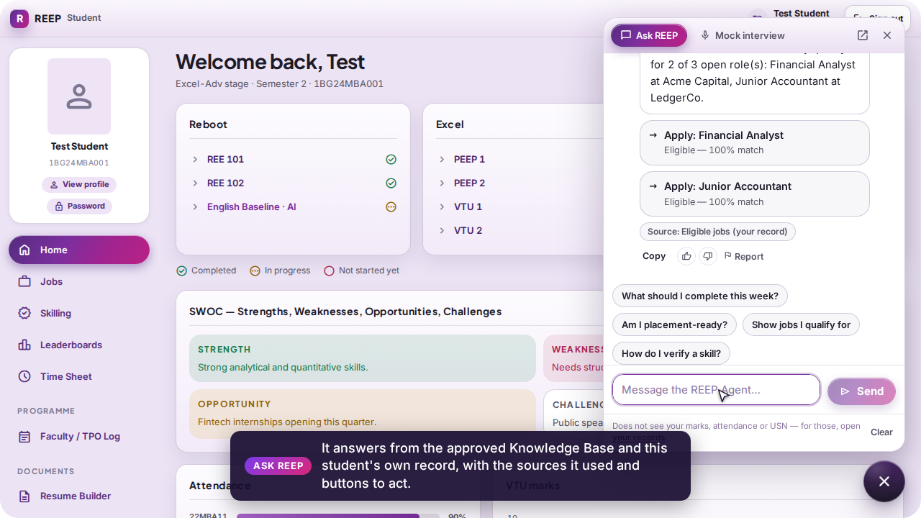
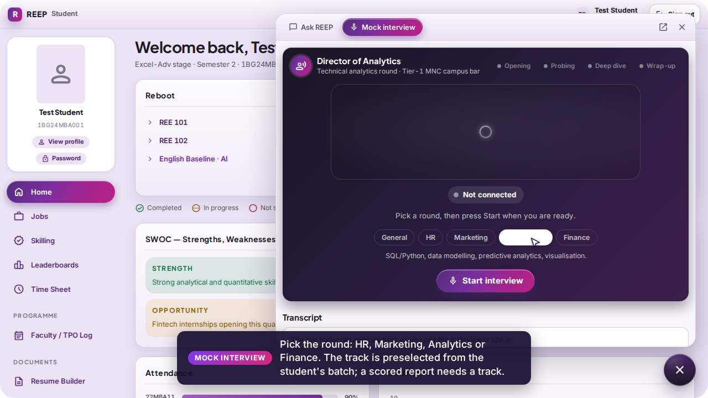
The assistant dock: Ask REEP and the Mock interview
STUDENT
The floating orb on every screen opens one dock with two tabs. Ask REEP is the typed agent: it answers from the approved Knowledge Base and the student's own record, shows its sources and offers buttons to act. Mock interview is a speech-to-speech campus-round interviewer (Amazon Nova 2 Sonic) with a real arc — opening, probing, deep dive, wrap-up — and a scorecard; the round is preselected from the student's batch, and consent is asked before anything is stored.
Ask REEP — “Which open jobs am I eligible for?”
Mock interview — pick the round, then Start
REEP · live portal walkthrough
11
Notes:
Both assistants are in the shell, not on a route, so they are on every screen. The interview engine runs inside the API process; on a machine without the cloud engine the room reports itself unavailable and nothing else is affected.

Slide 12

Faculty portal
Notebook · Mentee Log · Leave Requests · Skill Verifications · Upskilling — and the signature, the account screen and any console screen the office granted.
Signs in as mentor@bgscet.ac.in (Test Mentor), whose group holds Test Student
Every mentee screen is scoped to that group: a faculty member with no group sees nobody, never the whole programme
Logs a notebook entry, answers the student's meeting request, verifies the claim, applies for leave, files a certificate and a signature
Video
faculty.mp4 · 2:05

Slide 13
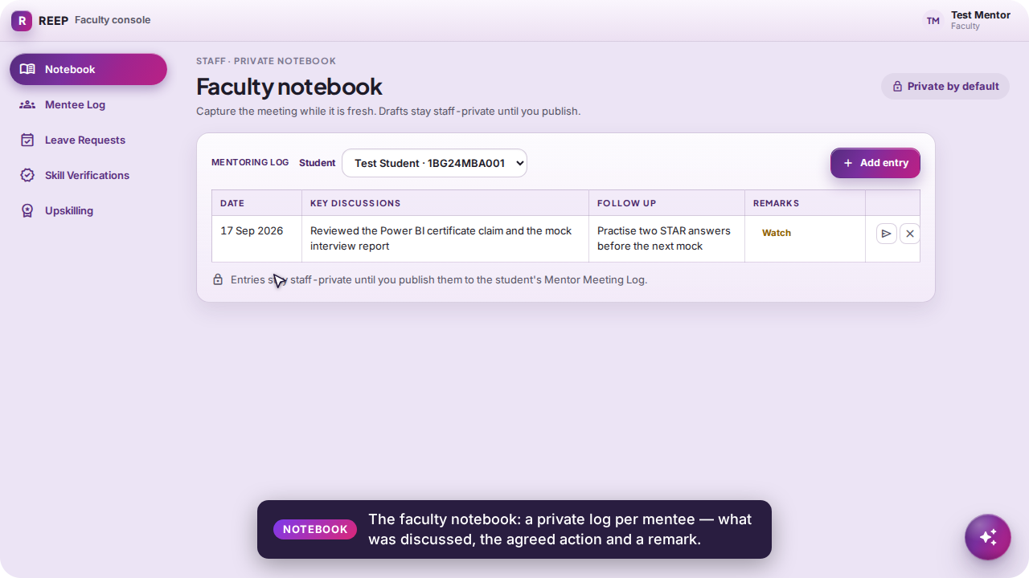
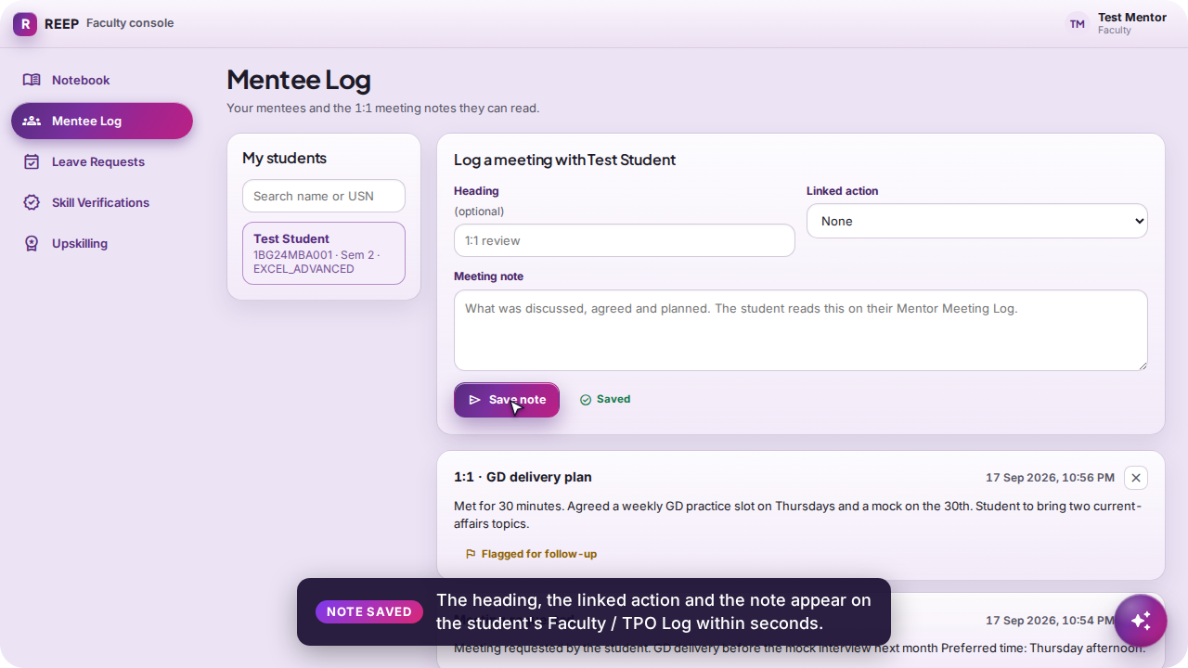
Notebook and Mentee Log
FACULTY
The notebook is the faculty member's private log per student: date, what was discussed, the agreed action, a remark. The Mentee Log is the shared record: the student's meeting request is already on it, and the note written back — heading, linked action, text — is exactly what the student reads on their Faculty / TPO Log. A “Full record” link opens the student's complete file when the office has granted that read.
Notebook — a private entry per mentee
Mentee Log — the note the student will read
REEP · live portal walkthrough
13
Notes:
Rule 2 in practice: the mentee list is the faculty member's own group and nothing else. The note form is the mentor's instrument; a meeting request from the student arrives as one of these notes.

Slide 14
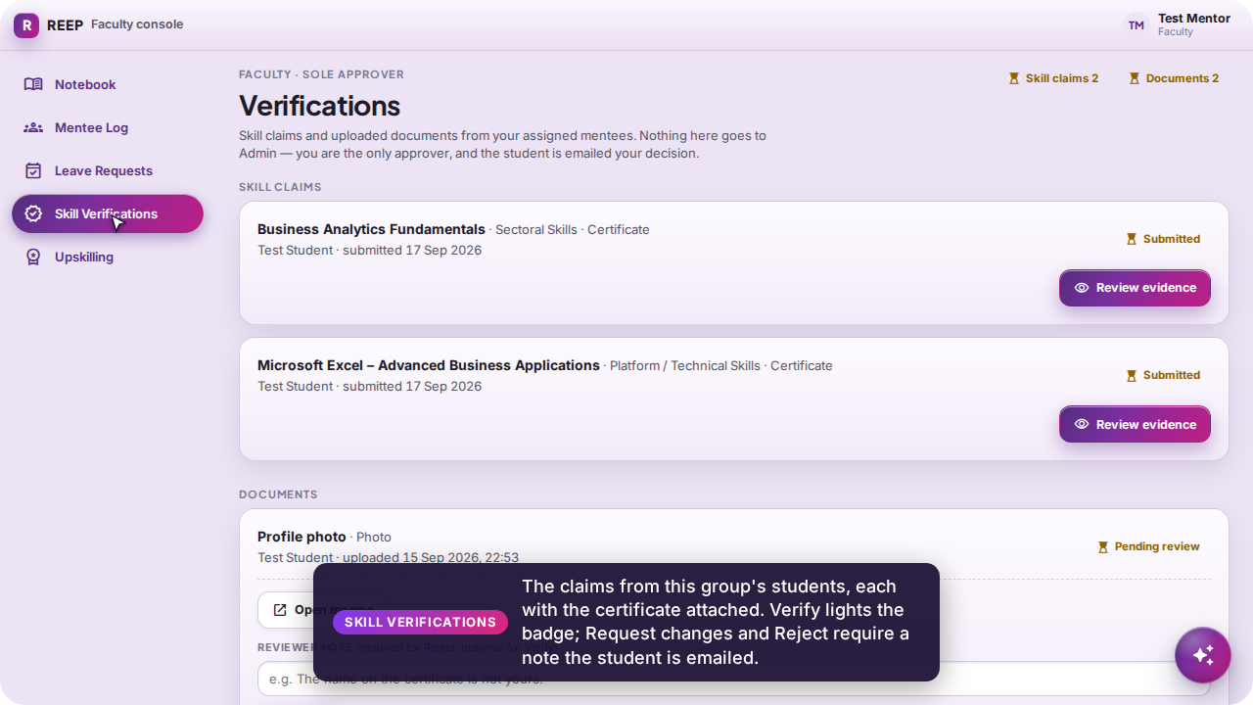
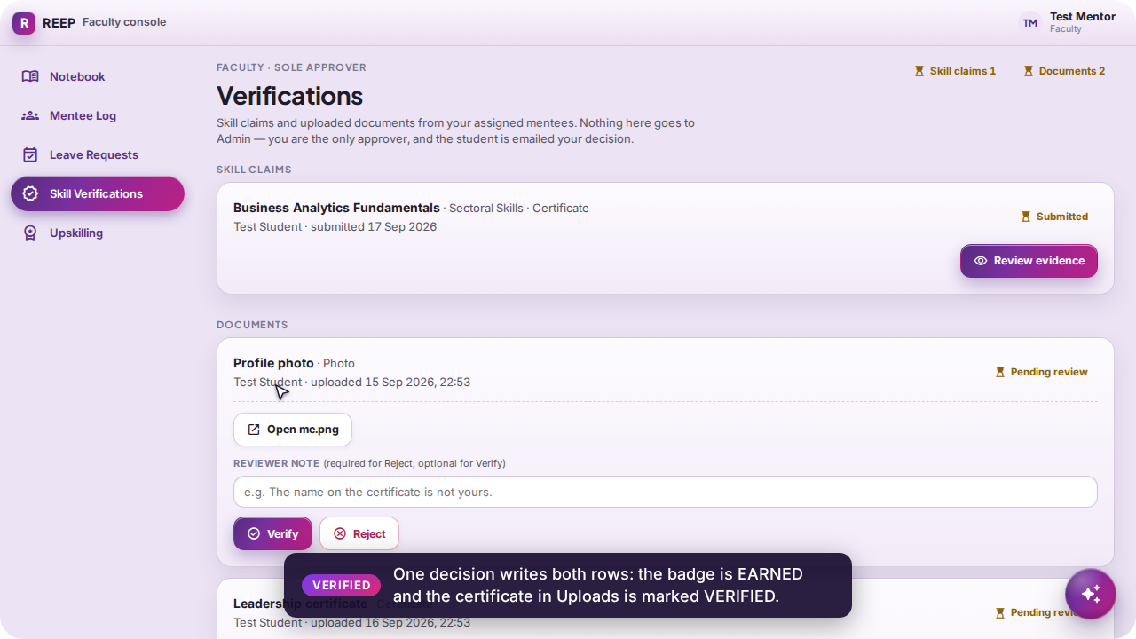
Skill Verifications — one decision writes both rows
FACULTY
The queue lists the claims from this group's students with the certificate attached. Verify mints the EARNED badge and marks the certificate VERIFIED in the student's Uploads in the same act. Request changes and Reject refuse without a note — the note is the whole of what the student is told, on screen and by mail.
The claim, its certificate, and the three decisions
Verified — the badge is lit on the student's board
REEP · live portal walkthrough
14
Notes:
This is the second half of the student–mentor loop. The mentor was emailed when the claim was filed; the student is emailed the decision with the note.

Slide 15
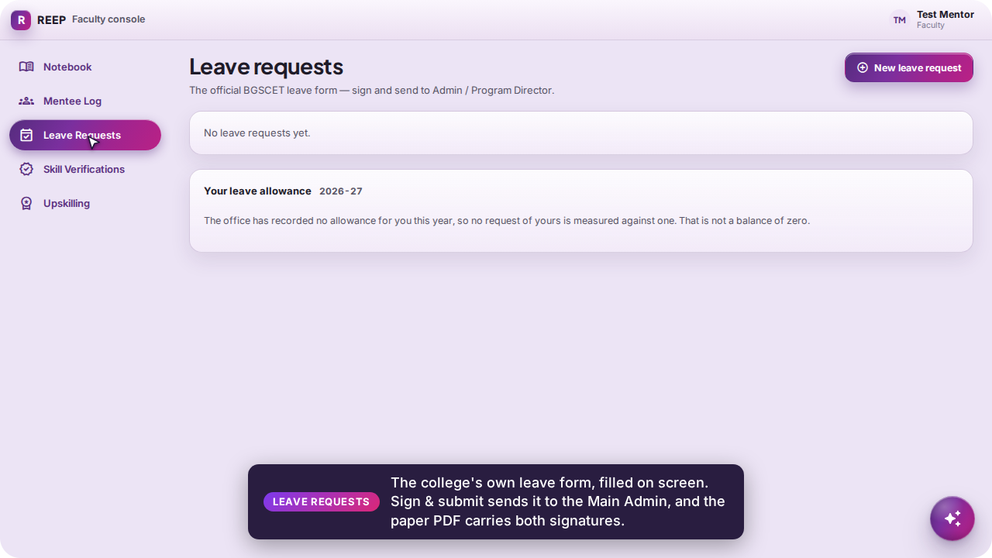
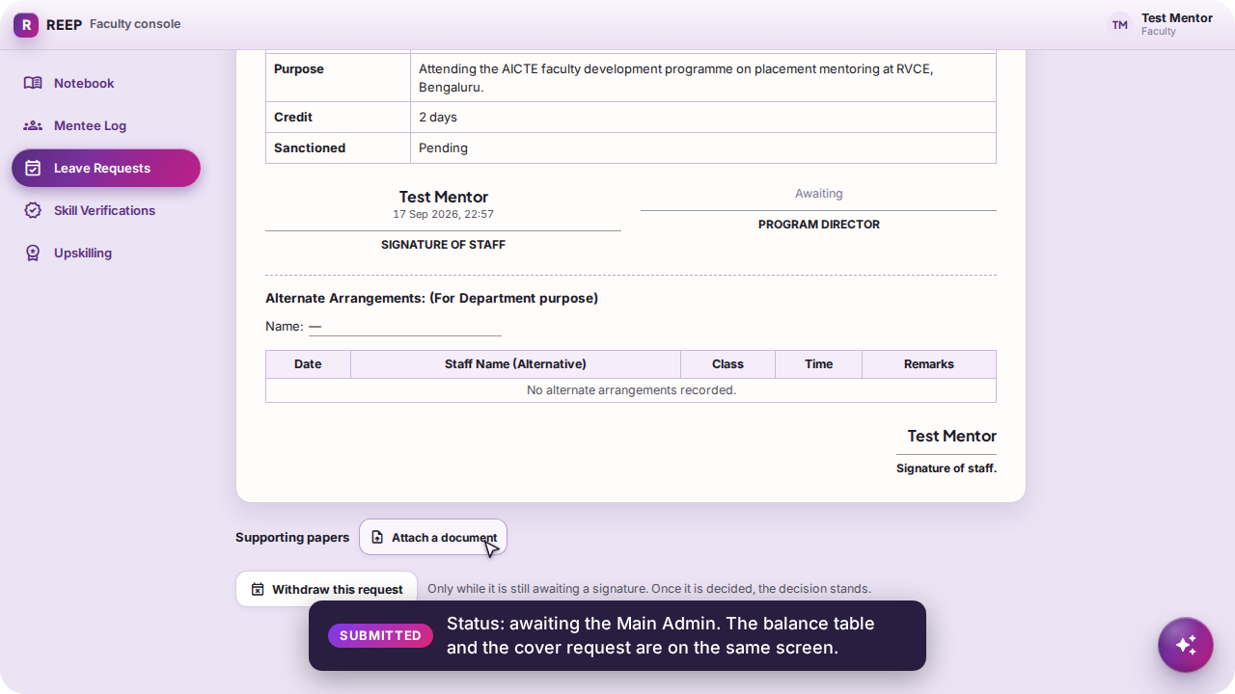
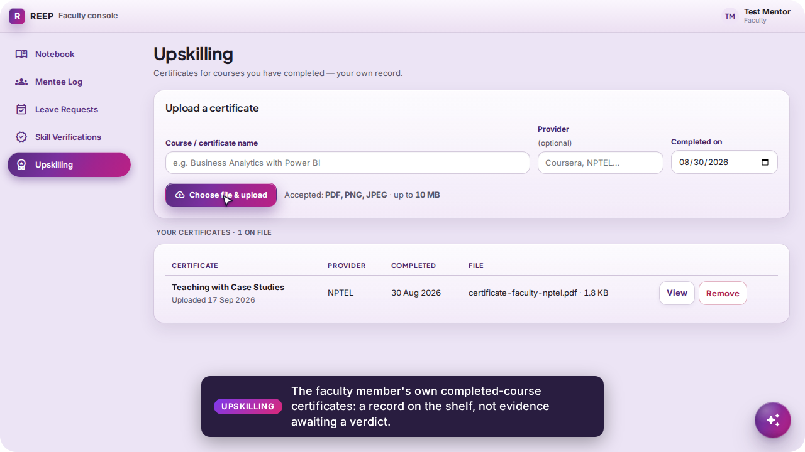
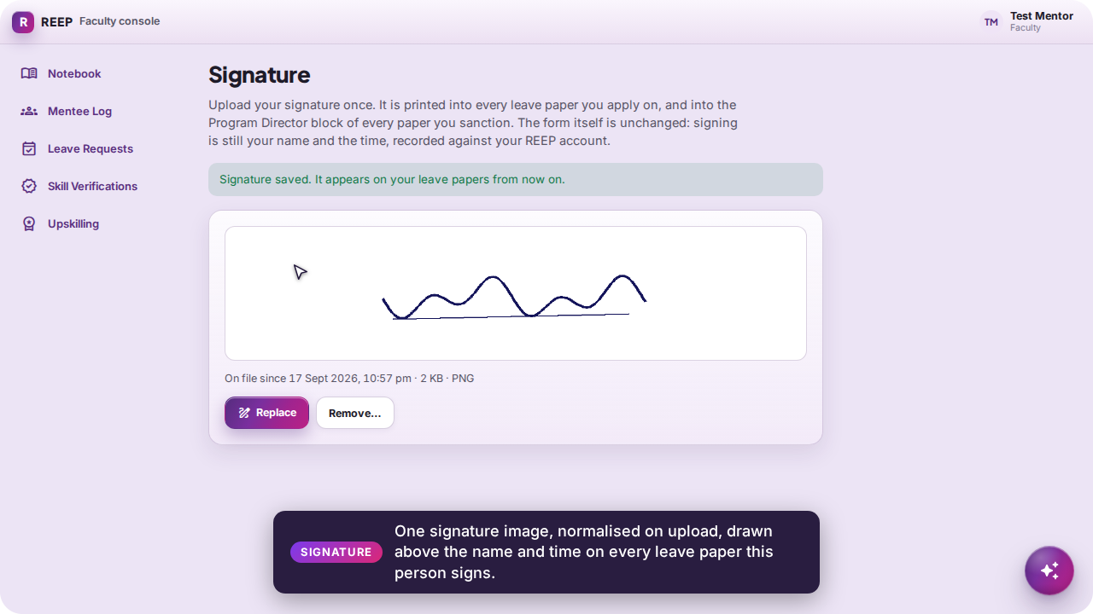
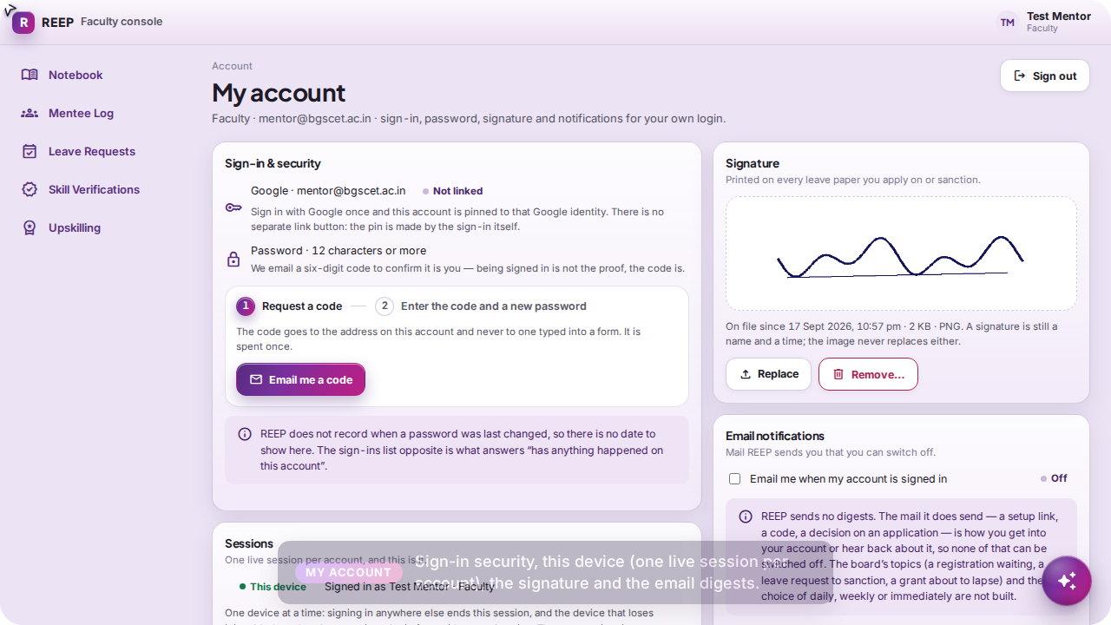
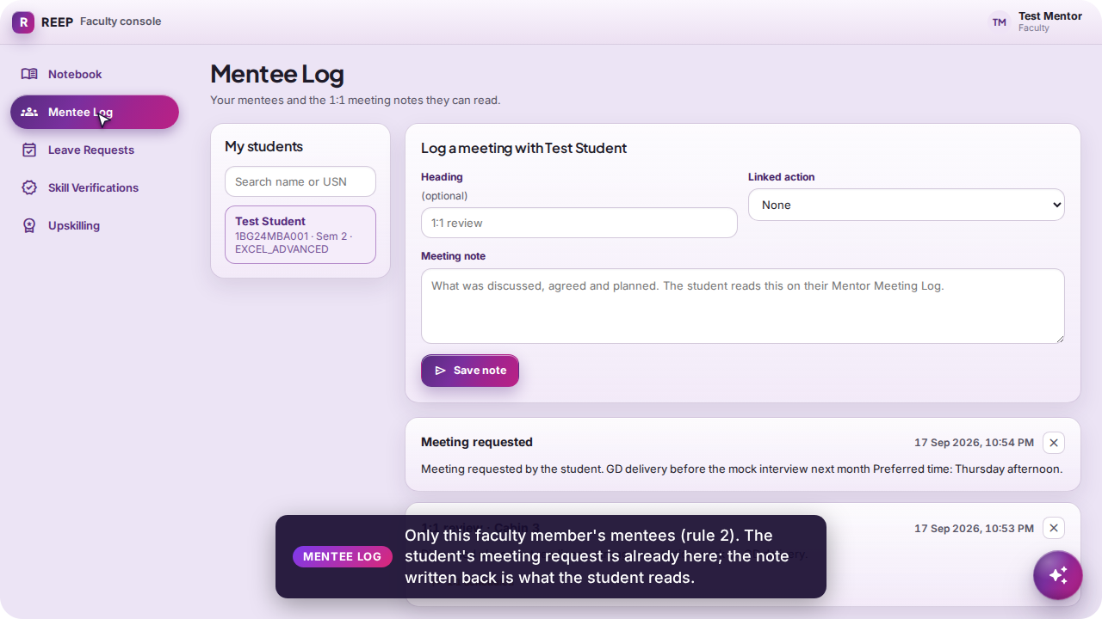
Leave, Upskilling, Signature, Account
FACULTY
Leave is the college's own form filled on screen and signed to the Main Admin; Upskilling is the faculty member's own certificate shelf; the signature is drawn on every leave paper they sign; My account holds sign-in security and this device.
Leave Requests — balances, cover and the form
Signed & submitted — awaiting the Main Admin
Upskilling — a record, not evidence
Signature — normalised on upload
My account — security, this device, digests
Mentee Log — the student's request waiting
REEP · live portal walkthrough
15
Notes:
The leave request dies at the schema if the dates run backwards. The paper PDF is the college's own form with the request written onto it, and the signature image is drawn above the name and time — never instead of them.

Slide 16

Main Admin console
People · Every day · Interviews · College setup · Settings — the placement office's one account, landing on a list of tasks in plain words.
Signs in through the Main Admin door as admin@bgscet.ac.in
Approves an application, opens a student's 360, seats a student under a faculty member, sanctions leave, publishes a job, writes a SWOC line, grants a screen to a faculty member
Nothing on the console explains itself: a label that needs decoding gets changed, not a tooltip
Video
admin.mp4 · 3:24

Slide 17
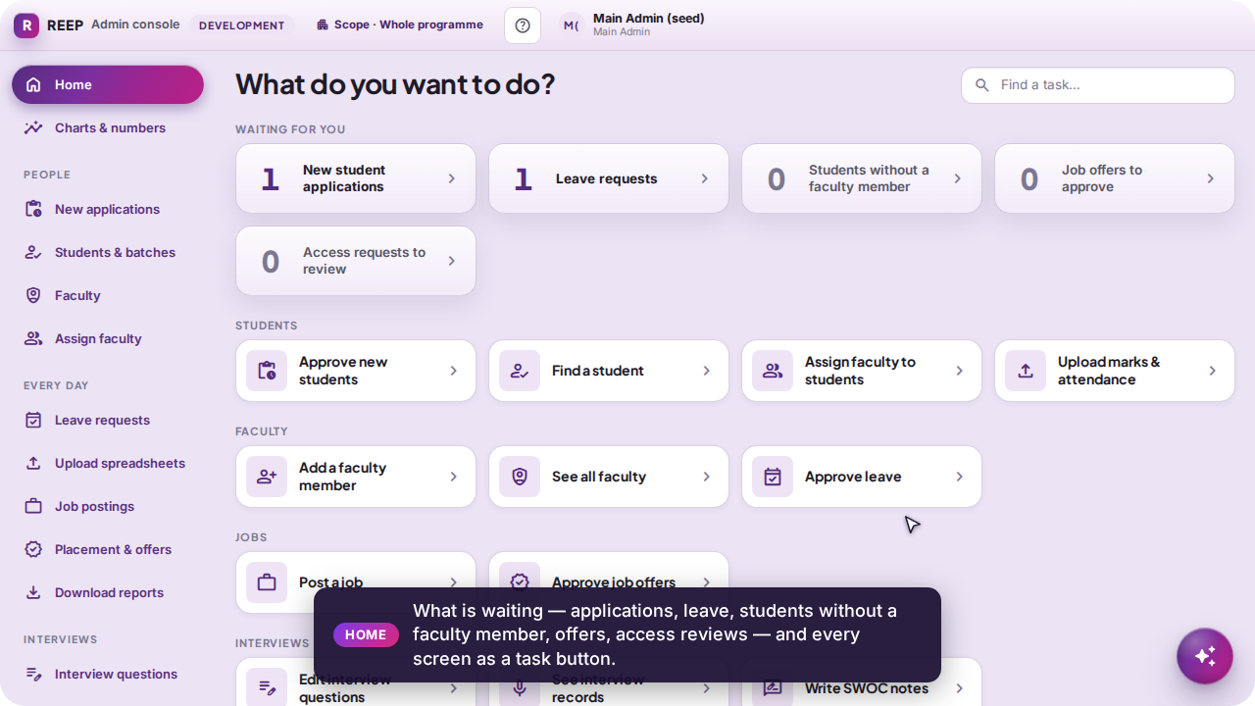
Home — what is waiting, and every task as a button
MAIN ADMIN
Five live counts, each a button to its queue: applications to review, leave to sanction, students without a faculty member, offers, access reviews.
Every screen as a task — “Approve new students”, “Post a job”, “Assign faculty” — grouped as People, Every day, Interviews, College setup, Settings.
Charts & numbers moved one row down: the right first screen for someone who knows the console, the wrong one for someone who does not.
REEP · live portal walkthrough
17
Notes:
The admin lands on tasks, not charts. The sidebar uses the same plain words.

Slide 18
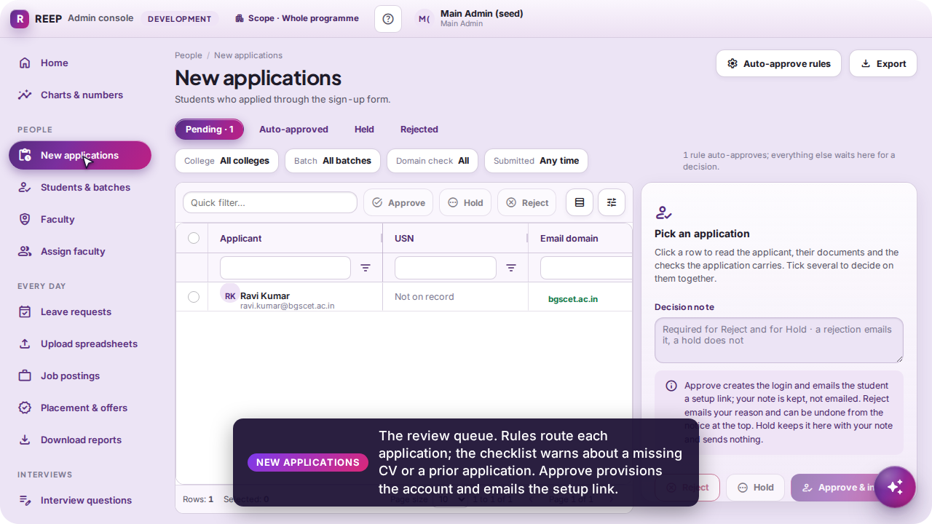
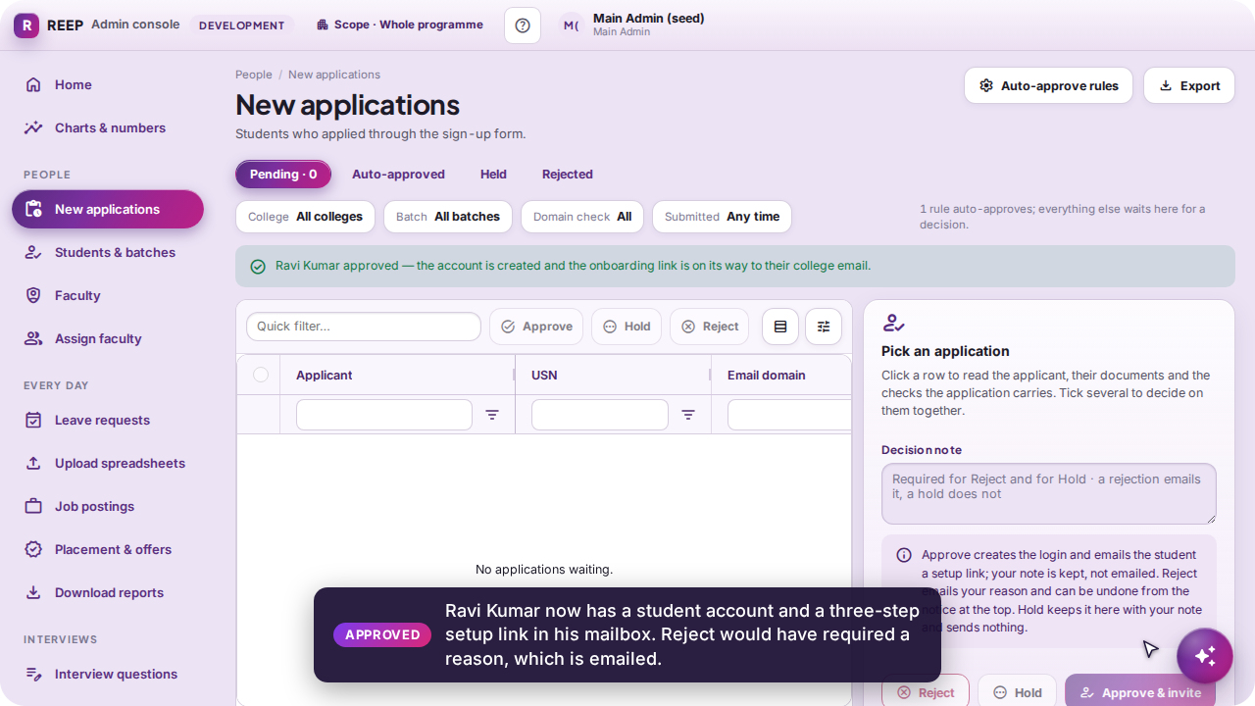
New applications — approve, hold, reject
MAIN ADMIN
Applications land in this queue the moment they are submitted; rules route them and a checklist warns about a missing CV, an off-domain address or a prior application. Approve provisions the account and emails the three-step setup link. Reject requires a reason and emails it, because a rejected applicant is not a user and that mail is the only channel. Hold keeps it with a note.
The queue, the checklist and the decision panel
Approved — the account exists and the setup link is in the mail
REEP · live portal walkthrough
18
Notes:
Approval is the ONLY way onto the roster: there is no admin-side create. That is what makes the roster the access control.

Slide 19
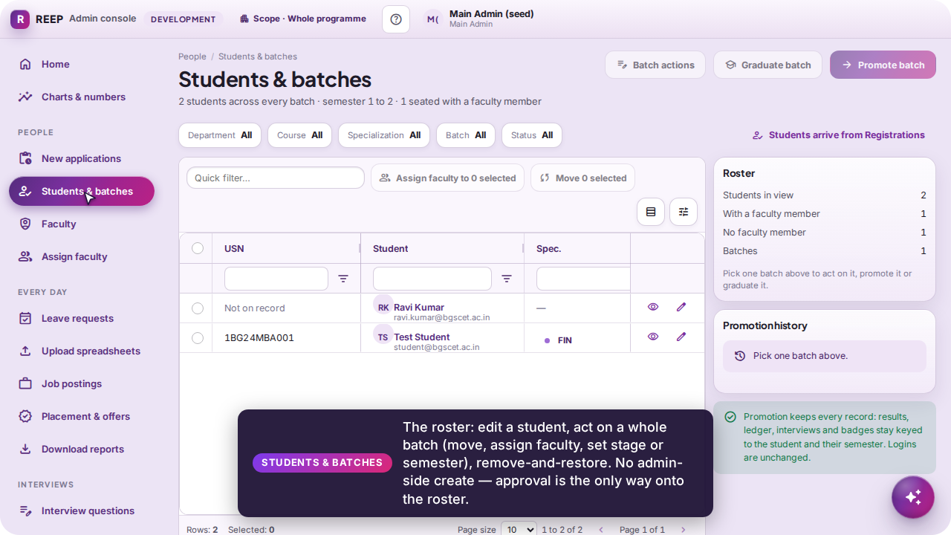
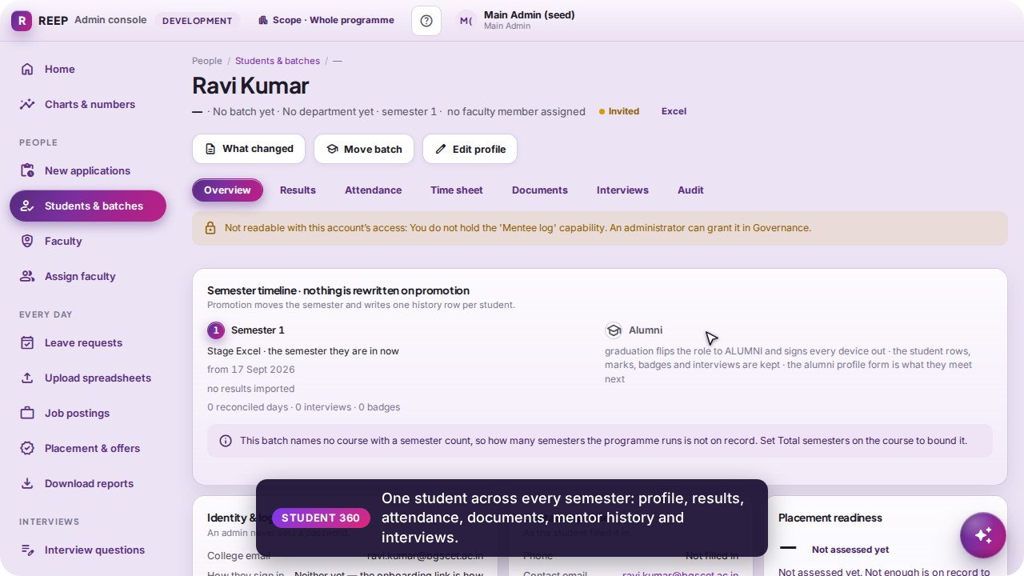
Students & batches, and the Student 360
MAIN ADMIN
The roster: edit a student (name, USN, batch, faculty, stage, semester), act on a whole batch with one action repeated — move, assign faculty, set stage or semester — remove-and-restore, or delete for good behind an emailed code. The eye opens the 360: one student across every semester — profile, results, attendance, documents, mentor history, interviews.
Students & batches — the roster grid
Student 360 — the complete record
REEP · live portal walkthrough
19
Notes:
REMOVE hides a person from every list and can be undone; DELETE FOR GOOD walks every dependent row and needs a six-digit code mailed to the office's own address.

Slide 20
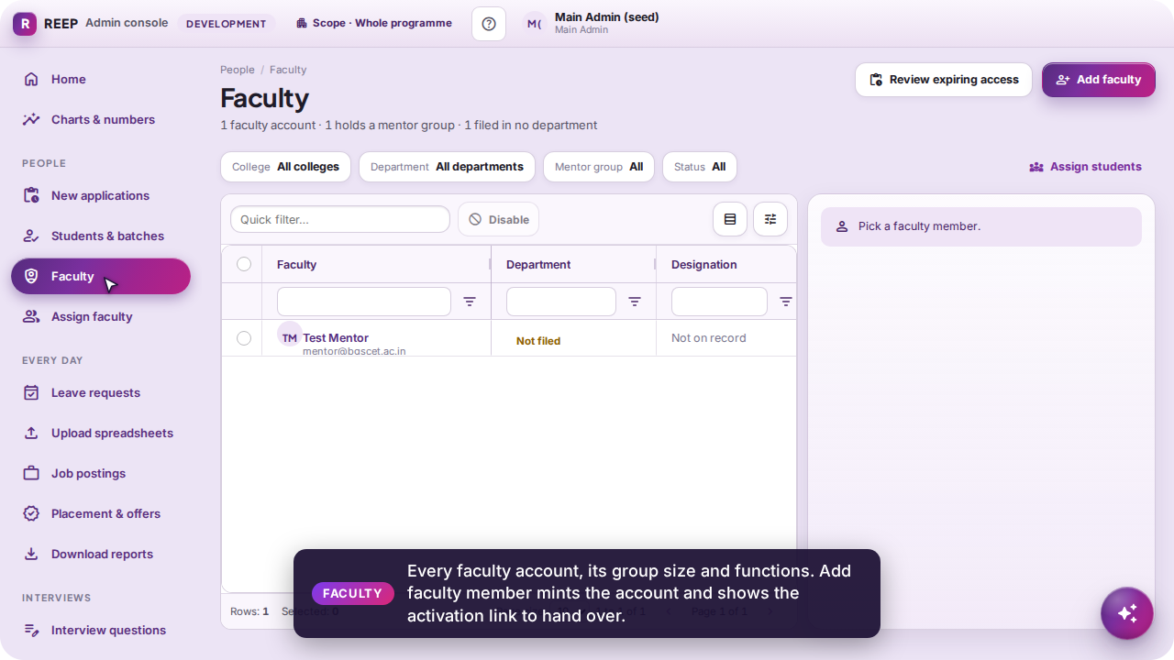
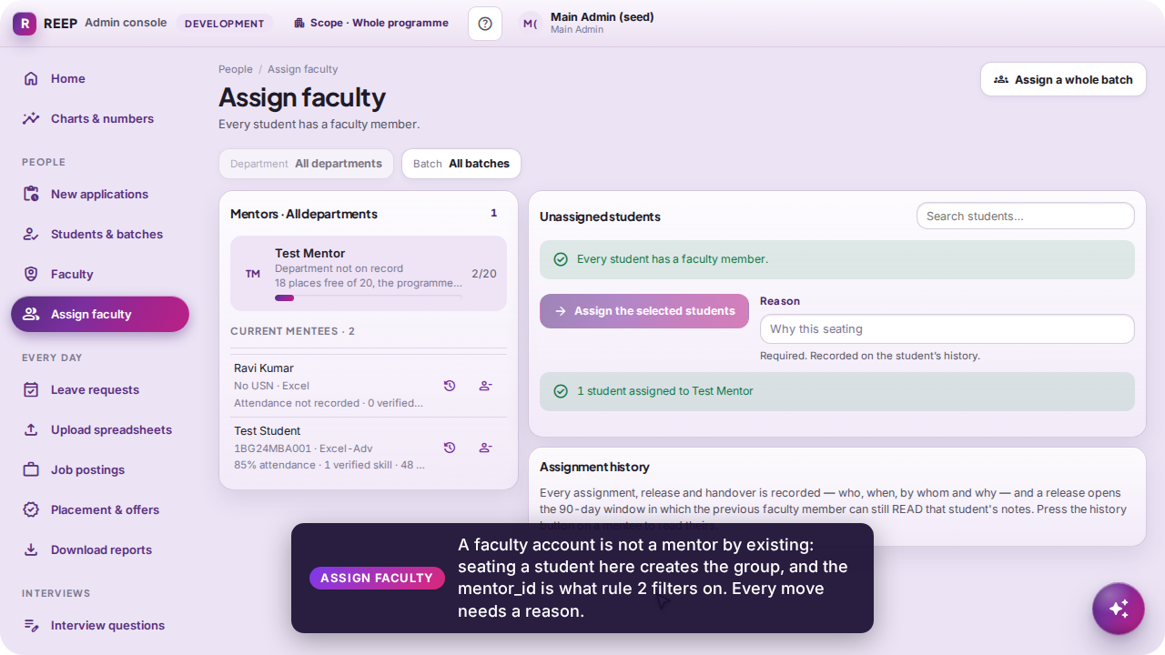
Faculty and Assign faculty
MAIN ADMIN
Faculty lists every account with its group size and functions; “Add faculty member” mints the account and shows the activation link to hand over. Assign faculty is where a faculty account becomes a mentor: pick the mentor, tick students in the unassigned pool, write the reason. The group is what scopes every mentee screen, and the history of who mentored whom is kept beside the pointer.
Faculty — accounts, groups, activation links
Assign faculty — a student seated, with a reason
REEP · live portal walkthrough
20
Notes:
A reason is required on every assignment because moving a student changes who may read their marks. Capacity is a number the screen shows, not a rule it enforces.

Slide 21
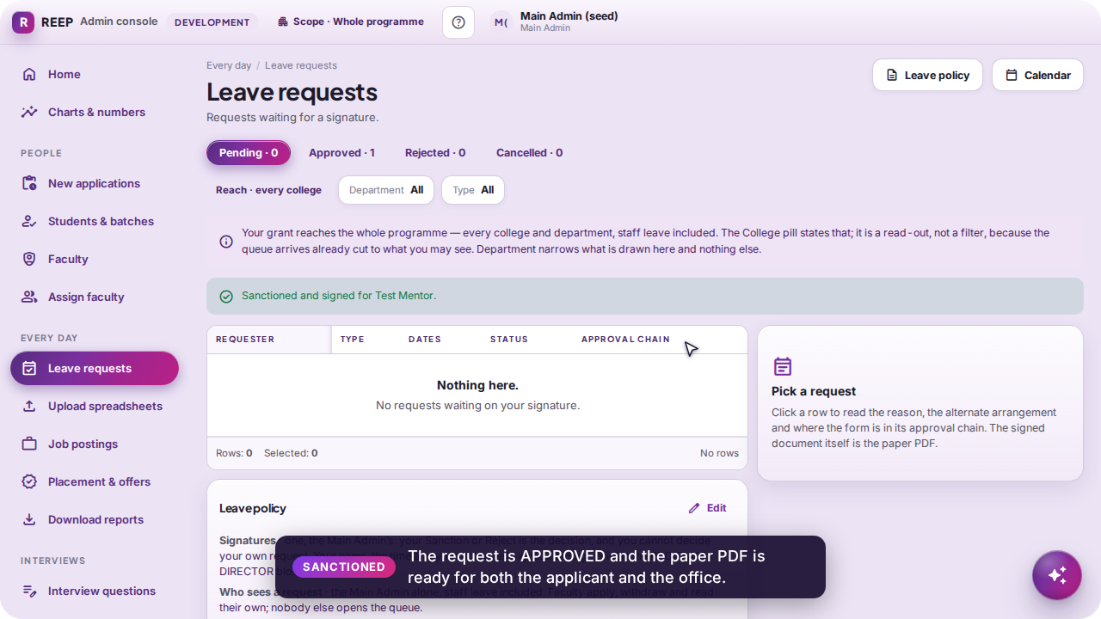
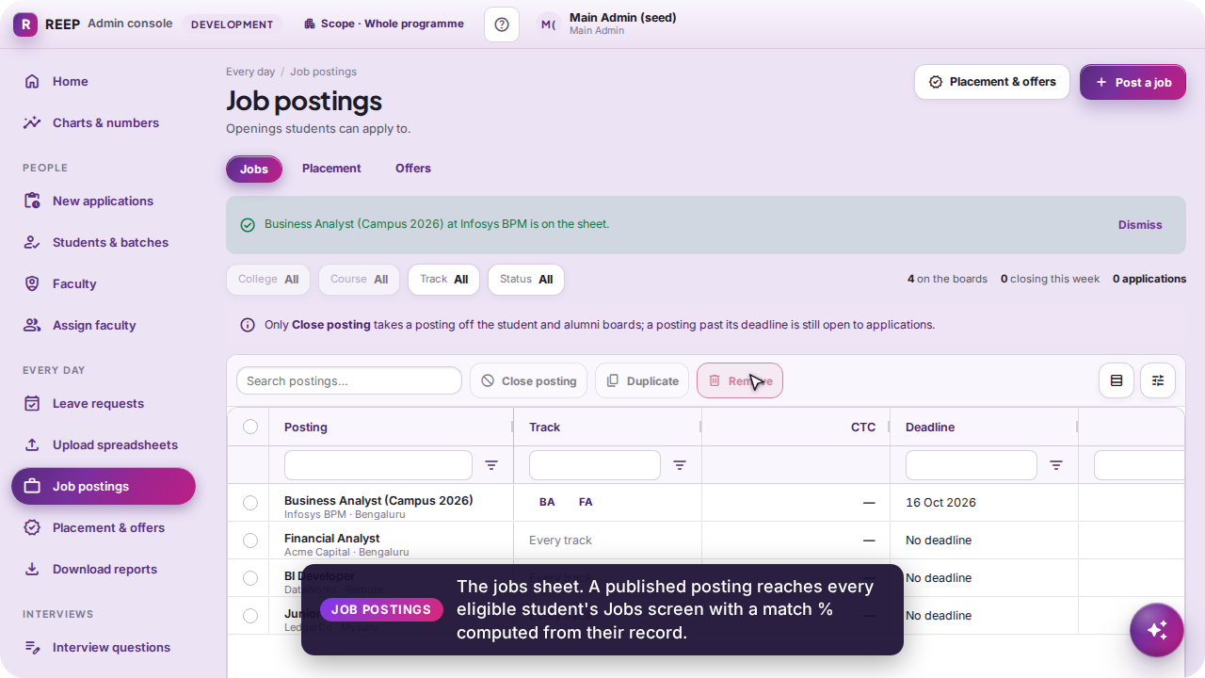
Leave requests and Job postings
MAIN ADMIN
Leave is one signature, the Main Admin's: select the request, Sanction with remarks, and the college-form PDF carries both signatures. Job postings is the jobs sheet: a published posting reaches every eligible student's Jobs screen with a match % computed from their own record; the alumni feed gets it without the verdict.
Leave requests — sanctioned with remarks
Job postings — published to every eligible student
REEP · live portal walkthrough
21
Notes:
The two-signature chain was retired because it deadlocked every staff request on a one-admin deployment; the office may hand its one signature to a named faculty member in Governance.

Slide 22
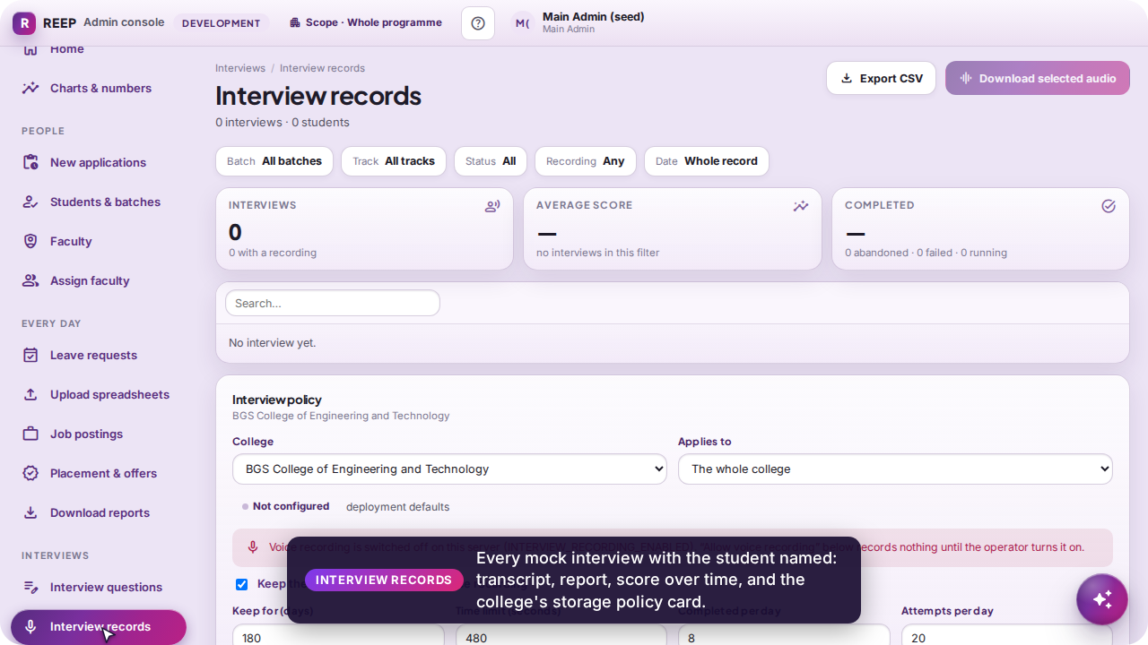
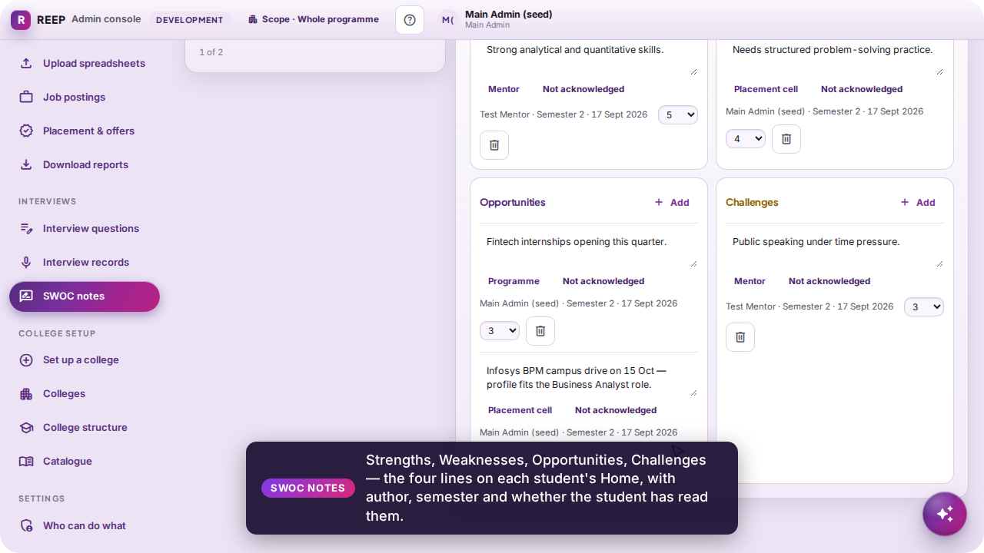
Interviews and SWOC notes
MAIN ADMIN
Interview questions is the bank per track — guidance the free-style interviewer rephrases. Interview records lists every mock interview with the student named: transcript, report, score over time, and the college's storage policy (transcript, audio, retention, caps). SWOC notes are the four lines on each student's Home, with author, semester and whether the student has read them.
Interview records — and the policy card
SWOC notes — a line the student sees at once
REEP · live portal walkthrough
22
Notes:
Consent is a row and the socket enforces it: no live grant, no interview. Audio needs three switches on — the operator's, the college's and the student's.

Slide 23
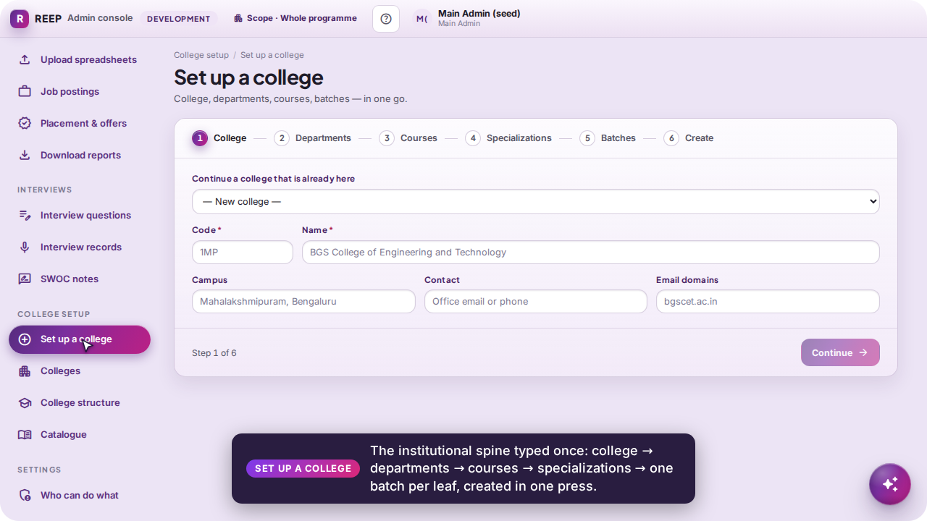
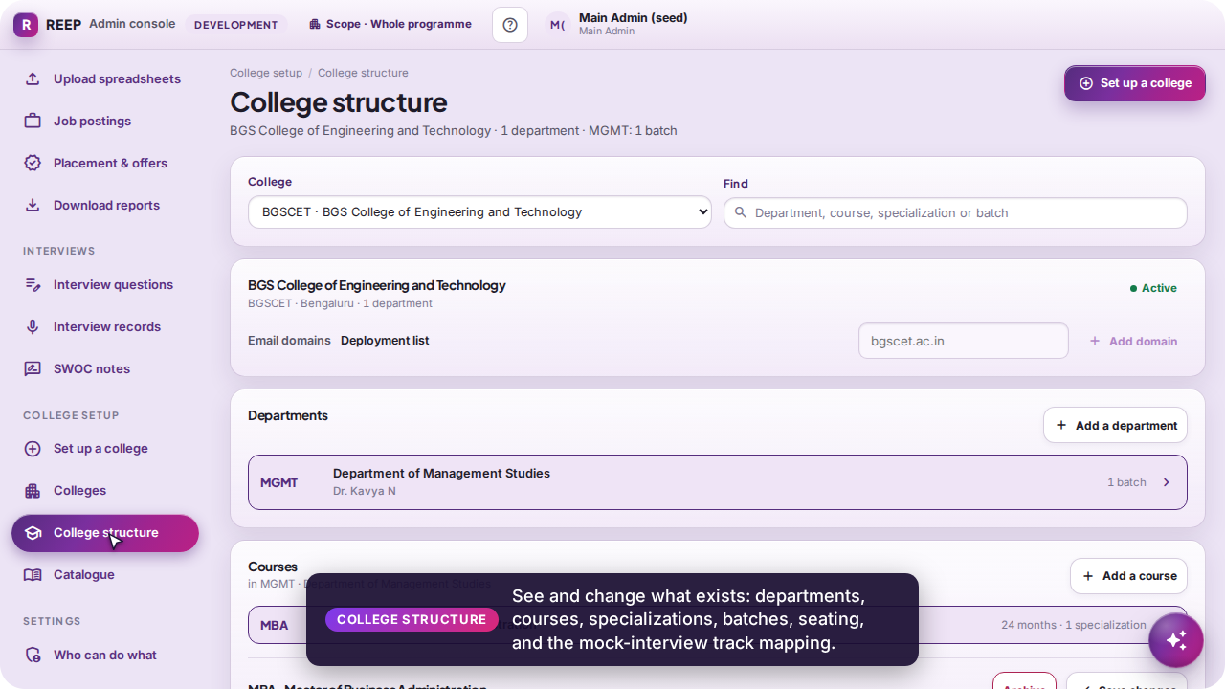
College setup — the institutional spine
MAIN ADMIN
College → Department → Course → Specialization → Batch → student. “Set up a college” is the spine typed once and created in one press; College structure sees and changes what exists (courses, batches, seating, the mock-interview track mapping, email domains); Colleges lists; Catalogue holds courses and the approved certifications. Course and Specialization are optional and a batch is a year — the links are the spine.
Set up a college — six steps, one press
College structure — see and change
REEP · live portal walkthrough
23
Notes:
The field that matters on a leaf is its code: it preselects the interview track by exact match, and a student on a batch with no track meets the general interview, which cannot be scored.

Slide 24
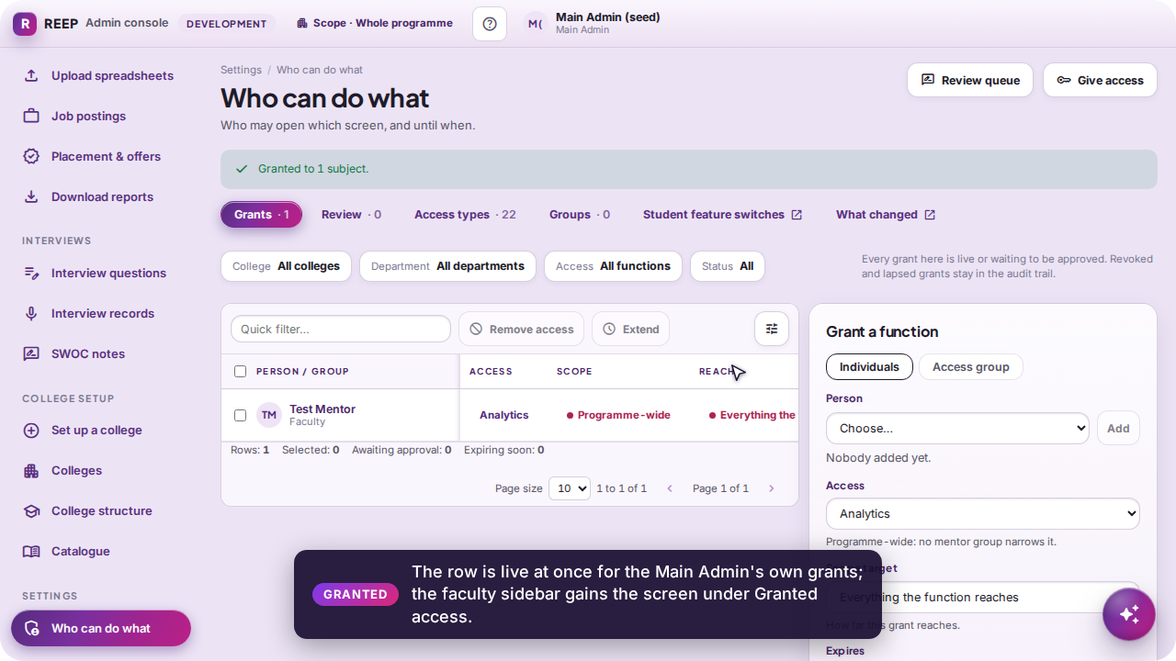
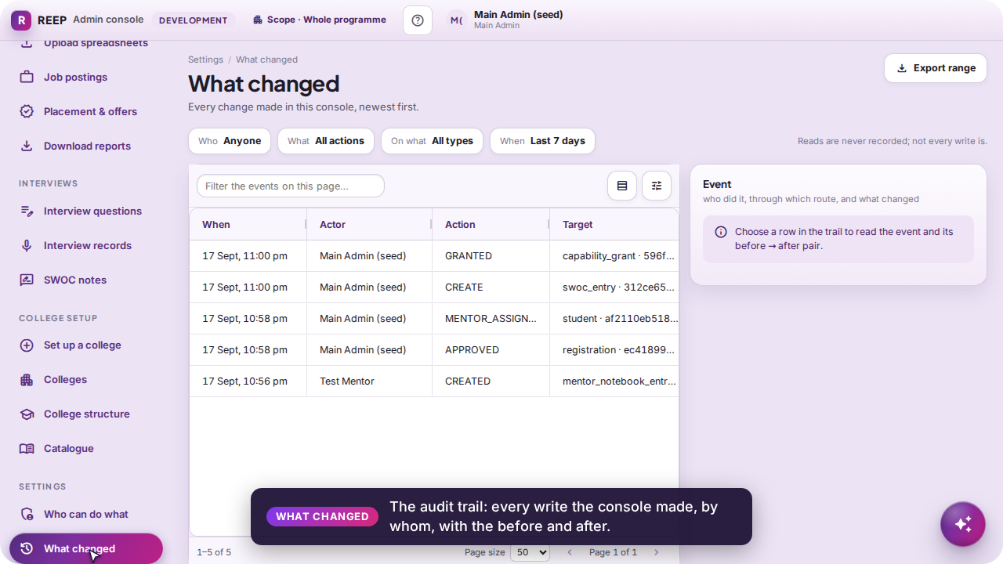
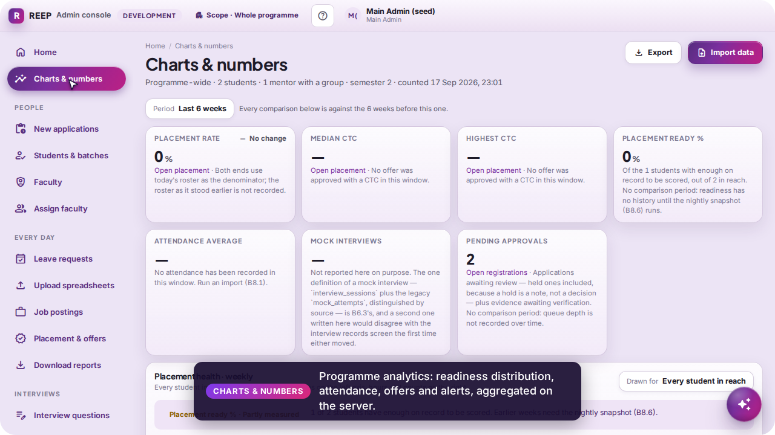
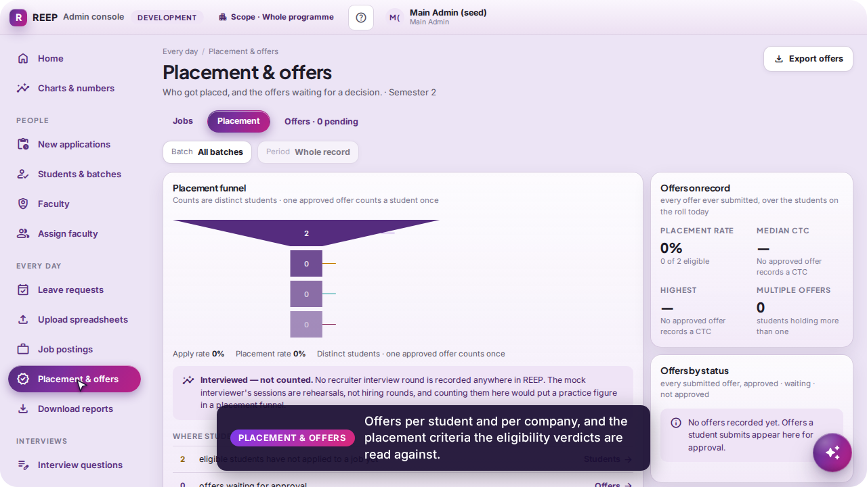
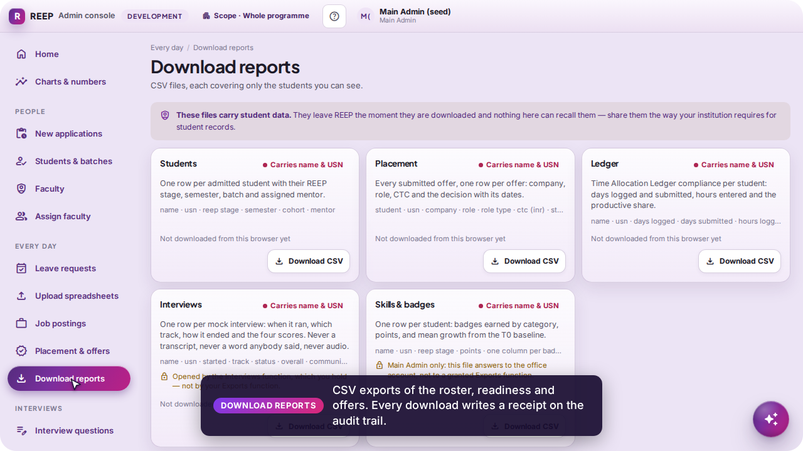
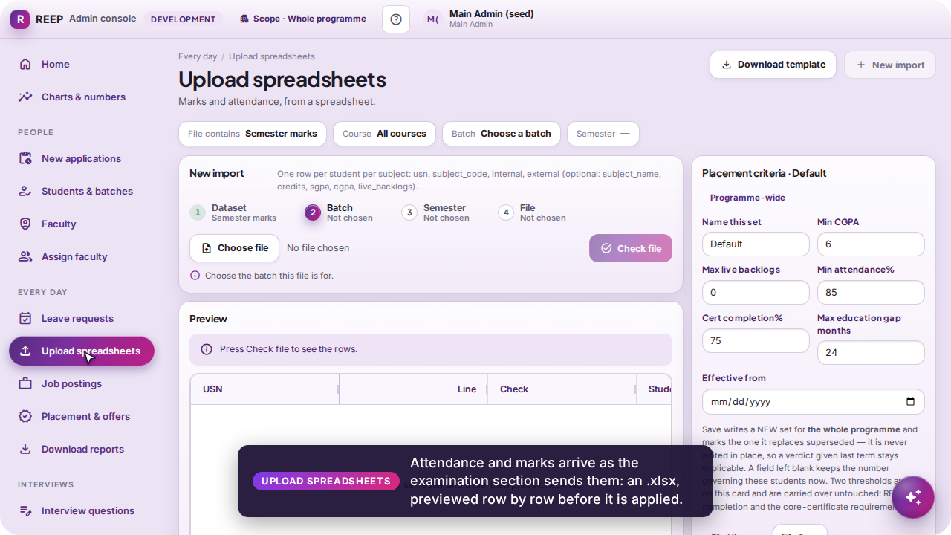
Access, the audit trail and the numbers
MAIN ADMIN
Access is a decision with a reach, a reason and an expiry; the audit trail records every write; analytics aggregate on the server.
Who can do what — a screen granted to a faculty member
What changed — the audit trail
Charts & numbers
Placement & offers
Download reports — every download leaves a receipt
Upload spreadsheets — attendance and marks
REEP · live portal walkthrough
24
Notes:
A grant hangs on a rung of the spine (college, department, course, specialization, batch or one student), so a faculty member can hold a screen for one department and not another. The Main Admin's own grants are live at once.

Slide 25
One workflow, three portals
What the student does, what the mentor and the office do about it, and where every action lands back on the student's screens.
1 · Student claims a skill and asks for a 1:1
2 · Mentor verifies the claim, records the meeting, applies for leave
3 · Main Admin writes a SWOC line, publishes a job, sanctions the leave
4 · Student: the SWOC line on Home, the lit badge, the mentor's note, the new job with a match %
Video
interlinked.mp4 · 4:01

Slide 26
How the portals link
STUDENT
FACULTY
MAIN ADMIN
1
STUDENT
2
FACULTY
5
MAIN ADMIN
Claims a skill with a certificate
Verifies the claim
Writes SWOC, posts a job
Skilling → Submit claim. Certificate filed under Uploads; mentor emailed.
Skill Verifications → Verify. Badge EARNED and certificate VERIFIED in one act.
SWOC notes → Save; Job postings → Publish. The line lands on Home, the job on Jobs.
3
STUDENT
4
FACULTY
8
MAIN ADMIN
Asks for a meeting
Records the 1:1
Assigns faculty, grants access
Faculty / TPO Log → Request a meeting. Arrives as a note on the Mentee Log.
Mentee Log → Save note. The note appears on the student's own log.
Assign faculty seats a student in a group (rule 2); Who can do what lends a screen.
6
FACULTY
7
MAIN ADMIN
Applies for leave
Sanctions the leave
Leave Requests → Sign & submit to Program Director.
Leave requests → Sanction with remarks; the college form PDF carries both signatures.
Back to the student: the lit badge on Skilling · the note on the Faculty / TPO Log · the SWOC line on Home · the job on Jobs
Every arrow is a database row the other portal reads through its own gate — nothing is copied between screens, and rule 2 filters every staff read.
REEP · live portal walkthrough
26
Notes:
Read this slide with interlinked.mp4. Each numbered box is one screen in the video; the arrows are the rows the other side reads: a claim, a note, a SWOC entry, a job, a leave request.

Slide 27
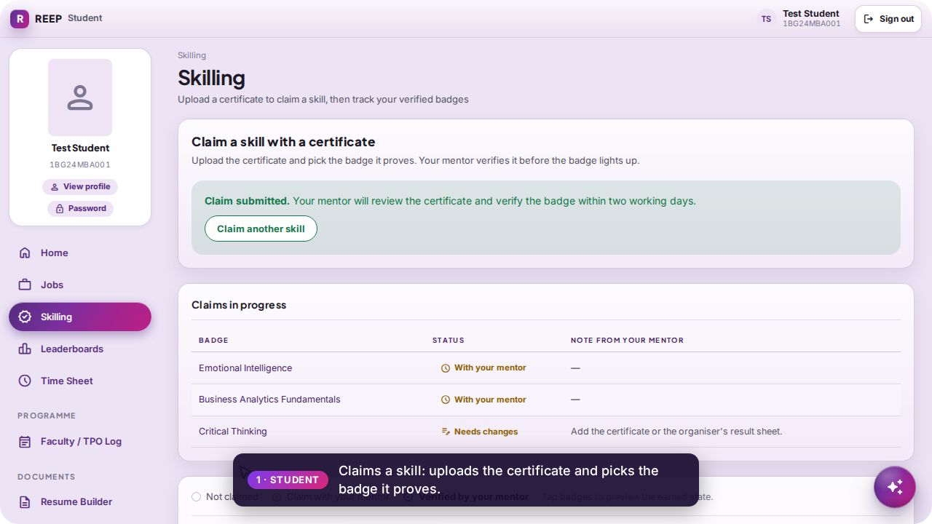
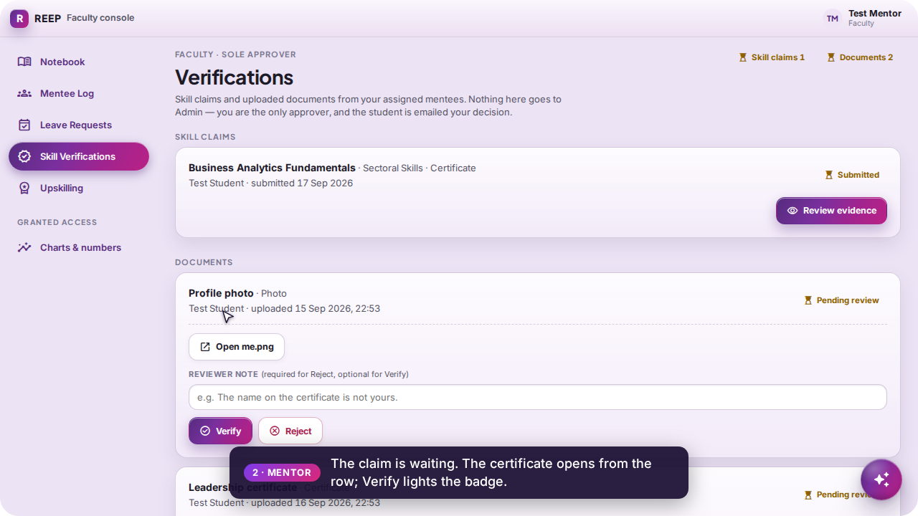
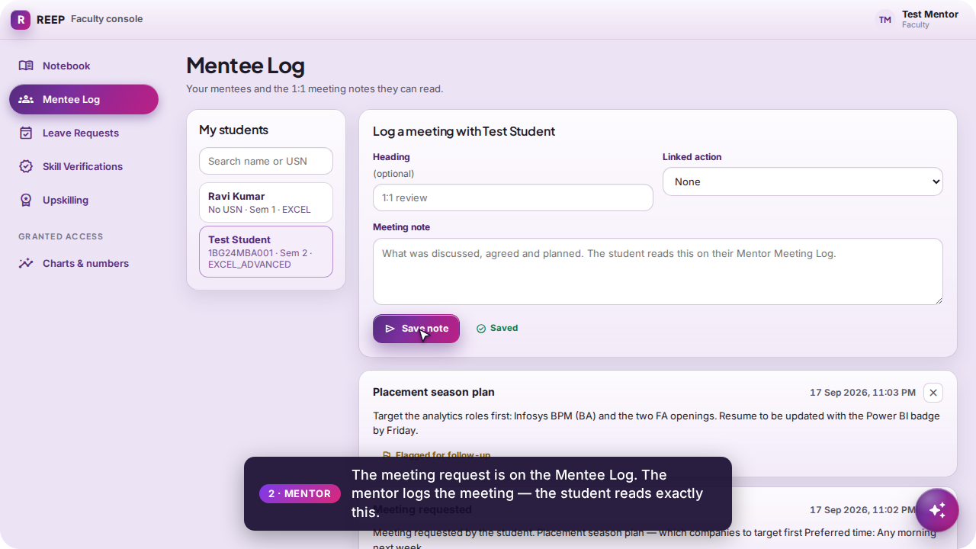
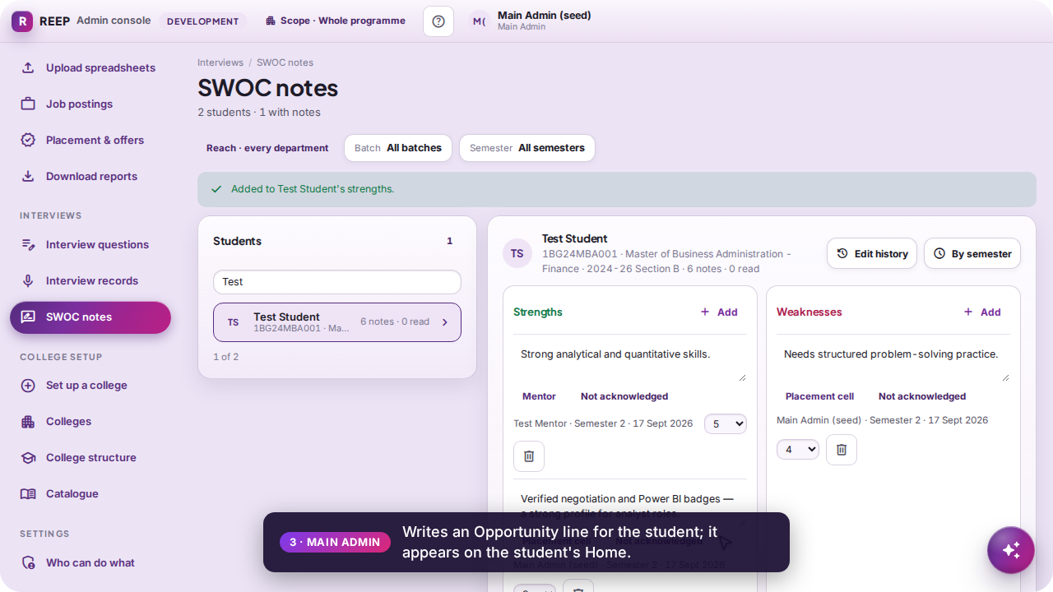
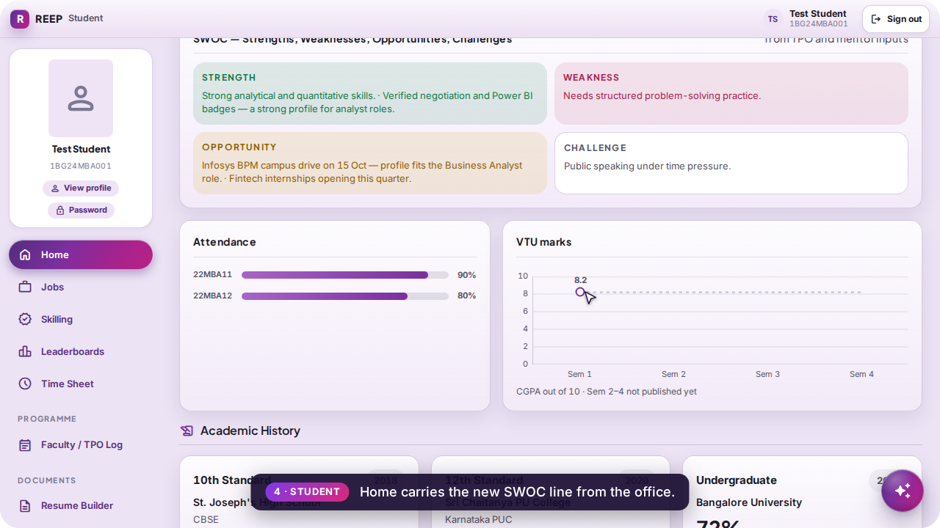
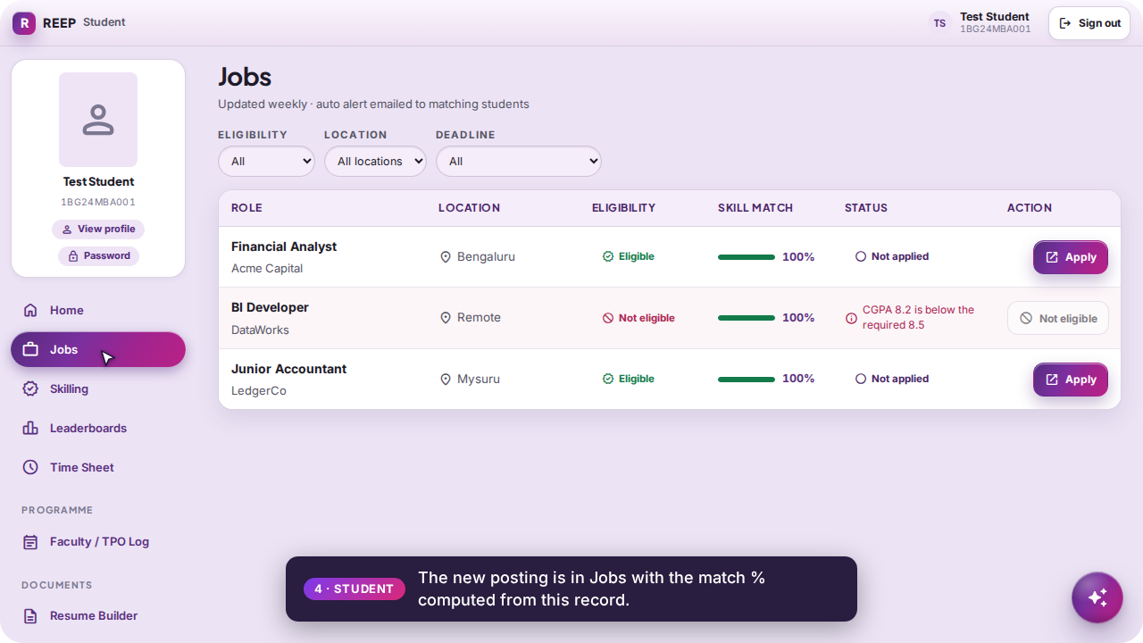
The interlinked workflow, as recorded
STUDENT
Six frames from interlinked.mp4 — the claim, the verification, the note, the SWOC line, and the student's Home and Jobs afterwards.
1 · Student — claim submitted
2 · Mentor — verified
4 · Mentor — the meeting note
5 · Main Admin — SWOC line saved
4 · Student — Home carries the line
4 · Student — the new posting with a match %
REEP · live portal walkthrough
27
Notes:
These are frames from the recording, not mock-ups: the same rows that were written in step 1–3 are what the student's screens show in step 4.

Slide 28


A new student's journey
Apply on the public form → the office approves → the emailed link's three steps (address, code, password) → first sign-in → the office assigns a faculty mentor → the mentor sees the new mentee.
Priya Menon applies with USN, phone, personal email, LinkedIn, CV and photo — every box compulsory except Specialization
The application is in the queue immediately; no email gate in between
The link proves the mail was opened, the code proves the mailbox is readable now, the ticket the code earns is the only thing that sets the password
Video
onboarding.mp4 · 3:18

Slide 29
From application to mentee — six steps, three roles
1
APPLICANT
2
MAIN ADMIN
3
APPLICANT
Apply
Approve
Set up
/register: name, USN, college and personal email, phone, LinkedIn, the spine, CV and photo. Files are checked before the application is created.
New applications: the checklist runs; Approve provisions User + Student + profile and emails “Your REEP account is approved — set it up”.
/onboard?token=…: type the address → a six-digit code is mailed → confirm → set the password with the 15-minute ticket. Signs nobody in.
4
STUDENT
5
MAIN ADMIN
6
FACULTY
First sign-in
Assign faculty
Sees the mentee
The ordinary front door: limiter, revocation and the one-device rule all apply. Home and the filled-in Profile card.
Pick the mentor, tick the new student in the pool, write the reason. The group now scopes every mentee screen.
Mentee Log lists the new student — and nobody the faculty member does not mentor.
Three purposes, three proofs: the link proves somebody opened mail sent there; the code proves the mailbox is readable now; the ticket is the only thing the password step accepts — so the code can never be skipped by holding the link.
REEP · live portal walkthrough
29
Notes:
Read with onboarding.mp4. Approval is the only way a student account is minted; the setup walk is what makes the mailbox proof real; assignment is what makes the mentor able to see the student.

Slide 30






The new student's journey, as recorded
APPLICANT
Six frames from onboarding.mp4.
1 · The public form
2 · Approved by the office
3 · The link: type the address
3 · Code confirmed; set the password
4 · First sign-in
6 · On the mentor's Mentee Log
REEP · live portal walkthrough
30

Slide 31


Alumni portal
ALUMNI
A real role with no student record and no staff scope. On first sign-in there is no profile row, so the create form appears: current company, designation, batch year and a resume. The jobs sheet is the same postings the office published — without the match % and eligibility verdict, which need a student's marks.
My Profile — created on first sign-in
Jobs Sheet — no match %, by design
REEP · live portal walkthrough
31
Notes:
alumni.mp4. The create-profile form is driven by whether a profile row exists, never by an empty company string.

Slide 32

Reproducing this walkthrough
Seeded logins (dev database only): student@bgscet.ac.in / student123 · mentor@bgscet.ac.in / mentor123 · admin@bgscet.ac.in / admin123 · alumni@bgscet.ac.in / alumni123
Stack: docker compose up -d (Postgres 17 + pgvector) · apps/api-py: alembic upgrade head, python -m app.seed, uvicorn on 3300 · apps/web: npx ng serve on 4200
Recorder: tools/demo/record-walkthrough.mjs drives the portal in Chromium and records it; tools/demo/render.sh makes the MP4s; tools/demo/build-deck.cjs rebuilds this deck from the screenshots
Everything the videos show was written to a throwaway seeded database; run tools/demo/reset-dev-db.sh to start again from the same state
Where the files are
docs/presentation/
REEP-portal-walkthrough.pptx — this deck
video/*.mp4 — the six recordings and the combined file
screens/*.png — every screenshot the deck uses
README.md — what each video covers, minute by minute
tools/demo/
the recorder, the renderer, the deck builder and the reset script
REEP · live portal walkthrough
32
Notes:
Everything here is reproducible from the repository: reset the dev database, run the recorder, render, rebuild the deck.

